Slide 2
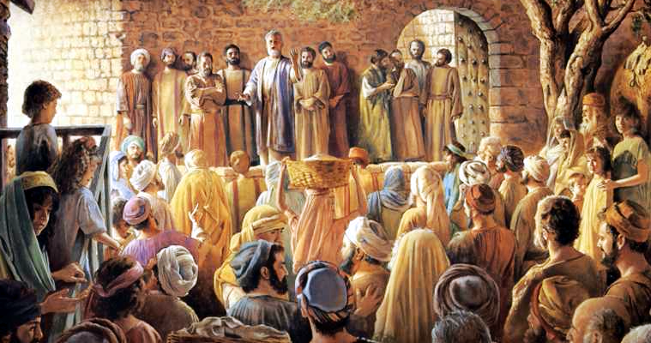
The Church at Thessalonica

Slide 3
1 Thessalonians
A Summary of the letter:
1. Their receptivity to the message of the Gospel (Chapter 1)
2. Paul's integrity as A messenger of the Gospel (Chapters 2-3)
3. Their maturity, growing in holiness and HOPE through the MEANS of the Gospel (Chapters 4-5).

Slide 4
1 Thessalonians
Some Themes/topics we have covered in past weeks:
1:1-4 – Pray for each other
1:5-10 – make a difference to those around us, by word, action and lifestyle.
2:13-20 – God’s active Word helps us endure suffering and persevere in hope.
3:1-10 – our faith builds up the faith of others.
4:1-8 – God calls us to walk in sexual purity and holiness.
4:13-5:11 – we have the hope of Christ’s return – of resurrection and eternal life in Christ.

Slide 5
1 Thessalonians 5:23-28
Two Parts:
A Benediction (vs 23-24).
Final instructions and farewell (vs 25-28)

Slide 6
1 Thessalonians 5:23-28
A Benediction (vs 23-24).
blessed in Christ to be a blessing (Gen 12:1-3)
Our God is a God of True peace (Romans 15:33; 16:20; Philippians 4:9 – see also 1 Corinthians 14:33; 2 Corinthians 13:11 and Hebrews 13:20.)
GREEK WORD For Peace is the Hebrew word “shalom”

Slide 8
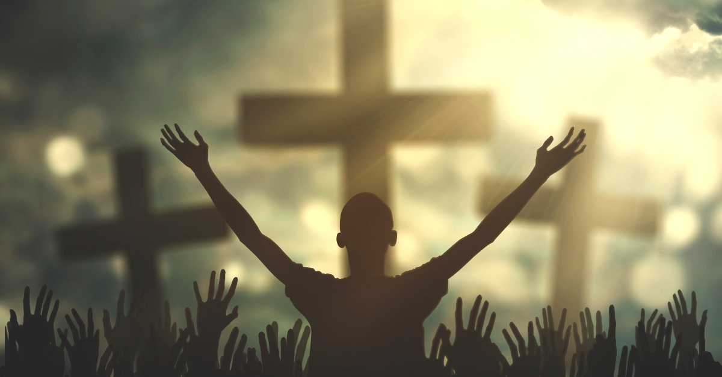
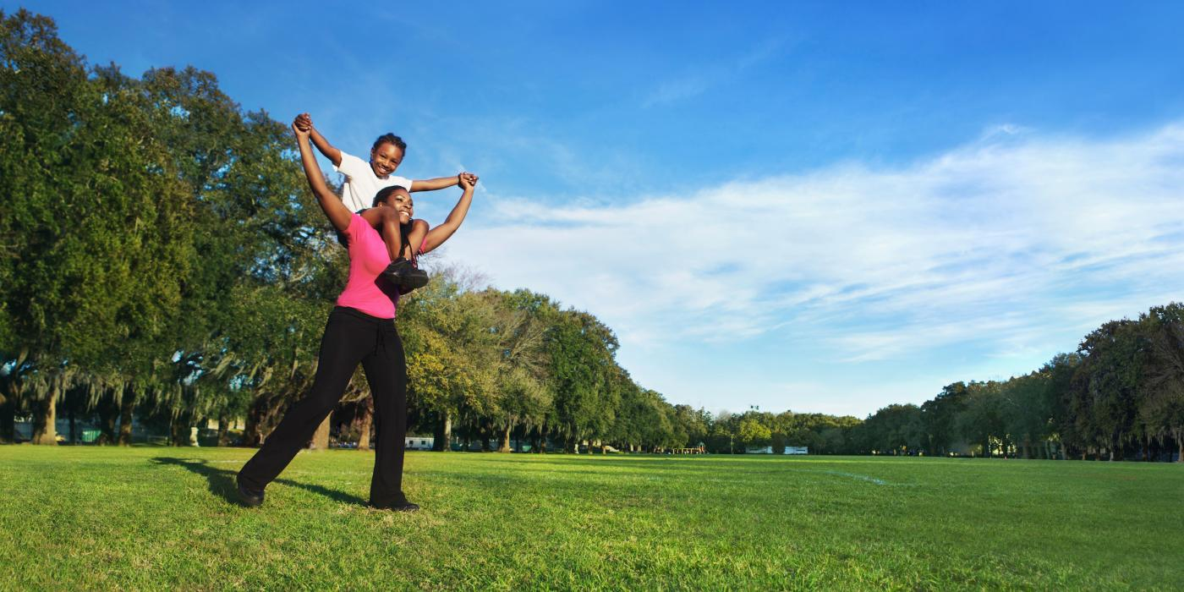
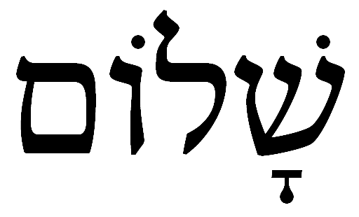
“A psycho-somatic-relational-racial-economic-spiritual wholeness.”
Darrel Johnson,
as quoted in Christianity Today Advent Devotional 2022 ”The Prince of Shalom” by Carolyn Arends.
SHALOM

Slide 10
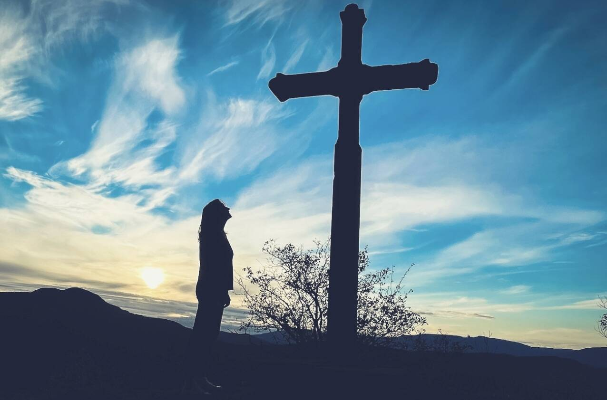

Slide 12
1 Thessalonians 5:23-28
A Benediction (vs 23-24).
blessed in Christ to be a blessing (Gen 12:1-3)
Our God is a God of True peace (Romans 15:33; 16:20; Philippians 4:9 – see also 1 Corinthians 14:33; 2 Corinthians 13:11 and Hebrews 13:20.)
GREEK WORD For Peace is the Hebrew word “shalom”
Verse 24 - God who calls us is ever faithful!

Slide 13
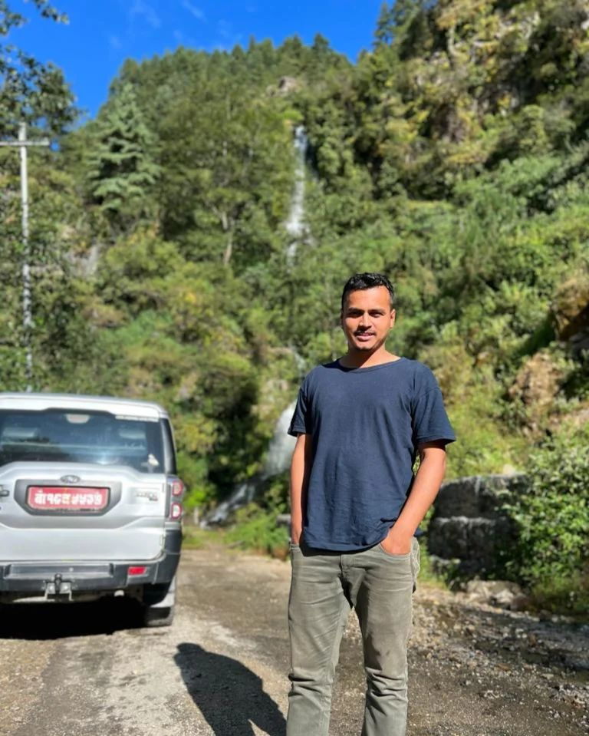
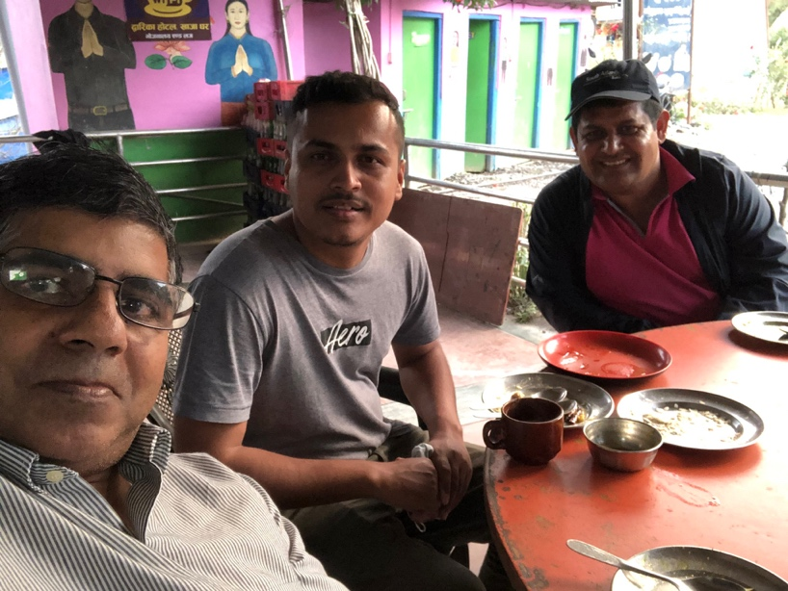
Pankaj Neupane, Pastor in Kathmandu, Nepal

Slide 14
1 Thessalonians 5:23-28
Final instructions and farewell (vs 25-28)
Pray for us (vs 25)
Greet one another (vs 26)
Read letter to everyone (vs 27)
The Grace of Jesus be with you (vs 28)

Slide 15
1 Thessalonians 5:23-28
ACTION STEPS:
Call out to our GOD for TRUE PEACE.
PRAY FOR THOSE WHO DON’t KNOW GOD’s GRACE AND PEACE TODAY.

