Slide 1
Attitude
Behavior
Character
Personality
Notes:
If you walk into the self-help section of a bookstore
or search for self-help resources online,
you will often see discussions about changing your attitude or behavior.
You will also see guidelines for developing positive character and personality traits.
What is interesting is that many traits, such as patience,
can be seen as an attitude or behavior.
It may also be called a character or a personality trait
Whether you call something an attitude, a behavior, a character, or a personality trait, the world clearly recognizes certain types as being positive.

Slide 2
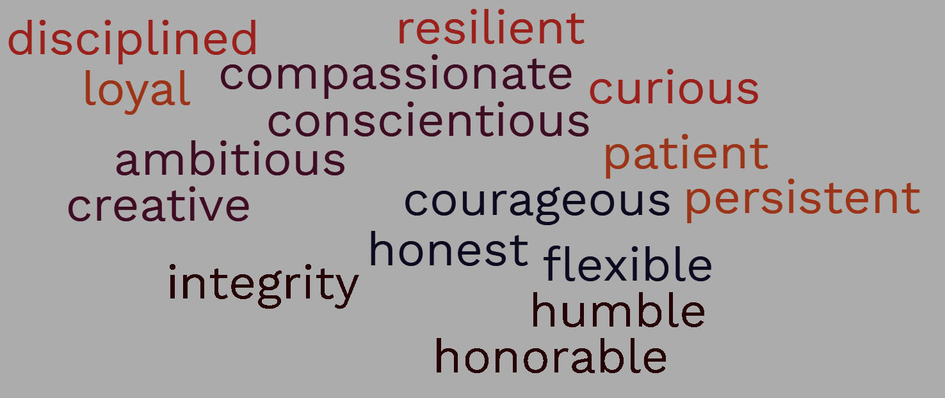
15 Top Character Traits
To Demonstrate at Work and in Resumes
Notes:
For instance, a list of the 15 top character traits
to demonstrate at work and in resumes
includes terms such as disciplined, resilient, ambitious, patient, courageous, and so on.
Therefore, when you see someone who displays a patient attitude, who behaves in a disciplined manner, has a compassionate character, and has an honest personality,
you would generally approve of that person,
whether for a job, as a friend, or whatever.
That is why when you watch TV, or see a movie,
successful people demonstrate many of these top fifteen traits.

Slide 3
Christianity in Popular Culture Media
Notes:
But what character traits do you see portrayed by “Christians” in TV shows or movies?

Slide 4
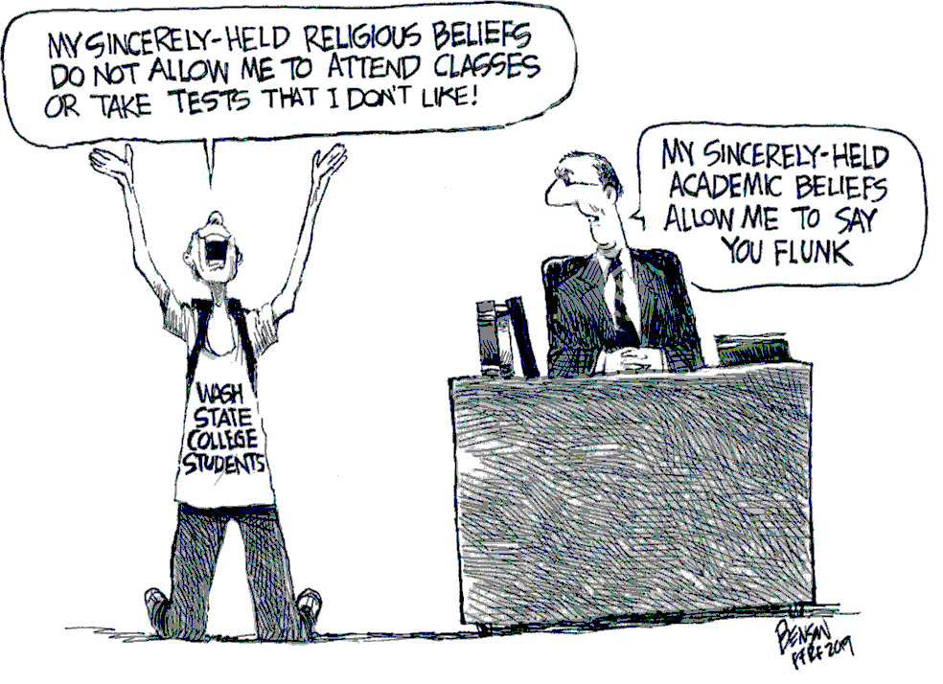
Notes:
It seems that modern media often stereotypes Christians as arrogant, fake, and hostile people;
This can also be seen in the news, where Christians who don’t act in a Christian-like manner are often publicized.
It is even worse in the comics. This one comic shows a supposed Christian college student whose religious beliefs keep him from attending classes or taking tests. I am not sure what Bible that comes from.
Or course, the smug professor then says his academic beliefs allow him to flunk the so-called Christians who are skipping class and not taking tests.
I believe that it is obvious that being a Christian doesn’t get you out of taking tests,
So then, what does being a Christian look like?
What type of Attitudes, Behaviors, and Character or Personality Traits should Christians Display?

Slide 5
How to Behave among God’s People
1 Thessalonians 5:12-22
Notes:
We will look at that in our study today on 1 Thessalonians 5:12-22.
We will see how to behave among God’s people.

Slide 6
Growing Stronger in Christ
Walking the hard but steady path of spiritual maturity
1 Thessalonians
Notes:
This is a continuation of our series in 1 Thessalonians called Growing Stronger in Christ, walking the hard but steady path of spiritual maturity.

Slide 7
How to Behave among God’s People
What does “Growing Stronger in Christ” look Like?
What does “Walking the hard but steady path of spiritual maturity” look like?
1 Thessalonians 5:12-22
Notes:
This sermon could also have been called,
“What does Growing Stronger in Christ Look Like?
It could also have been called “What does Walking the hard but steady path of spiritual maturity look like?”
Either way, we will see that 1 Thessalonians 5:12-22 shows us how to behave among God’s people.
Paul will do this in an interesting way.
Rather than just talking about attitude, behavior, character and personality traits,
he first describes two types of relationships
Relationships between leaders and the congregation,
and relationships between the weak and strong in faith.
He then discusses some specific character or personality traits
—first optimists and pessimists
and then cynical and gullible.
This is how Paul will show us how to behave among God’s People.
This is the type of behavior Christians should be known for.

Slide 8
Paul’s Formula
Notes:
As we are coming to the end of our series in 1 Thessalonians,
let me point out that many of Paul’s letters follow a simple formula in how they are written.
This formula is even stated by Paul, in his trial in front of King Agrippa,
which you can read about in Acts chapter 26
During his trial, he explains
that after encountering Jesus on the road to Damascus
he was given the commission to be a witness to the Gentiles,

Slide 9
I preached . . . that all must repent of their sins and turn to God—and prove they have changed by the good things they do. Acts 26:20 NLT
Notes:
Paul then states how he fulfilled that commission
by saying that He preached first to those in Damascus,
then in Jerusalem and throughout all Judea,
and also to the Gentiles,
that all must repent of their sins and turn to God
—and prove they have changed by the good things they do.
This is Paul’s formula, two basic parts
One: Repent of your sins and turn to God
And Two: prove you have changed by the good things they do.
Most of Paul’s letters start with theology:
that all must repent of their sins and turn to God.
This is followed by a description
of what repenting and turning to God looks like,
This is why he says to prove that they have changed
by the good things they do.
How can you prove you have changed?
How should you behave among God’s people?

Slide 10
We ask you, brothers,
to respect those
who labor among you
and are over you in the Lord
and admonish you,
and to esteem them
very highly in love
because of their work.
Be at peace among yourselves.
1 Thess 5:12-13
Notes:
First, you should value your leaders.
More specifically, the congregation should respect and esteem the church's pastors, teachers, elders, and deacons.
In addition, the congregation should have a good relationship with each other, as this is also part of valuing their leaders.

Slide 11
We ask you, brothers,
to respect those
who labor among you
and are over you in the Lord
and admonish you,
and to esteem them
very highly in love
because of their work.
Be at peace among yourselves.
1 Thess 5:12-13
Notes:
Taking a closer look, we see that Paul is speaking to the entire church here when he states, “we ask you brothers”
In Greek, we see the 2nd person plural pronoun, so we know it is “you all” he is asking the entire church.
What is Paul asking the church to do? He then gives 3 commands. In Greek, the commands are easy to identify since they are 2nd person imperative verbs.
Respect your leaders
Esteem your leaders.
Be at peace among yourselves.

Slide 12
We ask you, brothers,
to respect those
who labor among you
and are over you in the Lord
and admonish you,
and to esteem them
very highly in love
because of their work.
Be at peace among yourselves.
1 Thess 5:12-13
Notes:
Looking at the pronouns “those” and “them,” the grammar shows the focus is clearly about the church leaders.
Paul writes to respect those and esteem them.
What is interesting is that when Paul writes about the leaders; he uses general terms
to show that his discussion includes all church leadership,
the pastors, teachers, elders, deacons, etc.
These are not three separate offices of church leadership but three functions that should be seen in all church leaders.
These three general terms or functions of the various church leaders are:
one: those who are laboring among you,
two: those who are over you in the Lord
and three: those who are admonishing you
This is important because it shows that leaders have some responsibility as well.
You are not supposed to follow leaders blindly. Instead, you are to follow leaders who display Biblical traits for leaders, which can be found in other books of the Bible, such as 1 and 2nd Timothy, and Titus.
The same applies to leadership in government. Peter writes to be subject to all government authority, but then gives the caveat that the government’s job is to punish those who do evil and to praise those who do good.

Slide 13
We ask you, brothers,
to respect those
who labor among you
and are over you in the Lord
and admonish you,
and to esteem them
very highly in love
because of their work.
Be at peace among yourselves.
1 Thess 5:12-13
how
why
Notes:
So when you have church leaders that follow Biblical principles.
How are they to be respected and esteemed? With lofty titles? To be placed on a pedestal?
No, they are to be esteemed in love.
When you give a leader a lofty title or place them on a pedestal, they are no longer laboring among you, they are apart from you, and they no longer meet Paul’s definition of how a leader is to lead.

Slide 14
To put in mind: hence, admonish, warn, rebuke
We ask you, brothers,
to respect those
who labor among you
and are over you in the Lord
and admonish you,
and to esteem them
very highly in love
because of their work.
Be at peace among yourselves.
1 Thess 5:12-13
Notes:
Only when leaders are esteemed “very highly in love,“
can they carry out their duties effectively.
This is very clear when you look at the definition of the Greek word translated as admonish
The literal meaning is to put in mind.
But if you don’t esteem someone highly,
you won’t listen to them when they try to Put something in mind,

Slide 15
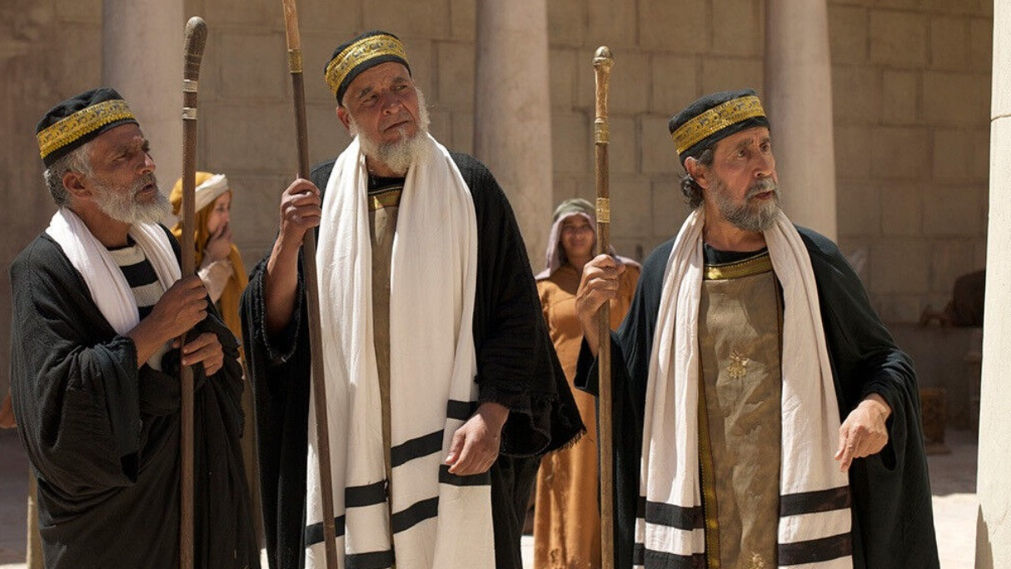
Pharisees
⁸ But you are not to be called rabbi, for you have one teacher, and you are all brothers. ⁹ And call no man your father on earth, for you have one Father, who is in heaven. ¹⁰ Neither be called instructors, for you have one instructor, the Christ.
Notes:
One example of supposed church leaders who did not deserve to be respected or esteemed was the Pharisees,
who not only continually opposed Jesus’s ministry.
but put the wrong things in mind; who pointed out the specks in others’ eyes while ignoring the logs in their own eyes.
Jesus has some strong words for them in Matthew Ch. 23, which is where he pronounces 7 woes.
But before he pronounces the woes, he says that you are not to be called rabbi, for you have one teacher, and you are all brothers. 9 And call no man your father on earth, for you have one Father, who is in heaven. 10 Neither be called instructors, for you have one instructor, the Christ.
Some people take this verse and ignore the context and conclude that we don’t need to give any person signs of respect by calling them rabbi, or pastor, or teacher, or elder.
But the context is clear in the gospel and in Paul’s writing that church leaders deserve to be valued. And it is okay to call them Pastor, elder, or deacon.
And if you disagree with your leadership, don’t stand up and loudly pronounce woe’s. Instead go to that leader one on one, and then with another brother in Christ.

Slide 16
over you in the Lord
God
Church Leaders
Congregation
Notes:
Many examples of improper behavior among Christians result from an incorrect view of leadership structure.
Although church leaders are “over you in the Lord,” they do not stand between you and God.
Over you in the Lord refers to the roles that church leaders are called.
Just as some are called to be doctors or lawyers,
church leaders are also called to shepherd the flock.
Church leaders may be gifted in certain aspects.
They may also have additional training and education, such as seminary.
When you are sick and need your appendix removed, you see a doctor, not a lawyer

Slide 17
over you in the Lord
God
Church Leaders
Congregation
Notes:
But when you need spiritual guidance,
you can go straight to God in prayer,
you can read the Bible,
or you can seed the guidance of your church leader.
Church leaders can be over you in the Lord
because of their functions of admonishing, bringing to mind warnings, rebuking
But leaders are also equal with the congregation under God
Because we are all part of one body, the church, whose head is Christ
When we follow this model, we will be behaving as we should among God’s people.

Slide 18
We ask you, brothers,
to respect those
who labor among you
and are over you in the Lord
and admonish you,
and to esteem them
very highly in love
because of their work.
Be at peace among yourselves.
1 Thess 5:12-13
Notes:
Another aspect of behaving properly among God’s people is to be at peace among yourselves.
You may ask, what does this have to do with leaders?
Being a seminary student, I don’t have first-hand pastoral experience dealing with issues within the church,
But in one of my classes, the teacher explained that much of the pastor’s time could be spent dealing with people who are not at peace amongst themselves.
This also reflects my experience in the Navy of dealing with groups of people who do not know how to get along with each other.
If fact, at my previous location, one issue that took up a lot of my time was dealing with two officemates who did not get along.
To make matters worse, both were counselors.
They were the ones who were telling others how to deal with problems,
But they couldn’t deal with their own issues.
I had to take time away from my schedule to mediate and counsel.
In the same manner, church leaders can be drawn into dealing with personal issues between people to the detriment of their ministry.
Therefore, when we are at peace among ourselves, we behave properly among God’s people,

Slide 19
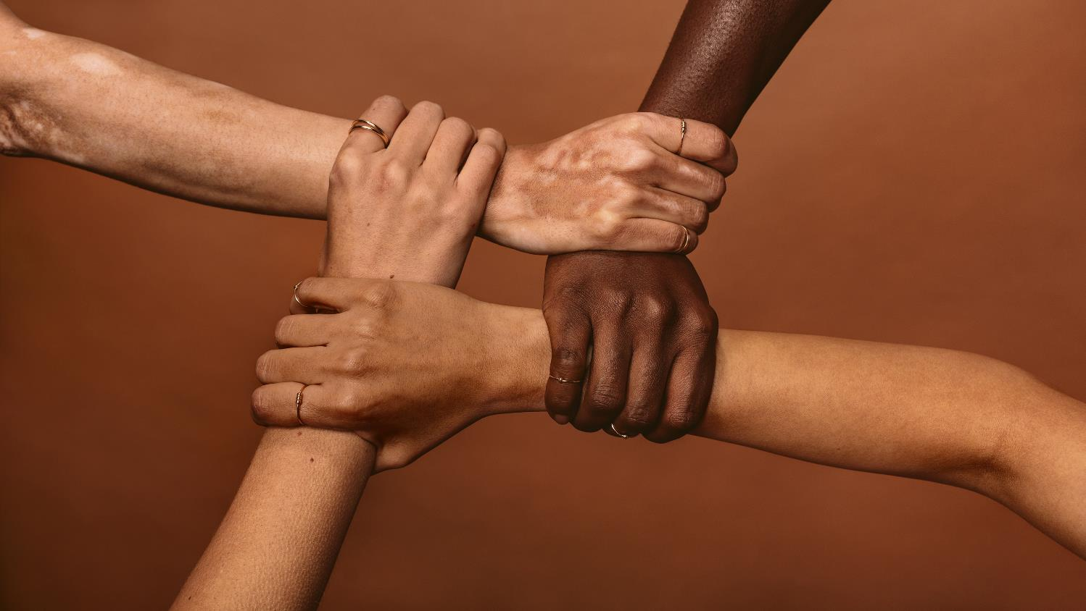
And he gave the apostles, the prophets,
the evangelists, the shepherds and teachers,
to equip the saints for the work of ministry
Eph 4:11-12a
Notes:
In addition, we are respecting and esteeming our church leaders,
Giving them the opportunity to equip the saints for the work of ministry.
That leads into the second relationship we are discussing today,
What is the ministry of the saints?
What is the work of the congregation?
Or more specifically, how should the strong in faith interact with the weak?

Slide 20
1 Thess 5:14-15
And we urge you, brothers,
admonish the idle,
encourage the fainthearted,
help the weak,
be patient with them all.
See that no one repays anyone evil for evil,
but always seek to do good
to one another
and to everyone.
Notes:
Verses 14 and 15 show us the proper relationship between the strong and weak in the faith.
(read verses 14 and 15)

Slide 21
1 Thess 5:14-15
And we urge you, brothers,
admonish the idle,
encourage the fainthearted,
help the weak,
be patient with them all.
See that no one repays anyone evil for evil,
but always seek to do good
to one another
and to everyone.
Notes:
When Christians are portrayed on TV and in the movies, they can be seen doing these three things:
admonishing the idle, encouraging the fainthearted, and helping the weak.
But it’s seen negatively because of how it is being done.
But if you are not patient,
If you are not seeking to do good to one another,
you become like the Pharisees.
This results in negative stereotypes of Christians.
So how should you admonish the idle, encourage the fainthearted, and help the weak?
First, recognize the necessity for these things. It’s not to make you feel good about what you are doing. That is legalism.
That is what the Pharisees were doing. Straining their wine so they wouldn’t accidentally swallow a gnat (which is unclean) but then would lie, cheat, and extort from the people.
That is what I was doing when I was young, I would be out partying with my friends, but when we ordered a pizza with pepperoni on a Friday night during lent, I would wait til after midnight to eat it, because I was Catholic, I was following rules for the wrong reason.
So back to the necessity of the strong coming alongside the weak,

Slide 22
15 Top Character Traits
To Demonstrate at Work and in Resumes
Notes:
You don’t see “idle, lazy, timid, faint-hearted, or weak” on the list of the 15 top character traits to demonstrate at work and in resumes.
Why do Christians need to be disciplined and not idle?
Jesus remarks that “The harvest is plentiful, but the laborers are few;
therefore pray earnestly to the Lord of the harvest to send out laborers into his harvest.”
So instead of spending 6 hours playing call of duty or watching K dramas on Netflix, prepare yourself to be a laborer.
Why do Christians need to be courageous and not fainthearted?
It’s not just the old testament command to be strong and courageous,
In the New Testament, Paul wrote to the Corinthians that
5 He who has prepared us for this very thing is God, who has given us the Spirit as a guarantee. 6 So we are always of good courage. We know that while we are at home in the body we are away from the Lord, 7 for we walk by faith, not by sight.
And when we are disciplined and courageous, we become strong spiritually.
But you can’t just tell people how to be disciplined, courageous, or strong.

Slide 23
Motivation
Notes:
Someone who stands in front of you and tells you what to do is a motivational speaker.
But a Christian brother will come alongside, climb that hill with you, give you a helping hand, and pull you up.
That is How to Behave among God’s People

Slide 24
1 Thess 5:14-15
And we urge you, brothers,
admonish the idle,
encourage the fainthearted,
help the weak,
be patient with them all.
See that no one repays anyone evil for evil,
but always seek to do good
to one another
and to everyone.
Notes:
The exhortation to be patient with them all is a reminder
that when you are helping someone,
you may have to help them again and again.
If someone is timid,
they don’t suddenly gain confidence and courage overnight.
If someone is idle or spends too much time doing various leisure activities, they can easily fall back into old habits.
Therefore, continue to encourage and help one another, knowing that this is an ongoing process.
And then, if someone, either purposely or accidentally, offends you,
don’t take offense and lash out in anger, don’t repay evil for evil.
This is simply a restatement of Jesus’s sermon on the mount, where Jesus said in Matthew chapter 5:38-42:
38 “You have heard that it was said, ‘An eye for an eye and a tooth for a tooth.’ 39 But I say to you, Do not resist the one who is evil. But if anyone slaps you on the right cheek, turn to him the other also. 40 And if anyone would sue you and take your tunic, let him have your cloak as well. 41 And if anyone forces you to go one mile, go with him two miles. 42 Give to the one who begs from you, and do not refuse the one who would borrow from you.
Can you imagine if Christians behaved like this all the time?
You would never see Christians on TV because there would be no drama.

Slide 25
Ch 4
¹ Finally, then, brothers, we ask and urge you in the Lord Jesus, that as you received from us how you ought to walk and to please God, just as you are doing, that you do so more and more.
Ch 5
¹² We ask you, brothers, to respect those who labor among you and are over you in the Lord and admonish you, ¹³ and to esteem them very highly in love because of their work. Be at peace among yourselves.
¹⁴ And we urge you, brothers, admonish the idle, encourage the fainthearted, help the weak, be patient with them all. ¹⁵ See that no one repays anyone evil for evil, but always seek to do good to one another and to everyone.
Notes:
Often when you read exhortations in the Bible,
it is because someone is not doing what they should.
But in this case, we have already seen Paul write
in chapter 4 of 1st Thessalonians:
“Finally, then, brothers, we ask and urge you in the Lord Jesus,
that as you received from us how you ought to walk and to please God,
just as you are doing, that you do so more and more.
It would appear the Thessalonians are doing well,
but Paul is encouraging them not only to continue to do well,
but to do it even better.
That should be a slogan: Do well, but Better!
Before we move away from discussion relationships, also let me point out that when Paul writes “we ask” or “we urge” or “we ask and urge,”
he is using these terms interchangeably, he is not making a point about one behavior being more important than another type of behavior.
It can also be seen as a paragraph marker, breaking up his letters into easily understandable sections.
We ask you to behave properly among God’s people by valuing your leaders.
We urge you to behave properly among God’s people by valuing one another, always seeking to do good
Paul will now move away from these relationships and into some specific behaviors or attitudes.

Slide 26
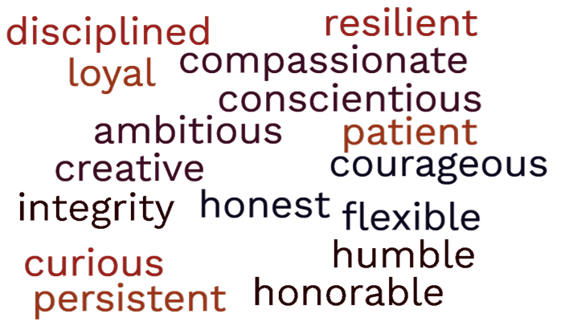
15 Top Character Traits
To Demonstrate at Work and in Resumes
Optimistic?
Discerning?
Notes:
In the remaining verses, Paul will discuss being optimistic yet discerning.
These traits do not appear in the list of 15 top character traits to demonstrate at work and in resumes.
However, I believe most employers would rather hire an optimistic person over a pessimistic person.
And Christians of all people have a reason to be optimistic.

Slide 27
Rejoice always,
pray without ceasing,
give thanks in all circumstances;
for this is the will of God in Christ Jesus for you.
1 Thess 5:16-18
Notes:
That is why Paul writes
Rejoice always, 17 pray without ceasing, 18 give thanks in all circumstances; for this is the will of God in Christ Jesus for you.
The Thessalonians were optimistic.
They had a strong faith and were walking in love.
They were looking forward to Christ’s return
because they knew their hearts were established blameless in holiness.
Paul even reassured the Thessalonians about those who pass along while waiting for Christ’s return,
They, too, will always be with the Lord.
And if you have repented and turned to God,
if you have accepted Jesus as your savior,
you are a part of the kingdom of God,
you are a beneficiary of the new covenant.
You should also be optimistic.
This behavior should be part of your identity.

Slide 28
For it has been granted to you that for the sake of Christ, you should not only believe in him but also suffer for his sake,
Indeed, all who desire to live a godly life in Christ Jesus will be persecuted,
Rejoice always,
pray without ceasing,
give thanks in all circumstances;
for this is the will of God in Christ Jesus for you.
1 Thess 5:16-18
Notes:
But it is necessary to remember these joyful exhortations
because being a Christian is not a bed of roses.
Phil 1:29 tells us that it has been granted to you that for the sake of Christ you should not only believe in him but also suffer for his sake,
2 Tim 3:12 tells us that Indeed, all who desire to live a godly life in Christ Jesus will be persecuted,
But we can still be optimistic, we can still be thankful.
Even when we are suffering persecution,
even when we experience the hardships and suffering of life,
we can lean on the relationships we have with each other,
the relationship we have with our church leaders,
and the relationship we have with God.

Slide 29
Behavior towards others
Rejoice
Pray
Give Thanks
Notes:
In fact, you could say that this section is about a personal relationship with God. It is something we have inside.
When we have a right relationship with God, that is on the inside,
we will rejoice always, pray unceasingly, and give thanks in all circumstances.
This will then be expressed in our behavior towards others.
We will be at peace among ourselves.
We will seek to do good for one another.
Our behavior affects our relationships.
Our relationships affect our behavior.
But we must be grounded in truth for this affect to be positive.

Slide 30
Do not quench the Spirit.
Do not despise prophecies,
but test everything;
hold fast what is good.
Abstain from every form of evil.
1 Thess 5:19-22
Notes:
The way to remain grounded in the truth is to be discerning, not cynical or gullible.
There is a fine balance when it comes to quenching the spirit and despising prophecies. The Corinthian church allowed free reign with the spirit, leading to disorderly worship.
We don’t see any spiritual issues with the Thessalonians, but when you think about spiritual fruits such as love, joy, peace, patience, kindness, goodness, faithfulness, gentleness, self-control; you see how very necessary the spiritual fruits are to maintaining harmonious relationships and ensuring proper behavior between God’s people.
With these first two phrases, Paul is basically warning against cynicism.
Do not quench the spirit,
Do not despise prochcies

Slide 31
Notes:
If you look at the characteristics of cynicism, it is clear this is how NOT to behave among God’s People.
Characteristics of cynicism include pessimism, dispositional attribution, distrust of people, doubt, skepticism, bitterness, sarcasm, and disbelief of others’ sincerity, honesty, and values.
And the opposite of cynicism is optimism, which we already discussed.

Slide 32
Do not quench the Spirit.
Do not despise prophecies,
but test everything;
hold fast what is good.
Abstain from every form of evil.
1 Thess 5:19-22
Notes:
The next group of phrases includes “do not despise prophecies” but test everything; hold fast what is good” was necessary because the New Testament was still in the process of being written.
A few letters were circulating, but Christianity was mainly spread by word of mouth. Someone comes to your town and claims to be telling a spiritual truth. How can you trust them? You must test what they are saying against scripture and the spirit.
Fortunately, today, we have a complete New Testament.
Unfortunately, it seems wrong theology is even more rampant and also believed by more people.
That is why everything you hear must be tested.
And with the internet, we have access to many untested statements.
People who believe anything you tell them are gullible.
Did you know that if you say orange real slow, it sounds like gullible?
As I look around, I can see that no one is trying to say orange real slow,
No one here is gullible; that is good!
But what happens if someone tells you something like “the early Christians did not worship Jesus as God, or “only people who attend church on Saturday go to heaven” where do you turn?

Slide 33
over you in the Lord
God
Church Leaders
Congregation
Notes:
This is where you must rely on the Bible, prayerful discernment, and your church leaders to guide you.
When reading the Bible, don’t just read the few verses someone shows you; read the surrounding text, read other letters by the same author, and read other translations to gain a better understanding.
One more thing you can do with uncertain teaching is ask,
how does that affect my behavior?
Remember Paul’s formula? Repent and turn to God.
Then prove that you have by your good works,
that is by our behavior.
Will my behavior be like a light placed on a stand so that it gives light to the whole house and that other see it shine and see the good works and give glory to God?
A proper understanding of God’s word should always lead us to uphold truth while showing love for others.

Slide 34
Do not quench the Spirit.
Do not despise prophecies,
but test everything;
hold fast what is good.
Abstain from every form of evil.
1 Thess 5:19-22
Notes:
We will conclude today with “abstain from every form of evil.”
This all-encompassing phrase adequately covers how to behave among God’s people.
When we abstain from every form of evil,
we will value our church leaders, allowing them to complete their work.
When we abstain from every form of evil,
we will build each other up in love and seek to do good to one another and to everyone
When we abstain from every form of evil,
we will be optimistic yet discerning.
When we abstain from every form of evil,
we will be behaving properly before God’s people.
But all this discussion on Attitude, Behavior, and Character means nothing unless we have repented and turned to God.

Slide 35
Repent of your sins and turn to God, for the Kingdom of Heaven is near
Matt 3:2 & 4:17 (NLT)
John the Baptist
Jesus of Nazareth
Notes:
The words of Jesus (and John the Baptist) come to mind. Both said, “Repent of your sins and turn to God, for the Kingdom of Heaven is near” Matt 3:2 & 4:17 (NLT).

Slide 36
Repent of your sins and turn to God,
For the forgiveness of your sins (Acts 2:38)
so your sins may be wiped away (Acts 3:19)
Peter
Notes:
We see similar phrases from Peter on two occasions, as shown in Acts 2:38 and 3:19.
However, Peter no longer mentions that the Kingdom of Heaven is near, instead, he states that they should be baptized in the name of Jesus Christ for the forgiveness of … sins. Then . . . receive the gift of the Holy Spirit.
Instead of the kingdom being near, it is now here. Entry into the kingdom is by repenting and turning to God, then being baptized in the name of Jesus, which results in receiving the Holy Spirit.

Slide 37
“God overlooked people’s ignorance about these things in earlier times, but now he commands everyone everywhere to repent of their sins and turn to him. (Acts 17:30)
Paul in Athens
Notes:
Paul shows that this invitation to join the kingdom was extended to the gentiles in Athens when he states that “God overlooked people’s ignorance about these things in earlier times, but now he commands everyone everywhere to repent of their sins and turn to him” (Acts 17:30).

Slide 38
“I preached first to those in Damascus, then in Jerusalem and throughout all Judea, and also to the Gentiles, that all must repent of their sins and turn to God—and prove they have changed by the good things they do. (Acts 26:20)
Paul on Trial
Notes:
When Paul is on trial, his answer to King Agrippa shows an interesting aspect of entering the kingdom, they would prove they would change by the good things they do (Acts 20:26).

Slide 39
prove they have changed by the good things they do. (Acts 26:20)
I will show you my faith by my good deeds.
(James 2:18)
Paul and James
Notes:
One early church father who strongly agrees with Paul’s sentiment is James, who said, “I will show you my faith by my good deeds” James 2:18).

Slide 40
let your light shine before others, so that they may see your good works and give glory to your Father who is in heaven.
Matt 5:16
Notes:
Even Jesus, when introducing the kingdom in the Sermon on the Mount, said, “let their light shine before others, so that they may see your good works and give glory to your Father who is in heaven.

