Slide 1
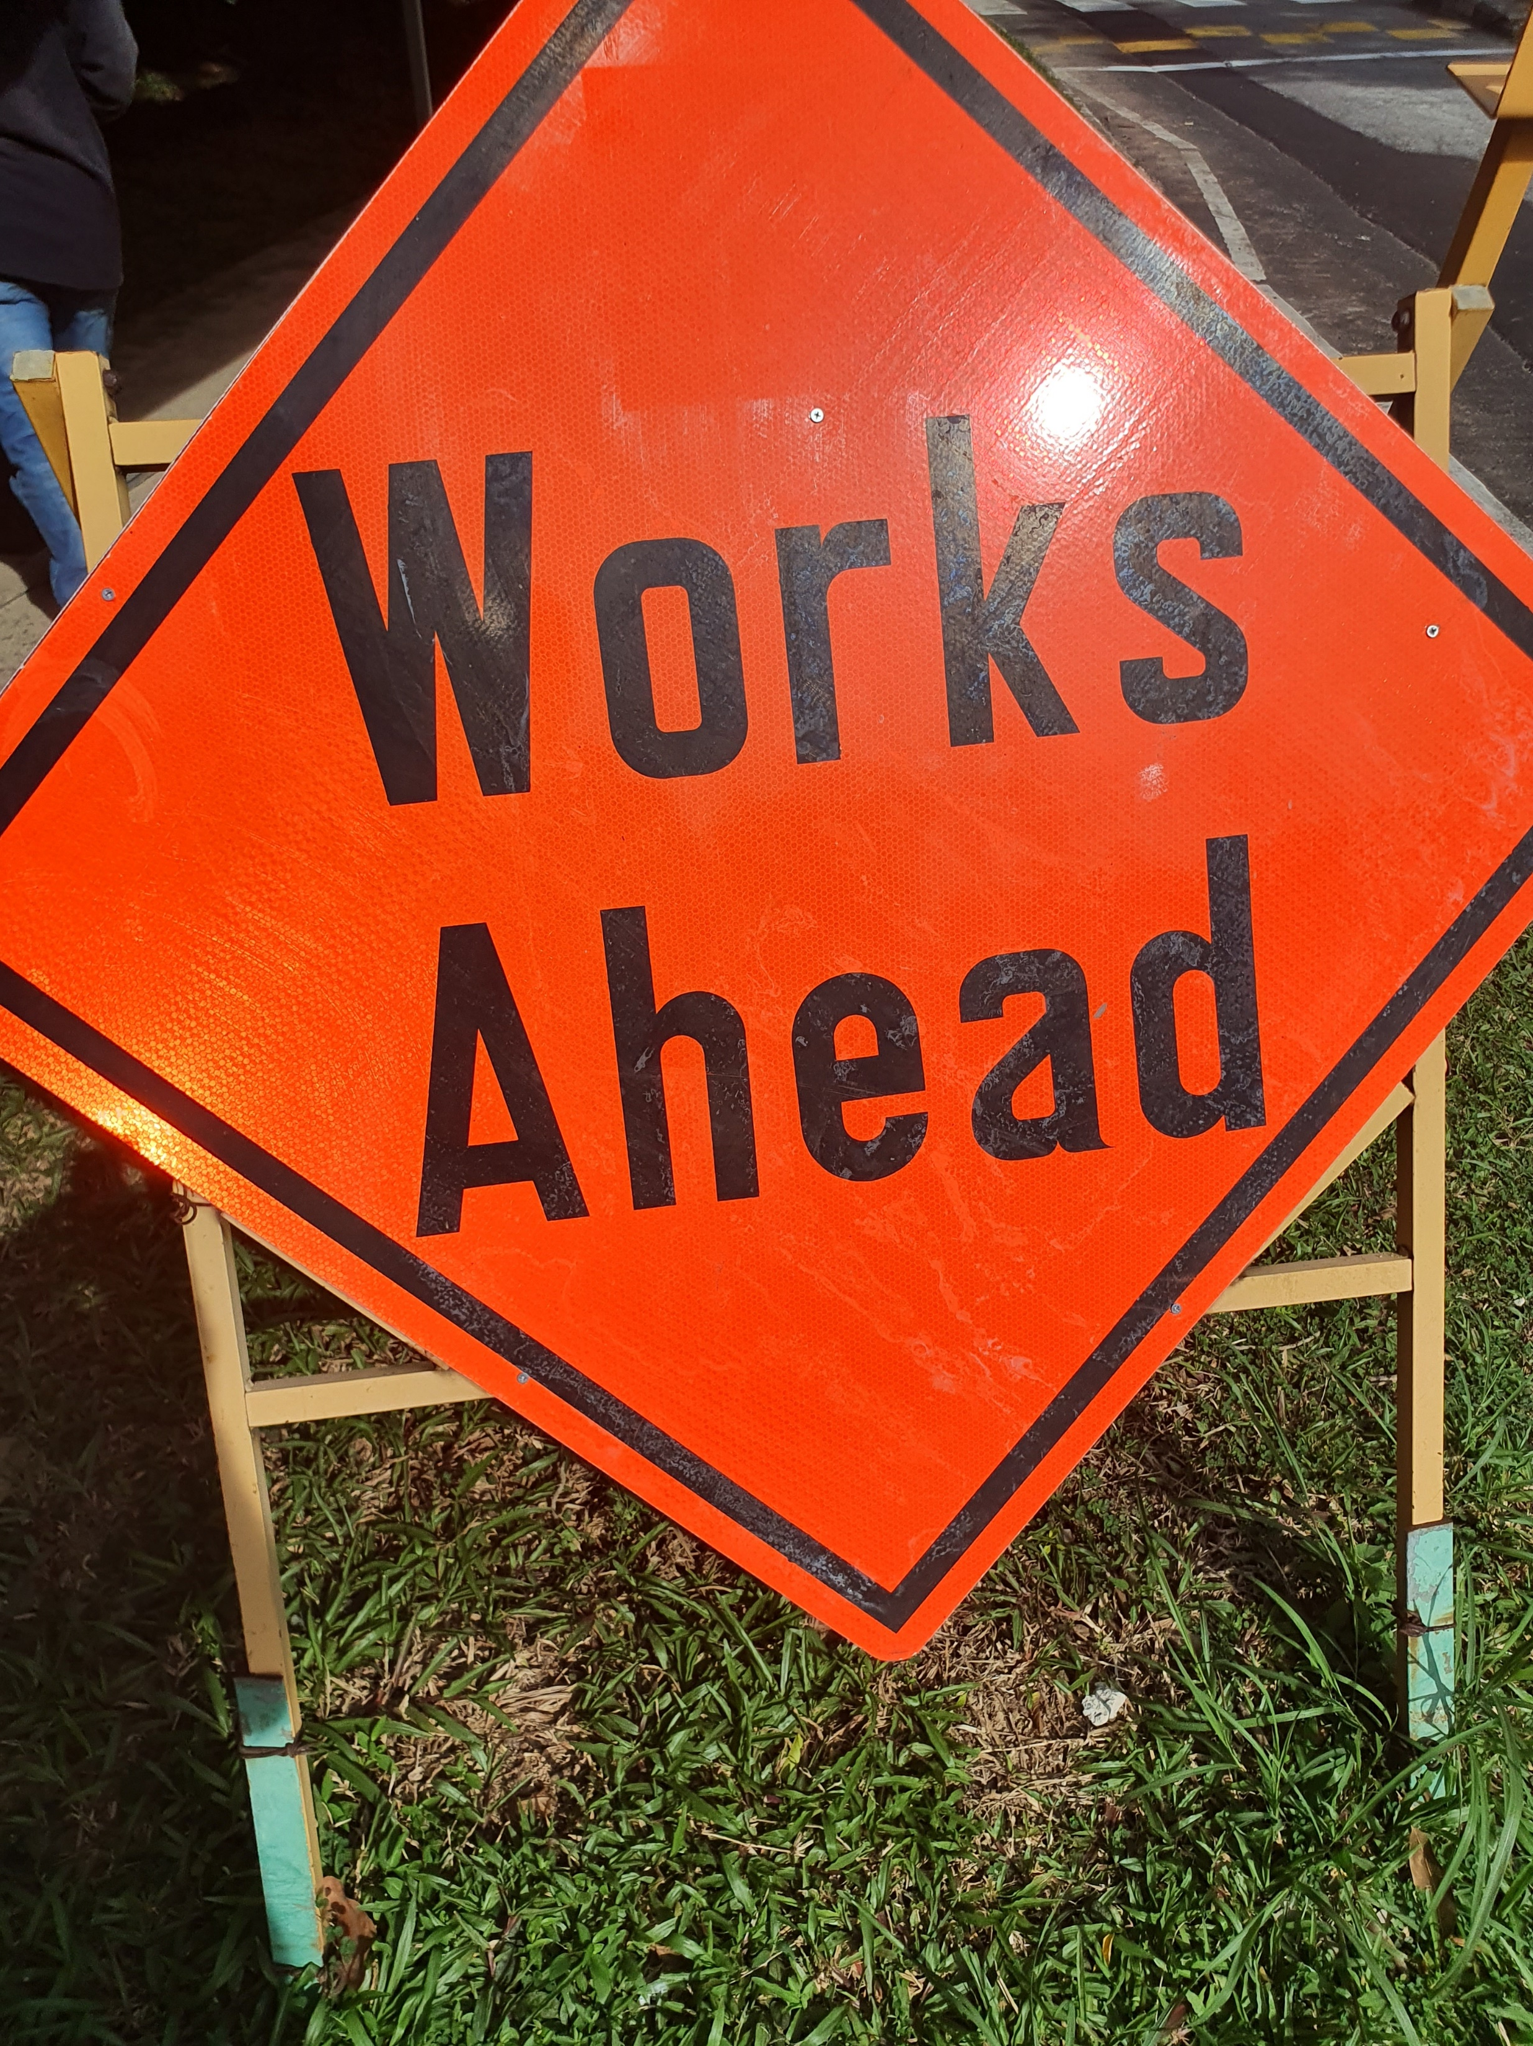

Slide 2
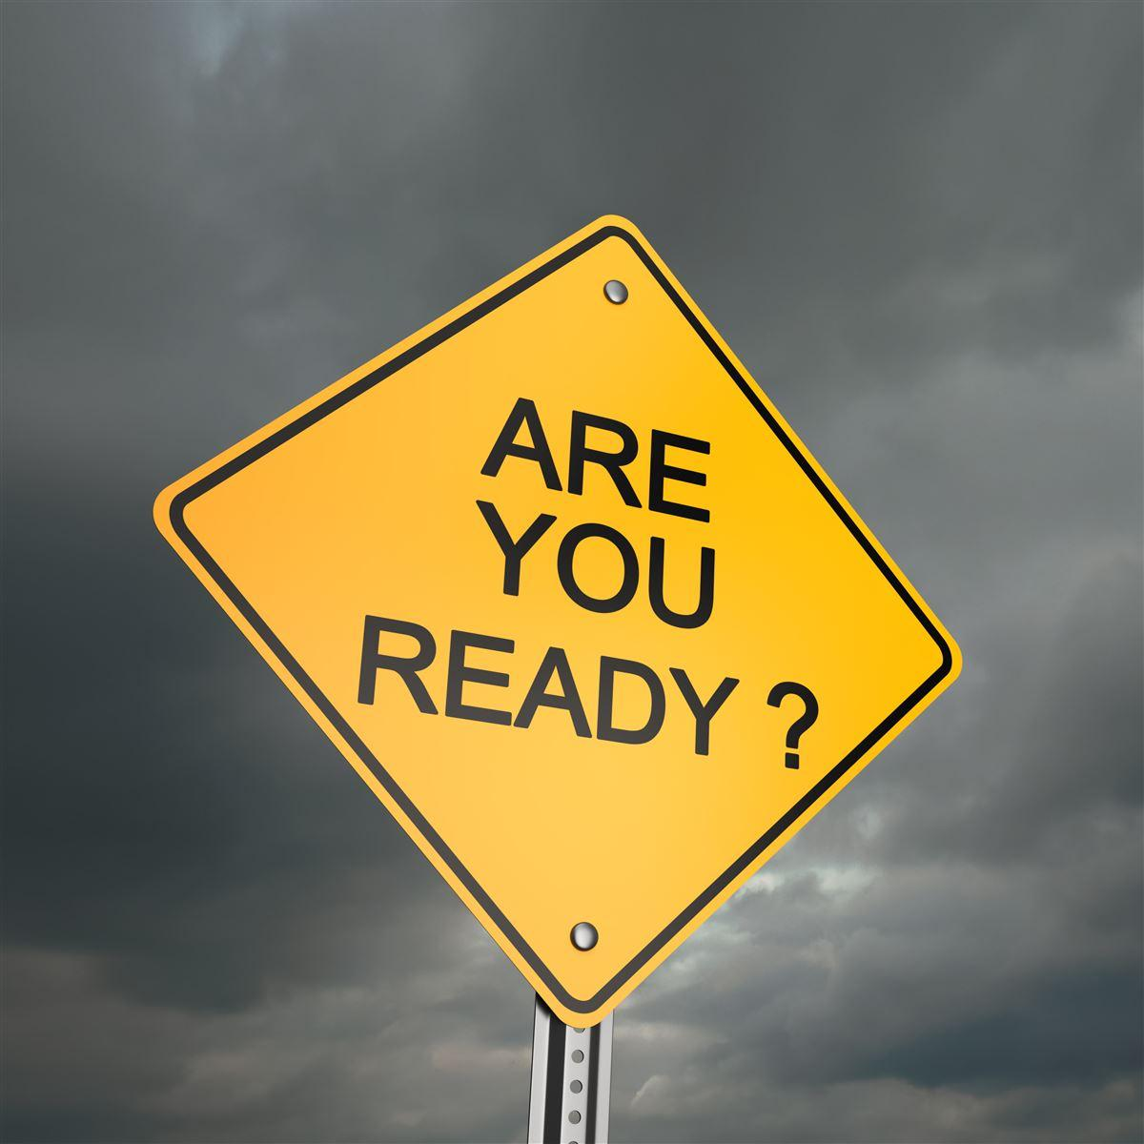
Be Ready
and Stay Ready
1 Thessalonians 5:1-11

Slide 4
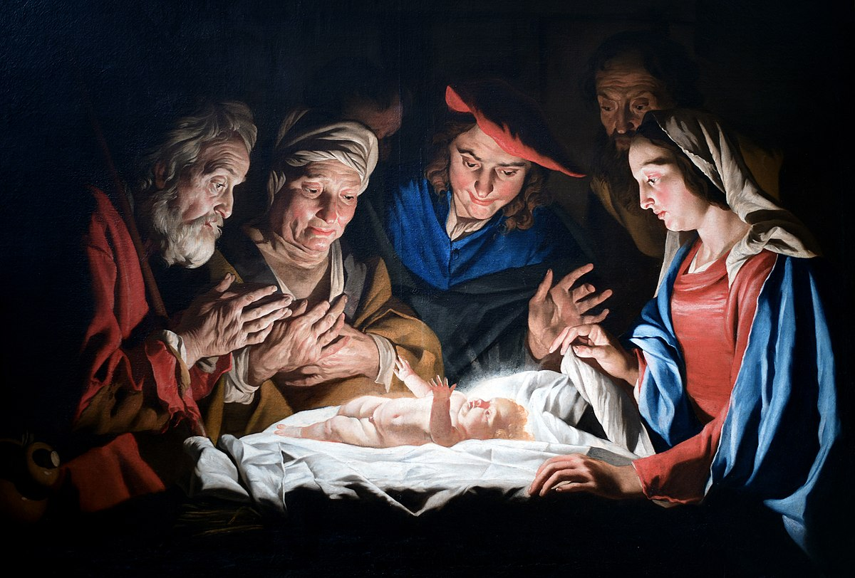
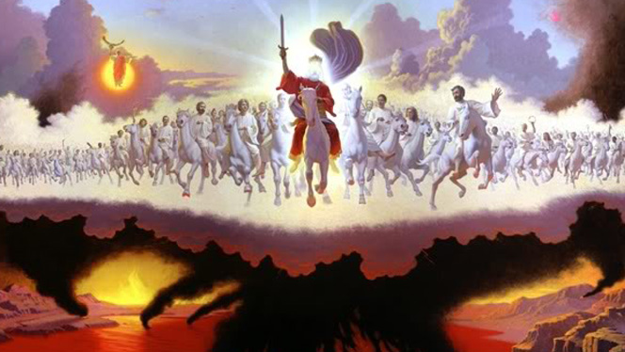
First Advent
Second Advent

Slide 5
“the day of the Lord”

Slide 6
The judgment of God comes suddenly and inescapably (vs. 1-3)
Hebrews 11:7
By faith Noah, being warned by God concerning events as yet unseen, in reverent fear constructed an ark for the saving of his household. By this he condemned the world and became an heir of the righteousness that comes by faith.

Slide 7
The judgment of God comes suddenly and inescapably (vs. 1-3)
Revelation 3:4-6
³ Remember, then, what you received and heard. Keep it, and repent. If you will not wake up, I will come like a thief, and you will not know at what hour I will come against you. ⁴ Yet you have still a few names in Sardis, people who have not soiled their garments, and they will walk with me in white, for they are worthy. ⁵ The one who conquers will be clothed thus in white garments, and I will never blot his name out of the book of life. I will confess his name before my Father and before his angels.

Slide 8
The judgment of God comes suddenly and inescapably (vs. 1-3)
Revelation 19:7-8 ⁷ Let us rejoice and exult and give him the glory, for the marriage of the Lamb has come, and his Bride has made herself ready; ⁸ it was granted her to clothe herself with fine linen, bright and pure”—
for the fine linen is the righteous deeds of the saints.

Slide 9
The judgment of God comes suddenly and inescapably (vs. 1-3)
Revelation 19:11-13 ¹¹ Then I saw heaven opened, and behold, a white horse! The one sitting on it is called Faithful and True, and in righteousness he judges and makes war. ¹² His eyes are like a flame of fire, and on his head are many diadems, and he has a name written that no one knows but himself. ¹³ He is clothed in a robe dipped in blood, and the name by which he is called is The Word of God. ¹⁴ And the armies of heaven, arrayed in fine linen, white and pure, were following him on white horses.

Slide 10
The future day of the Lord
{
}
Resurrection/rapture of the church
Great
Tribulation
Christ’s Return
to Earth
The Destruction of Earth

Slide 11
The judgment of God comes suddenly and inescapably (vs. 1-3)
Believers must be spiritually alert (vs. 4-11)
“The coming of Christ will take by surprise those that are carelessly giving way to indulgence, because, being enveloped in darkness, they see nothing, for no darkness is more dense than ignorance of God.”
John Calvin

Slide 12
The judgment of God comes suddenly and inescapably (vs. 1-3)
Believers must be spiritually alert (vs. 4-11)
Be alert to spiritual dullness
Counter tendencies to selfishness and worldliness

Slide 13
“For this is spiritual sobriety, when we use this world so sparingly and temperately that we are not entangled with its allurements.”
John Calvin

Slide 14
“Christianity is not a religion in which one can dabble. It is not possible to hedge the bet by belonging to both the church and another religious group. One is either of the light or in darkness.”
Michael Martin

