Slide 1
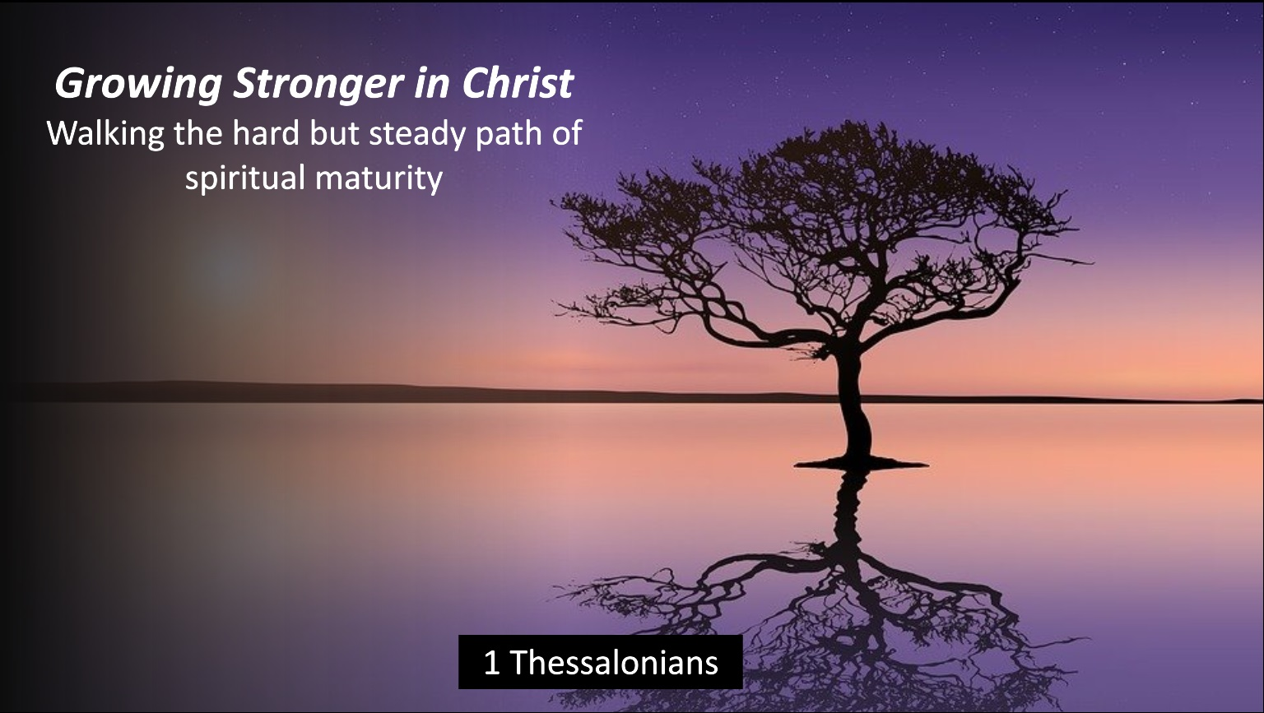

Slide 2

1 Thessalonians 4:1-8
Holy Walking before a Holy God

Slide 3


Slide 4

1 Thessalonians 4:1-2
KEEP WALKING
An encouragement to live out their faith in holy living. “We ask and urge you in the Lord Jesus …to walk and to please God….that you do so more and more.” (vs 1)

Slide 5

1-2 Thessalonians : a new covenant commentary
By DR. Nijay Gupta
For Paul, the free gift of new life in Messiah Jesus automatically entails a new set of personal and social standards under the Lordship of Jesus. The idea behind “walking” ….is that the religious life is lived at all times, not just in temples and religious meetings (Deut 6:4–12).

Slide 6
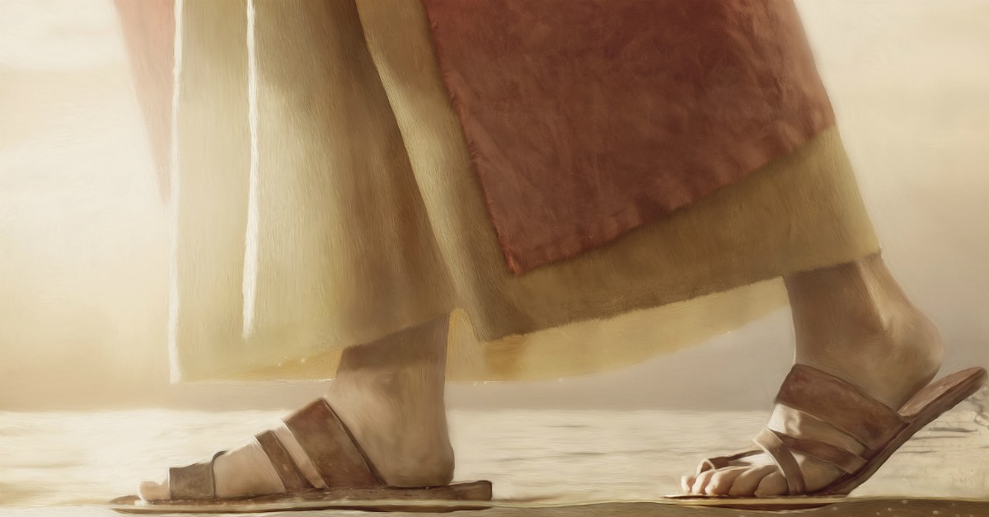
1 Thessalonians 4:1-2
KEEP WALKING
The Hebrew people saw all of life as a walk.
Godly people walked with God (e.g. Enoch and Noah in Genesis 5:24 and 6:9).
Deuteronomy 5:33 - "You shall walk in all the ways the Lord your God has commanded us."

Slide 7

How Should We Walk?
In holiness and sexual purity
(vs 1-8)
In love and responsibility
(vs 9-12)

Slide 8
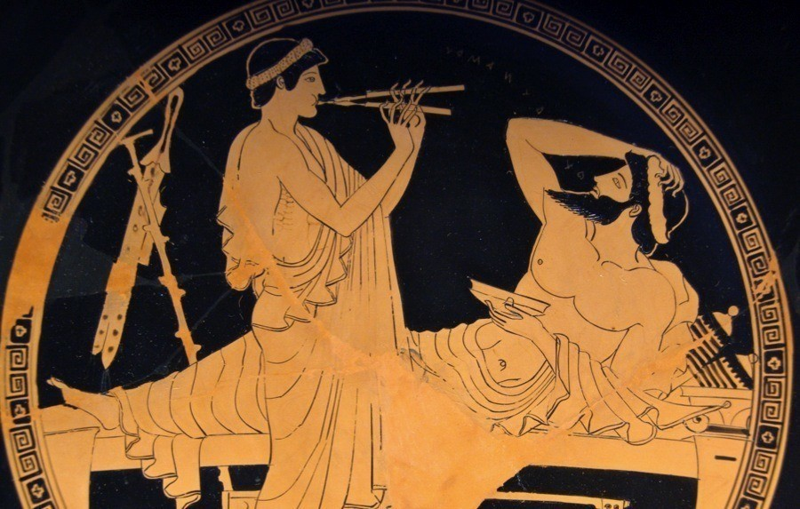
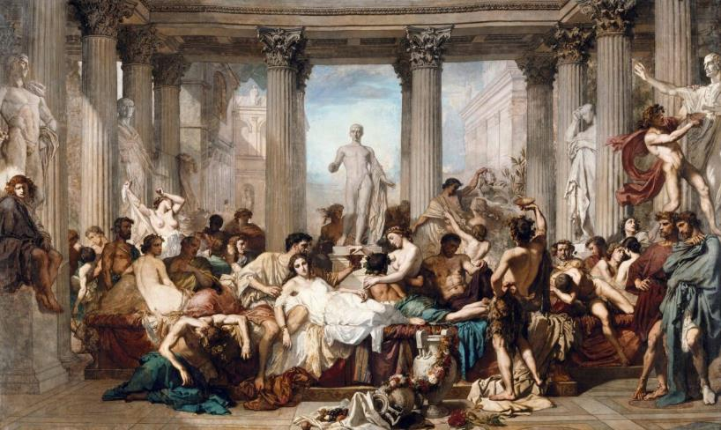
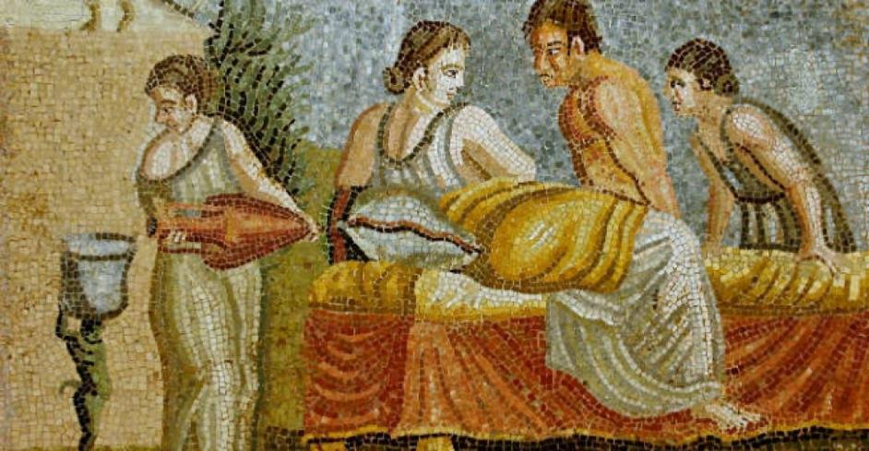
The debauchery of the ancient Greco-Roman world.

Slide 9
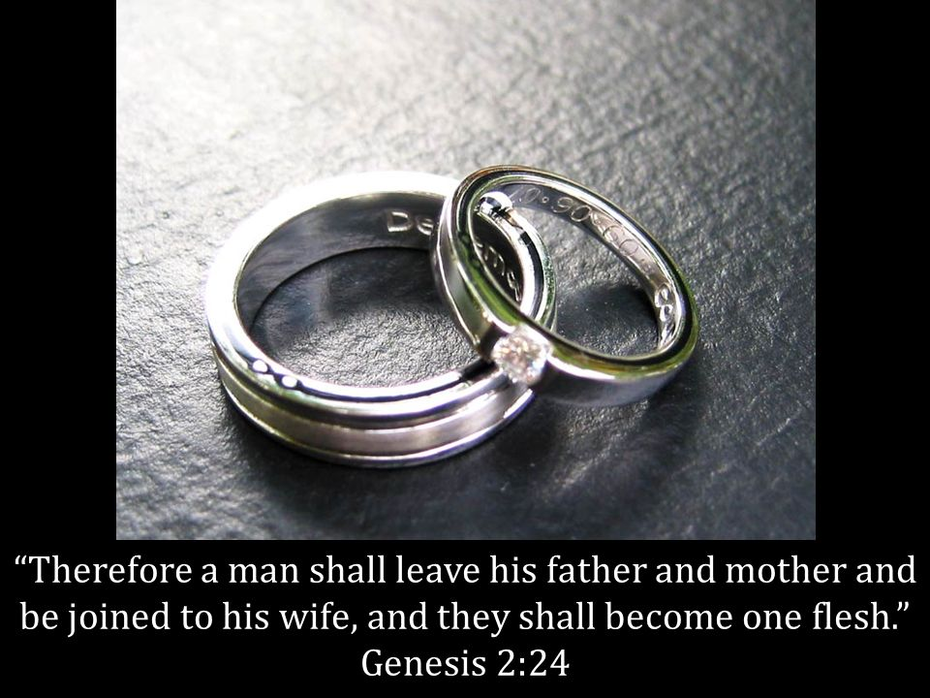

Slide 10

1 Thessalonians 4:1-2
LISTEN UP!
What they taught and instructed, was by authority of the Lord Jesus (vs 2).

Slide 11

1 Thessalonians 4:3-4
Be Holy
God’s will is for our sanctification (vs 3a).
"When we become Christians, we do not drop all [the habits of sin] overnight. In fact, we will spend the rest of our lives putting off these habits and putting on habits of holiness." (Jerry Bridges)
2 things we must do: 1) avoid sexual immorality and 2) control our own bodies. (vs 3b-4).

Slide 12

How to Stay Pure in an immoral world?
1. Flee from sexual temptation (1 Corinthians 6:18). Take God’s way out (1 Corinthians 10:13).
2. Find freedom in Christ and fellowship with his people (2 Timothy 2:22).

Slide 13
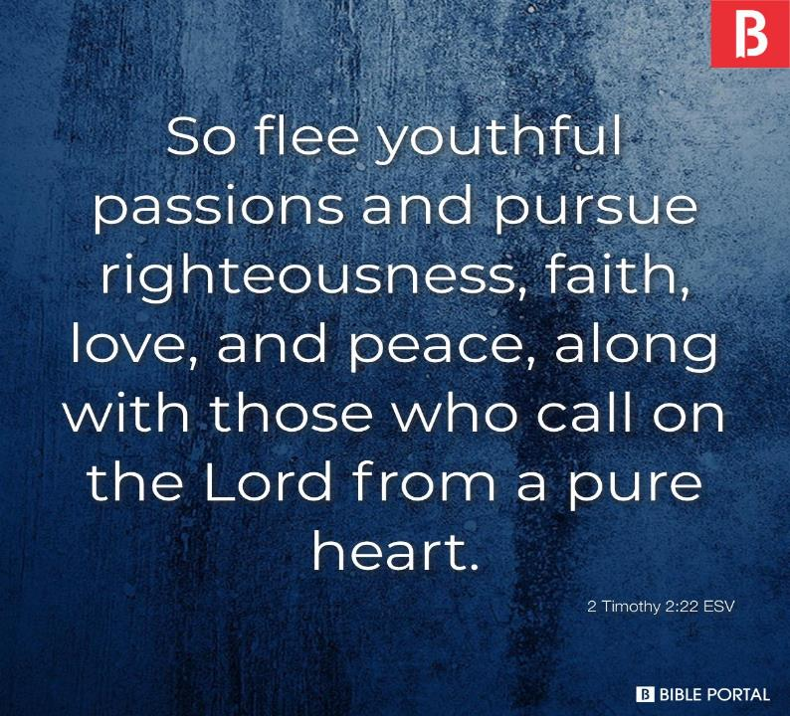

Slide 14
How to Stay Pure in an immoral world?
1. Flee from sexual temptation (1 Corinthians 6:18). Take God’s way out (1 Corinthians 10:13).
2. Find freedom in Christ and fellowship with his people (2 Timothy 2:22).
3. Follow God’s plan for rightful sexual intimacy (1 Corinthians 7:2)

Slide 15
1 Thessalonians 4:4-8
Be Different
”In holiness and honour” (vs 4) – living in a counter-cultural way.
The Lord will avenge those who sin against others in this way (vs 6).
We are called to holiness, not impurity (vs 7).

Slide 16


Slide 17
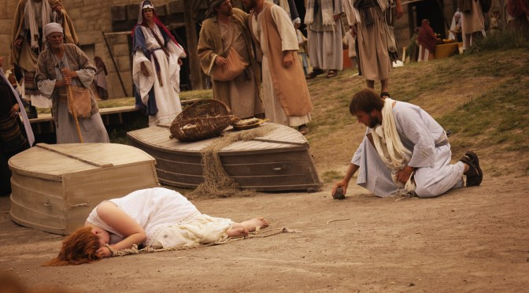
John 8:1-11
The Law
She must die!
Solution: Legalism
The World
She can do as she wants!
Solution: Licence
The Gospel of Jesus Christ
Her sin is judged, but Jesus took her place on the cross, forgives her and makes her pure.
Solution: Love and mercy, grace and truth.

