Slide 3
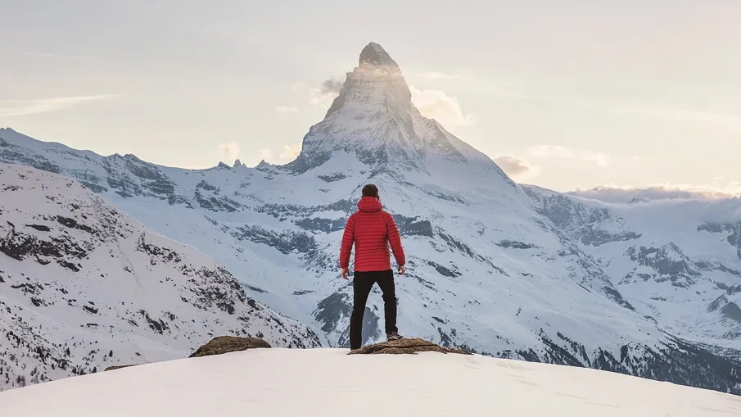
I Wish to God
-Praying stronger for other believers-
(1 Thessalonians 3:11-13)

Slide 4
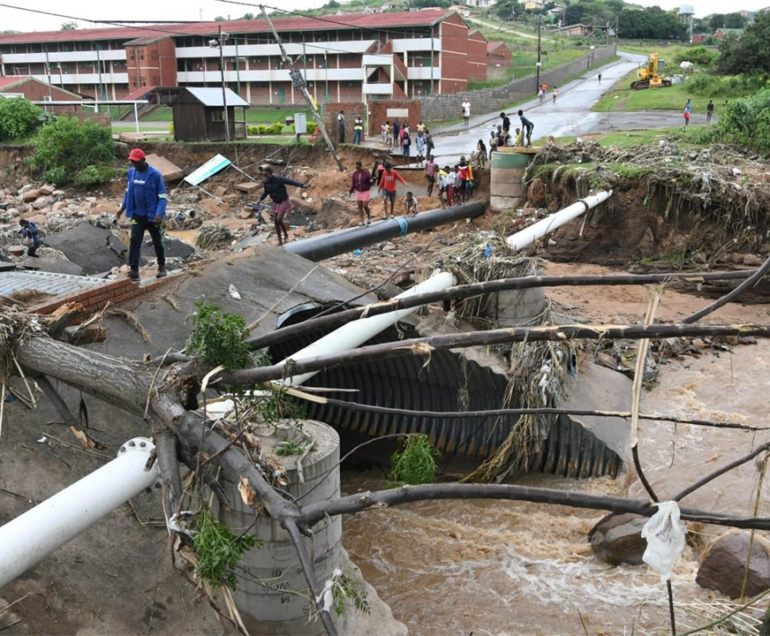
Pray that God clears away problems that prevent fruitful ministry to others (v. 11)

Slide 5
James 4:13-17
¹³ Come now, you who say, “Today or tomorrow we will go into such and such a town and spend a year there and trade and make a profit”— ¹⁴ yet you do not know what tomorrow will bring. What is your life? For you are a mist that appears for a little time and then vanishes. ¹⁵ Instead you ought to say, “If the Lord wills, we will live and do this or that.” ¹⁶ As it is, you boast in your arrogance. All such boasting is evil. ¹⁷ So whoever knows the right thing to do and fails to do it, for him it is sin.

Slide 6
Pray for love and care for others to move to the next level (v. 12)

Slide 7
Examples of Next Level love
Apologize to someone for hurtful things you have done to them even though they wronged you more.
Spend valued time with someone who can offer you little in return.
Confront someone you love over a sinful habit because their holiness depends on it.
Encourage someone for service that no one else notices.

Slide 8
Examples of Next Level love
Do a difficult chore for someone else without them requesting it and without drawing attention to it.
Join in thankful prayer with someone who has received something from God that you wish you had.
Invite someone to your house for a meal that you do not really know well so that you can get better acquainted. Then, talk about them instead of yourself.

Slide 9
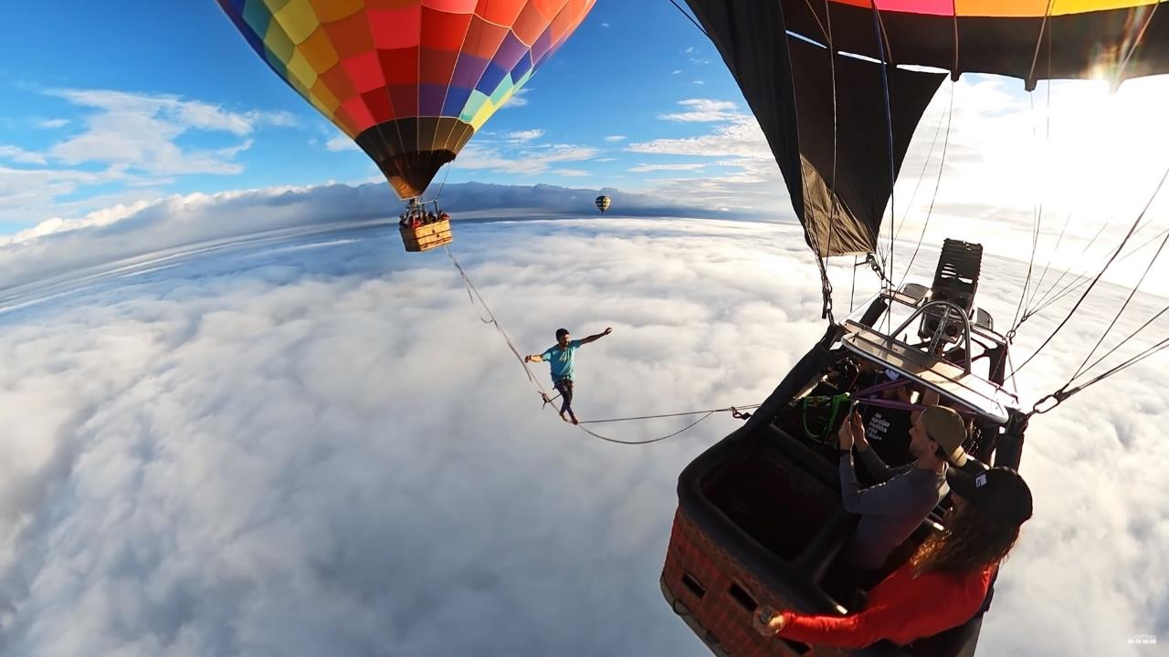

Slide 10
Pray for greater holiness of life by increasing sacrificial love
(v. 13)

Slide 11
Thessalonian prayer
O God, our caring Father, and Jesus, Ruler of all.
Clear away all the obstacles that prevent us from ministering effectively to other people.
Help us to take our love for others to the next level so that we deepen and broaden our care for both fellow believers as well as unbelievers.
Let our love grow to the point that our sinful selfishness is purged, and our hearts become strong in a holy state in the presence of God when Jesus returns in glory with all his angels and other believers from all history. Amen

