Slide 1
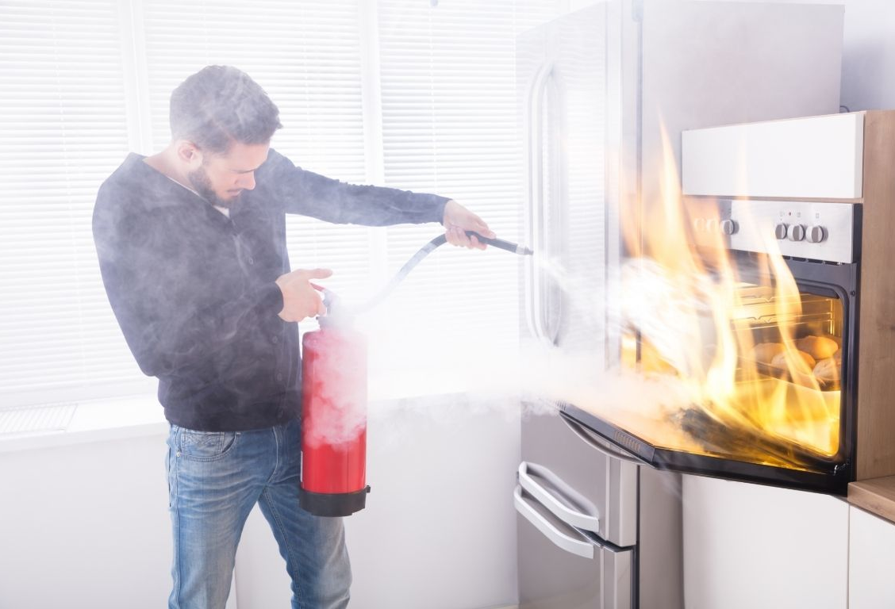
Notes:
Have you ever left your house in a hurry,
and then began to wonder,
did I leave the oven on?
Until you return, you feel a sense of anxiety.
You begin to imagine worst-case scenarios.
Although ovens are designed to operate
at elevated temperatures for prolonged periods of time,
if there happens to be something being overcooked in that oven,
then leaving it on for a long period of time
can result in a disastrous situation

Slide 2
1 Thessalonians 3:1-10
Notes:
Our passage today, 1st Thessalonians chapter 3 verses 1 thru 10,
starts with the apostle Paul expressing
that he had that same sort of anxiety
as if he left the oven on,
In Paul’s case,
he was anxious and concerned for the Thessalonian church
because he had to leave quickly and felt his teaching was unfinished.
At the end of the previous chapter, he says that
since we were torn away from you, brothers, for a short time,
in person not in heart,
we endeavored the more eagerly and with great desire
to see you face to face,
But Satan hindered us.
Our passage today, 1 Thessalonians chapter 3,
tells us how Paul alleviated his anxiety.
But we will see that Paul didn’t just return home and turn off the oven
Instead, he sent Timothy,
and not only was his anxiety alleviated.
Not only was his concern calmed,

Slide 3
The result of Paul’s concern for the Thessalonians was that Paul himself was comforted
1 Thessalonians 3:1-10
Notes:
We will see that the result of Paul’s concern for the Thessalonians
was that Paul himself was comforted.
This message is not just visible in the surface text,
but when did deeper,
we see Paul purposely uses specific words
and carefully crafted examples
to show his journey from wah jialat to joy.

Slide 4
Q
Wah! Jialat to Joy
The result of Paul’s concern for the Thessalonians was that Paul himself was comforted
1 Thessalonians 3:1-10
Notes:
Now for a Singlish lesson
Wah seems to be a word or sound that simply means I’m about to say something in Singlish.
Many Singlish sentences begin with Wah! or Aiya, or Aiyo.
But in the youtube videos I used to do my Singlish research, they always said “wah” before jialat
For jialat, the literal Hokkien meaning is to eat or drain away strength,
And in Singlish, it is used to describe a negative or disastrous situation.
In Paul’s three missionary journeys,
he experienced many negative or disastrous situations.
He was stoned, shipwrecked, beaten with rods,
received 39 lashes, went hungry and was cold.
But that is not what Paul would call disastrous.

Slide 5
I know that after my departure fierce wolves will come in among you, not sparing the flock; and from among your own selves will arise men speaking twisted things, to draw away the disciples after them.
Acts 20:29-30
Notes:
For Paul, the most disastrous situation
is what happened to a church after he left
This is what he spoke about with the Ephesian elders, saying
I know that after my departure fierce wolves will come in among you,
not sparing the flock;
and from among your own selves will arise men,
speaking twisted things,
to draw away the disciples after them.
And Paul was with the Ephesians for 3 years.
He was only in Thessalonica for about 3 months,
If he was worried about fierce wolves coming in after 3 years,
ministering and teaching sound doctrine
How much more would he be worried after just 3 months?
That is where our passage starts today, with Paul’s worry.

Slide 6
www.cicfamily.com
Sermon Series
Notes:
Time for a quick about the timings I just mentioned: 3 years in Ephesus, 3 months in Thessalonica
The Bible was not written to just be a history book, it is God’s special revelation to us.
This means that often, specific details not relevant to God’s special revelation are simply left out.
For example, the book of Acts tells us he spent only 3 sabbaths in the synagogues,
But we can infer from his statements that he worked there supporting himself,
and he also receiving multiple offerings from the Philippian church
and his pattern of always evangelizing first in the synagogues, and then in the markets
that he stayed and preached to the gentiles a little longer.
which is why most believe he spent about 3 months in Thessalonica
If you want to know more about Acts, you can listen to our previous series,
about God’s work through the early church in the book of Acts
On our church website www.cicfamily.com . . .
Now back to Paul’s journey from Jialat to Joy,

Slide 7
Notes:
Our journey today is part of our current series over 1st Thessalonians.
As we look at Paul’s journey,
we will see how it can help us grow stronger in Christ
When we dig deeper into the text, we will be encouraged
to continue walking the hard but steady path of spiritual maturity.

Slide 8
¹ Therefore when we could bear it no longer, we were willing to be left behind at Athens alone, ² and we sent Timothy, our brother and God's coworker in the gospel of Christ, to establish and exhort you in your faith,
1 Thessalonians 3:1-2
Notes:
Out passage starts with Paul expressing his anxiety
over what he fears could be a disastrous situation.
He wondered what has happened to the Thessalonian church
since he was forced to leave after just 3 short months?
That is why he writes Therefore when we could bear it no longer, we were willing to be left behind at Athens alone, and we sent Timothy, our brother and God's coworker in the gospel of Christ, to establish and exhort you in your faith,
Who is sending Timothy? It says “we” several times in the text,
just “who” is the “we”?
Let me point out that in English, we use pronouns such as I, you (singular), he/she/it, we, you (plural) and they all the time. In Greek, pronouns aren’t necessary since the verbs have pronouns built into their conjugation.
But similar to English, the 1st person plural could be a small group of “we” or a large group of “we” A member of the worship team can state that we play in the band so that we all can enjoy the music.
The first “we” who could bear it no longer likely included Paul, Timothy, and Silas, whom you recall from the opening line of the letter.
In fact, it likely was the entire ministry team, not just the three.
The second we are just those left behind,
so obviously does not include Timothy.
But the third we, who sent Timothy, likely includes Timothy.
He went willingly.

Slide 9
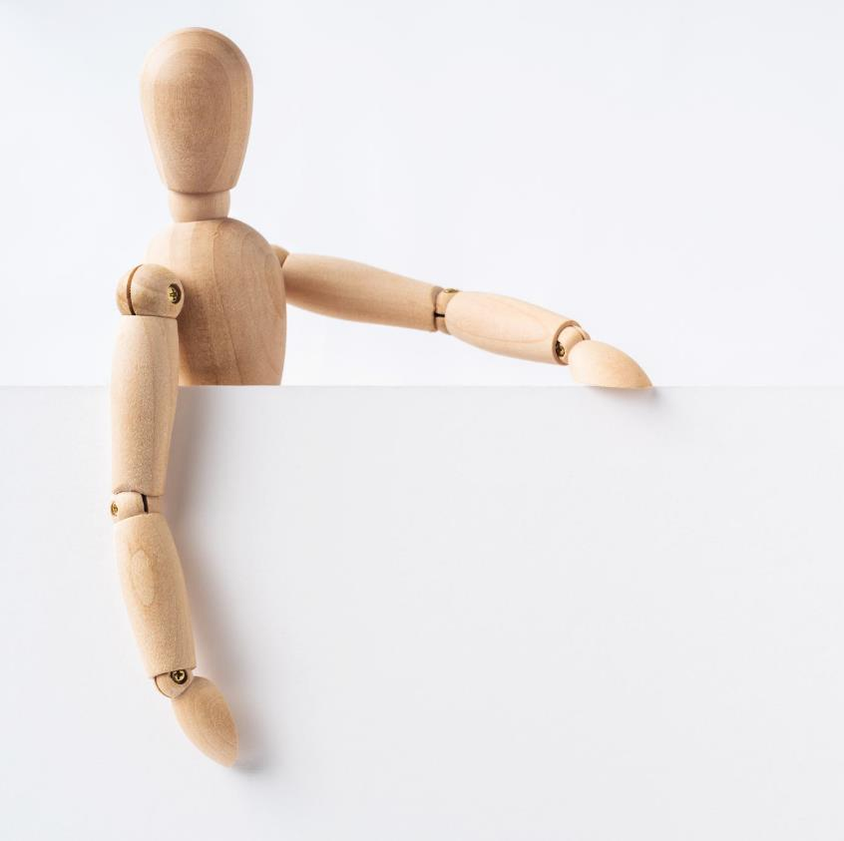
Ministry does not have to be in-person
1 Thessalonians 3:1-2
Notes:
One takeaway from these pronouns and these two verses is that ministry does not have to be in person.
Up to this point, Paul has been referring to the in-person ministry he and his fellow missionaries engaged in with the Thessalonians.
Chapter 1, vs 5: You know what kind of men we proved to be among you for your sake.
Chapter 2, vs 1: “that our coming to you was not in vain”
Chapter 2, vs 9: Remember our labor and toil, we worked day and night that we might not be a burden to any of you”
But now, the entire ministry team is not going back, instead, just one person, Timothy, is being sent to establish and exhort the Thessalonian church.
Other translations will state that Timothy was sent to strengthen, confirm, encourage, or comfort the church. That is the job of ministry, to edify the church so that they can grow stronger in Christ, and continue walking the hard but steady path of spiritual maturity.
And then in chapters 4 and 5, the letter itself provides the ministry.
Paul’s letters establish, exhort, confirm, encourage, and comfort believers. And not just Paul’s letters but all the letters that make up our Bible are there for us.
How often do you take advantage of this opportunity to hear from God’s word? While fellowship, small group discipleship, and weekly sermons are part of the Christian’s journey, Receiving comfort and exhortation directly from God’s word should be a key part of every Christians’ life

Slide 10
Ministry does not have to be in-person
and is not a
one-man show
1 Thessalonians 3:1-2
Notes:
A second takeaway is that ministry Is not a one-man show.
Although Paul rightfully receives credit for writing the letters,
and unfortunately receives much of the wrath for the message he is sharing he never claims to go alone.
At first, it is Barnabas and Saul who are set aside for the first missionary journey. But after Paul’s teaching and miracles, it soon became Paul and his companions.
But the message is clear that Paul is not doing ministry by himself.

Slide 11
¹ Therefore when we could bear it no longer, we were willing to be left behind at Athens alone, ² and we sent Timothy, our brother and God's coworker in the gospel of Christ, to establish and exhort you in your faith,
1 Thessalonians 3:1-2
Notes:
Ministry can be in person, through disciples, and through letters.
But what is the purpose of ministry?
The purpose of ministry is to simply share the good news, also known as the “gospel."
Paul writes that we sent Timothy, our brother, and God’s coworker in the gospel of Christ.
In 1st Thessalonians chapter 2, verses 2, 8, and 9, Paul writes about the Gospel of God. But in chapter 3, he mentions the Gospel of Christ. Is there a difference?

Slide 12
A gospel is an announcement of good news..
εὐαγγέλιον
euangelion
gospel
In particular, the gospel is the announcement that Jesus’ life, death, and resurrection have brought about salvation for Israel and the world.
Notes:
Well, the term gospel is simply an announcement of good news.
In fact, later Paul mentions that he received good news from Timothy
when referring to Timothy’s report on the Thessalonian church. He uses the same Greek word as used for gospel, just in a different form.
But in this case, the term often is used for a specific purpose,
which is the announcement that Jesus’ life, death, and resurrection
has brought about salvation for Israel and the world.
So, whether you read
gospel of the Kingdom, gospel of God, gospel of the Grace of God,
gospel of his son, gospel of Christ, gospel of the glory of Christ, gospel of peace, or the gospel of salvation,
It all refers to God’s wonderful plan to bridge the gap between a holy god and a sinful man through faith in Jesus because of the work of Jesus on the cross.
That indeed is good news!

Slide 13
¹ Therefore when we could bear it no longer, we were willing to be left behind at Athens alone, ² and we sent Timothy, our brother and God's coworker in the gospel of Christ, to establish and exhort you in your faith,
1 Thessalonians 3:1-2
Notes:
The gospel, or the good news, is that God has made a way for us to join with him, to experience his presence,
The way to God’s presence was paved by the death of Jesus,
And proven by his resurrection.
To receive this gift, you simply need to have faith in Jesus.
We are believers because we have faith.
Paul sends Timothy to establish and exhort their faith.
This shows that our faith needs to be encouraged.
We don’t have to be afraid that we can lose our faith. In Romans ch 8, Paul writes that nothing can separate us from the Love of God.
But our lives should be a journey of sanctification,
When we are saved, and we experience conversion,
theologians will tell us that conversion occurs simultaneously with
justification, union with Christ, adoption, and regeneration.
But after this instantaneous change,
we begin a process of growth that continues throughout our entire life.
This process of spiritual maturation is called sanctification.
By establishing, exhorting, strengthening, confirming, and comforting our faith, we are being sanctified.
And by ministering through Timothy and this letter, Paul’s goal is to grow the faith or sanctify the Thessalonian church.

Slide 14
Notes:
If you were to take the first 10 verses of this chapter and place them in a word cloud generator, it would show that the word faith occurs most often.
Therefore, we can see that faith is a key point in today’s reading since it is mentioned 5 times.

Slide 15
Notes:
One of the options in a word cloud generator is to ignore what it calls stop words, or smaller words.
But if you add them, the pronouns “you”, “your”, “we” and “our” stand out.
This shows the personal aspect of the letter,
to connect the missionaries (we / our) with the church (you / your) at Thessalonica.

Slide 16
Ministry does not have to be in-person
and is not a
one-man show
1 Thessalonians 3:1-2
Notes:
So from the first two verses, we see that ministry does not have to be in-person and is not a one-man show
Furthermore, the purpose of ministry is to share the “good news” of the salvation offered by faith in Jesus.
In our next section, we will see one of the benefits of having this faith in Jesus.

Slide 17
An established faith enables believers to endure expected adversity
1 Thessalonians 3:3-4
Notes:
The benefit is that an established faith enables believers to endure expected adversity
One of the reasons Paul and the team send Timothy is to
encourage, strengthen, and comfort the church
amidst anticipated afflictions

Slide 18
³ that no one be moved by these afflictions. For you yourselves know that we are destined for this. ⁴ For when we were with you, we kept telling you beforehand that we were to suffer affliction, just as it has come to pass, and just as you know.
1 Thessalonians 3:3-4
Notes:
Read vs 3 and 4
No one would say that Paul was a prosperity preacher.
In this letter, we have already seen that both Paul and his team,
along with the Thessalonians, had already suffered much and faced many afflictions.
Paul makes this clear in many of his other letters as well.
Phil 1:29 it has been granted to you that for the sake of Christ
you should not only believe in him but also suffer for his sake,
2 Tim 3:16 Indeed, all who desire to live a godly life in Christ Jesus will be persecuted,
Paul is not bragging about his prophetic skills,
He is not saying “I told you so,”
Instead, he reminds them of the need to stand firm in their faith.
to not be moved by these afflictions
Why? Because the focus of the entire letter of 1st Thessalonians as seen in each chapter is a focus on the future return of Christ
Therefore, although believers who are experiencing suffering and affliction, ultimately will be comforted.

Slide 19
⁵ For this reason, when I could bear it no longer, I sent to learn about your faith, for fear that somehow the tempter had tempted you and our labor would be in vain.
1 Thessalonians 3:5
Notes:
Verse 5 continues with the same basic premise as verses 3 and four,
that having an established faith enables believers
to endure expected adversity
But it expresses much more than that basic premise.
Paul writes “For this reason, when I could bear it no longer, I sent to learn about your faith,
for fear that somehow the tempter had tempted you and our labor would be in vain.”
Note the similarity to verse 1.
But in verse 1, it was when “we” could bear it no longer.
But now, the use of the 1st person singular,
when I could bear it no longer,
shows Paul’s fatherly concern for their faith because of adversity.
Paul is not trying to increase his performance indicators. He is not being graded by some metric. For Paul this is about him caring for the Thessalonians like he would care for his children.
This is why we see a strong expression about what caused Paul anxiety, what made him feel wah jialat
What can we learn from this?

Slide 20
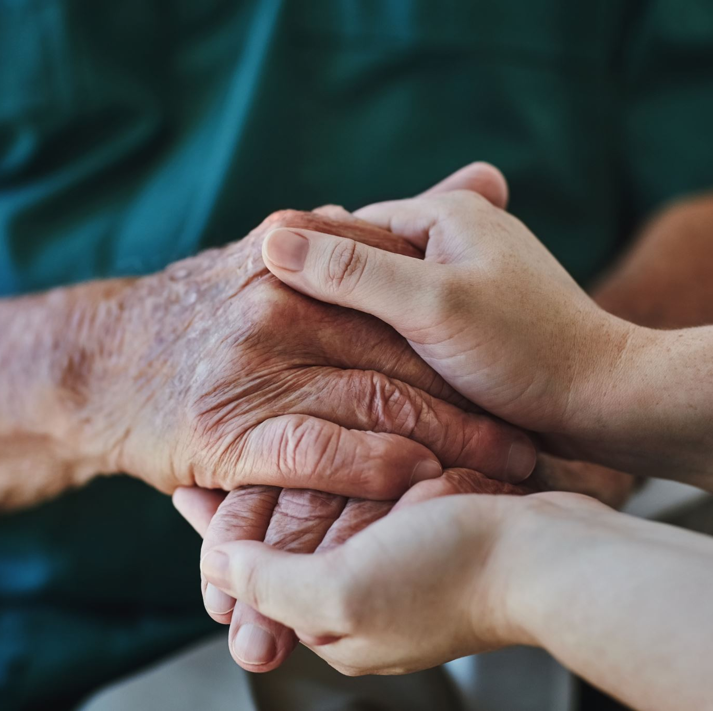
Believers encourage each other in faith to overcome temptation
1 Thessalonians 3:5
Notes:
That believers encourage each other in faith to overcome temptation.
In the game rock, paper, scissors, paper covers rock.
In a similar manner, encouragement and exhortations trump trials and temptations.

Slide 21
⁵ For this reason, when I could bear it no longer, I sent to learn about your faith, for fear that somehow the tempter had tempted you and our labor would be in vain.
1 Thessalonians 3:5
Notes:
The temptation of Satan must be taken seriously.
Paul already wrote how Satan hindered him from visiting the Thessalonians in chapter 2.
In chapter 2, the term Satan is used, whereas in chapter 3, he is called the tempter.
When Jesus is facing the temptations, Matthew also calls Satan the tempter.
Paul has already introduced us to Satan and shown he has the power to hinder believers.
Now Paul is showing us something of Satan’s character. He does so using a play on words.
In this case, the wordplay also translates to English. The tempter tempts. The runner runs.

Slide 22
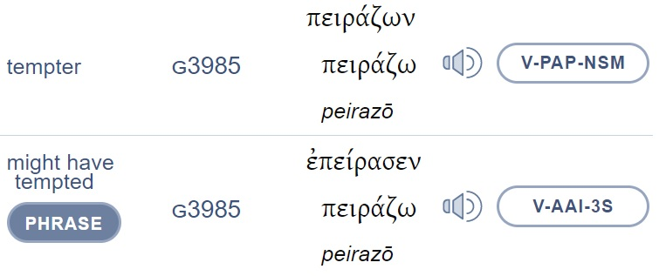
www.blueletterbible.org
Notes:
This can also be seen in the Greek.
Although I have paid software required for my schoolwork, I still like to use the blueletterbible.org website to study the Greek text.
In this case, I am using a reverse search, which means English word order. The yellow highlighted is the actual Greek text.
Below the actual text is the Greek root word. The root words are also numbered, making it easier to spot the similarities. As you can see, these two are the same word, just in a different form.
The website has a key so you can tell the top one is a Verb, Present Active Participle, Nominative, Singular, Masculine
An English major, or a google search, will tell you that the present active participle would be the tempting one.
The bottom one is also a verb, but in the Aorist Active Indicative third singular tense. Google says just to treat it like the past tense.
So you end up with the tempting one tempted.
That shows Satan’s character. He hinders believers, He tempts believers.
If believers give in to the temptations, they don’t lose their faith, but they could fail to reap the full benefits of the gospel message.
That is why believers encourage each other in faith: to overcome temptation

Slide 23
Believers are encouraged when other believers stay strong in their faith
1 Thessalonians 3:6-8
Notes:
We now get to see where Paul’s jialat is turned into joy.
In these next few verses, the good news of the Thessalonian’s steadfast faith brings Paul comfort
You can say that the message of verses 6 to 8 is that believers are encouraged when other believers stay strong in their faith

Slide 24
⁶ But now that Timothy has come to us from you, and has brought us the good news of your faith and love and reported that you always remember us kindly and long to see us, as we long to see you— ⁷ for this reason, brothers, in all our distress and affliction we have been comforted about you through your faith. ⁸ For now we live, if you are standing fast in the Lord.
1 Thessalonians 3:6-8
Notes:
Read vs 6 to 8
There are many similarities between this verse and the preceding verses.
We will focus on just a few as they highlight this section’s message of encouraging each other to stay strong in faith.

Slide 25
3:6 Timothy has . . . brought us the good news
3:7 in all our distress and affliction we have been comforted
3:8 For now we live, if you are standing fast in the Lord.
3:2 we sent Timothy . . . in the gospel of Christ
3:3 that no one be moved by these afflictions
3:4 we were to suffer affliction
Notes:
The need to encourage one another is seen in verse 6 when Timothy brings good news.
This is like verse 2, where Timothy is sent as a co-worker in the gospel, or Good News of Christ.
Suffering distress and experiencing affliction, as seen in verse 7, are times when believers need to edify one another.
Earlier we saw references to affliction in verse 3 and verse 4
In verse 8, we see that Paul and his companions now live, because the Thessalonians were standing fast.
This brings to mind verse 3, that no one be moved. If you are not moved, you are standing fast, you are standing firm in your faith.

Slide 26
⁶ But now that Timothy has come to us from you, and has brought us the good news of your faith and love and reported that you always remember us kindly and long to see us, as we long to see you— ⁷ for this reason, brothers, in all our distress and affliction we have been comforted about you through your faith. ⁸ For now we live, if you are standing fast in the Lord.
1 Thessalonians 3:6-8
Notes:
Now that we see the many connections between this section and the previous verses, lets get back to Timothy’s good news, which was that the Thessalonians were standing firm in Faith and Love!
Faith and Love go together like Chicken and Rice, or chili and crab.
Faith should be visible but in the proper fashion. What is the proper fashion?
Not like Jesus warned against in Matthew ch 6,
In his Sermon on the Mount, Jesus stated
Beware of practicing your righteousness before other people in order to be seen by them,
for then you will have no reward from your Father who is in heaven.
And then goes on to show criticize hypocrisy in giving, praying, and fasting.
But this follows a section where Jesus tells us to let our light shine before men, so that they may see our good works and give glory to God the father in heaven.
So, it is clear that our faith should be seen and will result in good works.
In fact, Jesus’s half-brother, James, expounds on this thought, saying
You have faith and I have works.” Show me your faith apart from your works, and I will show you my faith by my works.

Slide 27
Believers are encouraged when other believers stay strong in their faith
1 Thessalonians 3:6-8
Notes:
What do you think will happen when we show our faith by our works?
We will be encouraging other believes in staying strong in their faith,
They will in turn show their faith through their works and will encourage us.
This is known as a positive feedback loop.
Like pushing someone on a swingset,
a small push each time and they will go higher and higher.
But in this case, faith is doing the pushing.

Slide 28
⁶ But now that Timothy has come to us from you, and has brought us the good news of your faith and love and reported that you always remember us kindly and long to see us, as we long to see you— ⁷ for this reason, brothers, in all our distress and affliction we have been comforted about you through your faith. ⁸ For now we live, if you are standing fast in the Lord.
1 Thessalonians 3:6-8
Notes:
Just to illustrate that positive feedback, Paul writes that we have been comforted about you through your faith.

Slide 29
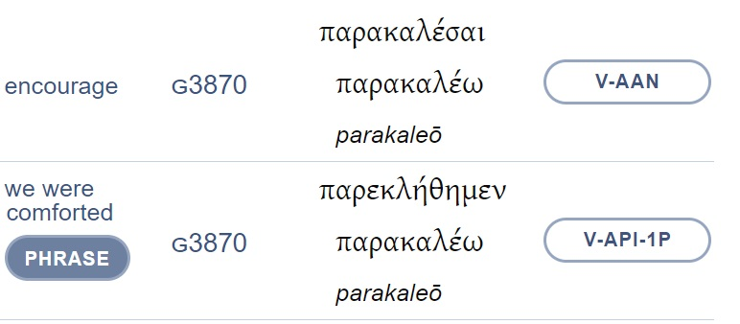
3:6 we have been comforted about you through your faith
Notes:
Looking at the ESV, the word comfort, or comforted only appears once in our text today.

Slide 30
3:2 we sent Timothy, . . .to establish and exhort you
3:6 we have been comforted about you through your faith
Notes:
But what the ESV translates as exhort, which can be translated as encourage, is the same root word, parakaleo
In verse 2, they sent Timothy to establish and exhort or comfort the Thessalonians in their faith.
This gives us our initial premise, that the result of Paul wanting to comfort the Thessalonians was that Paul himself was comforted

Slide 31
⁹ For what thanksgiving can we return to God for you, for all the joy that we feel for your sake before our God, ¹⁰ as we pray most earnestly night and day that we may see you face to face and supply what is lacking in your faith?
1 Thessalonians 3:9-10
Notes:
This leads to our final passage. (read vs 9-10)
Although there is a question mark, this is just a rhetorical question. It’s a bit easier if you have the question mark at the end of verse 9 as seen in some other translations.
But the thought or idea is that Paul praises God for their faith and prays for the opportunity to further that faith

Slide 32
Believers give all thanks to God and continue to pray for others
Notes:
This leads to our final point, that believers all give thanks to God and continue to pray for others.

Slide 33
Comfort to Comfort
Notes:
Today we see that Paul and his companions’ desire to send comfort to the Thessalonians resulted in they themselves being comforted.
In verses 1 and 2, Timothy is sent to establish and exhort the faith of the Thessalonians, showing that ministry is not always done in person, face to face, and not by just one person.
Verses 3 and 4 show us that An established faith enables believers to endure expected adversity
Verse 5 adds to that thought showing that believers encourage each other in faith to overcome temptation.
The meat of our text is found in verses 6 to 8, where believers are encouraged when other believers stay strong in their faith.
And we concluded with the need for believers to give all thanks to God and continue to pray for others.

Slide 34
Faith Builds Faith
Notes:
All this can be summed up with the phrase “Faith Builds Faith”
Faith is seen throughout the passage.
So I want to challenge you today, how is your faith?
Is your faith visible?
How do you show your faith and love?
Have you let the tempter distract you from fully benefitting from the gospel message?
What was the last time you were encouraged by someone else’s faith?
When was the last time you encouraged someone else’s faith?

