Slide 2
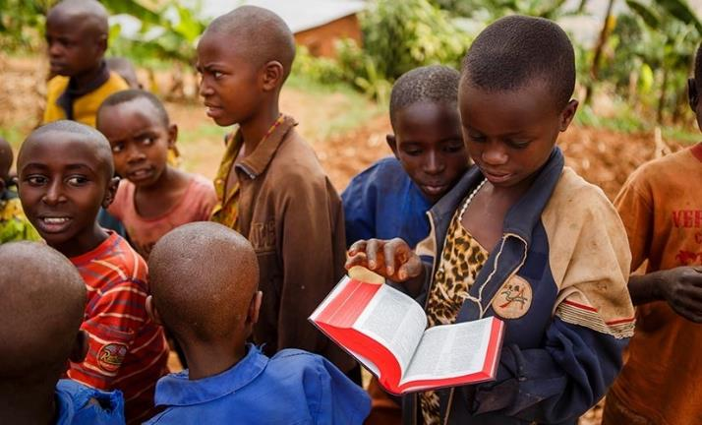
God’s Word at Work, God’s People of Purpose
1 Thessalonians 2:13-20

Slide 3
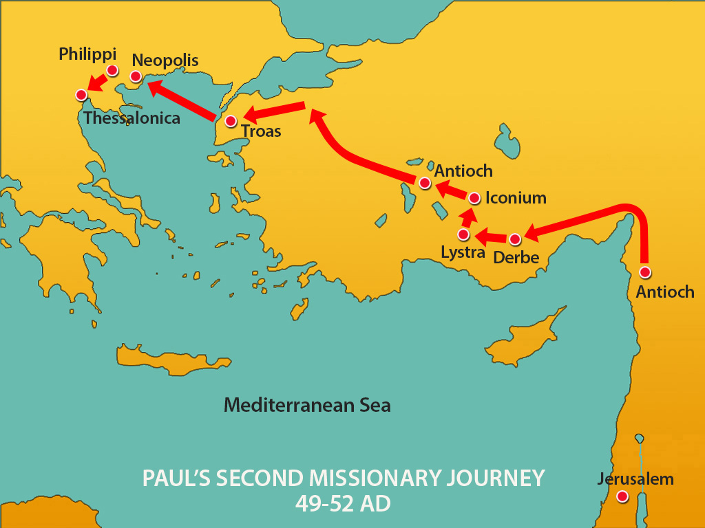
Where ON EARTH is Thessalonica?

Slide 4
1st Thessalonians 2:13-20
Context:
Paul’s delight in the Thessalonian believer’s faith and example (1:1-10).
Paul’s defense of their actions during their visit (2:1-12) and after leaving Thessalonica (2:13-3:13).

Slide 5
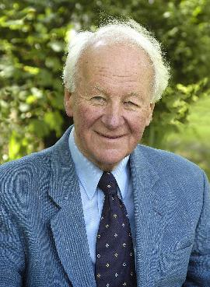
John Stott
Paul also determined to reply to the charges which were being levelled at him…. because the truth of the gospel and the future of the church were at stake. Chapters two and three of 1 Thessalonians are, in fact, his apologia pro vita sua.
The Message of 1 and 2 Thessalonians. IVP Academic, 1994, page 21.

Slide 6
God's Effective Word (verse 13)
Verse 13: What we thank God for reveals a lot about what we value.
What did Paul thank God for? That they “received God's word” for what it was, not simply the words of men.

Slide 7
God's Effective Word (verse 13)
God's word is alive, wielded in the hands of His Spirit, is:
powerful (Jeremiah 23:29),
authoritative (2 Tim 3:16) and
effective (Hebrews 4:12).
It's effect on the church is to bring about our growth into Christ (John 15:7; 17:17) and catalyse our mission into the world (Acts 12:24).

Slide 8
Pause and Ponder
How precious is the Word of God to you?
How much time do you invest daily in abiding in the words of Scripture, as Jesus said his disciples would? (John 8:31).

Slide 9
BIBLE STUDY or BIBLE PRACTICE?
Learning to Obey What we hear/read
1) What is God speaking to us to do? What will you do?
2) How can we help each other obey God’s word?
3) Who will I share this with this week?

Slide 10
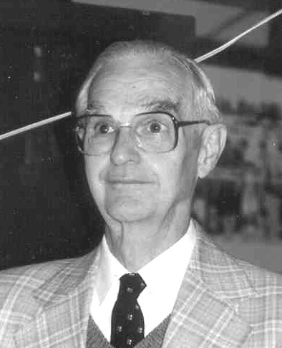
Leon L. Morris
The message was not only heard and received by the Thessalonians; it was welcomed.
1 and 2 Thessalonians : An Introduction and Commentary, page 50.

Slide 11
God's Persevering People (Verse 14-16)
Verse 14: 'Imitators of the churches of God in Christ Jesus in Judea’.
"Suffering is the true badge of discipleship." (Dietrich Bonhoeffer)
Vs 15-16 - Paul lists out the growing lists of measures taken by the Jews against Messiah Jesus, His church and the Gospel.

Slide 12
God's Enduring Purpose (verse 17-20)
If 2:1-16 can be seen as Paul's defence of their actions in Thessalonica, vs 17-3:13 is more Paul's defence of their absence from Thessalonica.
Vs 17: Drips with genuine love and companionship. Paul did not leave them voluntarily, he was forced out. ‘Torn away' is a derivative of the word 'orphanon' or "orphan”.

Slide 13
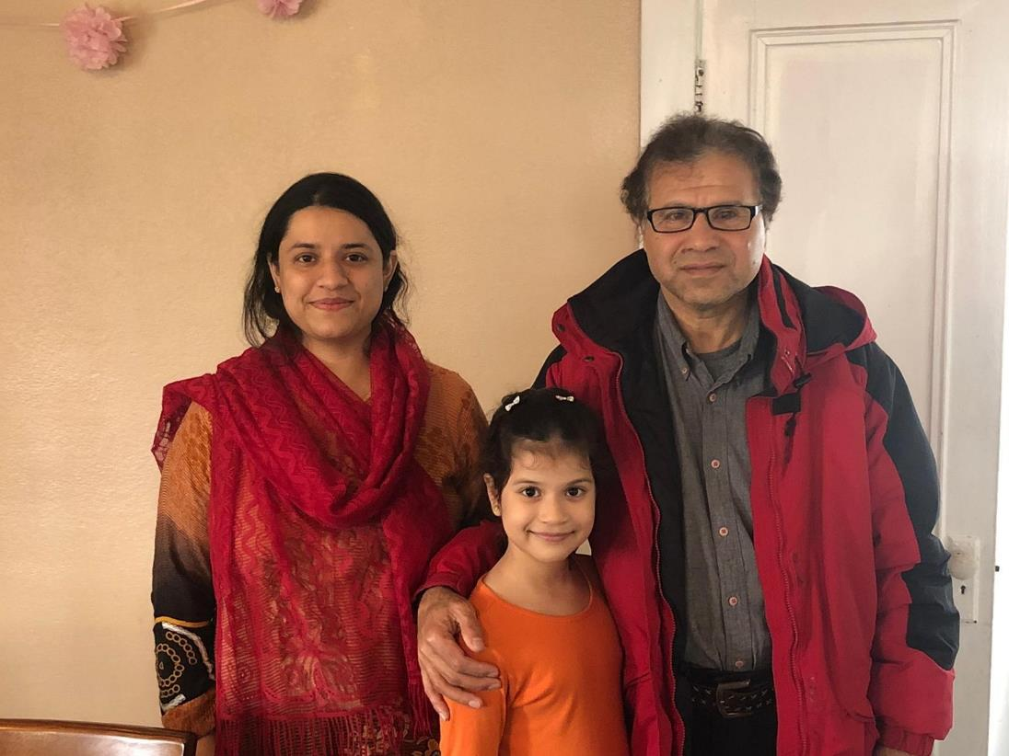
Saeed Akhtar and family Pashtun believer and former refugee

Slide 14
God's Enduring Purpose (verse 17-20)
Vs 18 "Satan hindered us." The devil can put obstacles in our way, but he cannot thwart the ultimate purposes of God.
Vs 19: The long-term perspective: “You are our hope”, “joy” and “crown of boasting” at the coming of Christ?
It's not what Paul has done that he glories in, but who he brings with him!

Slide 15
God's Enduring Purpose (verse 17-20)
Vs 20: Paul is making the point that both his present joy and future glory at Christ's return is tied up with what God has wrought in the Thessalonians through Paul and his team.
This is our highest privilege - that we get to be heralds of the Gospel, to bring others with us before Christ. Being and making disciples is part of our call.

Slide 16
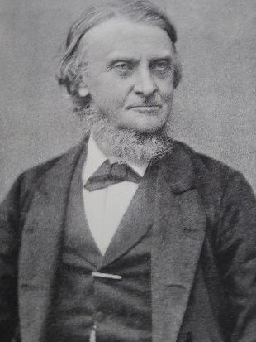
Alexander MACLAREN
The apostolic church thought more about the second coming of Jesus Christ than about death and heaven.

Slide 17
Pause and Ponder
Have you ever made another disciple?
When was the last time you shared your faith?

Slide 18
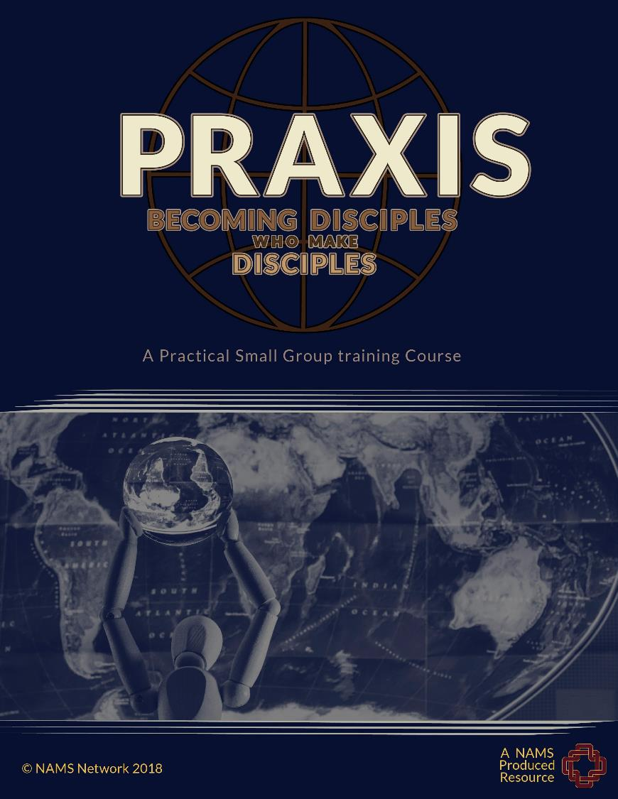
ADVERT
5-week small group training.
Interested to learn to be a Disciple-Making Disciple?
Let me know!

Slide 19
Application QUESTIONS
1) Do you read God’s word regularly? Read it daily and meet with each other to discuss and obey it. Join a CIC weekly group.
2) Are you making disciples? Who are you bringing with you when Christ returns?

