Slide 2
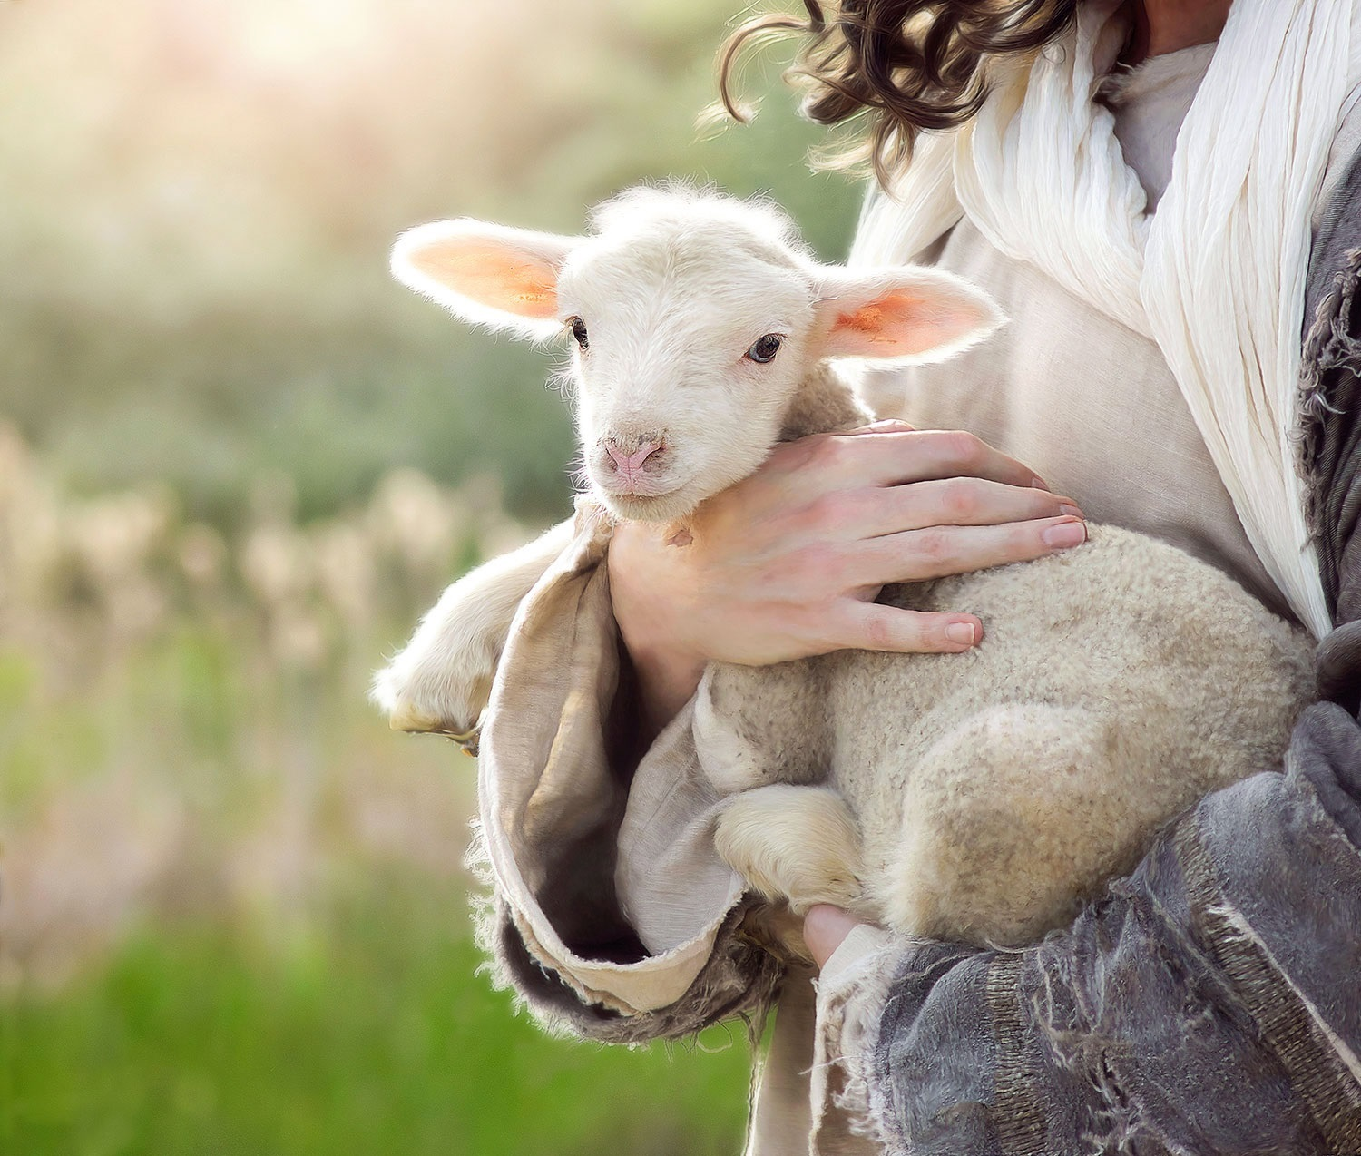
How do I know if I am chosen by God for salvation?
(1 Thessalonians 1:4-10)

Slide 3
You are convinced of God’s truth (v. 5)
You are eager to imitate godliness despite difficulties (v. 6)
You show the power of the gospel by applying its truths (vs. 7-9a)
You reveal genuine repentance of sin (v. 9b)
You live for the return of Christ instead of this life alone (v. 10)

