Slide 2
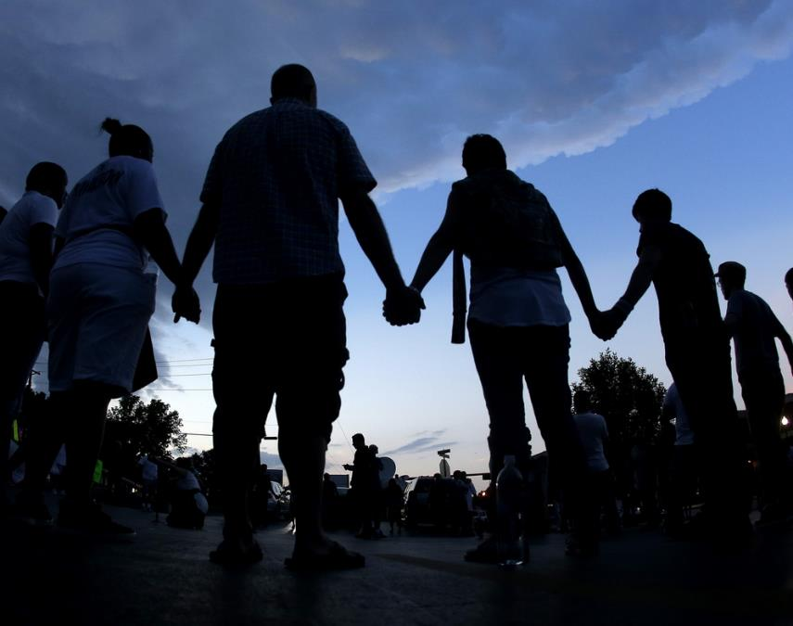
How do we pray for people in our church?
(1 Thessalonians 1:1-4)
Be amazed at the work of the Lord for saving souls and putting them in local churches (v. 1)

Slide 3
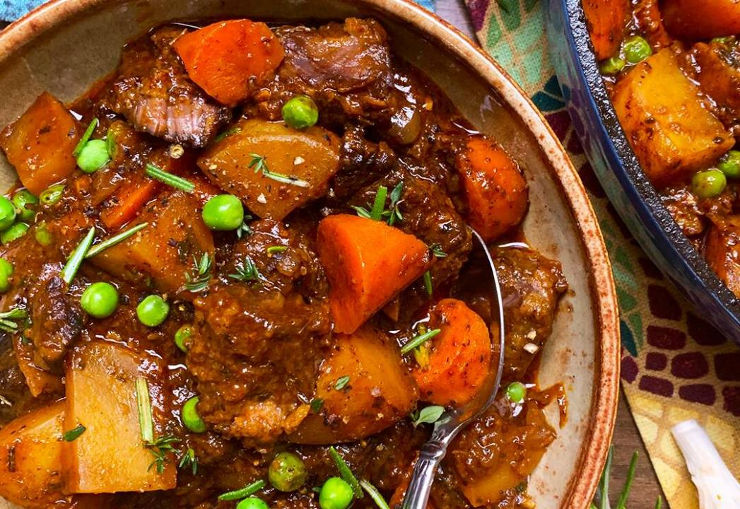
God sovereignly directs people to proclaim the gospel and disciple them
God assembles people into local churches with diverse backgrounds & spiritual states
Acts 17:4
And some of them were persuaded and joined Paul and Silas, as did a great many of the devout Greeks and not a few of the leading women.

Slide 4
God sovereignly directs people to proclaim the gospel and disciple them
God assembles people into local churches with diverse backgrounds & spiritual states
God grows people in faith despite hardship & opposition

Slide 5
How do we pray for people in our church?
(1 Thessalonians 1:1-4)
Be amazed at the work of the Lord for saving souls and putting them in local churches (v. 1)
Give thanks to God for each believer in the church and their growth in faith (v. 2-3)
Celebrate signs of people’s salvation (v. 4)

