Slide 1
Psalm 121 The God Who Watches
Crossroads International Church
25th September 2022

Slide 2
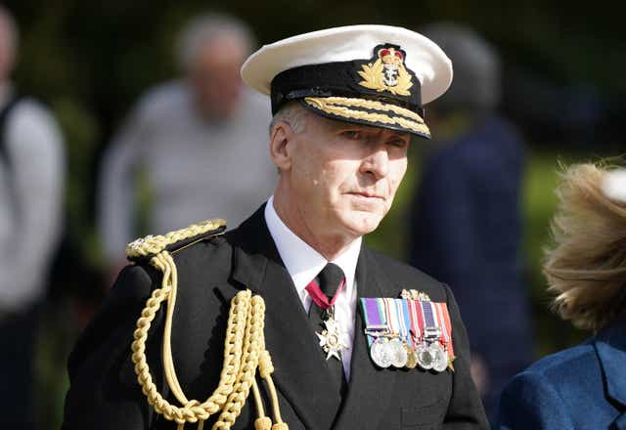

Slide 3
“Who Am I?” and “Where Am I Going?”
First Order Questions
1. Origin (why are we here?)
2. Meaning (what is the purpose of life?)
3. Morality (how should I live? How do I know right from wrong?)
4. Destiny (what happens after I die?)

Slide 4
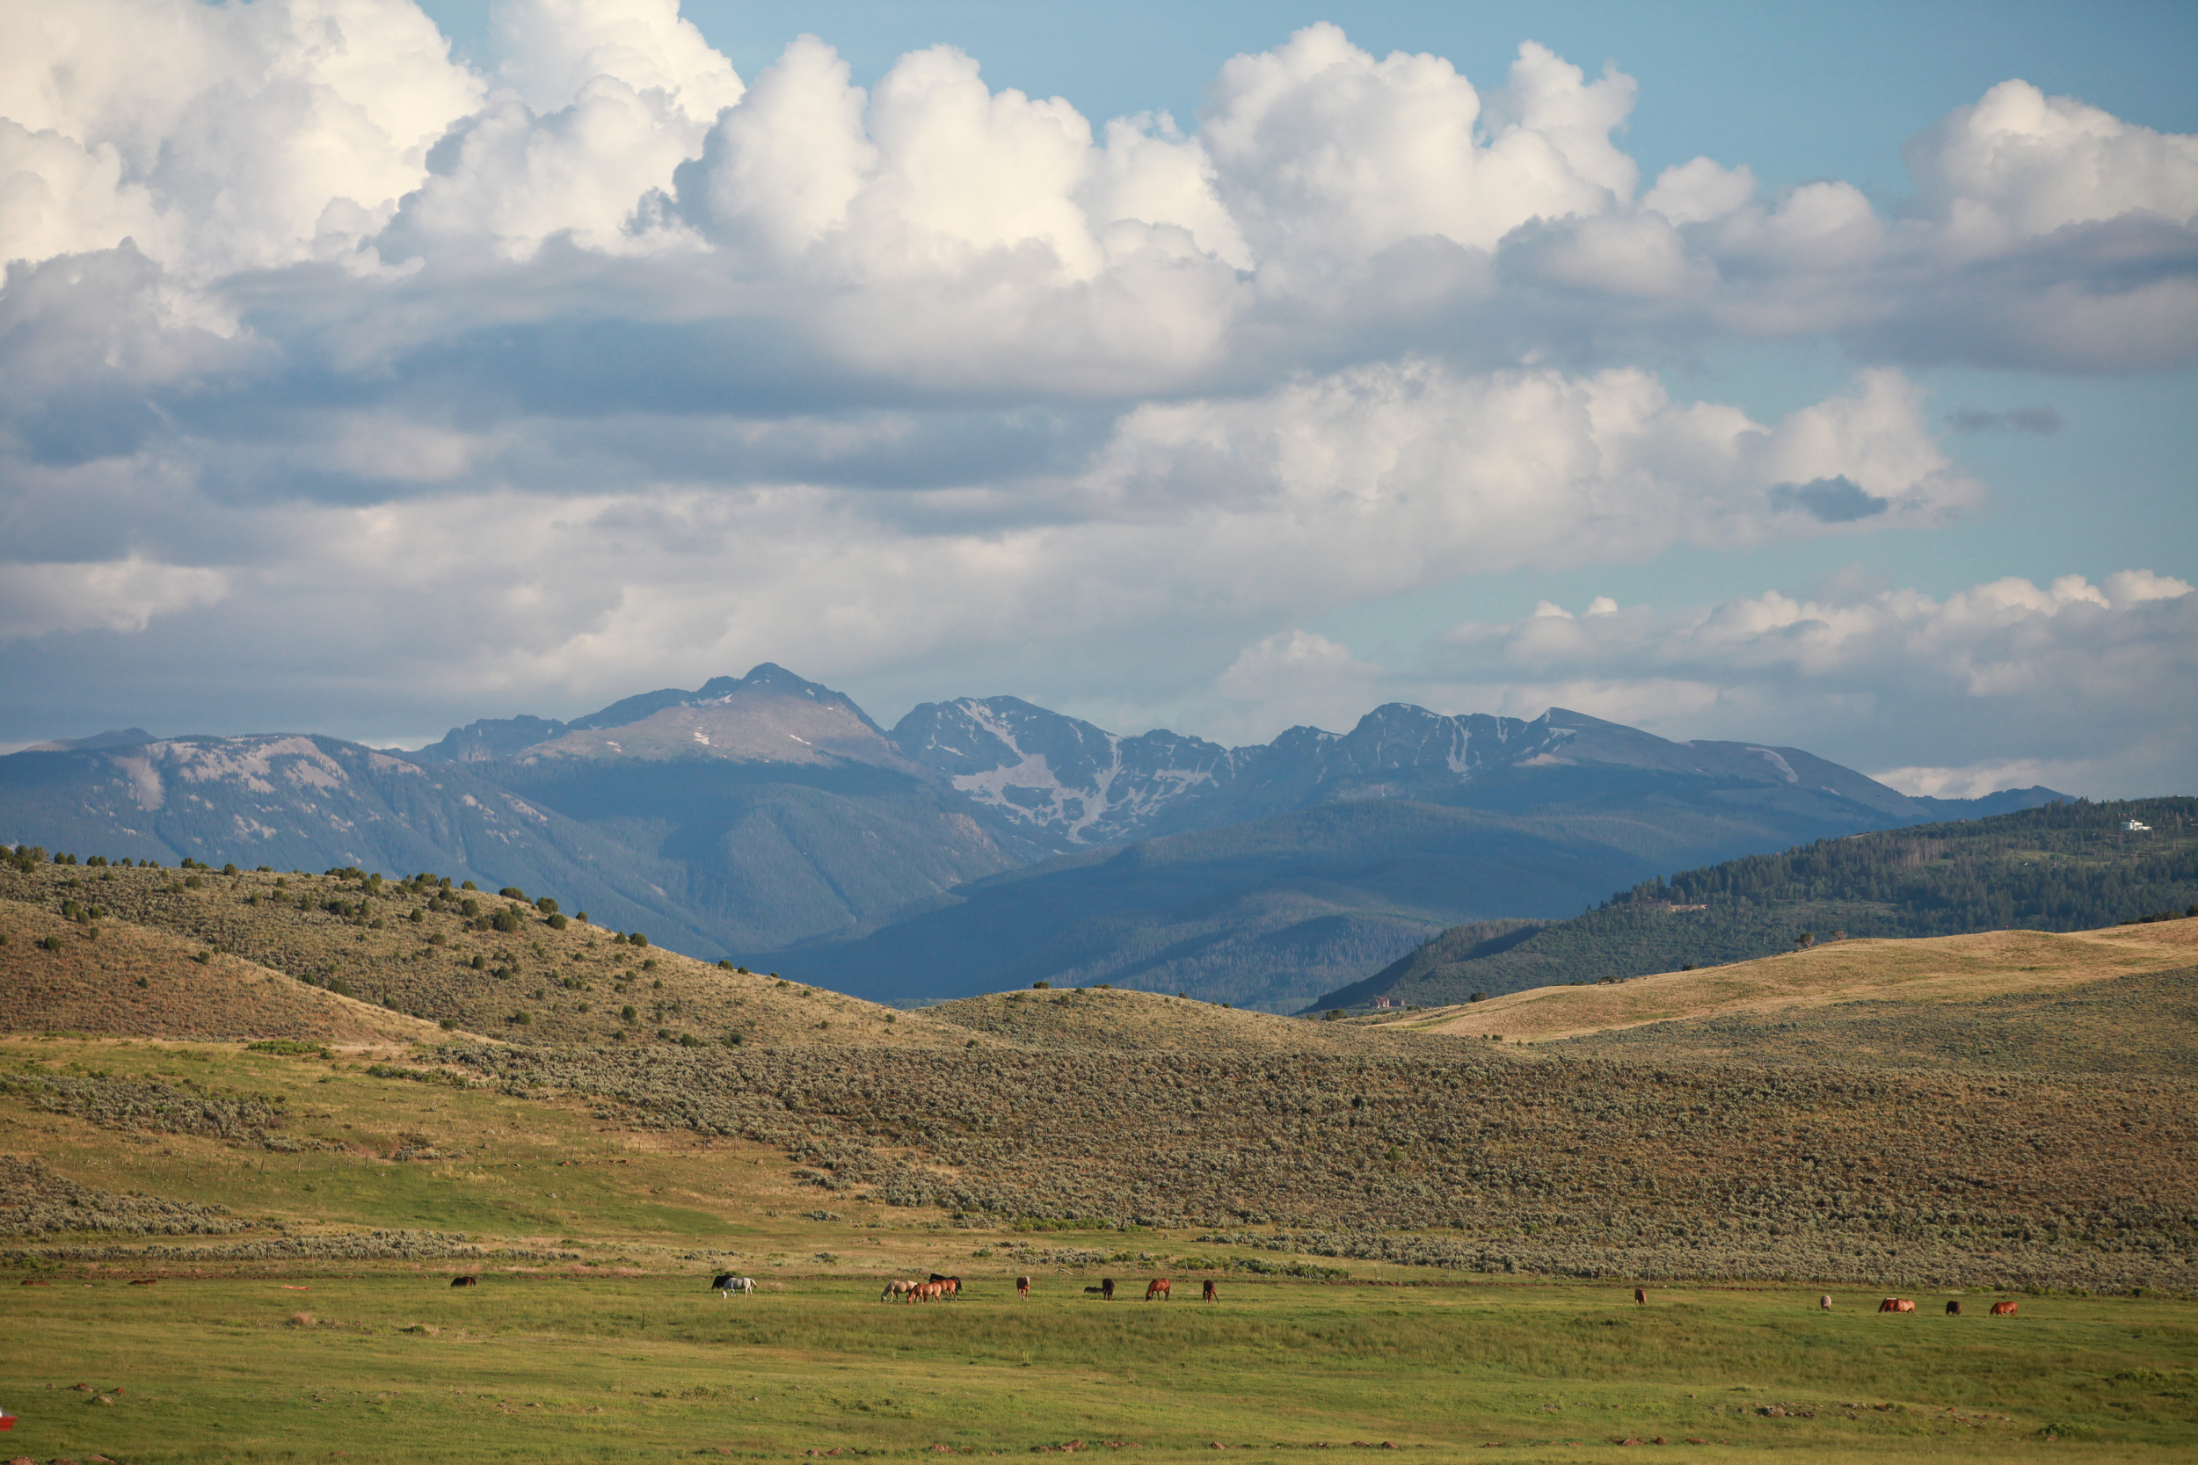
Context of Psalm 121
A Psalm of Ascent, a group of Psalms from 120 – 134, used by pilgrims coming up to Jerusalem for 3 yearly festivals (see Psalm 122:4 and 24:3).
Main point: ‘Our help is in the Lord who always watches over us.’

Slide 5
What this Psalm is not saying:
God is not Body Guard
God is not Domestic Servant

Slide 6
3 Steps to rightly discerning what the Scriptures are really saying:
1. Observation – What does it say?
2. Interpretation – What does it mean? (Context – historical, literary, canonical)
3. Application – In light of first two steps, what should we do?
Notes:
2. Goal is to grasp the meaning of the text as God intended. Key questions: ‘What did he mean then? What does it mean now?’

Slide 7
Psalm 121, verse 1-2
Principle: Look through our circumstance, not at it.
The light of God’s presence brings clarity-
eternal in scope, objective in truth, grounded in
His character and focused by His love.
“My help comes from the Lord, who made heaven
and earth.”
Hebrew term for ‘help’ is used 13 times in the Old
Testament of God’s ability to save and deliver.

Slide 8
Psalm 121, verse 3-8
Principle: God’s Sovereign Watch informs every
moment of our journey in life.
God is ever present, and never sleeps. (vs 3-4)
Contrast with gods of the time who were often
depicted as sleeping (1 Kings 18:27).

Slide 9
Psalm 121, verse 3-8
God keeps us protected in the shade. (vs 5-6).
PROTECTION at our right hand - Psalm 16:8;
109:31; 110:5.
SHADE - ‘Under the Shadow of His wings’ –
Psalm 17:8; 36:7; 57:1; 63:7; Isaiah 30:2-3.

Slide 10
Psalm 121, verse 3-8
God watches over our lives and its activities (vs 7-8).
KEPT from evil by His immanent Presence.
‘Coming and going’ – a merismus covering the
daily activity of life (1 Kings 3:7; 2 Kings 19:27;
Jeremiah 37:4).

Slide 11
APPPLICATION
Learn – to look often and intently to God for help

Slide 12
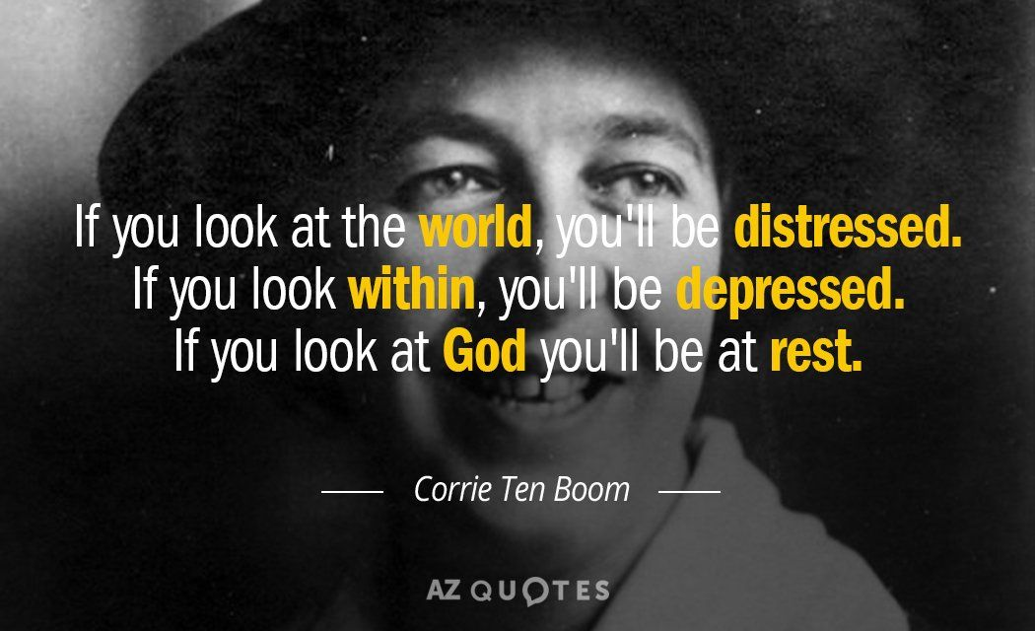

Slide 13
APPPLICATION
Learn – to look often and intently to God for help
Trust – in the One who ‘made heaven and earth, who is our helper.’

Slide 14
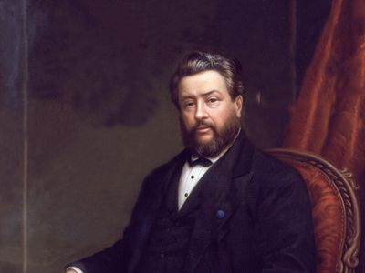
Charles Spurgeon on Psalm 46:1
"A help that is not present when we need it is of small value. The anchor which is left at home is of no use to the seaman in the hour of storm; the money which he used to have is of no worth to the debtor when a writ is out against him. Very few earthly helps could be called "very present": they are usually far in the seeking, far in the using, and farther still when once used.
But as for the Lord our God, …He is more than "present," He is very present. More present than the nearest friend can be, for He is in us in our trouble; more present than we are to ourselves, for sometimes we lack presence of mind. He is always present, effectually present, sympathetically present, altogether present. He is present now if this is a gloomy season. Let us rest ourselves upon Him.”

Slide 15
APPPLICATION
Learn – to look often and intently to God for help
Trust – in the one who ‘made heaven and earth, who is our helper’
Go – journey with the awareness and confidence in God’s super-intending over your life.

Slide 16
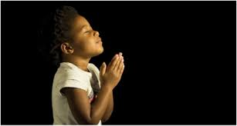
LET US PRAY….

