Slide 1
What does the Bible say about homosexuality?

Slide 2
What is the Basis for our Conclusion?

Slide 3
What Does the Bible Teach About Homosexuality?

Slide 4
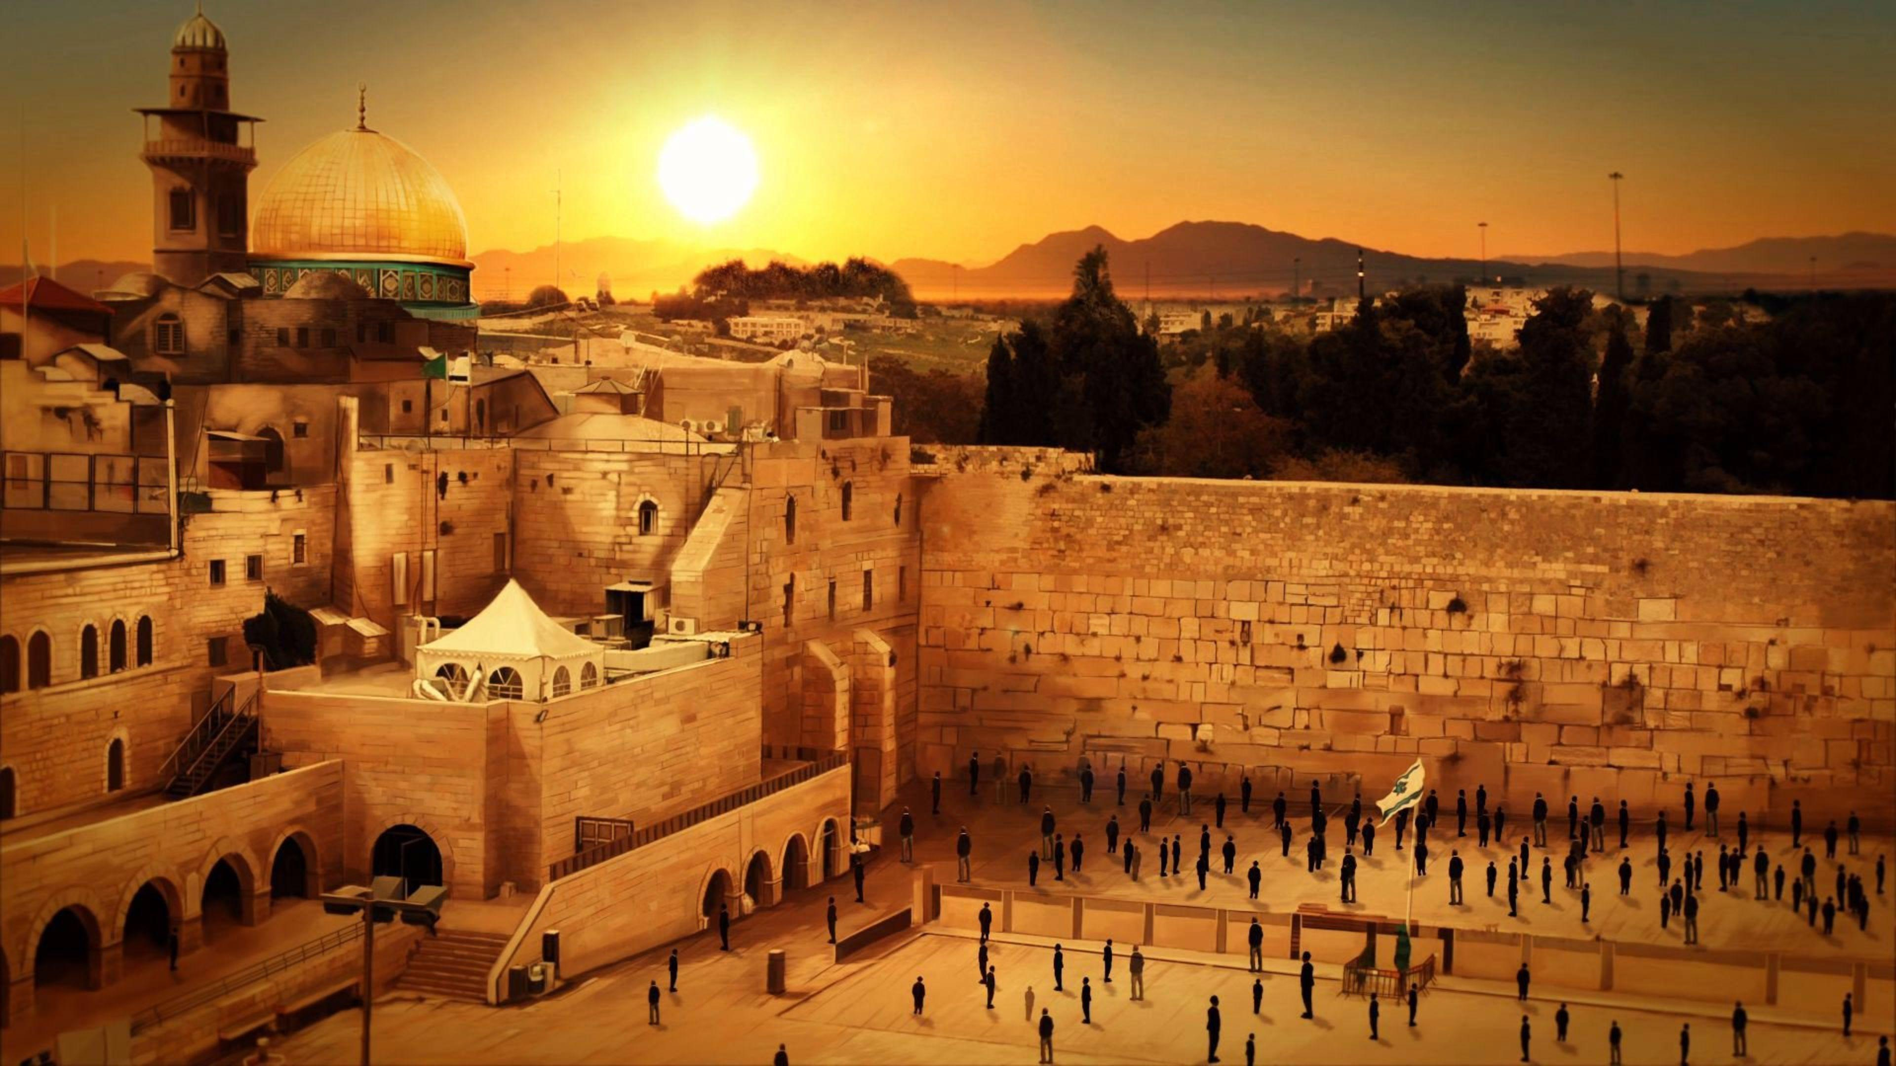
Israel
Leviticus 18
incest (vs. 6-17)
polygamy (v. 18)
adultery (v. 20)
homosexuality (v. 22)
bestiality (v. 23)
Leviticus 20
adultery (vs. 10-12, 21)
homosexuality (v. 13)
polygamy (v. 14)
bestiality (vs. 15-16)
incest (vs. 17, 19-20)

Slide 5
Leviticus 18:24-30
²⁴ “Do not make yourselves unclean by any of these things, for by all these the nations I am driving out before you have become unclean, ²⁵ and the land became unclean, so that I punished its iniquity, and the land vomited out its inhabitants. ²⁶ But you shall keep my statutes and my rules and do none of these abominations, either the native or the stranger who sojourns among you ²⁷ (for the people of the land, who were before you, did all of these abominations, so that the land became unclean), ²⁸ lest the land vomit you out when you make it unclean, as it vomited out the nation that was before you. ²⁹ For everyone who does any of these abominations, the persons who do them shall be cut off from among their people. ³⁰ So keep my charge never to practice any of these abominable customs that were practiced before you, and never to make yourselves unclean by them: I am the Lord your God.”

Slide 6
Israel
Judgment on Sodom & Gomorrah (Genesis 19; 2 Pet 2:6-8; Jude 1:7)
Judgment on Baal worship

Slide 7
1 Kings 14:22-24
²² And Judah did what was evil in the sight of the Lord, and they provoked him to jealousy with their sins that they committed, more than all that their fathers had done. ²³ For they also built for themselves high places and pillars and Asherim on every high hill and under every green tree, ²⁴ and there were also male cult prostitutes in the land. They did according to all the abominations of the nations that the Lord drove out before the people of Israel.

Slide 8
2 Kings 23:4-7
⁴ And the king commanded Hilkiah the high priest and the priests of the second order and the keepers of the threshold to bring out of the temple of the Lord all the vessels made for Baal, for Asherah, and for all the host of heaven. He burned them outside Jerusalem in the fields of the Kidron and carried their ashes to Bethel. ⁵ And he deposed the priests whom the kings of Judah had ordained to make offerings in the high places at the cities of Judah and around Jerusalem; those also who burned incense to Baal, to the sun and the moon and the constellations and all the host of the heavens.

Slide 9
⁶ And he brought out the Asherah from the house of the Lord, outside Jerusalem, to the brook Kidron, and burned it at the brook Kidron and beat it to dust and cast the dust of it upon the graves of the common people. ⁷ And he broke down the houses of the male cult prostitutes who were in the house of the Lord, where the women wove hangings for the Asherah.

Slide 10
Isaiah 3:8-9
⁸ For Jerusalem has stumbled, and Judah has fallen, because their speech and their deeds are against the Lord, defying his glorious presence. ⁹ For the look on their faces bears witness against them; they proclaim their sin like Sodom; they do not hide it. Woe to them! For they have brought evil on themselves.

Slide 11
Matthew 5:17-19
¹⁷ “Do not think that I have come to abolish the Law or the Prophets; I have not come to abolish them but to fulfill them. ¹⁸ For truly, I say to you, until heaven and earth pass away, not an iota, not a dot, will pass from the Law until all is accomplished. ¹⁹ Therefore whoever relaxes one of the least of these commandments and teaches others to do the same will be called least in the kingdom of heaven, but whoever does them and teaches them will be called great in the kingdom of heaven.
The Church
Jesus

Slide 12
Two Greatest Commandments
Love the Lord with all your heart, mind, soul, & strength
Love your neighbor as yourself

Slide 13
Two Greatest Commandments
Love your neighbor as yourself
Love the Lord with all your heart, mind, soul, & strength

Slide 14
The Church
Jesus
Paul
Homosexuality is unclean
Homosexuality is unnatural
Homosexuality is a sinful lifestyle

Slide 15
How Are We to Respond?
Recognize that homosexuality is a sin
Prepare to be attacked for opposing it
Consider possibility of conversion
Reach out in love to those who struggle in this sin

