Slide 1
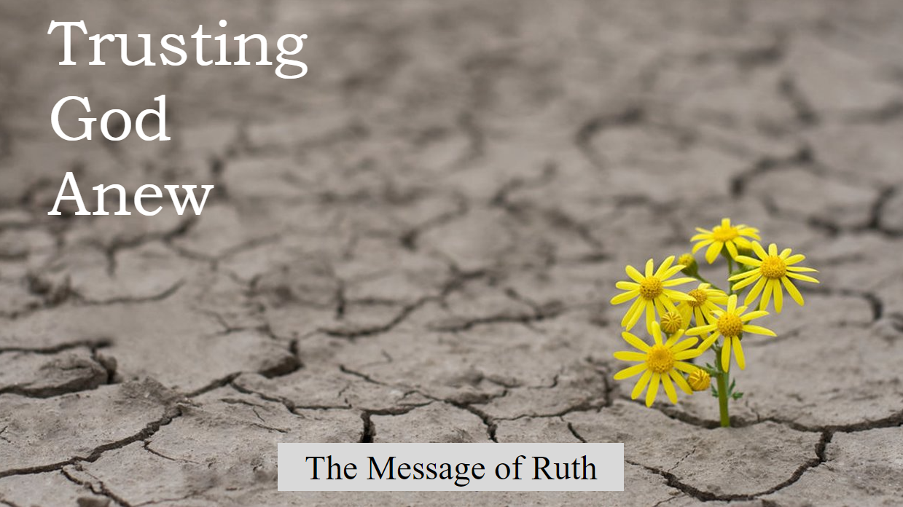

Slide 2

Act 4
The Resounding Answer
(Ruth 4:1-22)

Slide 3
Scene 1
Deal Done

Slide 4
Scene 2
“I’m sorry, Naomi.
Did you say something?”

Slide 5
Scene 3
The little picture
The big picture

