Slide 1
A Challenge for Those Who Suffer
(1 Peter 5:5-14)

Slide 3
Younger men submit to church leaders (v. 5a)​
Develop humility in the church (vs. 5b-7)

Slide 4
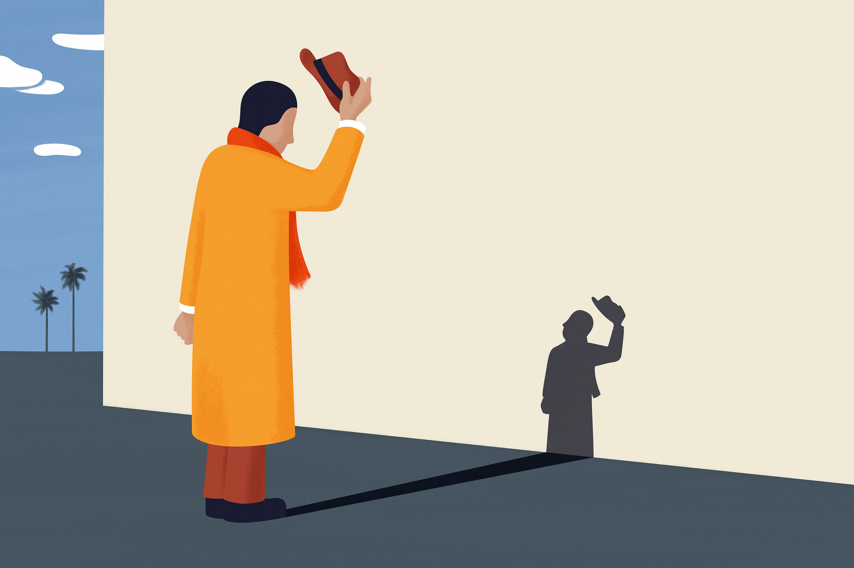
Resist self-centeredness (5b)
Accept God’s plan of suffering in your life (6-7)

Slide 5
“The cares and anxieties addressed here no doubt refer to the feelings of shame and social ostracism received on account of being a Christian.”
Greg Forbes

Slide 6
Younger men submit to church leaders (v. 5a)​
Develop humility in the church (vs. 5b-7)
Stay spiritually alert (vs. 8-11)

Slide 7
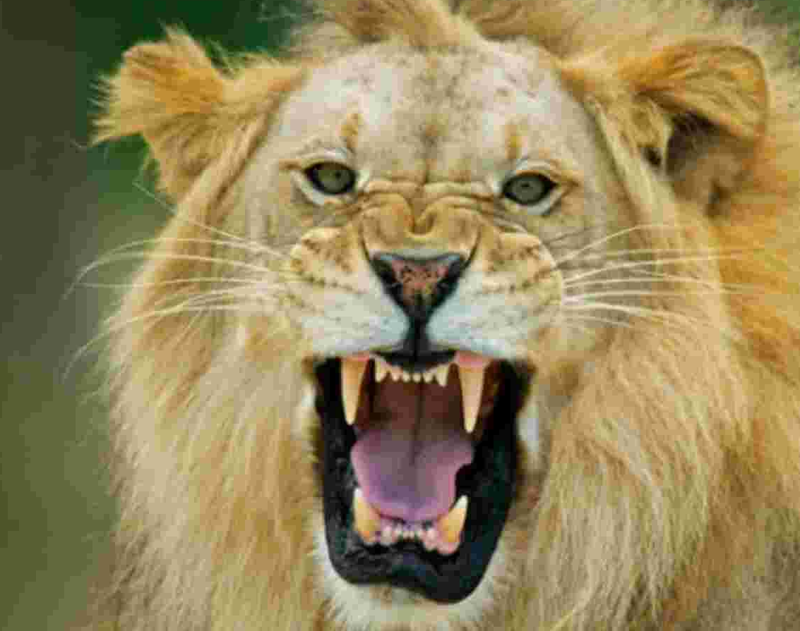
Revelation 12:10-11
¹⁰ And I heard a loud voice in heaven, saying, “Now the salvation and the power and the kingdom of our God and the authority of his Christ have come, for the accuser of our brothers has been thrown down, who accuses them day and night before our God. ¹¹ And they have conquered him by the blood of the Lamb and by the word of their testimony, for they loved not their lives even unto death.

Slide 8
“The contrast between God and the devil is quite striking. God tenderly cares for his children (5:6-7), inviting them to bring their worries to him so that he can sustain them. God promises to protect his flock (v. 2) in all their distress. Conversely, the devil’s aim is not to comfort but to terrify believers. He does not want to deliver them from fear but to devour their faith.”
Thomas Schreiner

Slide 9
RESIST
the devil by not rejecting God
REMEMBER​
you are not alone in suffering
RENEW
your hope in the Lord for the future

Slide 10
Younger men submit to church leaders (v. 5a)​
Develop humility in the church (vs. 5b-7)
Stay spiritually alert (vs. 8-11)
Be encouraged by other believers (vs. 12-14)

