Slide 2
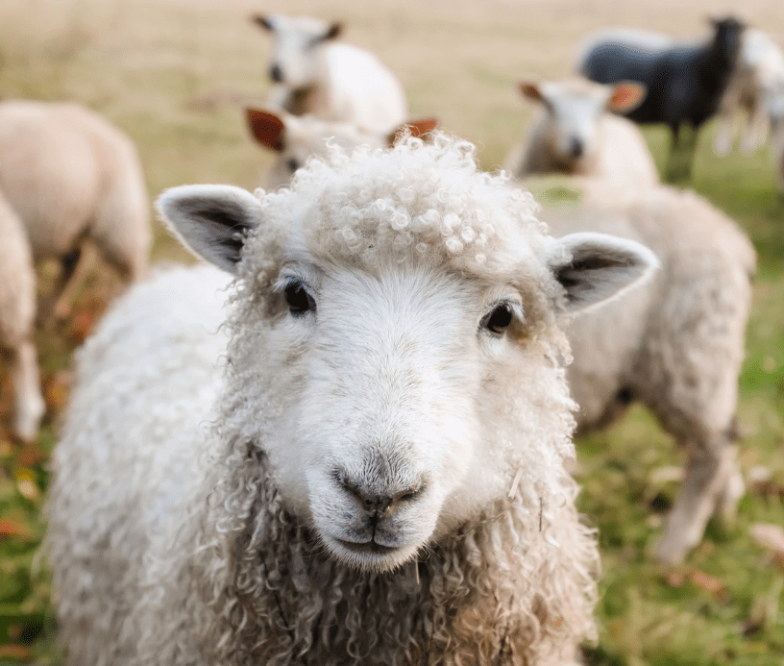
How to Lead Suffering Saints
(1 Peter 5:1-4)

Slide 3
Ephesians 5:23, 25-27
23 For the husband is the head of the wife even as Christ is the head of the church, his body, and is himself its Savior.
25 Husbands, love your wives, as Christ loved the church and gave himself up for her, 26 that he might sanctify her, having cleansed her by the washing of water with the word, 27 so that he might present the church to himself in splendor, without spot or wrinkle or any such thing, that she might be holy and without blemish

Slide 4
Ephesians 6:4
4 Fathers, do not provoke your children to anger, but bring them up in the discipline and instruction of the Lord.

Slide 5
1 Timothy 3:1
1 The saying is trustworthy: If anyone aspires to the office of overseer, he desires a noble task

Slide 6
Take the role of leadership seriously
(v. 1)
By accepting accountability

Slide 7
Hebrews 13:17
17 Obey your leaders and submit to them, for they are keeping watch over your souls, as those who will have to give an account. Let them do this with joy and not with groaning, for that would be of no advantage to you.

Slide 8
Take the role of leadership seriously
(v. 1)
By accepting accountability
By focusing on Christ’s sufferings
By anticipating eternal reward

Slide 9
Romans 8:18
18 For I consider that the sufferings of this present time are not worth comparing with the glory that is to be revealed to us.

Slide 10
Carry out the responsibility of leadership faithfully
(vs. 2-4)

Slide 11
John 21:15-17
15 When they had finished breakfast, Jesus said to Simon Peter, “Simon, son of John, do you love me more than these?” He said to him, “Yes, Lord; you know that I love you.” He said to him, “Feed my lambs.” 16 He said to him a second time, “Simon, son of John, do you love me?” He said to him, “Yes, Lord; you know that I love you.” He said to him, “Tend my sheep.”

Slide 12
John 21:15-17
17 He said to him the third time, “Simon, son of John, do you love me?” Peter was grieved because he said to him the third time, “Do you love me?” and he said to him, “Lord, you know everything; you know that I love you.” Jesus said to him, “Feed my sheep.”

Slide 13
By leading willingly
Carry out the responsibility of leadership faithfully
(vs. 2-4)
By leading selflessly
By leading as an example
By leading with eternal focus

Slide 14
2 Timothy 4:8
8 Henceforth there is laid up for me the crown of righteousness, which the Lord, the righteous judge, will award to me on that day, and not only to me but also to all who have loved his appearing.

Slide 15
James 1:12
12 Blessed is the man who remains steadfast under trial, for when he has stood the test he will receive the crown of life, which God has promised to those who love him.

Slide 16
Revelation 2:10
10 Do not fear what you are about to suffer. Behold, the devil is about to throw some of you into prison, that you may be tested, and for ten days you will have tribulation. Be faithful unto death, and I will give you the crown of life.

Slide 17
Revelation 3:11
11 I am coming soon. Hold fast what you have, so that no one may seize your crown.

