Slide 1
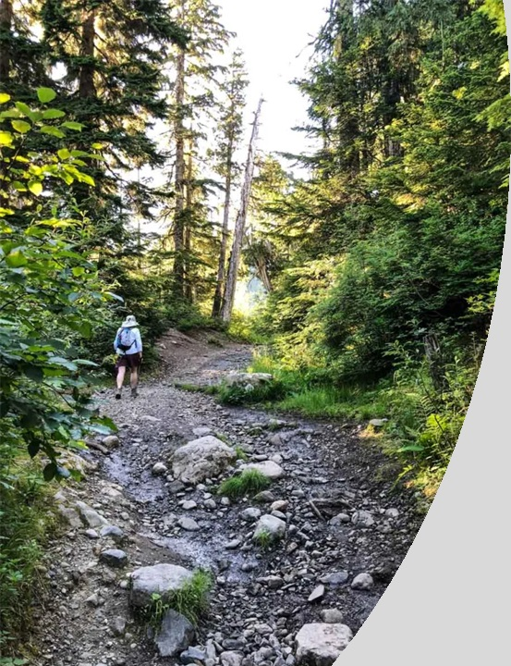
1 Peter
The Sojourner’s Life
Living effectively for the Lord in an unbelieving world
Notes:
That is why Peter calls on us to show hospitality.
That is why Peter asks us to live effectively for the Lord in an unbelieving world.
(CLK) There are two challenges with this command.
The first is stated quite clearly by Peter.
He tells us to show hospitality without grumbling.
It’s easy to get caught up in grumbling.
Especially if you are a hospitable person
and you end up taking on too much work.
I have an example from my own life. 20 years ago, I was one of four department heads on a Navy ship.
In addition to your primary job, the navy assigns collateral duties, which are distributed to even out the workload. Often these get overlooked. Shortly after arriving, the Captain realized I could fix broken programs, and get things back on track, so as others left, I ended up taking on extra collateral duties. Pretty soon, I had most of the DH-level collateral duties. It began to wear on me. I began to grumble and complain. Instead of grumbling and complaining, I should have said; I can’t handle anymore. Instead, I was not a good witness. I did not glorify God with my life.
But now, most of you know I am a full-time student. I also lead a small group on Sunday Evenings. How often have you seen an announcement that we are having a game night? Or we are taking a short break. Rather than complain, I cheerfully admit when I am overloaded.
The first challenge is to be hospitable without grumbling.
(CLK) The second challenge is that hospitality is frequently viewed as the recreational sharing of fellowship, lodging, and provisions AMONG FRIENDS OR RELATIVES
But in the Bible (and for luxury hotels),
hospitality involves receiving STRANGERS
—rather than merely reinforcing pre-existing friendships or bonds of affection.
hospitality involves receiving STRANGERS
—especially travelers, who then become guests or are treated as friends

Slide 2
Last Week: 1 Peter 4:7-11
Glorify God in your own lives.
A Christian has a distinctly different lifestyle.
Glorify God in relationships.
A Christian prioritizes relationships of love and forgiveness.
Glorify God through Christian Service. (vs. 10-11)
A Christian exercises the gifts of the spirit in service.
Now is the Time to Glorify God!
A Christian gives glory to God in all things.
Notes:
It is this new nature
brought about by the power of the Holy Spirit
that allows us to be self-controlled and sober-minded.
Then we can glorify God in our own lives.
It is this new nature that allows us to love one another earnestly
and be hospitable with one another
even strangers
Then we can glorify God in our relationships.
It is this new nature that allows us to
draw on God’s words and rely on God’s strength
and empowers us with spiritual gifts
Then we can glorify God in Christian Service.
We know that time is short, and the end is near.
Therefore,
(CLK) Now is the Time to Glorify God!
We give glory to God in all things!

Slide 3
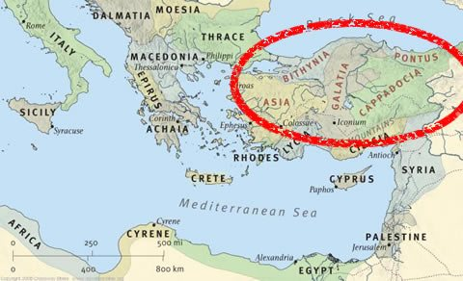

1 Peter
The Sojourner’s Life
Where in the world was Peter writing to?
Notes:
In the sermon today,
we will see that hospitality is just one of four “commands” mentioned.
The sermon title is “Live with the Proper Perspective of Time.”
In addition to these four commands,
Peter also gives us a goal to pursue.
That goal is to glorify God!
When we follow these four commands and direct our lives towards glorifying God,
we will live with the proper perspective of time.
This message was needed when Peter wrote it two thousand years ago.
It is also needed today. The reason?
Because we, like the early church, are enduring suffering.
A famous movie quote tells us that “Life is Pain.
Anyone who tells you differently is selling something.”
---------------------------------------------------------------------
Move Quote is from The Princess Bride, but it’s “inconceivable” that someone would not know ☺

Slide 4
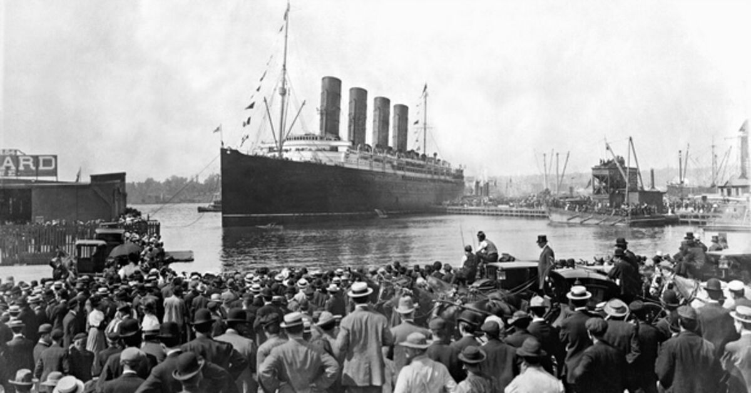
“You are not Home yet.”

Slide 5
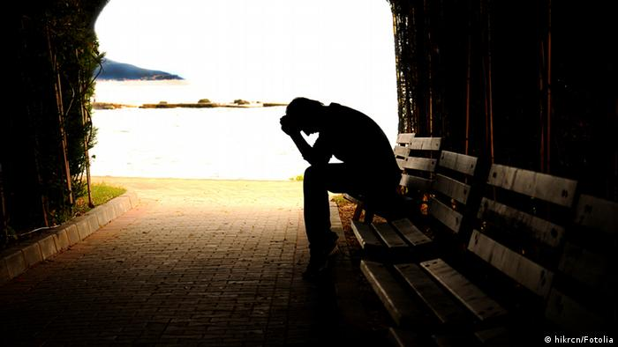
1 Peter 4:12-19
The theme of ‘Suffering’
Why, O Lord?

Slide 6


1 Peter 4:12-19
Is suffering:
A) punishment for sin OR
B) the result of a lack of faith?
Peter was writing to Christians who were suffering because of their
faith in Christ, not a lack of it.
In the Scriptures, suffering meaningless.

Slide 7
1 Peter 4:12-19
Obedience to God may involve suffering.
"Although (Jesus) was a son, he learned obedience through what he suffered." (Hebrews 5:8 – cf 1 Peter 2:21-23).

Slide 8
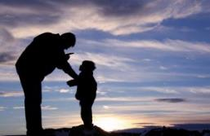
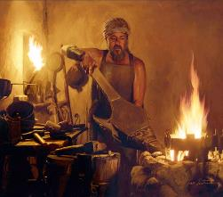
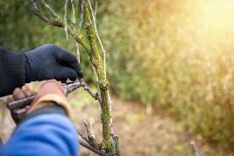
Suffering with Purpose
1) The Discipline of the Father -
(Heb 12:5-11 from Deut 8:5, Prov 3:11-12)
2) The Refiner of Silver and Gold
(Ps 66:10; Isa 48:10, Zech 13:9 -
1 Pet 1:6-7)
3) The Pruner of the Vine
(John 15:1-8)
From John Stott, The Cross of Christ, IVP: Nottingham 1986, page 365-366.

Slide 9
1 Peter 4:12-19
Verse 12: ‘Beloved, do not be surprised at the fiery trial when it comes upon you to test you, as though something strange were happening to you.”
‘Fiery trial’ = refining fire (cf 1 Peter 1:6-7, Proverbs 27:21).
Including accusations of doing wrong (2:12), physical abuse (2:18-20), insults (2:23, 3:9), threats (3:14) and ridicule (4:49).

Slide 10
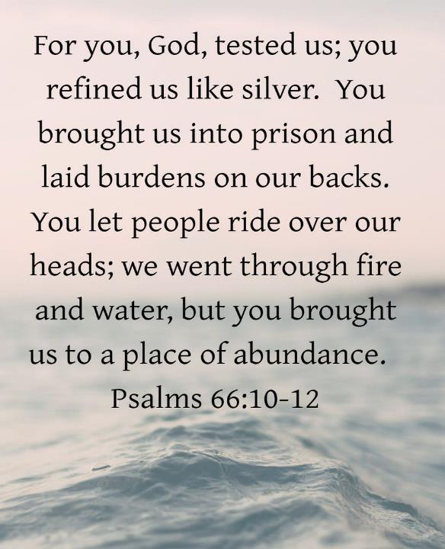

Slide 11
1 Peter 4:12-19
Verse 13: “But rejoice insofar as you share Christ's sufferings, that you
may also rejoice and be glad when his glory is revealed.
(See also James 1:2-4)
We need a long-term view of suffering (see Hebrews 11:2 and
2 Corinthians 4:17).
Never evaluate in the darkness of your struggles today, what can only be understood in the light of God's glory tomorrow.

Slide 12
1 Peter 4:12-19
Verse 14: “ If you are insulted for the name of Christ, you are blessed, because the Spirit of glory and of God rests upon you.”
Calls to mind Isaiah 11:2 – the Spirit that rested on Messiah is now on us.
Also Matthew 5:11-12.

Slide 13
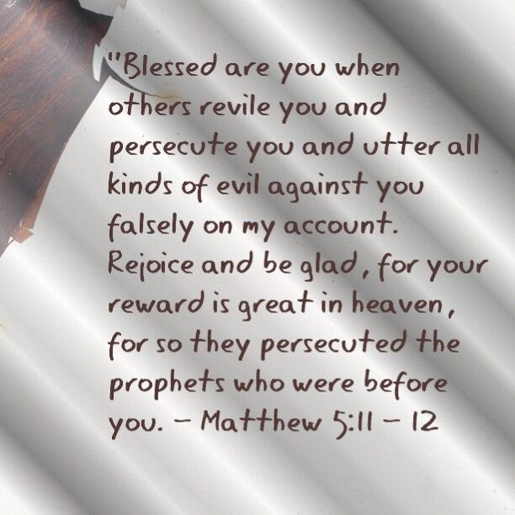

Slide 14
1 Peter 4:12-19
Verse 15 – the caveat.
Verse 16 – Glorify God as a Christian (‘Christian’ only used here and in Acts 11:26 and 26:28).
A Christian is one who belongs to Christ.

Slide 15
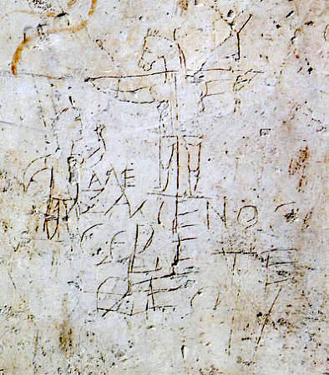
The Alexamenos Graffito
The Inscription reads:
“Alexamenos worships his god”

Slide 16
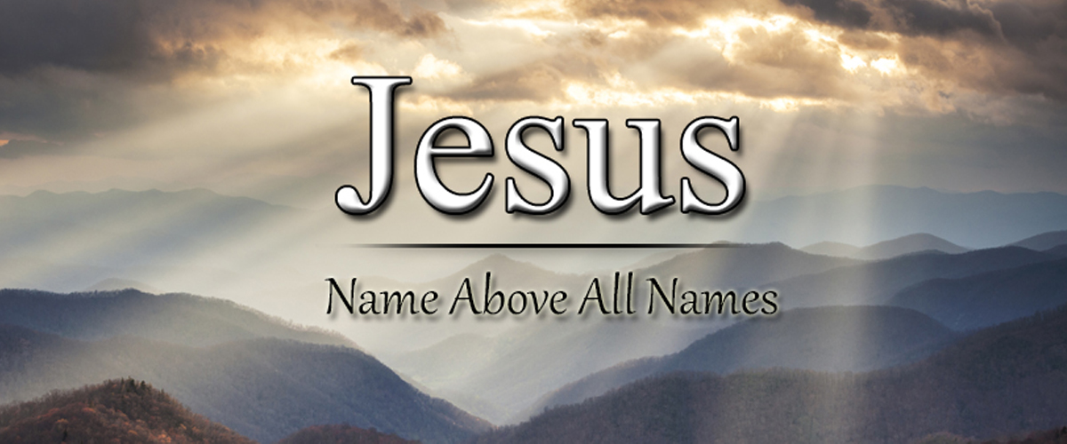

Slide 17
1 Peter 4:12-19
Verse 17-18 – “It is time for judgement to being at the household of
God.”
Judgement = Gk. “krima” meaning sentence or decree
God’s people do experience trials of various kinds and the judgement
of God first (Jeremiah 5:29; Zechariah 13:7-9; Mark 13:19-20; Acts
14:22; 1 Thessalonians 3:3-4; 2 Thessalonians 1:5-10; Rev 2:10).
But we will ALL one day stand before the judgement seat of God (2
Cor 5:10, 1 Peter 4:5)

Slide 18
1 Peter 4:12-19
Verse 20: “Therefore let those who suffer according to God’s
will entrust their souls to a faithful Creator while doing
good.”
2 things we must do:
1) ‘Entrust their souls to a faithful creator’ and
2) continue to 'do good’.

Slide 19
APPLICATION
Summary:
1. As we share in Christ's sufferings today, so we will rejoice when his glory is revealed tomorrow. (vs 13)
2. We are blessed when we are insulted for the name of Christ. God's glorious Spirit rests on us. (vs 14)
3. We need to glorify God as we bear the name of Christ (vs 16).
4. Judgement begins with us for our good, but ends with terrifying consequences for the ungodly and sinner. (vs 17-18).
5. Let us entrust ourselves to God and keep on doing good, we were suffer according to God's will.

Slide 20
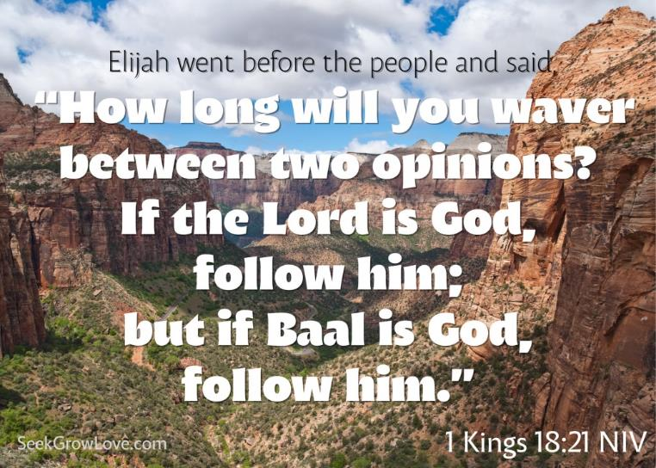
APPLICATION - DECIDE TODAY!

