Slide 1
Notes:
Singapore has a high concentration of luxury hotels.
According to the Five Star Alliance,
there are 28 5-star hotels on the little red dot,
which is relatively high
considering its small population of just over 6 million people.
Hong Kong,
which has over 7 million people,
only has 23 five-star hotels.
There are cities in Asia that have more of these high-quality hotels.
For example, Shanghai has 37 and Bangkok 35.
However, their populations are much larger than Singapore’s,
with 30 and 15 million people, respectively
---------------------------------------------------------------------
https://www.fivestaralliance.com/find-luxury-hotels/singapore
https://www.fivestaralliance.com/find-luxury-hotels/hong+kong
https://www.fivestaralliance.com/find-luxury-hotels/shanghai
https://www.fivestaralliance.com/find-luxury-hotels/bangkok

Slide 2
Hospitality
the friendly and generous reception and entertainment of guests, visitors, or strangers
Notes:
But whether you are in Shanghai, Bangkok, Hong Kong, or Singapore,
all these luxury hotels are known for hospitality.
(CLK) One definition of hospitality is
the friendly and generous
reception and entertainment
of guests, visitors, or strangers.

Slide 3
Live with the Proper Perspective of Time
1 Peter 4:7-11
Notes:
In the sermon today,
we will see that hospitality is just one of four “commands” mentioned.
The sermon title is “Live with the Proper Perspective of Time.”
In addition to these four commands,
Peter also gives us a goal to pursue.
That goal is to glorify God!
When we follow these four commands and direct our lives towards glorifying God,
we will live with the proper perspective of time.
This message was needed when Peter wrote it two thousand years ago.
It is also needed today. The reason?
Because we, like the early church, are enduring suffering.
A famous movie quote tells us that “Life is Pain.
Anyone who tells you differently is selling something.”
---------------------------------------------------------------------
Move Quote is from The Princess Bride, but it’s “inconceivable” that someone would not know ☺

Slide 4
1 Peter: The Sojourner’s Life
17-Jul-22 |  | Part 8: Face Suffering with Purpose 2 of 2
10-Jul-22 |  | Part 7: Face Suffering with Purpose 1 of 2
26-Jun-22 |  | Part 6: Submissive Living
19-Jun-22 |  | Part 5: Won by our Conduct
5-Jun-22 |  | Part 4: Be Subject for the Lordâ€™s Sake
29-May-22 |  | Part 3: Grow Into a People of God
22-May-22 |  | Part 2: Develop Habits of Holiness
14-May-22 |  | Part 1: Living Effectively for the Lord in an Unbelieving World
Notes:
But Peter isn’t selling something.
Instead, he is writing to give encouragement to a suffering church.
Our church is currently working through 1st Peter.
And today will be message 9 of 12.
The series is titled the Sojourner’s Life
because we, as Christians,
are traveling through this life as strangers in a stranger land.
At this point, Peter needs to give encouragement because
he has been talking about suffering since the middle of chapter 3.
In fact, the two previous sermons were about suffering.
And guess what the sermon next week is about? Suffering.
But this week, we will see Peter writing to encourage us to glorify God.

Slide 5
Background
God will ultimately judge those who reject His gospel (vs. 5-6)
1 Peter 4:5: but they will give account to him who is ready to judge the living and the dead.
Notes:
We saw a prelude to encouragement last week.
Pastor Jim ended with this point about 1 Peter 4 verses 5 and 6:
God will ultimately judge those who reject His gospel.
(CLK) Specifically, vs. 5 tells us that
“they” (those who reject the gospel, those who do not obey the word)
“they will give account to him who is ready to judge the living and the dead.”
Let me point out that:
We are NOT encouraged because non-believers face this judgment.
We are encouraged because we, as believers, DON’T face this judgment.
But we, as believers, don’t want ANYONE to face this judgment.

Slide 6
Background
Submission in all Relationships Pleases God
2:13–3:12
Government | Workplace | Marriage | Church and Unfriendly people
2:13-17 | 2:18-25 | 3:1-7 | 3:8-12
1 Peter 3:1 (ESV)
even if some do not obey the word,
they may be won without a word by the conduct . . .
Notes:
Because we don’t want anyone to face judgment,
we follow the relationship advice we already covered in chapters 2 and 3.
Peter’s relationship advice is concerning
leaders in our government,
employers and employees,
husbands and wives,
and other people in general,
whether in the church
or even with unfriendly people outside the church.
And in these relationships, it’s not our words,
but our conduct that matters.
even if some do not obey the word,
they may be won without a word by the conduct . . .
From a different translation: Our godly lives will speak to them without any words.
They will be won over by observing our pure and reverent lives (1 Peter 3:1 NLT)
How do we lead pure and reverent lives? As I already said,
Peter is going to give us four commands that lead to the goal of glorifying God.
But the overall structure of the sermon today
will be based on three areas where we can glorify God.

Slide 7
Glorify God in your own lives. (vs.7)
A Christian has a distinctly different lifestyle.
⁷ The end of all things is at hand; therefore
be self-controlled and sober-minded
for the sake of your prayers.
Notes:
So the first area where we can glorify God is with our own lives.
As Christians, we are called to have a lifestyle that is distinctly different from the world around us.
Verse 7 reads “The end of all things is at hand; therefore
be self-controlled and sober-minded
for the sake of your prayers.”
The first thing that pops out is the . . .

Slide 8
Glorify God in your own lives. (vs.7)
A Christian has a distinctly different lifestyle.
⁷ The end of all things is at hand; therefore
be self-controlled and sober-minded
for the sake of your prayers.
Notes:
. . . “therefore.”
When you see “therefore,” you need to ask what it is “there for.”
It is there to tell us something about the phrase “the end of all things is at hand.”

Slide 9
⁷ The end of all things is at hand
Notes:
That can sound ominous.
What does that mean?
Is it like a movie where it flashes “the end” up on the screen, then goes dark?
Is it like a dead-end road abruptly stopping because the bridge is out?

Slide 10
Psalm 90:2
Before the mountains were brought forth, or ever you had formed the earth and the world, from everlasting to everlasting you are God.
⁷ The end of all things is at hand
Notes:
No, because we know there is no end!
Our current life will be followed by eternity.
And we will spend eternity with the everlasting God.
Psalm 90 tells us that:
Before the mountains were brought forth, or ever you had formed the earth and the world, from everlasting to everlasting you are God.
We know our God is eternal. We know our God is everlasting.
When do we get to experience eternity with God in heaven?
The answer can be found in the lyrics of the song “In Christ Alone,”
which we sang as our opening hymn,
The lyrics go: Till He returns or calls me home
Here in the power of Christ, I’ll stand.
And so we look forward to his return.
Last week, when we read “they will give account to him who is ready to judge the living and the dead,” we saw Peter talking about Christ’s return.

Slide 11
1 Cor 11:26
For as often as you eat this bread and drink the cup,
you proclaim the Lord's death until he comes.
Psalm 90:2
Before the mountains were brought forth, or ever you had formed the earth and the world, from everlasting to everlasting you are God.
⁷ The end of all things is at hand
Notes:
When we take communion, we are also looking forward to Christ’s return.
That is why Paul wrote
“For as often as you eat this bread and drink the cup,
you proclaim the Lord's death until he comes.
So the phrase “the end of all things is at hand” is not an ominous warning about impending doom
Instead, it is there to tell us WHEN we need to heed the commands that Peter will give in this section.
And the answer to WHEN is . . . ?

Slide 12
Now,
Glorify God in your own lives. (vs.7)
A Christian has a distinctly different lifestyle.
⁷ The end of all things is at hand; therefore
be self-controlled and sober-minded
for the sake of your prayers.
Notes:
Now! Now is the time to glorify God in your own lives.
And how do we glorify God in our own lives?
By being self-controlled and sober-minded.
Now let's take a closer look at what these two commands mean.

Slide 13
Proverbs 25:28
A man without self-control is like a city broken into and left without walls.
self-control
Indicating a sober, temperate, calm, and dispassionate approach to life, having mastered personal desires and passions.
1 Thessalonians 5:6
So then let us not sleep, as others do, but let us keep awake and be sober.
2 Timothy 1:7
for God gave us a spirit not of fear but of power and love and self-control.
Notes:
First, let's look at self-control.
One Bible Dictionary states that self-control indicates
a sober, temperate, calm, and dispassionate approach to life,
having mastered personal desires and passions.
Self-control is an essential concept in the Bible.
Therefore, we see it mentioned quite frequently.
(CLK) Proverbs 25:28
A man without self-control
is like a city broken into and left without walls.
1 Thessalonians 5:6
So then let us not sleep, as others do, but let us keep awake and be sober.
This passage does not use the “word” self-control, but the concept is the same.
2 Timothy 1:7
for God gave us a spirit not of fear but of power and love and self-control.
There are a couple more verses listed in the handout that you can look up on your own.

Slide 14
self-control
Gal 5:13 For you were called to freedom, brothers. Only do not use your freedom as an opportunity for the flesh, but through love serve one another.
Indicating a sober, temperate, calm, and dispassionate approach to life, having mastered personal desires and passions.
Matt 5:16
Let your light shine before others, so that they may see your good works and give glory to your Father who is in heaven.
Notes:
Now let me give you two reasons why self-control is essential.
First, as Christians, we don’t have to follow a list of do’s and don’ts.
We have freedom in Christ, because of Christ,
Because of his suffering, death, and resurrection.
But even though we have freedom,
we can’t just cast off all moral restraint and do what we desire!
That is what Paul is writing about in Galatians 5:13 where he states
For you were called to freedom, brothers.
Only do not use your freedom as an opportunity for the flesh,
but through love serve one another.
Remember, we are called to be distinctly different from the world.
The second reason we must have self-control is that we must be in the world.
We can’t lock ourselves away in a monastery.
We need to be distinctly different, but still in the world.
Why? Because we want the world to see us, Jesus said:
“Let your light shine before others,
so that they may see your good works
and give glory to your Father who is in heaven.”
Do I want the world to be watching me?
Do I have enough self-control so that when people see me they give glory to God?

Slide 15
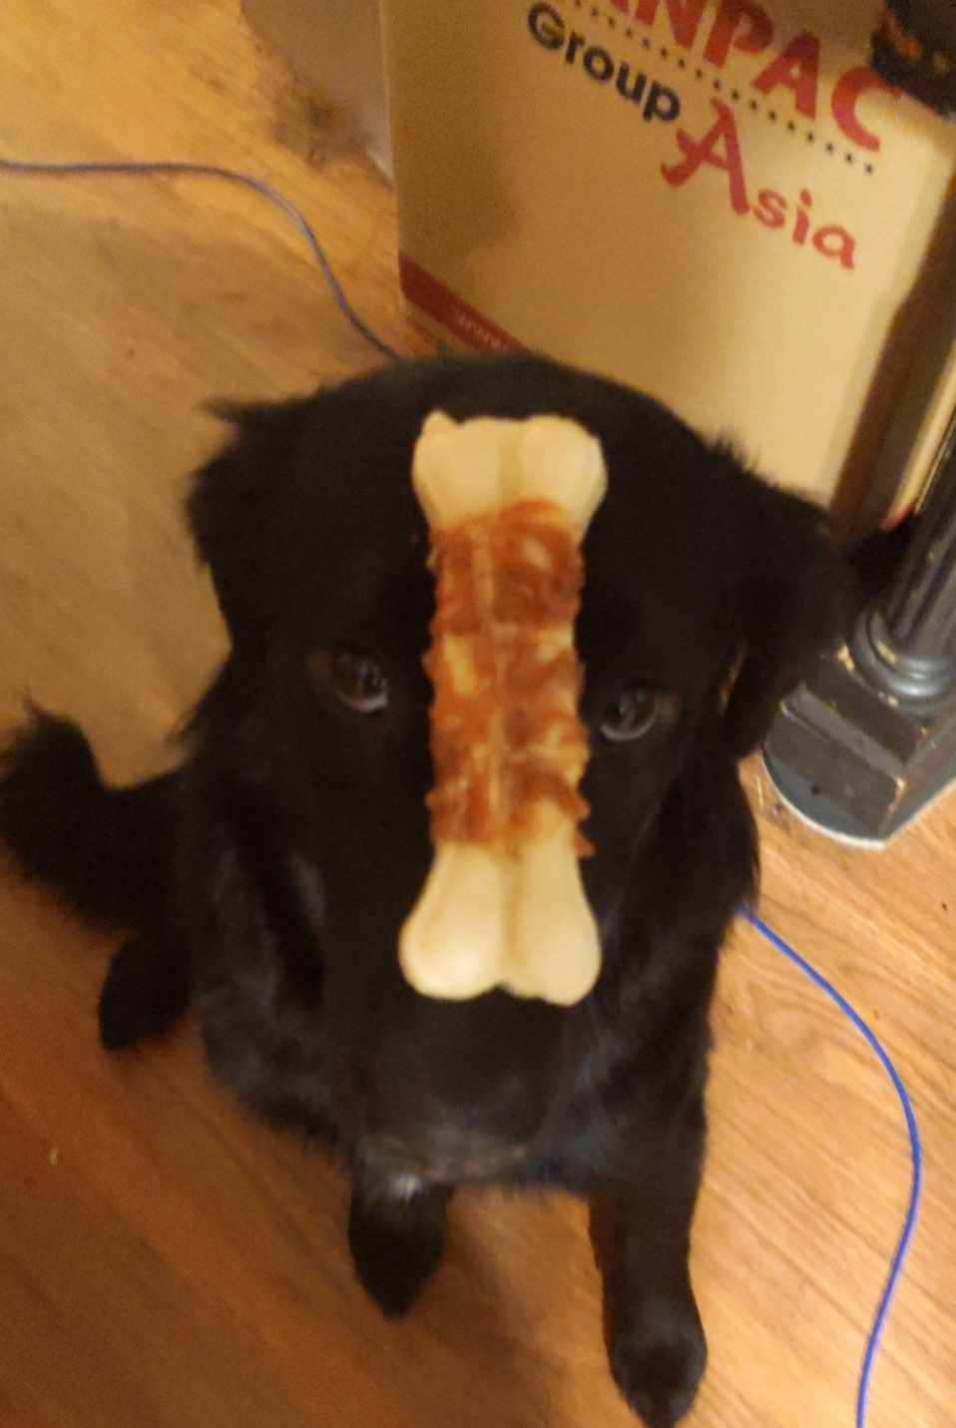
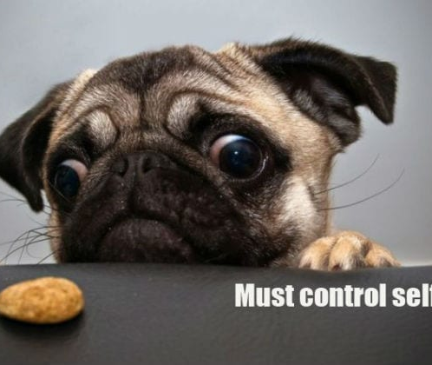
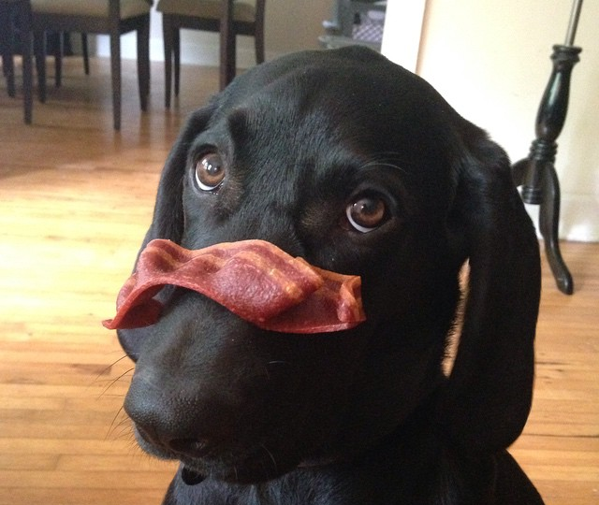
self-control
Notes:
Fortunately, self-control can be taught.
Many dog owners teach their dogs self-control using a treat such as a dog bone.
(CLK) But even more enticing than a dog bone is bacon. Everybody loves bacon.
(CLK) Now the ultimate test of self-control for a dog is a bacon-wrapped bone.
Now, this is not just any dog demonstrating utmost self-control.
This is Malu, which is Hawaiian for peacefulness.
And for now, Malu is the closest thing Karla and I have to a grandkid.
We have three adult children, but none are married,
and only one has a pet.
Malu was trained by Joshua, our son, to have self-control.
We too can be trained to have self-control, but we need to be sober minded

Slide 16
sober-minded
Literal: Free from intoxicating influences
Biblical: We do not allow ourselves to be captivated by any type of influence that would lead us away from sound judgment.
1 Cor 15:34
Wake up from your drunken stupor, as is right, and do not go on sinning.
Notes:
Which is the second command we will look: to be sober-minded.
The literal meaning of sober-minded is to be free from intoxicating substances.
But from a Biblical sense, being sober-minded means being free from ANY influence that would lead you away from sound judgment.
In 1 Corinthians chapter 15, Paul addresses the influence of false teachers
who said there is no resurrection.
Paul states their false teaching had the same effect as being drunk.
It was leading the Corinthians away from sound judgment and truth.
That is why he writes:
“Wake up from your drunken stupor, as is right, and do not go on sinning.”

Slide 17
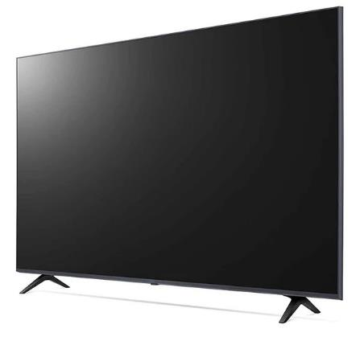
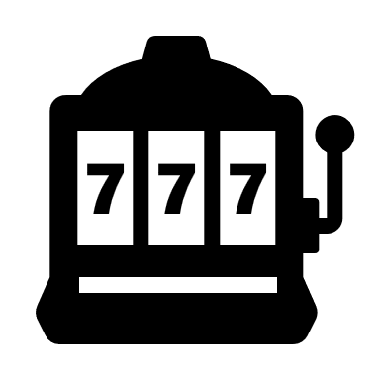
Negative Influences
Notes:
Unfortunately, today we are surrounded by many negative influences
that try to lead us away from sound judgment.
Remember, we are trying to glorify God in our own lives.
We are trying to live distinctively different lives from the non-Christians around us.
So, what are some negative influences we need to watch out for?
(CLK)
Obviously, intoxicating substances come to mind.
When you are under the influence, you make poor decisions.
If you are addicted and suffer withdrawal, you also make poor decisions.
(CLK)
You can be addicted to other things as well, such as gambling.
And with online gambling, you don’t need to leave the house
to get your fix or get into trouble.
(CLK)
People can be bad influences.
For example, in 2nd Samuel 13, Jonadab influenced his cousin Amnon badly.
The results led to a civil war in ancient Israel.
(CLK)
With the rise of online podcasts, millions of people are getting bad advice,
influencing them to make poor judgments.
(CLK)
The movies and TV shows we watch also influence us.
(CLK)
And of course the computer.
When you are addicted to games or porn, the consequences can be disastrous.
I want you to talk a close look at the list up on the screen.
Now take a close look at your life.
Are any of these items (or anything else) causing you to make poor decisions?

Slide 18
Challenge
Notes:
That list was by no means all-inclusive.
There are so many things that can be bad influences in your life,
And sometimes, we may not recognize how something as innocent as a Disney cartoon
Not only exposes us to a worldview that is contrary to what the church teaches.,
It can make us accepting of that worldview.
Therefore, I challenge you to take the time to closely scrutinize everything in your life.
I want to challenge you to practice self-control.
I want to challenge you to be sober-minded.
Just as Peter challenged the early church.

Slide 19
Now,
Glorify God in your own lives. (vs.7)
A Christian has a distinctly different lifestyle.
⁷ The end of all things is at hand; therefore
be self-controlled and sober-minded
for the sake of your prayers.
Notes:
Peter finishes his challenge with a reminder of the importance of prayer.
I find it amazing that the God who created the universe out of nothing
invites us to pray.
The God who knows us before we are born
The God who knows the number of hairs on our head,
He desires that we communicate with him.
That we sing to him in praise,
and cry out to him in sorrow.

Slide 20
Notes:
Jeremiah captures this sentiment well, stating:
Then you will call on me
and come and pray to me,
and I will listen to you.
You will seek me and find me
when you seek me with all your heart.
But what happens when you are not self-controlled or sober-minded,
you won’t be seeking with all your heart.
One way to help with being self-controlled and sober-minded is with daily devotions.
With the internet and online signups, these can be sent to you automatically every day.
If you don’t know where to start, just go to Biblegateway.com,
and select “explore more” from the menu, then choose Devotionals.
They have a wide variety of devotionals you can sign for.

Slide 21
Now,
Glorify God in your own lives. (vs.7)
A Christian has a distinctly different lifestyle.
The plural suggests specific, individual prayers throughout each day.
Wayne Grudem
⁷ The end of all things is at hand; therefore
be self-controlled and sober-minded
for the sake of your prayers.
Notes:
Now back to prayer. How often should we pray?
Peter writes for the sake of your prayer”s”. Notice the s at the end, It is plural.
(CLK) Wayne Grudem tells us that
“the plural suggests specific, individual prayers throughout each day. “
This is similar to the Apostle Paul, who tells us to “Pray without Ceasing!”
This appeal to pray throughout the day falls perfectly in line with our first point,
which is that:
Believers should glorify God in their own lives.

Slide 22
Now,
Glorify God in your own lives.
A Christian has a distinctly different lifestyle.
Glorify God in relationships. (vs. 8-9)
A Christian prioritizes relationships of love and forgiveness.
⁸ Above all, keep loving one another earnestly,
since love covers a multitude of sins.
⁹ Show hospitality to one another
without grumbling.
Notes:
Looking at the next two verses, not only do we see two more commands,
we see a SECOND area where we can glorify God.
We are called to Glorify God in relationships.
Specifically, a Christian prioritizes relationships of love and forgiveness.
The verses read 8 Above all, keep loving one another earnestly,
since love covers a multitude of sins.
9 Show hospitality to one another without grumbling.

Slide 23
Now,
Glorify God in your own lives.
A Christian has a distinctly different lifestyle.
Glorify God in relationships. (vs. 8-9)
A Christian prioritizes relationships of love and forgiveness.
⁸ Above all, keep loving one another earnestly,
since love covers a multitude of sins.
⁹ Show hospitality to one another
without grumbling.
Notes:
It is easy to identify the two commands, Keep loving one another and show hospitality.
The command to love one another is not a new concept to Christians.

Slide 24
Love One Another
John 13:35
By this all people will know that you are my disciples, if you have love for one another.
The Great Commandment
Luke 10:27
And he answered, “You shall love the Lord your God with all your heart and with all your soul and with all your strength and with all your mind, and your neighbor as yourself.”
1 Cor 13
If I speak in the tongues of men and angels, but have not love, . . .
since love covers a multitude of sins.
Notes:
In all three of the synoptic gospels, Matthew, Mark, and Luke, we see the great commandment, which is:
“You shall love the Lord your God
with all your heart and with all your soul
and with all your strength and with all your mind,
and your neighbor as yourself.”
The Apostle John records Jesus telling his followers:
By this all people will know that you are my disciples,
if you have love for one another.
When Christians show love for one another, and others can see it,
we are genuinely being distinctively different from the world.
Finally, no discussion of love would be complete without mentioning Paul’s seminal chapter on love: 1 Cor 13

Slide 25
1 Cor 13
Notes:
Although this is a short chapter, it is very compelling.
As we listen to the first six verses, it is easy to see why Peter writes that love covers a multitude of sins.

Slide 26
¹ If I speak in the tongues of men and of angels, but have not love, I am a noisy gong or a clanging cymbal.
² And if I have prophetic powers, and understand all mysteries and all knowledge, and if I have all faith, so as to remove mountains, but have not love, I am nothing.
Notes:
Note: audio plays automatically in the slideshow for these three slides, but slides must be advanced manually.

Slide 27
³ If I give away all I have, and if I deliver up my body to be burned, but have not love, I gain nothing.
Notes:
Note: audio plays automatically in the slideshow for these three slides, but slides must be advanced manually.

Slide 28
Love One Another
since love covers a multitude of sins.
⁴ Love is patient and kind; love does not envy or boast; it is not arrogant ⁵ or rude.
It does not insist on its own way; it is not irritable or resentful; ⁶ it does not rejoice at wrongdoing, but rejoices with the truth.
⁷ Love bears all things, believes all things, hopes all things, endures all things.
Notes:
Note: audio stops with verse 7
Rather than continue with the rest of the chapter,
let me focus your attention on verses 4 through 6
This is a short list about love. It contains:
2 things that love is: patient and kind
4 things that love is not: arrogant, rude, irritable, or resentful
4 things that love does not do: Love does not envy, boast,
insist on its own way, or rejoice at wrongdoing
But the most extensive list is the 5 things that love does:
rejoices with the truth, bears all things, believes all things,
hopes all things and endures all things
Earlier we read that people will know we are disciples of Jesus
if we have love for another.
And since love consists of a lot of doing,
it will be easy for people to see us loving one another.
(CLK) Going back to what Peter wrote:
Above all, keep loving one another earnestly,
since love covers a multitude of sins.
We see that when we demonstrate love towards one another
using Paul’s definition from 1 Cor 13
we will be distinctively different from the world,
and we will be glorifying the father.

Slide 29
Now,
“Where love abounds in a fellowship of Christians, many small offenses, and even some large ones, are overlooked and forgotten. But where love is lacking, every word is viewed with suspicion, every action is liable to misunderstanding, and conflicts abound”
Wayne Grudem
Glorify God in your own lives.
A Christian has a distinctly different lifestyle.
Glorify God in relationships. (vs. 8-9)
A Christian prioritizes relationships of love and forgiveness.
⁸ Above all, keep loving one another earnestly,
since love covers a multitude of sins.
⁹ Show hospitality to one another
without grumbling.
Notes:
One more thing to point out about love covering a multitude of sins.
Love is not condoning sin.
Love is not justifying sin.
Love is not saying it is okay to sin.
But love does make it easier to FORGIVE sins.
Sins occur when someone hurts someone else.
But when both parties are demonstrating true Christian love,
it is much easier to forgive and move on.
(CLK) Grudem puts it this way: “Where love abounds in a fellowship of Christians,
many small offenses, and even some large ones, are overlooked and forgotten.
But where love is lacking,
every word is viewed with suspicion,
every action is liable to misunderstanding, and conflicts abound.”
That’s why we need to keep loving one another earnestly,

Slide 30
Hospitality
the friendly and generous reception and entertainment of guests, visitors, or strangers
Notes:
When we keep loving each other deeply,
we will inevitability show hospitality.
We’ve already discussed hospitality from the standpoint of luxury hotels.
Luxury hotels want you to feel welcome, so you spend your money there.
But the definition of hospitality goes back further, back to the Old Testament.

Slide 31
Lev 19:33-34
When a stranger sojourns with you in your land, you shall not do him wrong. You shall treat the stranger who sojourns with you as the native among you, and you shall love him as yourself, for you were strangers in the land of Egypt: I am the Lord your God.
Notes:
In Leviticus chapter 19, we read that
When a stranger sojourns with you in your land,
you shall not do him wrong.
You shall treat the stranger who sojourns with you as the native among you,
and you shall love him as yourself,
for you were strangers in the land of Egypt:
I am the Lord your God.
Just as the nation of Ancient Israel were strangers sojourning in the land of Egypt,
Today, Christians are strangers sojourning in the land of the secular world.
But by showing hospitality, we are shining a light on God’s glory.

Slide 32
1 Peter
The Sojourner’s Life
Living effectively for the Lord in an unbelieving world
Challenges:
Without Grumbling
Hospitality to Strangers
Notes:
That is why Peter calls on us to show hospitality.
That is why Peter asks us to live effectively for the Lord in an unbelieving world.
(CLK) There are two challenges with this command.
The first is stated quite clearly by Peter.
He tells us to show hospitality without grumbling.
It’s easy to get caught up in grumbling.
Especially if you are a hospitable person
and you end up taking on too much work.
I have an example from my own life. 20 years ago, I was one of four department heads on a Navy ship.
In addition to your primary job, the navy assigns collateral duties, which are distributed to even out the workload. Often these get overlooked. Shortly after arriving, the Captain realized I could fix broken programs, and get things back on track, so as others left, I ended up taking on extra collateral duties. Pretty soon, I had most of the DH-level collateral duties. It began to wear on me. I began to grumble and complain. Instead of grumbling and complaining, I should have said; I can’t handle anymore. Instead, I was not a good witness. I did not glorify God with my life.
But now, most of you know I am a full-time student. I also lead a small group on Sunday Evenings. How often have you seen an announcement that we are having a game night? Or we are taking a short break. Rather than complain, I cheerfully admit when I am overloaded.
The first challenge is to be hospitable without grumbling.
(CLK) The second challenge is that hospitality is frequently viewed as the recreational sharing of fellowship, lodging, and provisions AMONG FRIENDS OR RELATIVES
But in the Bible (and for luxury hotels),
hospitality involves receiving STRANGERS
—rather than merely reinforcing pre-existing friendships or bonds of affection.
hospitality involves receiving STRANGERS
—especially travelers, who then become guests or are treated as friends

Slide 33
Now,
Glorify God in your own lives.
A Christian has a distinctly different lifestyle.
Glorify God in relationships. (vs. 8-9)
A Christian prioritizes relationships of love and forgiveness.
Show Biblical love for others.
Show this love by being hospitable without grumbling.
Show love and hospitality to strangers, not just friends and family.
Notes:
To summarize:
You need to show Biblical love for others.
You show this love by being hospitable without grumbling.
And you show love and hospitality to strangers, not just friends and family.
And by doing this, by prioritizing relationships of love and forgiveness,
You will be glorifying God.

Slide 34
Now,
Glorify God in your own lives. (vs. 8)
A Christian has a distinctly different lifestyle.
Glorify God in relationships. (vs. 9-10)
A Christian prioritizes relationships of love and forgiveness.
Glorify God through Christian Service. (vs. 10-11)
A Christian exercises the gifts of the spirit in service.
¹⁰ As each has received a gift, use it to serve one another, as good stewards of God's varied grace: ¹¹ whoever speaks, as one who speaks oracles of God; whoever serves, as one who serves by the strength that God supplies—in order that in everything God may be glorified through Jesus Christ. To him belong glory and dominion forever and ever. Amen.
Notes:
Now we come to a third area where we can glorify God,
which is through Christian service.
A Christian exercises the gifts of the spirit in service.
(CLK)
Verses 10 and 11 tell us that:
As each has received a gift, use it to serve one another,
as good stewards of God's varied grace:
whoever speaks, as one who speaks oracles of God;
whoever serves, as one who serves by the strength that God supplies
—in order that in everything God may be glorified through Jesus Christ.
To him belong glory and dominion forever and ever. Amen.
This final section is a little different than the previous 2 sections.
Vs. 8 contained the commands to be self-controlled and sober-minded
in order to Glorify God in our own lives.
Vs. 9 and 10 contained the commands to love and be hospitable
in order to Glorify God in relationships.
You can say this final section contains a “command”
to use your gifts to serve one another
to Glorify God in Christian Service.

Slide 35
Manner:
The speaker is asserting
how something is done,
how something happened, or
how someone is behaving
¹⁰ As each has received a gift, use it to serve one another, as good stewards of God's varied grace: ¹¹ whoever speaks, as one who speaks oracles of God; whoever serves, as one who serves by the strength that God supplies—in order that in everything God may be glorified through Jesus Christ. To him belong glory and dominion forever and ever. Amen.
Notes:
You could also state that this verse shows the MANNER
in which we glorify God through Christian service.
The manner is a statement where the speaker is asserting
how something is done,
how something happened, or
how someone is behaving
In this case, Peter is asserting how something is done,
specifically, how to glorify God by using spiritual gifts

Slide 36
Spiritual Gifts
the result of God’s grace
each believer has received at least one spiritual gift
¹⁰ As each has received a gift, use it to serve one another, as good stewards of God's varied grace:
Notes:
Where do the gifts come from?
They are the result of God’s grace.
Therefore, believers shouldn’t boast about the gift they have.
We can work on and improve our gifts.
A musician practices his instrument.
A singer works on breathing techniques and vocal exercises
A seminary student studies preaching methods
and should listen to recordings of himself.
But regardless of how much practice one puts in,
by acknowledging God’s grace as the source of the gift,
you glorify God with your service.
(CLK)
Another thing that Peter points out is that each one of us has at least one spiritual gift.
But, if you are not self-controlled and sober-minded,
if you are not loving and hospitable to one another,
Can you use your spiritual gift to serve others and glorify God?
Of course not!

Slide 37
Types of Service
Get
words from God
Speaking | Serving
Teaching | Administering
Evangelism | Faith
Pastor-Teacher | Giving
Encouraging | Service
 | Mercy
Get
strength from God
¹¹ whoever speaks, as one who speaks oracles of God;
whoever serves, as one who serves by the strength that God supplies
Notes:
It is fairly easy to see why Peter would use categories of speaking and serving to discuss the spiritual gifts.
Gifts such as teaching, evangelism, encouraging, and pastoral teaching and encouraging
involve speaking or getting words from God.
And gifts such as administering, faith, giving, service, and mercy
involve getting strength from God.
Does that mean all gifts can fit into one of these two categories?

Slide 38
Types of Service
Get
words from God
Speaking | Serving
Teaching | Administering
Evangelism | Faith
Pastor-Teacher | Giving
Encouraging | Service
 | Mercy
Mentoring
Get
strength from God
¹¹ whoever speaks, as one who speaks oracles of God;
whoever serves, as one who serves by the strength that God supplies
Notes:
Certainly not!
Mentoring involves both speaking and serving.
It involves both words from God and strength from God.
But the KEY thing to remember is that
the words, the strength, the talent, the wisdom,
whatever trait your gift needs,
it comes from God!

Slide 39
¹¹ whoever speaks, as one who speaks oracles of God;
whoever serves, as one who serves by the strength that God supplies
—in order that in everything God may be glorified through Jesus Christ. To him belong glory and dominion forever and ever. Amen.
Notes:
This is why Peter concludes with:
that in everything God may be glorified through Jesus Christ.
To him belong glory and dominion forever and ever. Amen.

Slide 40
Now,
Glorify God in your own lives.
A Christian has a distinctly different lifestyle.
Glorify God in relationships.
A Christian prioritizes relationships of love and forgiveness.
Glorify God through Christian Service. (vs. 10-11)
A Christian exercises the gifts of the spirit in service.
Notes:
I want to point out that Peter put these commands and principles
in this order on purpose.
But some people try to do things backward.
(CLK) They think they can jump into serving using their own merits and strengths
They think they can have relationships without love and hospitality
but rather based on being mutually beneficial for each other.
They think if they do all this stuff,
the broken pieces in their own lives won’t matter.
We need to realize the broken pieces in our lives are the result of sin.
The Bible teaches that because of sin, we are condemned and separated from God.
Because of sin, we are unable to gain God’s favor or forgiveness by self-effort.
But we also know that Jesus’s shed blood on the cross
allows us to overcome the power and eternal penalty of sin.
We know that when we admit that we are a sinner,
when we repent and believe that Jesus died and rose again,
when we receive the Lord Jesus Christ personally as the only Savior
Then we receive a new nature and become a true born-again Christian.

Slide 41
Now,
Glorify God in your own lives.
A Christian has a distinctly different lifestyle.
Glorify God in relationships.
A Christian prioritizes relationships of love and forgiveness.
Glorify God through Christian Service. (vs. 10-11)
A Christian exercises the gifts of the spirit in service.
Now is the Time to Glorify God!
A Christian gives glory to God in all things.
Notes:
It is this new nature
brought about by the power of the Holy Spirit
that allows us to be self-controlled and sober-minded.
Then we can glorify God in our own lives.
It is this new nature that allows us to love one another earnestly
and be hospitable with one another
even strangers
Then we can glorify God in our relationships.
It is this new nature that allows us to
draw on God’s words and rely on God’s strength
and empowers us with spiritual gifts
Then we can glorify God in Christian Service.
We know that time is short, and the end is near.
Therefore,
(CLK) Now is the Time to Glorify God!
We give glory to God in all things!

