Slide 1
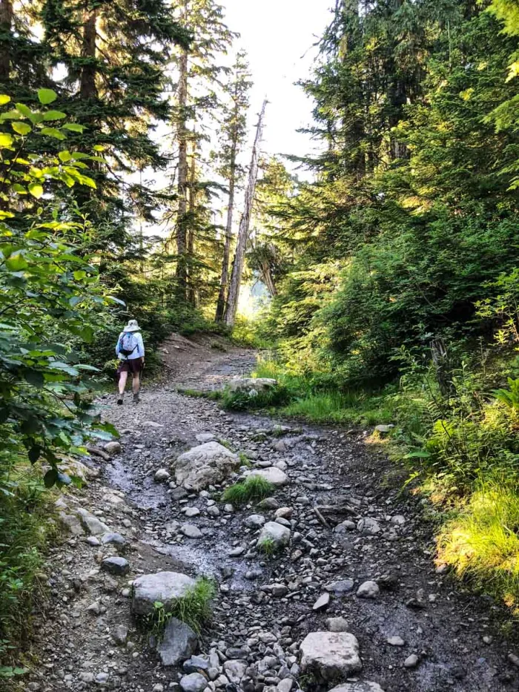
1 Peter
The Sojourner’s Life
Living effectively for the Lord in an unbelieving world

Slide 2
Be Grounded in Your Salvation (1:1-12)
… through our identity in Christ
Develop Holiness habits (1:13-25)
… through our love for Christ and for one another
Grow into a people of God (2:1-10)
… through being a bonded community
Live different from the world: in marriage (3:1-7)
… through honoring our spouses
Pursue unity with believers (3:8-12)
… through a transformed life in love through Christ
Be Subject for the Lord’s Sake (2:11-25)
… through living as ‘free’ servants of God

Slide 3
“What God has done for you in Christ” (Indicative) to
”How you must live for God in Christ” (Imperative).

Slide 4
Face Suffering with Purpose: Part 1
1 Peter 3:13-22

Slide 5
We learn to face suffering with purpose by appreciating the long game

Slide 6
V. 13 “Now who is there to harm you if you are zealous for what is good?”
Does it mean that those who are eager in doing good will not be harmed?

Slide 7
V. 12 - 13 “For the eyes of the Lord are on the righteous,
and his ears are open to their prayer.
But the face of the Lord is against those who do evil.
[therefore] who is there to harm you if you are zealous for what is good?”

Slide 8
Does it mean that those who are eager in doing good will not be harmed?
Not just anyone who is eager in doing good, but the righteous.

Slide 9
Who are the righteous? Who are those who suffer for righteousness’ sake?
The Righteous are those who are chosen by God through his saving act of grace alone and as a response shows an uncompromising faithfulness to God and his divine, moral law.

Slide 10
Do we see this happening in the world today in principle? The righteous being blessed and the evil punished?
Yes and No.

Slide 11
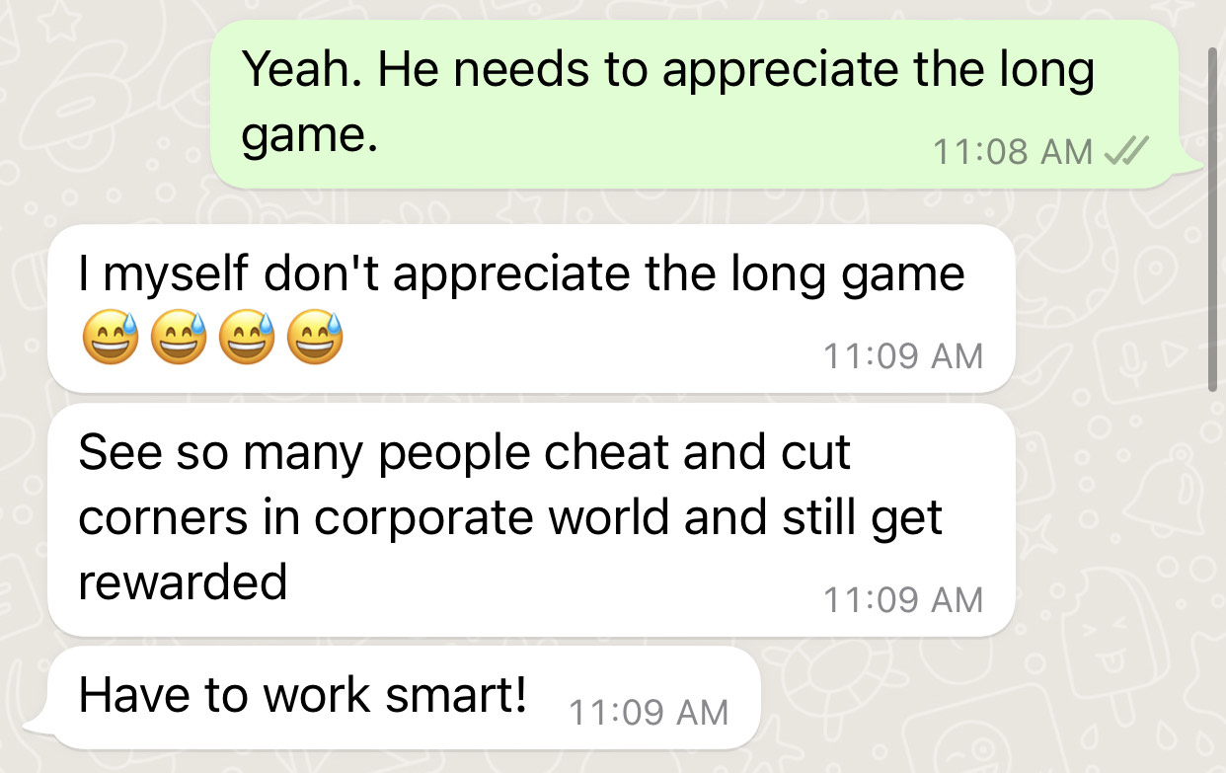

Slide 12
Psalm 73:2-3
“But as for me, my feet had almost stumbled,
my steps had nearly slipped.
For I was envious of the arrogant
when I saw the prosperity of the wicked.”
John 16:33
“In the world you will have tribulation”

Slide 13
Why should we endure such harm and suffer for righteousness sake then?
V. 13 - 15 For the eyes of the Lord are on the righteous, and his ears are open to their prayer. But the face of the Lord is against those who do evil.”
[Therefore] who is there to harm you if you are zealous for what is good?
[Indeed] even if you should suffer for righteousness' sake, you will be blessed.

Slide 14
Why should we endure such harm and suffer for righteousness sake then?
You will be blessed…

Slide 15
Why should we endure such harm and suffer for righteousness sake then?
You will be blessed by keeping to God’s divine moral code because even if you are not blessed now and suffer for it by the hands of man, God will bless you and vindicate you in the final judgment.

Slide 16
Therefore it seems to imply, that the Righteous, because of God’s salvation work through Jesus and the inworking of the Holy Spirit, have now an inbuilt divine moral code, called Christlikeness, that compels to right every wrong; a light against every darkness, push against oppression, challenge injustice, to feed the hungry, “to look after orphans and widows,” with the love of Christ and through a bonded community.
(Jer 22:3, Pro 19:17, Pro 29:7, Jam 1:27, Phil 2:12-13)

Slide 17
Psalm 82:3
“Give justice to the weak and the fatherless;
maintain the right of the afflicted and the destitute.”
Proverbs 29:7
“A righteous man knows the rights of the poor;
a wicked man does not understand such knowledge.”
Isaiah 1:17
“learn to do good;
seek justice,
correct oppression;
bring justice to the fatherless,
plead the widow's cause.”
James 1:27
“Religion that is pure and undefiled before God the Father is this: to visit orphans and widows in their affliction, and to keep oneself unstained from the world.”

Slide 18
This is every Christian’s moral code, our purpose, and we should never betray it nor go against it,
no matter how challenging or tempting it may be.

Slide 19
Wow!…That’s very interesting! What else does it say about this?

Slide 20
V. 14b- 15a Have no fear of them, nor be troubled, but in your hearts honor Christ the Lord as holy
Do not be afraid nor troubled of the suffering that is afflicted by men, stay loyal to God and his moral code.

Slide 21
Matthew 10:28
“...do not fear those who kill the body but cannot kill the soul. Rather fear him who can destroy both soul and body in hell.”

Slide 22
V. 15b always being prepared to make a defense to anyone who asks you for a reason for the hope that is in you;
Ready to explain why you uphold this divine moral code and choose to endure

Slide 23
V. 15c - 16a yet do it with gentleness and respect, having a good conscience,
Having this relationship with God and his divine moral code does not make the righteous better than the unbelievers

Slide 24
V. 16b - 17 so that, when you are slandered, those who revile your good behavior in Christ may be put to shame. For it is better to suffer for doing good, if that should be God's will, than for doing evil.
Those who accuse falsely over our intentions to serve God alone, will recognise that they were mistaken either in this lifetime or on the day of judgment and for that to happen, the suffering that Christians receive must only be for doing good and not for doing wrong.

Slide 25
We learn to face suffering with purpose by appreciating what Christ has done on behalf of the righteous

Slide 26
How can believers be confident and refrain from fear that God will right every wrong eventually?
Because Jesus has endured the greatest suffering on our behalf and paved the way for us.

Slide 27
V. 18 For Christ also suffered once for sins, the righteous for the unrighteous, that he might bring us to God, being put to death in the flesh but made alive in the spirit,
Jesus didn’t just take on the suffering afflicted from man during his passion week, going up on the cross, but took on the full suffering afflicted from God for sins’ sake, thought he was blameless and sinless, to save us once and for all from sin so that we can be brought back to God

Slide 28
V. 19 - 20 in which he went and proclaimed to the spirits in prison, because they formerly did not obey, when God's patience waited in the days of Noah, while the ark was being prepared, in which a few, that is, eight persons, were brought safely through water.
In the same context, Jesus went and declared victory to fallen angels who had gone against their divine moral code, showing that victory only belongs to those who keep the divine moral code.

Slide 29
Jude 6
And the angels who did not stay within their own position of authority, but left their proper dwelling, he has kept in eternal chains under gloomy darkness until the judgment of the great day
Gen 6:1-4
When man began to multiply on the face of the land and daughters were born to them, the sons of God saw that the daughters of man were attractive. And they took as their wives any they chose. Then the Lord said, “My Spirit shall not abide in man forever, for he is flesh: his days shall be 120 years.” The Nephilim were on the earth in those days, and also afterward, when the sons of God came into the daughters of man and they bore children to them. These were the mighty men who were of old, the men of renown.

Slide 30
V. 21 Baptism, which corresponds to this, now saves you, not as a removal of dirt from the body but as an appeal to God for a good conscience, through the resurrection of Jesus Christ,
Through this, we “appeal to God for a good conscience”, that by making this decision, we are loyal and nothing will hold us back from loving and following Christ.

Slide 31
V. 22 who has gone into heaven and is at the right hand of God, with angels, authorities, and powers having been subjected to him.
In all the suffering, Jesus rules and reigns.
In all our suffering, Jesus still rules and reigns.

Slide 32
How does this apply to me?
Suffering has meaning
Suffering for Christ's sake is therefore not a punishment but an opportunity for us to be glorified as he was
Suffering is a way for unbelievers to know God
Suffering shows our loyalty
Do we fear God or man?
Does suffering draw me closer to God? Or to my addictions and temptations?

Slide 33
Let us pray

