Slide 1
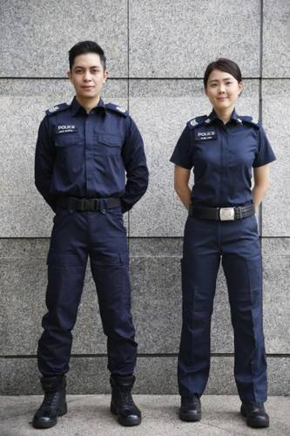
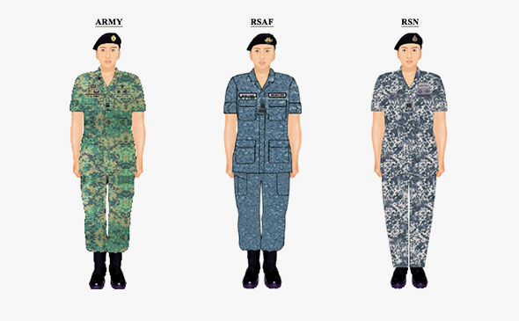
Notes:
As a society, we are familiar with uniforms.
In Singapore, you can see a variety of uniforms
such as those worn by the Singapore Police Force
or the branches of the Singapore Armed Forces.
A lot of research goes into the design of these uniforms.
There are also pages of regulations on how to wear them.

Slide 2
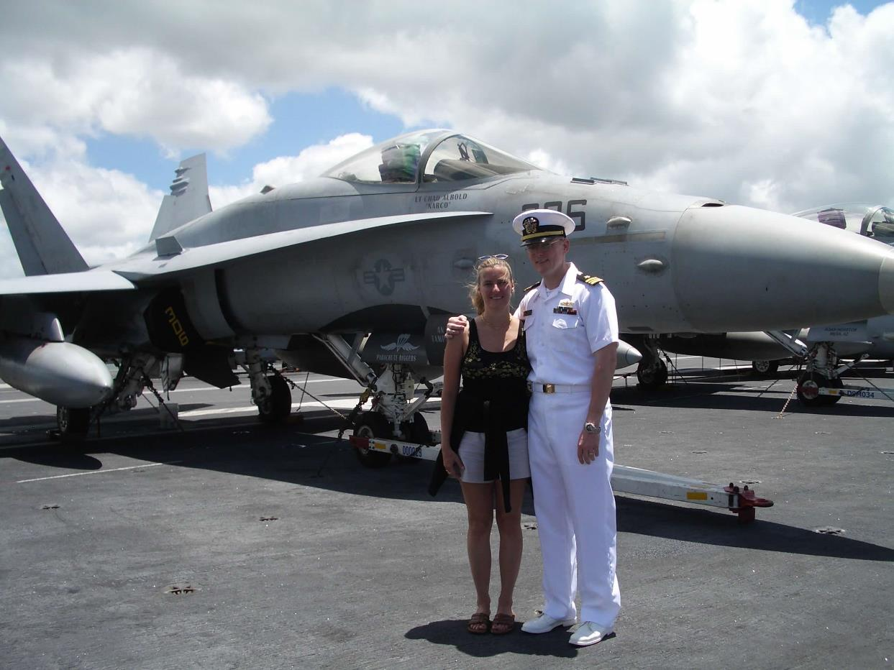
Notes:
Movies such as Top Gun feature uniforms.
I believe the combination of fighter jets and uniforms makes that movie popular.
Just ask the young lady in this picture.

Slide 3
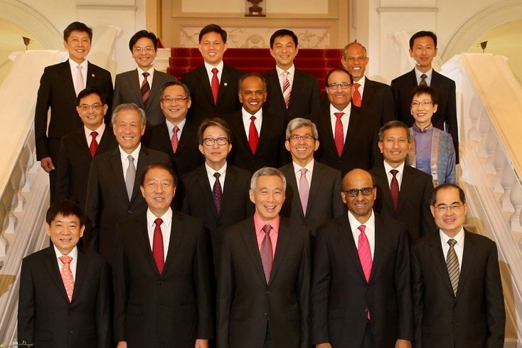
Notes:
We also see uniforms in everyday life.
You recognize a doctor because of the surgical clothes or “scrubs” they wear.
And if you are an MP or member of parliament in Singapore, you need a black coat and preferably a red tie.

Slide 4
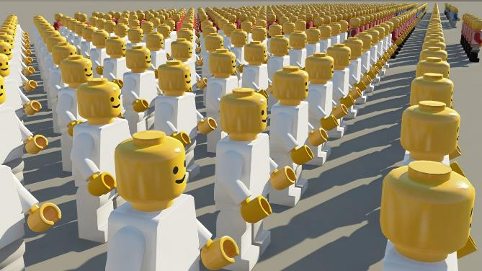
Uniformity in appearance shows a cohesive group aligned for a specific purpose
Notes:
Why do we have uniforms?
Because uniformity in appearance shows a cohesive group aligned for a specific purpose.

Slide 5
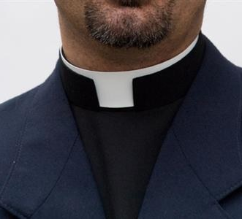
Uniform in appearance?
Notes:
Crossroads International Church is a cohesive group aligned for a specific purpose.
But are we uniform in appearance?
(CLICK) Now think not just about CIC, but the “church” as a whole?

Slide 6
4.8 The Church – The Church is the universal Body of Christ consisting of all born-again Christians made one by the indwelling Holy Spirit. The local church exists for the corporate worship of God, prayer, teaching God’s Word, fellowship among believers, evangelism of a needy world and acts of Christian compassion.
(Acts 2:42; Matthew 28:18-20; 1 Corinthians 11:17-34; 12:13).
www.cicfamily.com
Notes:
And by “church” as a whole, I am thinking of the definition that can be found on the CIC website under “our beliefs” and states:
(CLICK) The “Church” is the universal Body of Christ consisting of all born-again Christians made one by the indwelling Holy Spirit.
The local church exists for the corporate worship of God, prayer, teaching God’s Word, fellowship among believers, evangelism of a needy world and acts of Christian compassion.
From this definition, we can see that the entire “church”, as well as the local church at CIC, are cohesive groups aligned for a specific purpose.
How does the worldwide church and how do we at CIC show uniformity?

Slide 7
The “church” is called to have
uniformity in belief and
uniformity in behavior
Notes:
I believe the answer can be found in 1st Peter, where the apostle calls the church to have
Uniformity in belief, and
Uniformity in behavior.

Slide 8
1 Peter
The Sojourner’s Life
Living effectively for the Lord in an unbelieving world
Notes:
Today will be the 6th message in our series on 1st Peter called the Sojourner’s life.
In this series, we have been looking at how to live effectively for the Lord in an unbelieving world. As I mentioned before, Peter is writing to tell the church to be unified in belief and behavior.
One example of where Peter tells us what to believe can be found in chapter 1 vs 3: Blessed be the God and Father of our Lord Jesus Christ! According to his great mercy, he has caused us to be born again to a living hope through the resurrection of Jesus Christ from the dead, 4 to an inheritance that is imperishable, undefiled, and unfading, kept in heaven for you, 5 who by God's power are being guarded through faith for a salvation ready to be revealed in the last time.
An example where Peter tells us how to behave is found in Chapter 2 vs 1: put away all malice and all deceit and hypocrisy and envy and all slander.
Or in chapter 2 vs 11 and 12: abstain from the passions of the flesh, which wage war against your soul. 12 Keep your conduct among the Gentiles honorable,
Being a short book which takes about 20 minutes to read, or 13 minutes if you increase the speed to “fast” at ESV.ORG, I encourage you go through and pull out everything Peter tells you to believe and everywhere he tells you how to behave. You may find it interesting.

Slide 9
Practicing Submission
2:13–3:12
Government | Workplace | Marriage
2:13-17 | 2:18-25 | 3:1-7
¹³ Be subject for the Lord's sake to every human institution, whether it be to the emperor as supreme, ¹⁴ or to governors as sent by him to punish those who do evil and to praise those who do good.
Linking doctrine with practice
Notes:
As you can see, Peter effectively links doctrine, or what you believe, with practice, or how you behave.
The last two messages in this series have been about practicing submission in relationships.
So far, we have covered three specific relationships where Peter exhorts believers to be submissive to show God’s love.
The first relationship is with the government. Peter tells all believers to submit to legitimate governments.
He writes, be subject for the Lord's sake to every human institution, whether it be to the emperor as supreme, or to governors as sent by him to punish those who do evil and praise those who do good.

Slide 10
Submission
2:13–3:12
Government | Workplace | Marriage
2:13-17 | 2:18-25 | 3:1-7
¹³ Be subject for the Lord's sake to every human institution, whether it be to the emperor as supreme, ¹⁴ or to governors as sent by him to punish those who do evil and to praise those who do good. | ¹⁸ Servants, be subject to your masters with all respect, not only to the good and gentle but also to the unjust.
Notes:
The next relationship is within the workplace. Here, Peter tells workers to obey their employers, or
Servants to be subject to your masters with all respect, not only to the good and gentle but also to the unjust.

Slide 11
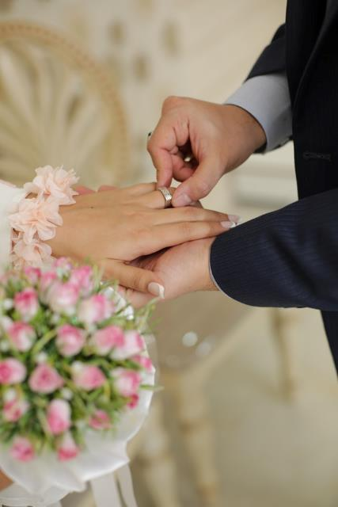
Submission
2:13–3:12
Government | Workplace | Marriage
2:13-17 | 2:18-25 | 3:1-7
¹³ Be subject for the Lord's sake to every human institution, whether it be to the emperor as supreme, ¹⁴ or to governors as sent by him to punish those who do evil and to praise those who do good. | ¹⁸ Servants, be subject to your masters with all respect, not only to the good and gentle but also to the unjust. | ¹ wives, be subject to your own husbands, so that even if some do not obey the word, they may be won without a word by the conduct of their wives,
⁷ Likewise, husbands, live with your wives in an understanding way, showing honor
Notes:
The third relationship Peter discusses is within marriage. He addresses both wives and husbands.
He tells the wives to be subject to their husbands, so that even if some do not obey the word, they may be won without a word by the conduct of their wives,
For the husbands he says the same thing applies, stating likewise, husbands live with your wives in an understanding way, showing honor.

Slide 12
Submission
2:13–3:12
Government | Workplace | Marriage | Church and Unfriendly people
2:13-17 | 2:18-25 | 3:1-7 | 3:8-12
Submission in all relationships pleases God!
Notes:
Today, when we look at chapter 3 verses 8-12,
In this section, Peter will discuss two more relationships where we are called to be submissive.
The first relationship Peter will discuss is how we should act with other believers, those within the church body
The second relationship Peter will discuss is how we should act towards unfriendly people.
(CLICK) From these five verses, we will see that ‘Submission in all relationships pleases God!”

Slide 13
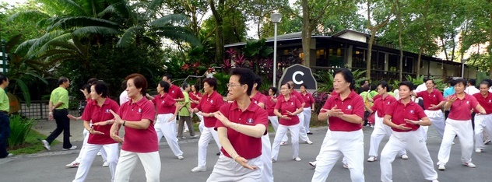
Notes:
So what relationships are missing in Peter’s summary?
He has already discussed relationships believers have with the authorities or a government, relationships between employers and employees, and relationships between wives and husbands.
I believe that today, people have many more types of relationships than they did in the 1st century.
We spend 12 or more years in school. We have relationships with classmates and teachers. We have extracurricular or co-curricular activities which introduce us to more people.
As we get older, we take part in recreational group activities, such as basketball, badminton, or group classes.
We have hobbies and often come together with others who have the same passion as us.
And we have our family. Peter discussed husbands and wives, but what about dealing with a mother or a father-in-law?
Fortunately, 1 Peter chapter 3, verses 8-12, tells us how to deal with these various relationships.
In fact, these five verses effectively summarize not just the three relationships already discussed, but all possible relationships.

Slide 14
⁸ Finally, all of you, have unity of mind, sympathy, brotherly love, a tender heart, and a humble mind.
Live in Harmony
With One Another
Notes:
Starting with verse 8, it reads, “finally, all of you have unity of mind, sympathy, brotherly love, a tender heart, and a humble mind.”
(CLICK) This tells us that we are to live in harmony with one another. Within the church, we are to be of one accord.
Just as believers submit to governments, servants to masters, wives to husbands, and husbands honor their wives, we as believers are to submit to one another.
And these are the traits we need in order to do that.

Slide 15
⁸ Finally, all of you, have unity of mind, sympathy, brotherly love, a tender heart, and a humble mind.
Notes:
Taking a closer look, we know this is a conclusion because of the term “finally.” The NASB states “to sum up” but then has a footnote stating “finally.
Either way, we understand these last few verses conclude a section that started back in chapter 2 vs. 13 with everyone to “be subject to governments, followed by servants be subject to your master.
Peter used linking words such as likewise, and repeated words such as “be subject” to show continuity across this large section.
“likewise, wives be subject to your husbands.
“likewise husbands. . . honor your wives
And now the conclusion, finally,

Slide 16
⁸ Finally, all of you, have unity of mind, sympathy, brotherly love, a tender heart, and a humble mind.
Notes:
. . . is addressed to the entire church, “all of you.”
This is not just for servants, or masters, or wives, or husbands, but for everyone who is a part of the church.

Slide 17
⁸ Finally, all of you, have
unity of mind,
sympathy,
brotherly love,
a tender heart,
and a humble mind.
Refers to believers
Notes:
How does everyone in the church live in harmony with one another?
We need to have unity of mind, sympathy, brotherly love, a tender heart, and a humble mind.
(CLICK) We know this is addressed to the church, or believers, because of the command to have unity of mind. And we cannot be like-minded with non-believers.
Peter already addressed that in chapter 1 verse 14 where he writes “As obedient children, do not be conformed to the passions of your former ignorance.
He is saying Do not be like-minded with the passions of our former ignorance.
This is how we know these 5 traits refer to believers, or at least should refer to believers.

Slide 18
ESV have | NASB be
unity of mind | harmonious
sympathy | sympathetic
brotherly love | loving
a tender heart | compassionate
a humble mind | humble
Live in Harmony With One Another
Notes:
Looking at the NASB, we see a very similar translation. The 5 traits are not something we do, but something we are to have.
In the ESV we have unity of mind, sympathy, brotherly love, a tender heart, and a humble mind.
For the NASB we must be harmonious, sympathetic, loving, compassionate, and humble.

Slide 19
ESV have | NASB be | NIV
unity of mind | harmonious | be like minded
sympathy | sympathetic | be sympathetic
brotherly love | loving | love one another
a tender heart | compassionate | be compassionate
a humble mind | humble | and humble
Live in Harmony With One Another
Notes:
The NIV continues the same thought, stating you must be like-minded, sympathetic, compassionate, and humble. The only difference, instead of having brotherly love, or being loving, the NIV issues a command to “love one another.”

Slide 20
ESV have | NASB be | NIV | NLT
unity of mind | harmonious | be like minded | Should be of one mind.
sympathy | sympathetic | be sympathetic | Sympathize with each other
brotherly love | loving | love one another | Love each other as brothers and sisters
a tender heart | compassionate | be compassionate | Be tenderhearted, and
a humble mind | humble | and humble | keep a humble attitude.
Acts 1:14 All these with one accord were devoting themselves to prayer
Live in Harmony With One Another
Notes:
The NLT follows the NIV in that it issues a command to love each other as brothers and sisters.
The NLT also gives a command to sympathize with each other and keep a humble attitude.
But whether these are verbal commands or passive objects, the point is clear. If we call ourselves believers, these are the traits we must demonstrate.
(CLICK) Demonstrating these traits is how we live in harmony with one another.
(CLICK) Living out these values is how we can be of one accord just like the church in Acts 1.

Slide 21
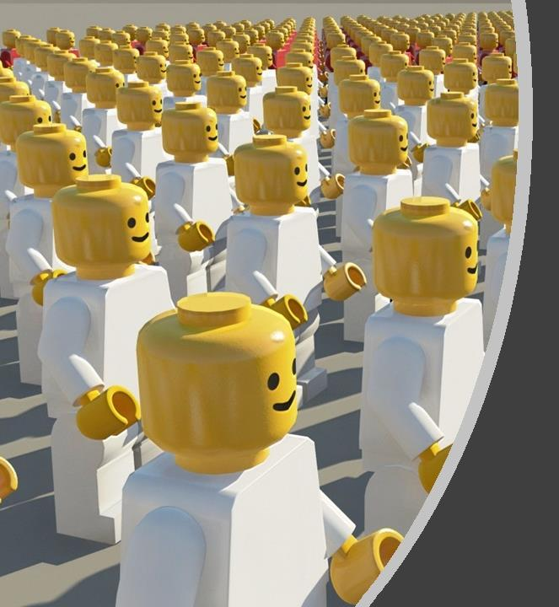
⁸ Finally, all of you, have
unity of mind,
sympathy,
brotherly love,
a tender heart,
and a humble mind.
Q: What is the chief end of man?
A: Man's chief end is to glorify God and enjoy him forever.
1 Corinthians 10:31: So, whether you eat or drink, or whatever you do, do all to the glory of God.
Notes:
Let’s talk briefly about these traits or values.
What exactly does “unity of mind” or like-mindedness really mean? Do we need to all wear the same clothes, eat the same food, and perform the same rituals? Obviously not!
The “church” is called to have uniformity in belief and uniformity in behavior. But the behavior is simply to be submissive, live in harmony with one another, and show that we are a cohesive group aligned for a specific purpose.
(CLICK) When it comes to our specific purpose, I like question 1 from the Westminster Shorter Catechism:
Q: What is the chief end of man?
A: Man's chief end is to glorify God and enjoy him forever.
This comes from 1 Corinthians 10:31: So, whether you eat or drink, or whatever you do, do all to the glory of God.

Slide 22
⁸ Finally, all of you, have
unity of mind,
Sympathy
brotherly love,
a tender heart (compassion)
and a humble mind.
Sympathy means you can understand what the person is feeling.
Compassion is the willingness to relieve the suffering of another.
Notes:
What about sympathy?
I will look at sympathy and a tender heart, or compassion together since they are similar.
(CLICK) Sympathy means you can understand what the person is feeling.
Compassion is the willingness to relieve the suffering of another.

Slide 23
⁸ Finally, all of you, have
Sympathy
a tender heart (compassion)
Google: Ways to express sympathy
Be there when needed
Listen
Reach out and touch (literally)
Look for an immediate need and fill it
Provide food
Send a note, card, letter, or make a phone call
Notes:
Another definition is that compassion is simply expressing sympathy.
I googled ways to show sympathy and was rewarded with this list:
Now let’s compare this with the example in the Book of Job.
1) Job’s friends were there
2) Job’s friends listened (good), but then they tried to give advice (bad)
Over 1/3 of the book of Job (42 chapters) are speeches by his friends.

Slide 24
⁸ Finally, all of you, have
Sympathy
a tender heart (compassion)
Sympathy means you can understand what the person is feeling
Notes:
I think we can learn something about sympathy and compassion from the cartoon character Garfield.
In the first frame, Garfield’s owner, Jon, remarks that cats have an incredible innate ability to sense when you are not feeling well. Peter wants us as believers to be looking out for others to see when they are not feeling well.
(CLICK) In the next frame, we see the cat, Garfield, coming up to his owner and we see his thoughts, we see that Garfield recognizes that his owner, Jon, is not feeling well. That is how we defined sympathy.
(CLICK) But, in the final frame, Garfield is seen walking away, and Jon, remarks that cats also have an incredible innate lack of sympathy.
But that is wrong. Jon does not understand the difference between sympathy and compassion. Garfield recognized Jon was not feeling well. But Jon wanted compassion, he wanted Garfield to do something to relieve his suffering.

Slide 25
⁸ Finally, all of you, have
Sympathy
a tender heart (compassion)
Compassion is the willingness to relieve the suffering of another.
Notes:
In the following cartoon, Jon understands the difference between sympathy and compassion better.
He says he is sick and is asking Garfield to show a little compassion. It would be more correct to say “show sympathy” or “have compassion,” but he’s not feeling well, so I won’t hold that against him.
(CLICK) In the final frame, Garfield, having googled how to express sympathy, reaches out and touches Jon, literally! But he uses a fake hand that was tied to a stick. Although Garfield is willing to relieve Jon’s suffering, he goes about it the wrong way.

Slide 26
Compassion is the willingness to relieve the suffering of another.
During the second epidemic (ca. 251), Bishop Dionysius described events in Alexandria: “At the first onset of the disease, they [pagans] pushed the sufferers away and fled from their dearest, throwing them into the roads before they were dead and treated unburied corpses as dirt, hoping thereby to avert the spread and contagion of the fatal disease; but do what they might, they found it difficult to escape”….
As for action, Christians met the obligation to care for the sick rather than desert them, and thereby saved enormous numbers of lives!
Notes:
But Christians are willing to relieve the sufferings of others.
During a plague that struck the Roman Empire in the 3rd century, if you got sick, your family would push you to the streets because they were afraid of getting sick.
But Christians would take care of the sick, and by taking care of the sick, many lives were saved. But many Christians also ended up getting and many died.
But that is compassion. Being willing to relieve the suffering of another, even at the risk of hurting yourself.

Slide 27
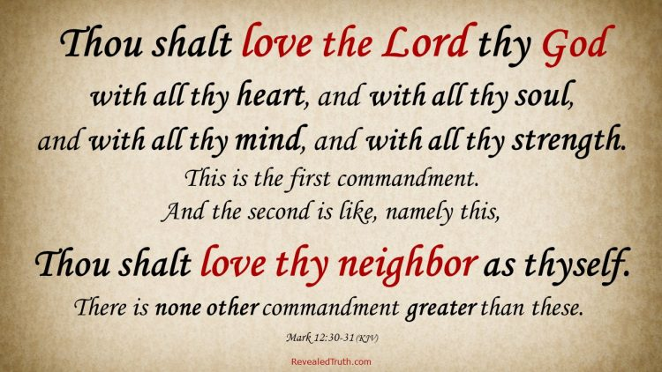
⁸ Finally, all of you, have
unity of mind,
sympathy,
brotherly love
Notes:
Christians taking care of the sick not only have sympathy and compassion, they also have brotherly love.
Being in the center of the list, some say this is the most important, but I think they all work together.
This is clearly a reference to the second part of the great commandment.
(CLICK) Found in Matthew and Mark, the great commandment says you shall love the Lord your God with all your heart, soul, mind, and strength,
And you shall love your neighbor as yourself.
When you love your neighbor as yourself, this is brotherly love.

Slide 28
⁸ Finally, all of you, have
and a humble mind (attitude)
Notes:
And now we come to the last item on our list. To have a humble mind or attitude.

Slide 29
1 Peter 3:8
Philippians 2:2-4
⁸ Finally, all of you, have
unity of mind,
brotherly love
a humble mind (attitude).
sympathy,
a tender heart (compassion)
² complete my joy by being of the same mind, having the same love, being in full accord and of one mind.
³ Do nothing from selfish ambition or conceit, but in humility count others more significant than yourselves.
⁴ Let each of you look not only to his own interests, but also to the interests of others.
Notes:
If you look at Philippians chapter 2 verse 3, you see a similar exhortation from Paul. Paul uses a lot more words, so I will let Paul define what it means to have a humble mind or attitude.
To have a humble mind or attitude means to do nothing from selfish ambition or conceit but in humility count others more significant than yourselves.
(CLICK) Looking at the rest of Paul’s exhortation, it begins with, “complete my joy by being of the same mind, having the same love, being in full accord and of one mind.” This encompasses Peter’s unity of mind and brotherly love.
(CLICK) Paul completes his encouragement with sympathy and compassion, stating, “Let each of you look not only to his own interests, but also to the interests of others.”
We have now looked at these 5 traits or attitudes in detail, we saw they are addressed to all believers, and that they can apply to any relationship. So when we follow the exhortations of either Peter or Paul,

Slide 30
1 Peter 3:8
Philippians 2:2-4
⁸ Finally, all of you, have
unity of mind,
brotherly love
a humble mind (attitude).
sympathy,
a tender heart (compassion)
² complete my joy by being of the same mind, having the same love, being in full accord and of one mind.
³ Do nothing from selfish ambition or conceit, but in humility count others more significant than yourselves.
⁴ Let each of you look not only to his own interests, but also to the interests of others.
Live in Harmony
With One Another
Notes:
We see that we can live in harmony with one another.
These five traits or values don’t just allow us to live in submission to one another; they also allow us to

Slide 31
1 Peter 3:9
⁹ Do not repay evil for evil or reviling for reviling, but on the contrary, bless, for to this you were called, that you may obtain a blessing.
Return good for evil, and you will inherit a blessing from God
Notes:
Return good for evil so that you will inherit a blessing from God.
In other words, verbally blessing unfriendly people allows God to reward believers.
Verse 9 reads, “do not repay evil for evil or reviling for reviling, but on the contrary, bless, for to this you were called, that you may obtain a blessing.”
Who are the unfriendly people causing evil? Some say that since vs. eight addresses relationships in the church, then vs. nine addresses relationships outside the church.
But there can be unfriendly people who are believers. Often, they are family members or work associates.
So regardless of the relationship or whether or not they are believers, the appeal to return evil with blessings always applies.

Slide 32
Following in Christ’s Example
1 Peter 2:21-23
1 Peter 3:9
²¹ For to this you have been called, because Christ also suffered for you, leaving you an example, so that you might follow in his steps. ²² He committed no sin, neither was deceit found in his mouth. ²³ When he was reviled, he did not revile in return; when he suffered, he did not threaten,
⁹ Do not repay evil for evil or reviling for reviling, but on the contrary, bless, for to this you were called, that you may obtain a blessing.
Notes:
Taking a closer look, we can see that 9 refers back to verses 21 to 23 from Chapter 2.
When Peter tells us to not repay evil for evil or reviling for reviling, he is telling us to follow Christ’s example.
Because Christ, “when he was reviled, he did not revile in return; when he suffered, he did not threaten.”
Therefore, when we experience unfriendly people, we need to be Christ-like and not repay evil for evil or reviling for reviling.

Slide 33
Following in Christ’s Example
1 Peter 2:21-23
1 Peter 3:9
²¹ For to this you have been called, because Christ also suffered for you, leaving you an example, so that you might follow in his steps. ²² He committed no sin, neither was deceit found in his mouth. ²³ When he was reviled, he did not revile in return; when he suffered, he did not threaten,
⁹ Do not repay evil for evil or reviling for reviling, but on the contrary, bless, for to this you were called, that you may obtain a blessing.
Notes:
Looking again back in ch 2 vs. 21, Peter tells us that we are called to suffer.
Being called to suffer may not be a popular message, but it’s true.
Peter is speaking truth when he says for to this you have been called, because Christ also suffered for you, leaving you as an example, so that you might follow in his steps.
Paul is speaking the truth when he says in Phil 1:29 For it has been granted to you that for the sake of Christ you should not only believe in him but also suffer for his sake
Paul also speaks the truth 2 Tim 3:12, “all who desire to live a godly life in Christ Jesus will be persecuted.”

Slide 34
Following in Christ’s Example
1 Peter 2:21-23
1 Peter 3:9
²¹ For to this you have been called, because Christ also suffered for you, leaving you an example, so that you might follow in his steps. ²² He committed no sin, neither was deceit found in his mouth. ²³ When he was reviled, he did not revile in return; when he suffered, he did not threaten,
⁹ Do not repay evil for evil or reviling for reviling, but on the contrary, bless, for to this you were called, that you may obtain a blessing.
Rom 12:14 Bless those who persecute you; bless and do not curse them.
Notes:
Now Peter clarifies that we are not just called to suffer, we are also called to obtain blessing!
See the similar wording between ch 2 and ch 3.
For to this you have been called to suffer.
For to this you were called to obtain blessing
But we can only receive this blessing if we bless evil, unfriendly people.
(CLICK) Fortunately, we have encouragement from Paul, who writes in Romans 12:14: Bless those who persecute you; bless and do not curse them.
By doing this, by returning good for evil, and you will inherit a blessing from God.

Slide 35
Finally,
all of you, have
unity of mind,
sympathy,
brotherly love,
a tender heart, and
a humble mind.
Do not repay evil for evil or reviling for reviling,
but on the contrary, bless,
for to this you were called,
that you may obtain a blessing.
Live in Harmony
With One Another
Return good for evil, and you will inherit a blessing from God
Notes:
So the motivation for returning good for evil is to inherit a blessing.
(CLICK) But this would not be possible unless you can live in harmony with one another and you have traits such as
unity of mind,
sympathy,
brotherly love,
compassion, and
a humble attitude
If we were to diagram these two verses, we see that a two part intro, finally showing this is a concluding statement, and all of you, indicating this is for all the believers.
This is followed by the five characteristics or traits that allow believers to repay good for evil.
This command is followed by the motivation, which is to receive God’s blessing.
So now you can see how these two verses come together to form one thought, one idea, and that is

Slide 36
Live in Harmony
With One Another
Submission in all relationships pleases God!
Return good for evil, and you will inherit a blessing from God
Notes:
That submission in all relationships pleases God.
Now, the idea that you receive blessings when you please God is not groundbreaking or earth-shattering.
In fact, it is found in the Old Testament. Peter’s next three verses are simply a quote from Psalm 34, verses 12 to 16.
Peter uses the Psalm to justify his claim that you receive blessings by pleasing God.

Slide 37
1 Peter 3:10-12
For
“Whoever desires to love life and see good days,
let him keep his tongue from evil and his lips from speaking deceit; let him turn away from evil and do good; let him seek peace and pursue it.
For the eyes of the Lord are on the righteous, and his ears are open to their prayer. But the face of the Lord is against those who do evil.”
Notes:
The quote starts with the premise that one desires to love life and see good days.
This is actually good. Although not quoted, you can look at vs. 11 of Psalm 34, where the psalmist writes:
Come, O children, listen to me; I will teach you the fear of the Lord.
This is followed by vs. 12, which Peter then quotes, “Whoever desires to love life and see good days.”
The psalmist equates the desire to love life and see good days with fear of the Lord.
(CLICK) The psalmist then gives three commands to obey for the person who desires to follow God. The commands are to
be careful what you say,
let him turn away from evil and do good; let him seek peace and pursue it.
(CLICK) But The commands are followed by the carrot and the stick, the rewards and punishment
The rewards are the blessings. God is watching us, He is listening to our prayers. That is why Peter can motivate us to repay good for evil.

Slide 38
Broken Relationships
Notes:
As members of the church, we are called to be unified in certain beliefs and behaviors.
Today we read about the importance God places on relationships.
We saw that submission in all relationships pleases God.
We also saw that traits such as being like-minded, showing sympathy and compassion, having brotherly love, and displaying a humble attitude are essential for successful relationships.
But we don’t always demonstrate these traits.
Do you have any broken relationships that need to be mended? Are there people with whom you find it hard to express sympathy or be humble?
Peter writes that unbelievers can be won by our conduct without words. Does your conduct demonstrate love, sympathy, compassion, or a brotherly love? If not, pray for the power of the Holy Spirit
What about your relationship with God? Do you know that you can have an inheritance that is imperishable, undefiled, and unfading, kept in heaven for you?
All you need to do is submit to God. John the Baptist and Jesus preached, repent and turn to God for the kingdom of heaven is near.
Peter preached Now repent of your sins and turn to God, so that your sins may be wiped away.
Paul had a similar message, saying that all must repent of their sins and turn to God—and prove they have changed by the good things they do.
To be saved from the power and eternal penalty of sin, you must admit that you are a sinner, repent and believe that Jesus died and rose again, and receive the Lord Jesus Christ personally as the only Savior.
When you do that, you will receive and becomes a true born-again Christian. Salvation is not a reward for good works but a free gift of God received by faith in Jesus Christ.

