Slide 1
1 Peter
The Sojourner’s Life
Living effectively for the Lord in an unbelieving world

Slide 2
1 Peter 3:1-7 “WON BY OUR CONDUCT”

Slide 3
RECALL…
In 1 Peter 2:13-25, Peter addressed practical concerns of how to live as Christian sojourners in the midst of a hostile world.
He instructed the believers to submit to authorities, ‘for the Lord’s sake’ vs 13.
Likewise, we can be subject as slaves to unjust masters, following in the example and redemption of Jesus for us in going to the cross (vs 18-25).
A truly subversive act!

Slide 4
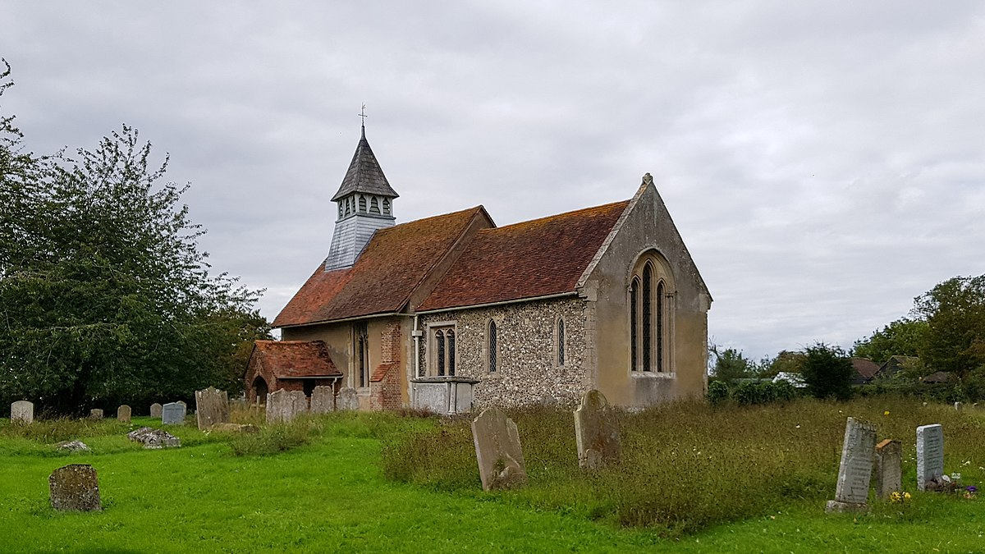
Marriage as GOD intended
Marriage is a picture of Christ and the church (Ephesians 5:25-27)
The Puritans called marriage ‘the little church within the Church.’

Slide 5
1 Peter 3:1-6
Vs 1 – ‘Likewise’ links to previous section.
Peter addresses wives who have unbelieving husbands (‘who do not obey the word.’).
“….they may be won without a word…when they see your respectful and pure conduct” (vs 1-2) – there needs to be evangelical effect in our action that speaks louder than words.

Slide 6
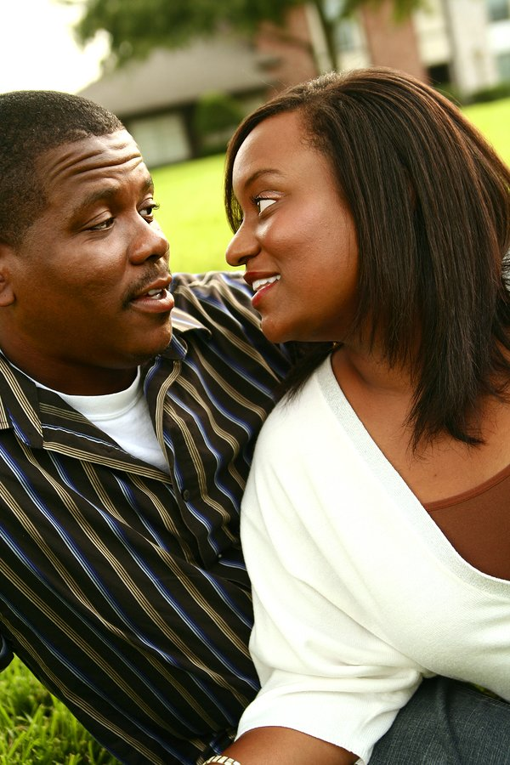
1 Peter 3:1-6
Question: What does it mean to ‘be subject’?
What it doesn’t mean:
A) Be a ‘doormat’ to your husband. Instead, obey Jesus first.
B) You are inferior or of less worth. Instead you are ‘joint-heirs’ – vs 7.
It DOES mean a deference to the headship of the husband in the marriage, and a willingness to follow and submit to his leading, as to Christ. (Ephesians 5:22-23; Colossians 3:18; 1 Corinthians 11:3, 8-9).

Slide 7
1 Peter 3:1-6
Vs 3-4 – Women are to adorn themselves with ‘inner beauty’.
A) Our heart more important to God than our outward appearance (1 Samuel 16:7).

Slide 9
1 Peter 3:1-6
Vs 3-4 – Women are to adorn themselves with ‘inner beauty’.
A) Our hearts are more important to God than our outward appearance (1 Samuel 16:7).
B) The source of true beauty for a woman is in having ‘a gentle and quiet spirit’ (vs 4) – very precious to God.
Vs 5-6 – Holy women of past adorned themselves – by ‘submitting to their own husbands’ – e.g. of Sarah obeying Abraham.

Slide 10
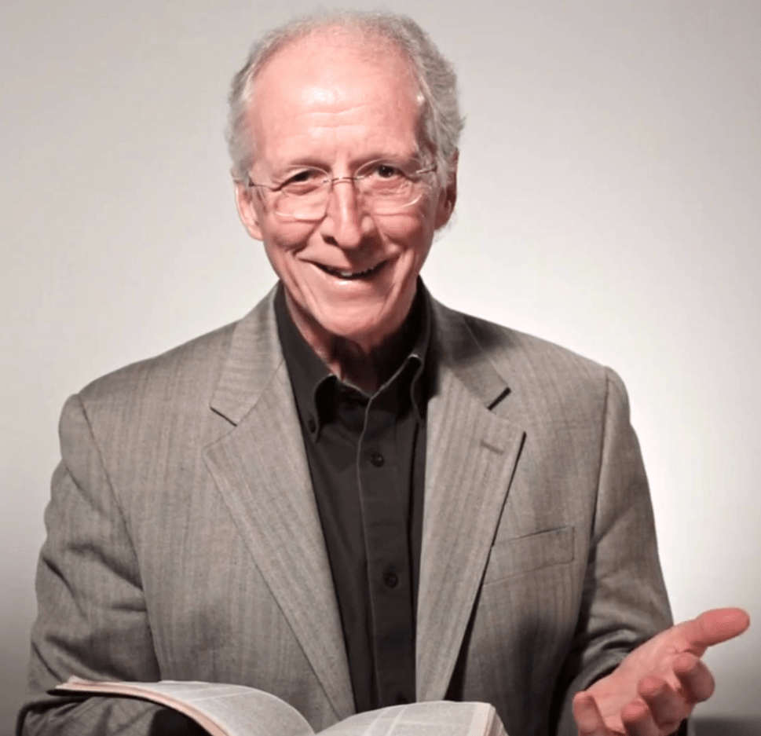
John Piper
The deepest root of Christian womanhood mentioned in this text is hope in God. “Holy women who hoped in God.” A Christian woman does not put her hope in her husband, or in getting a husband. She does not put her hope in her looks. She puts her hope in the promises of God.
https://www.desiringgod.org/messages/the-beautiful-faith-of-fearless-submission

Slide 11
1 Peter 3:1-6
Vs 3-4 – Women are to adorn themselves with ‘inner beauty’.
A) Our hearts are more important to God than our outward appearance (1 Samuel 16:7).
B) The source of true beauty for a woman is in having ‘a gentle and quiet spirit’ (vs 4) – very precious to God.
Vs 5-6 – Holy women of past adorned themselves – by ‘submitting to their own husbands’ – e.g. of Sarah obeying Abraham.
Therefore, as children of Sarah, wives are called to 'do good' and 'not to fear anything.’

Slide 12
1 Peter 3:7
Vs 7 – Husbands to live with understanding towards their wives, honouring them as the ‘weaker vessel’.
Note: ‘Weaker’ here is the Greek word ‘asthenēs’ – referring to physical weakness.
Wives are ‘heirs with (their husbands) of the grace of life.’
Our prayers will be hindered if we don’t treat our wives right.

Slide 13
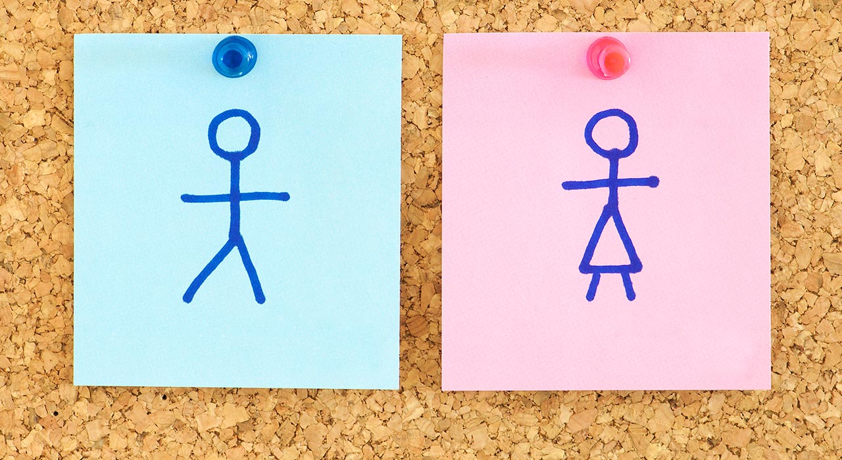
A Complementarian View of Marriage Equal Worth But Differing Roles.
1 Peter 3:1-7 shows that the apostolic pattern of thought in Scripture did not feel any tension between a call for wives to submit to their husbands (verse 1) and a clear declaration that husbands and wives are joint heirs of the grace of life (verse 7)…..Submission in role and equality in dignity and importance stand side-by-side in apostolic thought.
Wayne Gruden, “Wives like Sarah, and the Husbands Who Honor Them 1 Peter 3:1-7” in Recovering Biblical Manhood and Womanhood - A Response to Evangelical Feminism. John Piper and Wayne Grudem (eds), Crossway Books, 1991, page 19.

Slide 14
1 Peter 3:1-7- ‘Won By Our Conduct’
APPLICATION:
What kind of husband or wife am I called to be, in the light of God’s word today?

