Slide 1
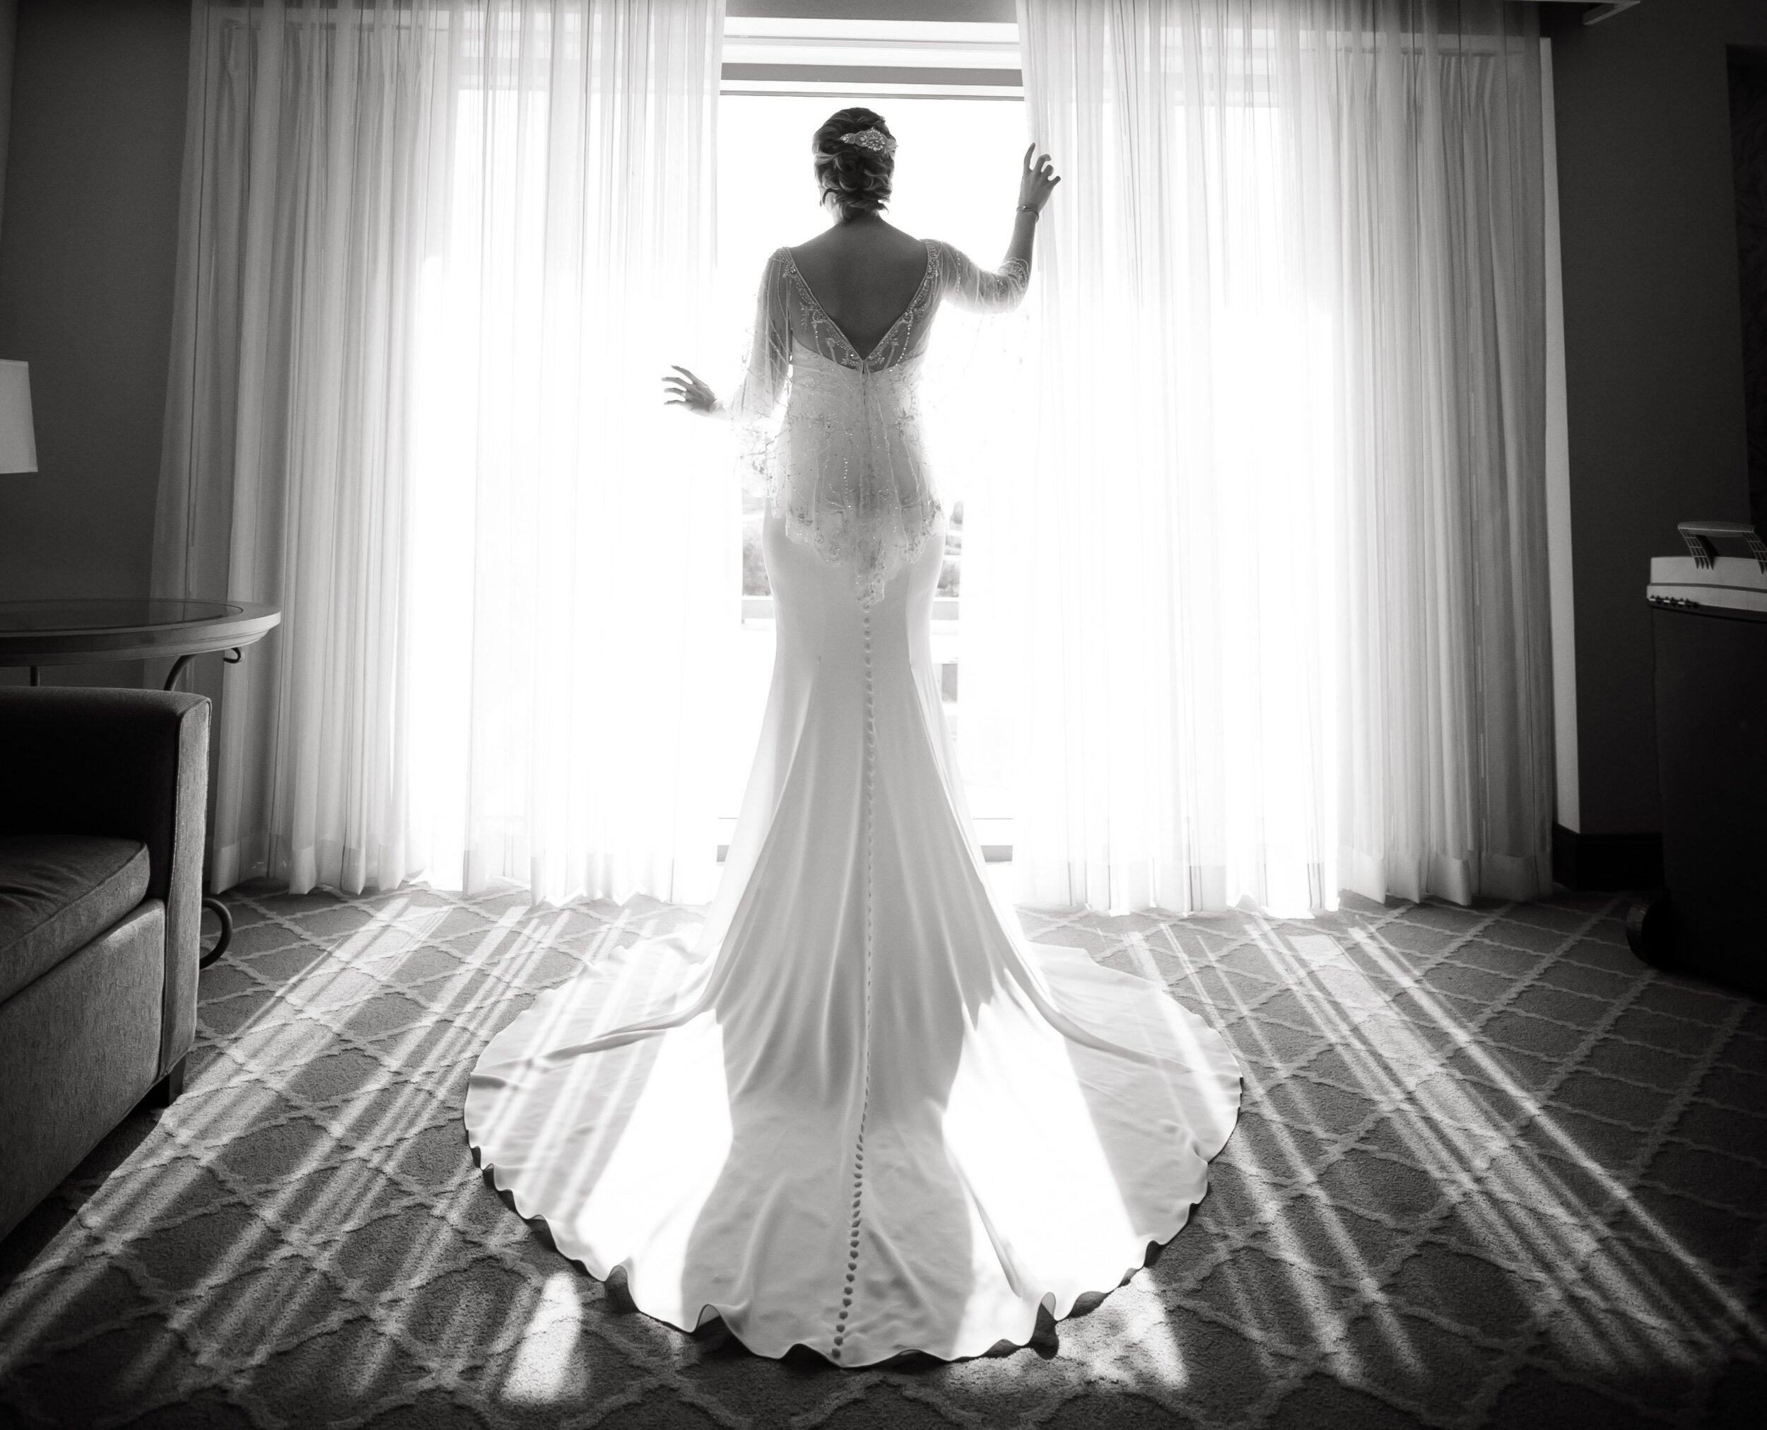
The Precious
Bride

Slide 2
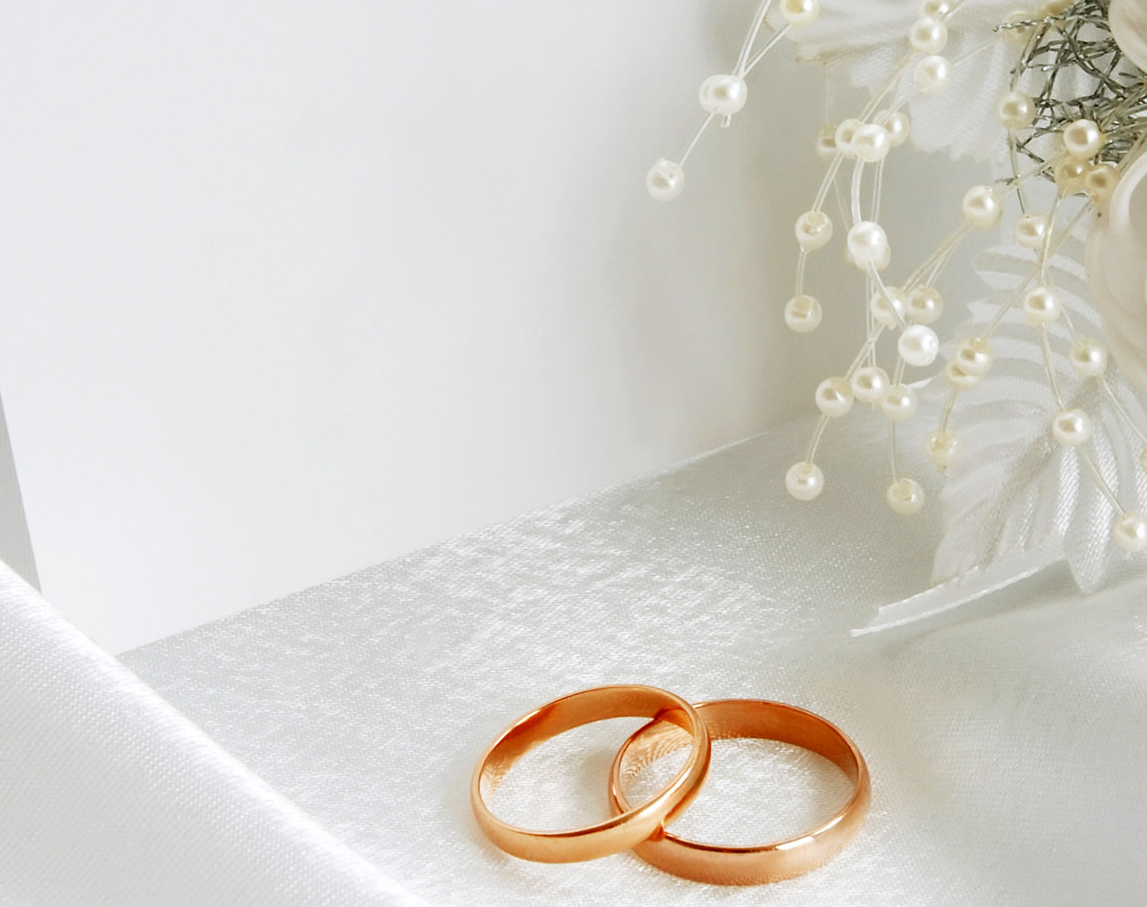
saves her
loves her
gives himself up for her
nourishes her
cherishes her
secures her
The Bride is precious to Christ

Slide 3
Revelation 19:6-9
6 Then I heard what seemed to be the voice of a great multitude, like the roar of many waters and like the sound of mighty peals of thunder, crying out,
“Hallelujah! For the Lord our God the Almighty reigns. 7 Let us rejoice and exult and give him the glory, for the marriage of the Lamb has come, and his Bride has made herself ready; 8 it was granted her to clothe herself with fine linen, bright and pure”—
for the fine linen is the righteous deeds of the saints.
9 And the angel said to me, “Write this: Blessed are those who are invited to the marriage supper of the Lamb.” And he said to me, “These are the true words of God.”

Slide 4
The Bride is prepared by Christ

Slide 5
Gifts to build
The Bride is responsible before Christ
Leaders to guide

Slide 6
2 Corinthians 11:1-3
1 I wish you would bear with me in a little foolishness. Do bear with me! 2 For I feel a divine jealousy for you, since I betrothed you to one husband, to present you as a pure virgin to Christ. 3 But I am afraid that as the serpent deceived Eve by his cunning, your thoughts will be led astray from a sincere and pure devotion to Christ.

Slide 7
Gifts to build
The Bride is responsible before Christ
Leaders to guide
Charges to fulfil
1 Peter 1:15 – holiness
Colossians 3:12-14 – love
Ephesians 4:25 – truthfulness

