Slide 1
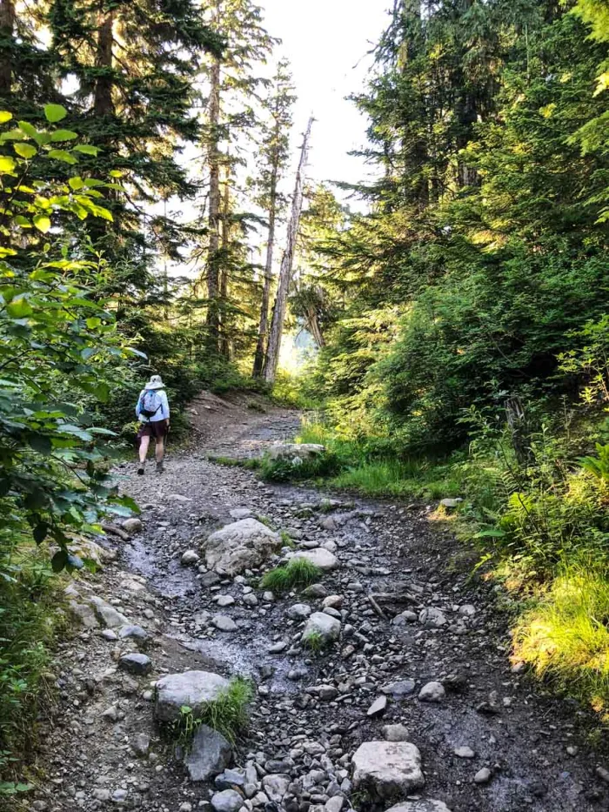
1 Peter
The Sojourner’s Life
Living effectively for the Lord in an unbelieving world

Slide 2
Grow Into a People of God
1 Peter 2:1-10

Slide 3
Being nourished by the Lord through the word (vs. 1-3)

Slide 4
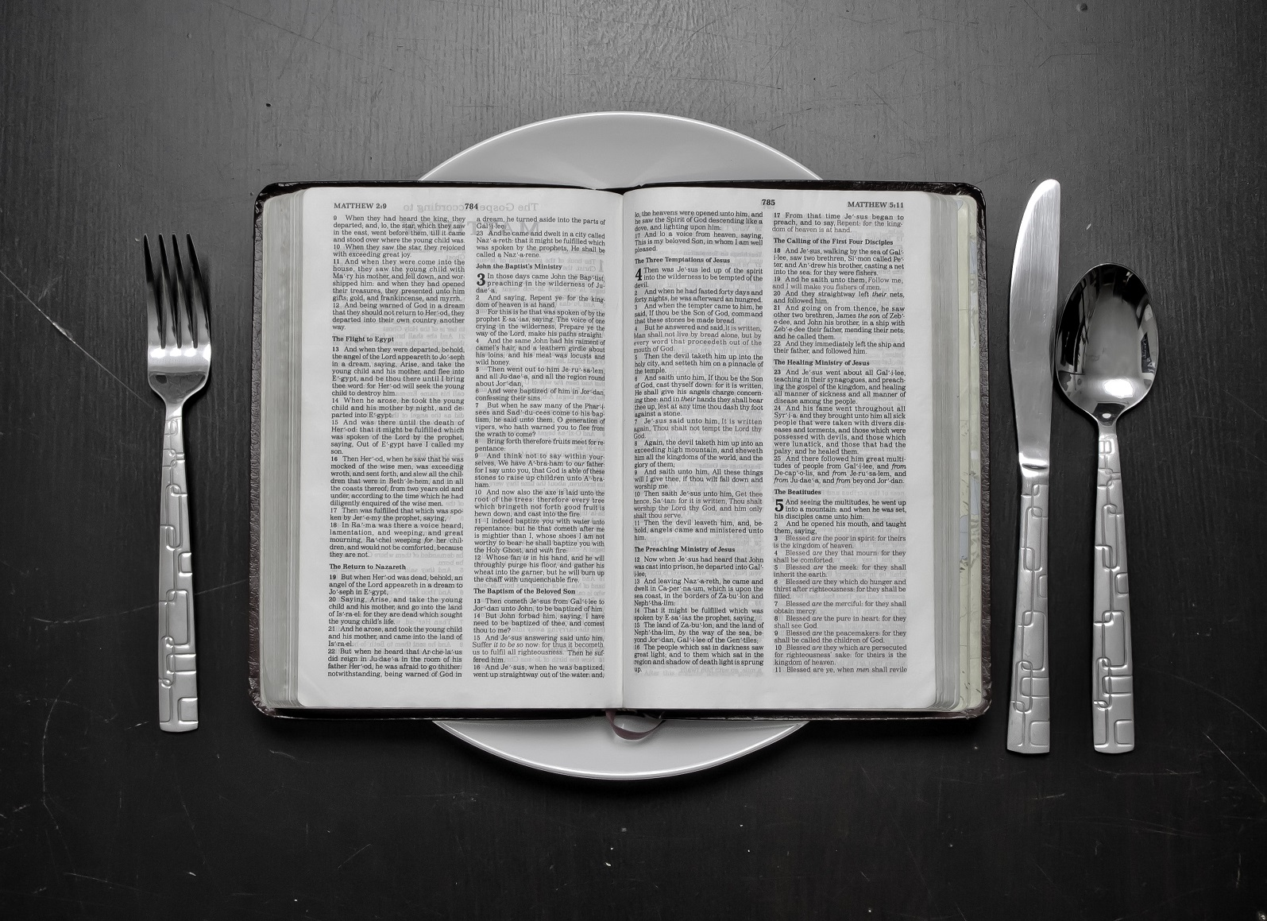
Have strong desires for healthy food - God’s word

Slide 5
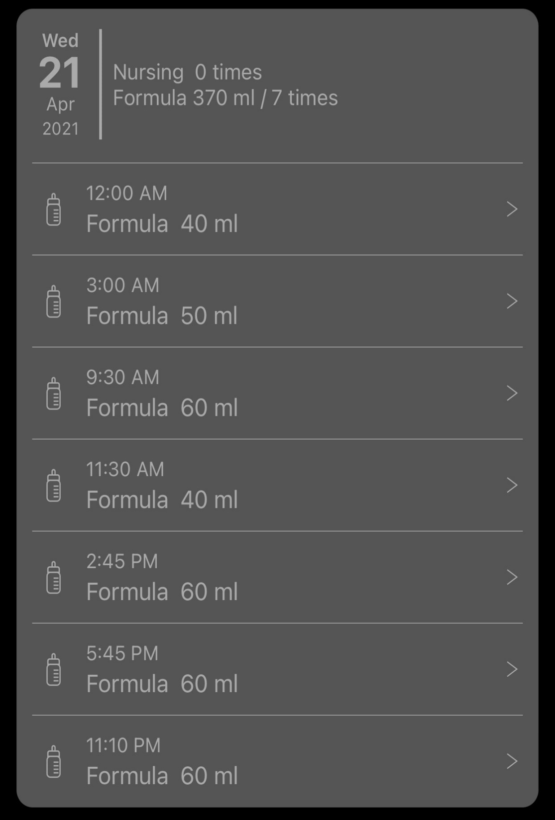
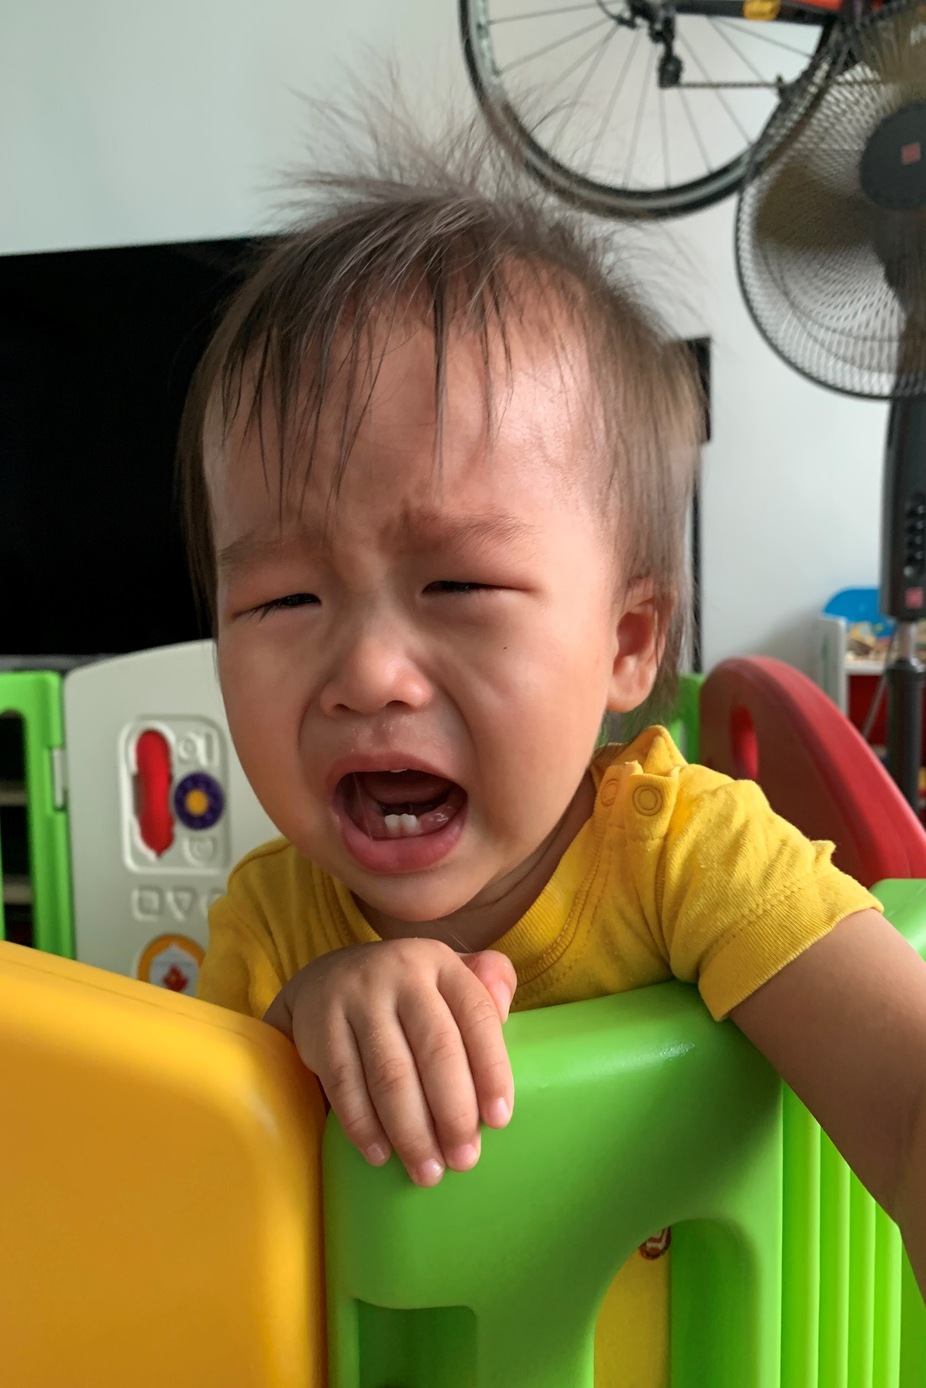

Slide 6
Reject all unhealthy foods

Slide 7
Malice | Desiring harm on others
Deceit | Cheating others for personal gain
Hypocrisy | Being insincere and pretend
Envy | Jealousy over another's good
Slander | Speaking bad about people

Slide 8
Stick to the diet

Slide 9
Abiding in Christ as the new temple (vs. 4-8)

Slide 10
Old Temple system | New Temple system
Centered around a physical temple | Centered around Jesus
Only select priest can come before God | All Christians can come before God
Animal sacrifices | Spiritual sacrifices
Led by Moses | Led by Jesus - a new exodus
Build with dead stones | Build with living stones

Slide 11
Romans 12:1-2
“I appeal to you therefore, brothers, by the mercies of God, to present your bodies as a living sacrifice, holy and acceptable to God, which is your spiritual worship. Do not be conformed to this world, but be transformed by the renewal of your mind, that by testing you may discern what is the will of God, what is good and acceptable and perfect.”

Slide 12
Ephesians 2:19-22
“So then you are no longer strangers and aliens, but you are fellow citizens with the saints and members of the household of God, built on the foundation of the apostles and prophets, Christ Jesus himself being the cornerstone, in whom the whole structure, being joined together, grows into a holy temple in the Lord. In him you also are being built together into a dwelling place for God by the Spirit.”

Slide 13
Proclaiming the excellencies of God (vs. 9-10)

Slide 14
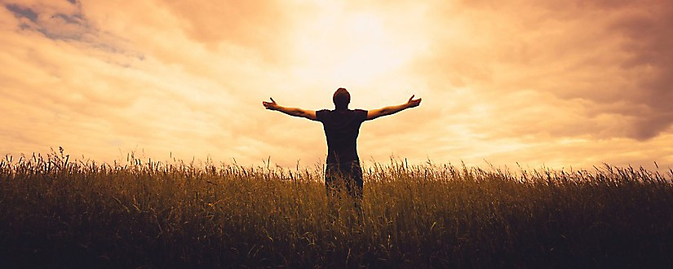
Just like Israel was supposed to be a nation distinct to draw people to God,
we are to do the same.
Just like the old temple was supposed to represent God to the people,
we are to do the same.
Just like how Israel was chosen by God not because they were strong but because they were small, God chose us.

Slide 15
“The Christians of Asia Minor are encouraged to think along the lines of a reframed identity… Christians, who have been purified by the sprinkling of the blood of Christ, now offer God new obedience and spiritual worship… Peter presents us with a timely question: “Whose guiding narrative, whose grand story do we embody?” Recent studies in neurobiology confirm that as humans we are concerned about making storied sense of our lives. Peter points us toward the ultimate story of our liberation in Christ.”
Bryan D. Estelle, Echoes of Exodus

Slide 16
How do we grow into a people of God?
Being nourished by the Lord through the word (vs. 1-3)
Abiding in Christ as the new temple (vs. 4-8)
Proclaiming the excellencies of God (vs. 9-10)

