Slide 1
1 Peter
The Sojourner’s Life
Living effectively for the Lord in an unbelieving world

Slide 2
“So Christians are to live in this world as in a place to which they do not belong, and where they do not expect for ever to stay."
Alan Stibbs

Slide 3
Develop Habits of Holiness
1 Peter 1:13-25

Slide 4
Think like a sojourner (vs. 13-16)

Slide 5
Be disciplined of mind
King James Version
"gird up the loins of your mind"

Slide 6
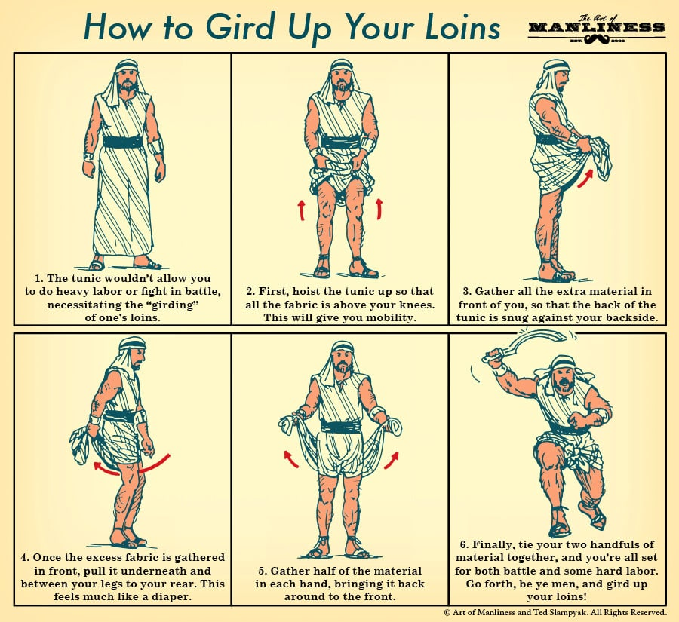

Slide 7
Be disciplined of mind
“A girded mind is one that is strong, composed, cool and ready for action. It is unimpeded by the distraction of human fear or persecution."
William MacDonald

Slide 8
Be disciplined of mind
Resist conforming to sinful patterns of the past
Conform to God’s pattern of holiness
2 Corinthians 7:1
"Since we have these promises, beloved, let us cleanse ourselves from every defilement of body and spirit, bringing holiness to completion in the fear of God."

Slide 9
Be disciplined of mind
Resist conforming to sinful patterns of the past
Conform to God’s pattern of holiness
Hebrews 12:14
"Strive for peace with everyone, and for the holiness without which no one will see the Lord."

Slide 10
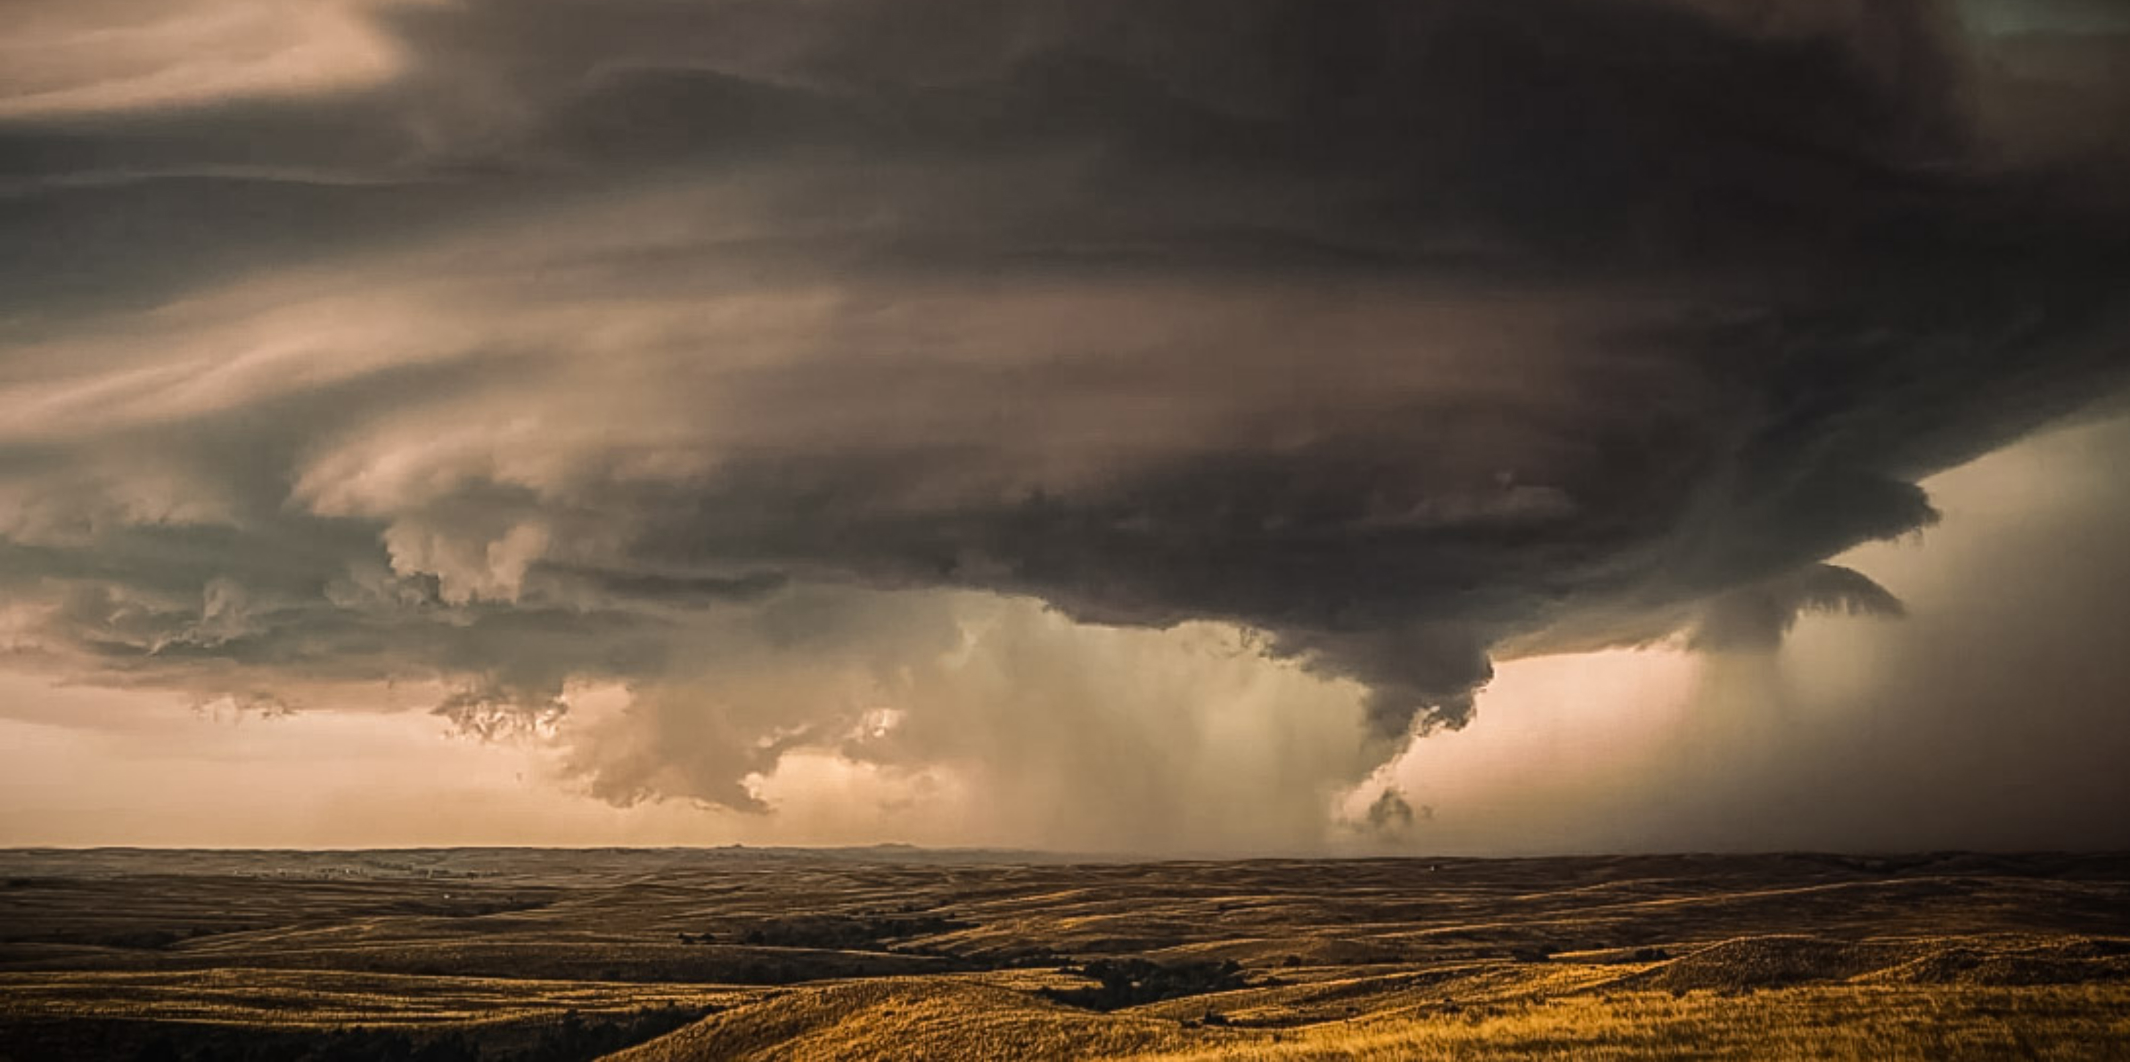
Recognize God judges impartially
Recall God has shown you great mercy
Live in fear of the Lord (vs. 17-21)

Slide 11
Learn to love one another
(vs. 23-25)

Slide 12
Let love be sincere, earnest, and pure

Slide 13
Let love be sincere, earnest, and pure
Let love be based on our unity of salvation

