Slide 1
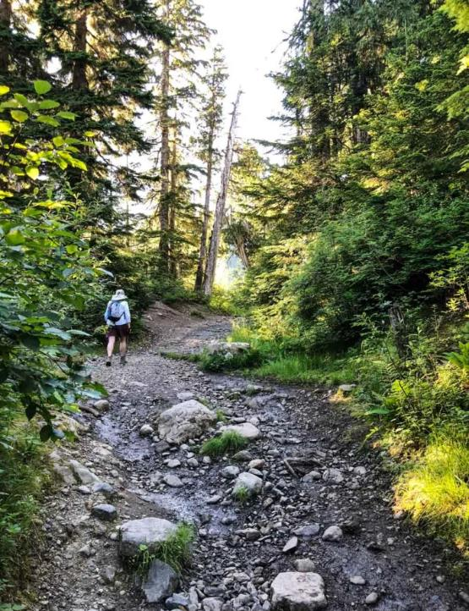
1 Peter
The Sojourner’s Life
Living effectively for the Lord in an unbelieving world

Slide 2
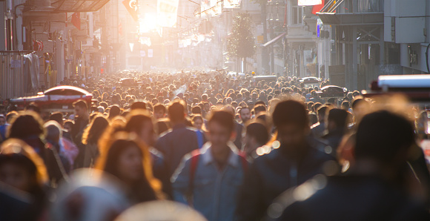
John 18:36
Jesus answered, “My kingdom is not of this world. If my kingdom were of this world, my servants would have been fighting, that I might not be delivered over to the Jews. But my kingdom is not from the world.”
2 Corinthians 4:4
In their case the god of this world has blinded the minds of the unbelievers, to keep them from seeing the light of the gospel of the glory of Christ, who is the image of God.

Slide 3
John 16:33
“I have said these things to you, that in me you may have peace. In the world you will have tribulation. But take heart; I have overcome the world.”
John 15:18-19
¹⁸ “If the world hates you, know that it has hated me before it hated you. ¹⁹ If you were of the world, the world would love you as its own; but because you are not of the world, but I chose you out of the world, therefore the world hates you.”

Slide 4
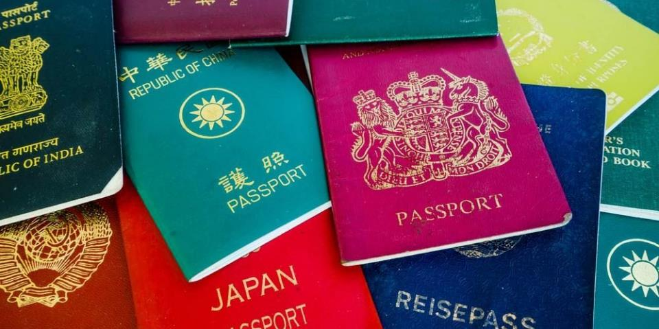
Be Grounded in Your Salvation
1 Peter 1:1-12

Slide 5
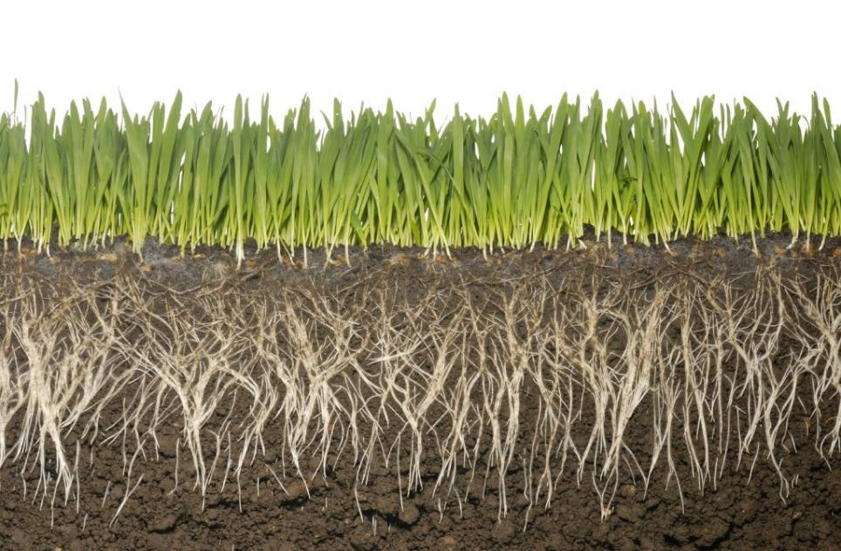
Recognize your identity is in Christ and not the world (1:1-2)​
You are planned by God

Slide 6
Acts 13:48
And when the Gentiles heard this, they began rejoicing and glorifying the word of the Lord, and as many as were appointed to eternal life believed.
Romans 11:2​
God has not rejected his people whom he foreknew. Do you not know what the Scripture says of Elijah, how he appeals to God against Israel?​

Slide 7
Recognize your identity is in Christ and not the world (1:1-2)​
You are planned by God
You are set apart from the world
You live by different standards than the world

Slide 8
“Those who understand themselves as God’s elect have the ammunition to resist the norms and culture of the society they inhabit. Divine election reminds the readers that they have status, not because they are so worthy or noble but because God has bestowed his grace upon them. Hence, they have the energy to counter accepted cultural norms and to live in accord with God’s purpose.”
Thomas Schreiner

Slide 9
Recognize your identity is in Christ and not the world (1:1-2)​
You are planned by God
You are set apart from the world
You live by different standards than the world
You are forgiven by the blood of Christ

Slide 10
Exodus 24:5-8
⁵ And he sent young men of the people of Israel, who offered burnt offerings and sacrificed peace offerings of oxen to the Lord. ⁶ And Moses took half of the blood and put it in basins, and half of the blood he threw against the altar. ⁷ Then he took the Book of the Covenant and read it in the hearing of the people. And they said, “All that the Lord has spoken we will do, and we will be obedient.” ⁸ And Moses took the blood and threw it on the people and said, “Behold the blood of the covenant that the Lord has made with you in accordance with all these words.

Slide 11
Hebrews 9:13-14
¹³ For if the blood of goats and bulls, and the sprinkling of defiled persons with the ashes of a heifer, sanctify for the purification of the flesh, ¹⁴ how much more will the blood of Christ, who through the eternal Spirit offered himself without blemish to God, purify our conscience from dead works to serve the living God.

Slide 12
Recognize your identity is in Christ and not the world (1:1-2)​
Realize God’s ongoing work in your life (1:3-12)
Your future reward is secured
Your current suffering has purpose

Slide 13

“If you have but little love to Christ, you will be apt to faint in the day of adversity, to shrink when you are called to take up His cross and suffer for his sake. Lesser sufferings will discompose you, greater sufferings will frighten and amaze you, and you will be in danger of turning into fearful apostates in time of great trials. There is need of great love to Christ, as well as great faith, to carry you through sufferings with courage, that you may persevere unto the end.”

Slide 14
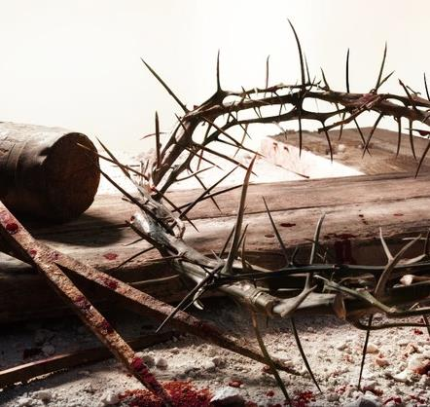
Messiah’s sufferings
(Gen 3:15; Pss 22:1-18; 34:19-20; 69:21; Isa 50:6; 52:14-15; 53:1-12; Zech 12:10; 13:7)
Messiah’s glory
(Pss 2; 16:10; 22:22; 45:7; 110:1, 4; Isa 9:6; 40:3-11; 42:1-4; 61:1-3; Jer 33:14-15; Ezek 34:23; Dan 7:13-14; Mal 3:1-3)

Slide 15
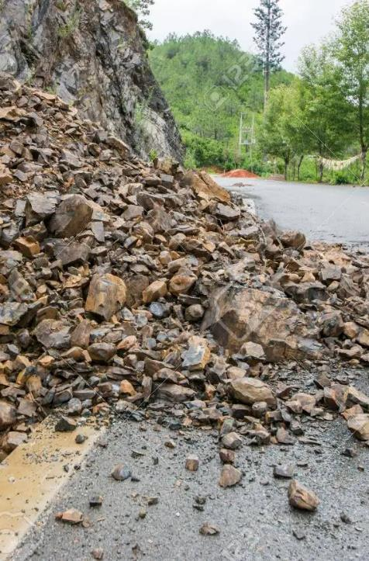
How does our love for Christ affect us?
It balances us when we prosper in life
It buoys us when sinking in despair of afflictions in life
It motivates us to serve him without external obligation
It guards us against temptations of the sinful flesh
It prepares you to suffer for Christ
It comforts us in grief
It surpasses love of others and ministry endeavours
It is a privilege not shared by any other creature

