Slide 1
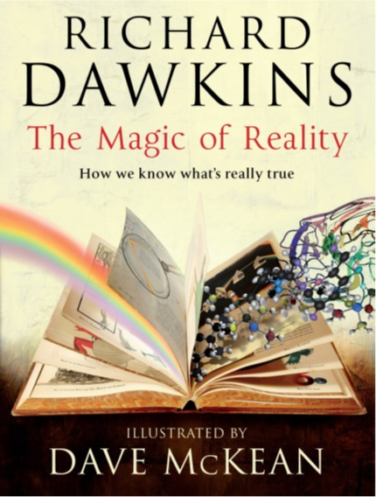
Notes:
Richard Hawkins, a renowned scientist and an avowed atheist, wrote a graphic science book aimed primarily at children and young adults titled the Magic of Reality.
In this book, he explains that supernatural magic is what our ancestors invoked to explain the world before they developed the scientific method.
Each chapter usually begins by showing how a myth from some ancient civilization attempts to explain something that we know today can be defined scientifically.
In addition to looking at these many different myths, in each chapter, he goes to great lengths to make sure he also talks about the Hebrew tribes of the Middle East. For example, he states that they had a single god, whom they regarded as superior to the gods of rival tribes.”
In fact, he goes out of his way to relate the God of the Bible to the many fictitious beliefs that have existed throughout time.

Slide 2
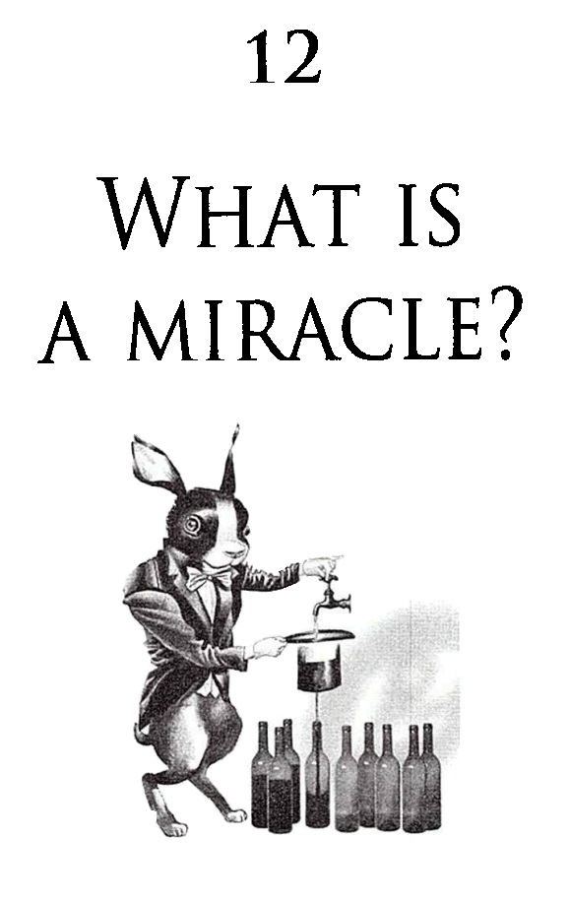
Notes:
Dawkins’ attack on the God of the Bible culminates in his final chapter titled “What is a Miracle?”
He claims to scientifically look at various miracles and uses this formula to see what is most plausible
The story was fabricated; it was made up (he also gives a few examples of hoaxes)
Something happened that can be explained scientifically but was misunderstood by those who saw it.
Or it really happened but uses outrageous claims, such as “the sun really did move about the sky and come crashing down towards the horrified crowd.” The language he uses is clearly designed to discredit the miracle.
He concludes that the stories in the Bible are pure fiction. He emphasizes this over and over. And all this is in a “science” book.
You know what?
His repeated attacks show this is a NOT book about science.
You know what else?
He is wrong! Miracles do exist.

Slide 3
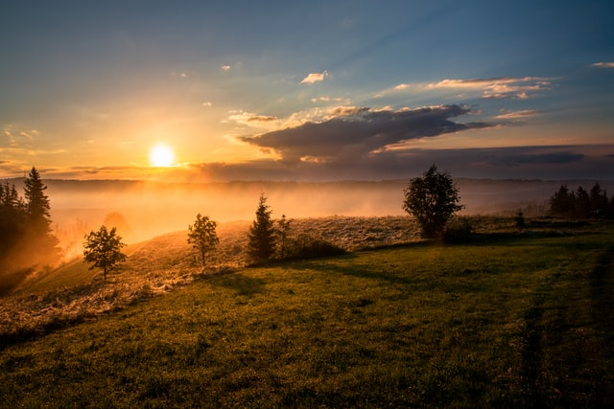
The Reason for Miracles
1 Kings 17
Notes:
That is our topic today. Our goal is to answer the question, “Why do miracles happen?”
Our text will be 1st Kings Chapter 17. In our text, we will see a series of miracles. The miracles themselves are fantastic. But more impressive is how God uses them for his purposes.
1st Kings 17 introduces a new prophet for the nation of Israel. His name is Elijah, and he delivers a prophecy to king Ahab. Elijah then wanders off into the wilderness and experiences a miracle. Eventually, God directs Elijah to a town on the Mediterranean seacoast, where more miracles follow.

Slide 4

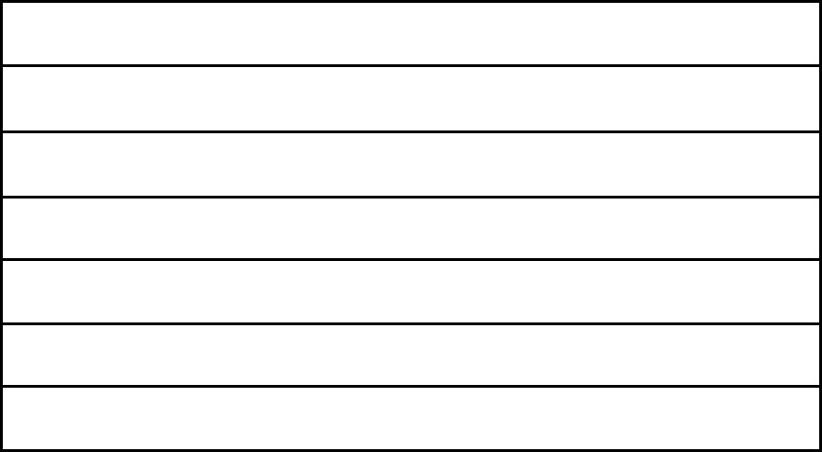
7 Great Periods of History
PERIOD
YEARS
SCRIPTURE
2000+
GEN 1 - 11
NATIONS
ISRAEL
2000
GEN 12 - MAL 4
SILENT YEARS
400
NONE
CHRIST ON EARTH
About 33
MATT 1 - ACTS 1
CHURCH ON EARTH
~ 1990 + ??
ACTS 2 - REV 3
TRIBULATION
7
REV 4 - 19
CHRIST'S KINGDOM
1000
REV 20–22
Terry Hall, Bible Panorama, 157
Notes:
To understand why Elijah delivers his prophecy to King Ahab, we need to ground ourselves in history.
Terry Hall shows us that the entire history of the world can be divided into 7 great periods and that these seven periods are explained in the Bible.
The first period is covered by Genesis chapters 1 through 11. Terry Hall calls that period “Nations.”
The second period of history is called “Israel.” It is covered from Genesis chapter 12 through the rest of the Old Testament. Our story today is found in the Israel period.

Slide 5
7 Great Periods of History
PERIOD
YEARS
SCRIPTURE
2000+
GEN 1 - 11
NATIONS
ISRAEL
2000
GEN 12 - MAL 4
SILENT YEARS
400
NONE
CHRIST ON EARTH
About 33
MATT 1 - ACTS 1
CHURCH ON EARTH
~ 1990 + ??
ACTS 2 - REV 3
TRIBULATION
7
REV 4 - 19
CHRIST'S KINGDOM
1000
REV 20–22
Terry Hall, Bible Panorama, 157
Notes:
We know there is a gap between the Old and New Testaments of about 400 years. These are called the silent years.

Slide 6
7 Great Periods of History
PERIOD
YEARS
SCRIPTURE
2000+
GEN 1 - 11
NATIONS
ISRAEL
2000
GEN 12 - MAL 4
SILENT YEARS
400
NONE
CHRIST ON EARTH
About 33
MATT 1 - ACTS 1
CHURCH ON EARTH
~ 1990 + ??
ACTS 2 - REV 3
TRIBULATION
7
REV 4 - 19
CHRIST'S KINGDOM
1000
REV 20–22
Terry Hall, Bible Panorama, 157
Notes:
We are currently living in the period called the “Church on Earth.” This is covered by Acts chapter 2 through Revelation chapter 3.
But again, today we will take a closer look at the great period of History about Israel.

Slide 7
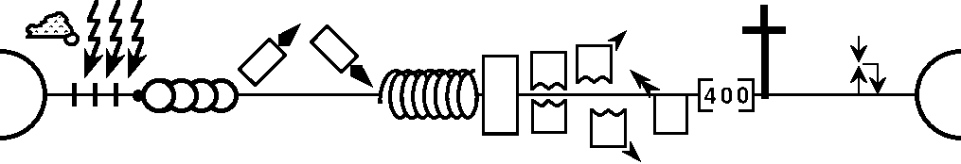

-------------------------------------------- 1 & 2 Chronicles -------------------------------------------------------
Deuteronomy
Gospels –
Acts 1
Genesis
12-50
1 Samuel
Acts 2 –
Rev 3
Leviticus
2 Samuel
Nehemiah
Numbers
Rev 4-19
Exodus
Joshua
Judges
1 Kings
2 Kings
Rev 20-22
Genesis 1-11
Ruth
Ezra
Esther
NATIONS
ISRAEL
P • G • H • R
Eternity
Flood
S • D • S
2nd Coming
Fall
Babel
1st Coming
Eternity
J (R) & I (J)
Abraham
Isaac
Joseph
Creation
Jacob
Joshua
J (B) & I (A)
Moses
Cycles
Z • E • N
1000
1990+
400
Exodus
Beginnings
Conquests
Patriarchs
Kingdom
Judges
Silent Years
Church
United Kingdom
Divided Kingdom
Restoration
Captivity
Max Anders, Dallas Theological Seminary
Notes:
Max Anders uses a diagram a little more complex than the 7 great periods of history.
This diagram was beneficial for me in understanding the Old Testament.
When I read a story or passage, I see how it fits by looking at this diagram.
The handout for today explains the symbols and acronyms on the diagram. Above the diagram, I also added a timeline showing the historical books of the Bible.
Our study today is from 1st Kings Chapter 17. It is represented by the split boxes shaded in yellow. The box is split, because the kingdom that was united under Saul, David, and Solomon was divided, hence the term Divided Kingdom. J for Judah was southern Kingdom, and its King was Rehoboam, the son of Solomon, hence the R in parenthesis after the J.
The northern Kingdom is called Israel and its first king was Jeroboam.

Slide 8
United
Saul
David
Solomon
Kings of Israel
Israel
Jeroboam
Nadab
Baasha
Elah
Zimri
Omri
Ahab
Judah
Rehoboam
Abijam
Asa
Notes:
For the first 50 years after the split, there were 7 kings in Israel but only 3 in Judah.
Judah was more stable, like Singapore, with only 3 prime ministers since its independence in 1965.
The Bible tells us quite a bit about Jeroboam, the first King. All you really need to know is that he was an evil King.
He sinned against God and caused Israel to turn away from God.
In fact, he was so bad that the Bible gave a name to his behavior, calling it the “sins of Jeroboam.”
The rest of Israel’s kings were also evil. They were also compared to Jeroboam.

Slide 9




Jeroboam
Nadab
Baasha
Elah
Zimri
Omri
Ahab
Morphine
Oxycodone
Methadone
Fentanyl
Notes:
Just how bad were the Kings of Israel?
We are familiar with comparisons. For example, in medicine and law enforcement, the relative strength of opioid pain killers is compared to morphine.
Oxycodone is 1.5x more potent than morphine. Methadone is 3x stronger than morphine. And fentanyl, 50 to 100x.
The Bible tells us that the four kings following Jeroboam were just as bad or evil as Jeroboam. They were morphine level bad.
But then Omri did more evil than his predecessors. So he would be oxycodone level.
And then we come to Ahab, the son of Omri. He was worse. He would be methadone or fentanyl.

Slide 10
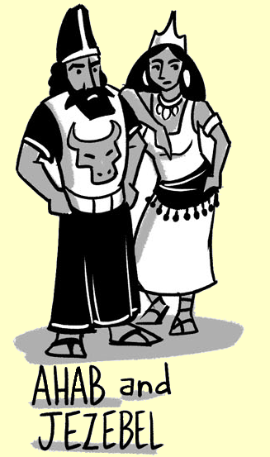
Took Jezebel as wife
Erected an alter for Baal
Made an Asherah pole
Rebuild Jericho
Notes:
Why was Ahab so bad?
Let me just read from 1 Kings 16 vs 30 to 33:
³⁰ Ahab son of Omri did more evil in the eyes of the Lord than any of those before him.
³¹ He not only considered it trivial to commit the sins of Jeroboam son of Nebat, but he also married Jezebel daughter of Ethbaal king of the Sidonians, and began to serve Baal and worship him.
³² He set up an altar for Baal in the temple of Baal that he built in Samaria.
³³ Ahab also made an Asherah pole and did more to arouse the anger of the Lord, the God of Israel, than did all the kings of Israel before him.
So what can you expect when you have 7 bad kings in a row?

Slide 11
¹ Now Elijah the Tishbite, of Tishbe in Gilead, said to Ahab, “As the Lord, the God of Israel, lives, before whom I stand, there shall be neither dew nor rain these years, except by my word.”
1 Kings 17:1
Notes:
What you see in 1 Kings chapter 17, verse 1
The prophet Elijah proclaims God’s judgment on Ahab and Israel.
Because King Ahab did more evil in the eyes of the Lord than any of the kings before him, God kept it from raining in all of Israel.
Starting at verse 1 we read that:
Now Elijah the Tishbite, of Tishbe in Gilead, said to Ahab, “As the Lord, the God of Israel, lives, before whom I stand, there shall be neither dew nor rain these years, except by my word.”
Elijah is proclaiming that the God of Israel is superior to those other gods that Ahab worships and then pronounces the judgment: there will be a long drought.
Why a drought? The Baal of Ahab and Jezebel was a storm-god. Baal worshipers believed that their god made rain, which is a quite important detail in an agricultural community. Elijah apparently prays for a drought to prove that Yahweh, not Baal, is in charge of crop-enriching rains.
Does this sound like the beginning of an epic battle between good and evil? Not really. Of course, we know Ahab is evil.
But who is Elijah? What do we know about him besides being a Tishbite from Tishbe?
Where does this confrontation take place?
How does King Ahab react?

Slide 12
When you know you stand before God, you will have the courage to stand up to kings
1 Kings 17:1
Notes:
Our chapter today does not tell us much about Elijah.
The name E-li-jah sounds similar to the Hebrew word E-lo-him. Elijah means “my God is Yahweh,” a name that shouted defiance to Ahab while declaring allegiance to the Lord.
He is from Tisbe in Gilead. We don’t know where Tishbe is, but Gilead is east of the Jordan River.
In our passage today, he is seen to speak for God. And then when God speaks, he obeys.
If you jump forward to 1 Kings 18, the next chapter, you will see that Elijah is well known. The palace administrator recognized him, bowed down to the ground, and said, “Is it really you, my lord Elijah?”
But in this chapter, it is not really important who Elijah is. What is more important is what he does. What he does is stand up to the King.
His courage illustrates a key principle. When you know you stand before God, you will have the courage to stand up to kings.

Slide 13
Be alert for when God’s truth is being challenged in our time.
1 Kings 17:1
Notes:
Today we don’t stand up before kings. Instead, we stand up before the world, especially when God’s word is challenged.
God’s word says, “So God created man in His own image, in the image of God he created him; male and female he created them.”
God’s word says, “For you formed my inward parts; you knitted me together in my mother’s womb. I praise you, for I am fearfully and wonderfully made. “
But man says a woman’s right to choose supersedes the image of God, the image that is on the unborn child in the womb of the mother.
In fact, at American schools, if your child has a headache, the school nurse won’t give out a Paracetamol, or Tylenol.
But suppose your daughter wants to get an abortion. In that case, she can walk into a clinic in many states and have a full-blown medical procedure performed with parental consent.
That is why we must be alert for when God’s truth is being challenged in our time.
God’s word was being challenged in Elijah’s time. Elijah was alert! Elijah had the courage to stand before the King! So now what?
Where would Elijah go after pronouncing his prophecy? How would he be taken care of if there was famine in the land due to lack of rain?

Slide 14
² And the word of the Lord came to him: ³ “Depart from here and turn eastward and hide yourself by the brook Cherith, which is east of the Jordan.
1 Kings 17:2-16
Notes:
Elijah goes where God tells him to go. And when he does, we will see that God miraculously provides for Elijah.
In this next section of scripture, from vs. 2 to 16, we will see that Elijah is taken care of unexpectedly, not once, but twice.
Now reading vs. 2 and 3: And the word of the Lord came to him: “Depart from here and turn eastward and hide yourself by the brook Cherith, which is east of the Jordan.
God gives Elijah a command. It is a very precise and detailed command in 3 parts. I find it interesting that we are told more about Elijah’s trivial departure than the crucial confrontation in vs. 1.
Obviously, there is something not so trivial going on. You see, God is preparing Elijah for a future battle. Elijah has learned to stand up for God. Now he must learn to trust in God. Fortunately, God gives him very clear directions, in 3 parts.
From these directions, we can surmise that the confrontation in verse 1 took place in Samaria, Ahab’s capital because Gilead would be east of the city.

Slide 15
² And the word of the Lord came to him: ³ “Depart from here and turn eastward and hide yourself by the brook Cherith, which is east of the Jordan. ⁴ You shall drink from the brook, and I have commanded the ravens to feed you there.”
1 Kings 17:2-16
Notes:
God continues giving Elijah directions in the next verse. He says, “You shall drink from the brook.”
Drink from a brook? That’s easy to follow.
But then God says, “and I have commanded the ravens to feed you there.”
If Elijah had asked “Hey Siri, what do ravens eat? Siri would tell him that ravens eat a wide variety of insects, including beetles, caterpillars, rodents, lizards, and frogs. Ravens also regularly eat the decaying flesh of animals and garbage.
Elijah didn’t have Siri, but he probably knew what ravens ate. So what does Elijah do?

Slide 16
² And the word of the Lord came to him: ³ “Depart from here and turn eastward and hide yourself by the brook Cherith, which is east of the Jordan. ⁴ You shall drink from the brook, and I have commanded the ravens to feed you there.” ⁵ So he went and did according to the word of the Lord. He went and lived by the brook Cherith that is east of the Jordan.
1 Kings 17:2-16
Notes:
Elijah obeyed the Lord. The Hebrew text is very clear Elijah followed God’s direction.
“So he went and did according to the word of the Lord.”
Notice two separate verbs. He went where the Lord told him to go. He did what the Lord told him to do.
And then, the author repeats Elijah’s compliance with the word of the Lord. Stating that “He went and lived by the brook Cherith that is east of the Jordan.”

Slide 17
² And the word of the Lord came to him: ³ “Depart from here and turn eastward and hide yourself by the brook Cherith, which is east of the Jordan. ⁴ You shall drink from the brook, and I have commanded the ravens to feed you there.” ⁵ So he went and did according to the word of the Lord. He went and lived by the brook Cherith that is east of the Jordan.
⁵ So Elijah did as the Lord told him and camped beside Kerith Brook, east of the Jordan. (NLT)
1 Kings 17:2-16
Notes:
I want to point out that we have been reading from the English Standard Version. But as you know, I am ambidextrous when it comes to using Bible translations. I like to look at a verse in different translations and compare the differences.
While there are many different good translations, I tend to stick with the ESV, NASB, NIV, and NLT.
The ESV and NASB attempt to retain much of the structure of the original language. These are known as formal-equivalent translations, whereas the NIV and NLT try to use more standard English phrases and grammar.
As a result, the text of the NLT is usually much longer than the ESV. But in this case, the NLT removes much of the repetitiveness found in the original language and simply states, “So Elijah did as the Lord told him and camped beside Kerith Brook, east of the Jordan.
The NLT has the same meaning. It shows Elijah obeys the Lord. But when you compare it with the ESV, you get a much fuller understanding of the importance of Elijah’s compliance with the word of the Lord.
And because of this compliance, . . .

Slide 18
² And the word of the Lord came to him: ³ “Depart from here and turn eastward and hide yourself by the brook Cherith, which is east of the Jordan. ⁴ You shall drink from the brook, and I have commanded the ravens to feed you there.” ⁵ So he went and did according to the word of the Lord. He went and lived by the brook Cherith that is east of the Jordan. ⁶ And the ravens brought him bread and meat in the morning, and bread and meat in the evening, and he drank from the brook.
1 Kings 17:2-16
Notes:
We read that “And the ravens brought him bread and meat in the morning, and bread and meat in the evening, and he drank from the brook.”
Again, notice the repetition. The author could have just written the ravens brought Elijah bread and meat. But he goes out of the way to mention that it was twice a day.
This is our first miracle.

Slide 19
² And the word of the Lord came to him: ³ “Depart from here and turn eastward and hide yourself by the brook Cherith, which is east of the Jordan. ⁴ You shall drink from the brook, and I have commanded the ravens to feed you there.” ⁵ So he went and did according to the word of the Lord. He went and lived by the brook Cherith that is east of the Jordan. ⁶ And the ravens brought him bread and meat in the morning, and bread and meat in the evening, and he drank from the brook.
A miracle is an unexpected outpouring of God’s power in an event that defies ordinary explanation, which occurs for the purpose of advancing God’s kingdom.
1 Kings 17:2-16
Notes:
One definition is that a miracle is an unexpected outpouring of God’s power in an event that defies ordinary explanation, which occurs for the purpose of advancing God’s kingdom.
Elijah receiving food from ravens fits this definition of a miracle.
Some might say this was expected because God said so, maybe, but it definitely defies ordinary explanation.
And the purpose? How is God’s kingdom being advanced? In this case, I would say that Elijah is learning to trust in God and that God can provide for him.

Slide 20
² And the word of the Lord came to him: ³ “Depart from here and turn eastward and hide yourself by the brook Cherith, which is east of the Jordan. ⁴ You shall drink from the brook, and I have commanded the ravens to feed you there.” ⁵ So he went and did according to the word of the Lord. He went and lived by the brook Cherith that is east of the Jordan. ⁶ And the ravens brought him bread and meat in the morning, and bread and meat in the evening, and he drank from the brook. ⁷ And after a while the brook dried up, because there was no rain in the land.
1 Kings 17:2-16
Notes:
But if God is providing for him, why is it that “after a while the brook dried up?”
The answer is obvious. “Because there was no rain in the land.” That was the judgment that Elijah pronounced. And without rain, the small brooks and creeks eventually dry up.
This was actually an annual occurrence in many places. After the snow melts in the mountains, the water would flow west, towards the Mediterranean sea; or east towards the Sea of Galilee, the Jordan River, and the Dead Sea.
The smaller creeks would swell with water in the spring and eventually dry up late in the summer.
We don’t know if the Cherith brook was one that generally dried up every year. But we do know that it went dry due to the drought pronounced by Elijah.
Would you call this a miracle? It could be. The drought resulted from an outpouring of God’s power.
And it is being used to advance His kingdom by showing the impotence of Baal, the supposed god of rain.
But in this chapter, it is mentioned matter-of-factly. So I would conclude that this could be a miracle, but it is not the focus of this chapter. The other miracles will answer the question, “Why do miracles happen?”

Slide 21
⁸ Then the word of the Lord came to him, ⁹ “Arise, go to Zarephath, which belongs to Sidon, and dwell there. Behold, I have commanded a widow there to feed you.” ¹⁰ So he arose and went to Zarephath.
1 Kings 17:2-16
Notes:
Before we get to that answer, let’s look at our second miracle. God has already used ravens to provide for Elijah. But due to the drought, he no longer has access to water.
So we read that 8 “Then the word of the Lord came to him, “Arise, go to Zarephath, which belongs to Sidon, and dwell there. Behold, I have commanded a widow there to feed you.” 10 So he arose and went to Zarephath.
In the same manner as the first miracle, when God told Elijah to go, he went.
In this case, instead of being fed by ravens, God tells Elijah that a widow will feed him.
This is unusual because widows and orphans are usually the poorest in society. But Elijah obeyed. He got up and went to Zarephath.

Slide 22
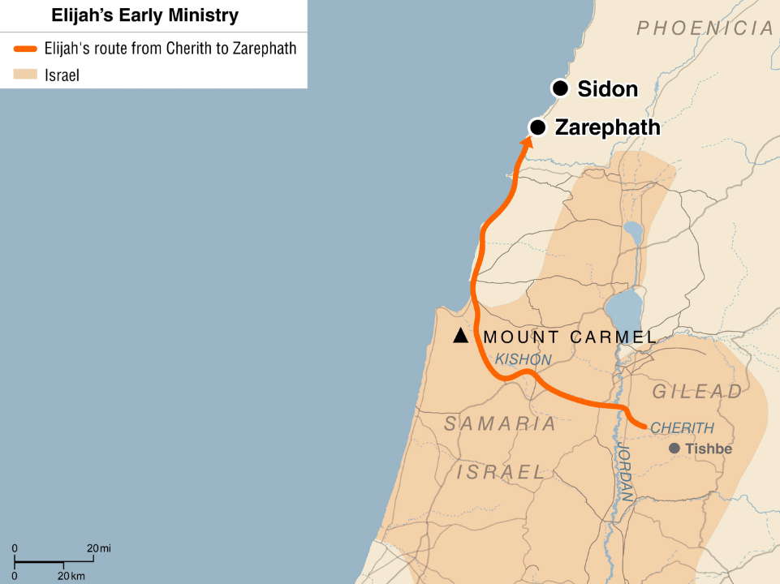
Notes:
Where is Zarephath? It is part of the Kingdom of Sidon. Earlier we read that the King of Sidon was Jezebel’s father. Jezebel was Ahab’s queen. She introduced Ahab to Baal worship. Later in 1 Kings, we see that she is pretty wicked herself.
Yet God sends Elijah to the doorstep of the Kingdom of Sidon.

Slide 23
⁸ Then the word of the Lord came to him, ⁹ “Arise, go to Zarephath, which belongs to Sidon, and dwell there. Behold, I have commanded a widow there to feed you.” ¹⁰ So he arose and went to Zarephath. And when he came to the gate of the city, behold, a widow was there gathering sticks. And he called to her and said, “Bring me a little water in a vessel, that I may drink.” ¹¹ And as she was going to bring it, he called to her and said, “Bring me a morsel of bread in your hand.”
1 Kings 17:2-16
Notes:
And when he came to the gate of the city, behold, a widow was there gathering sticks. And he called to her and said, “Bring me a little water in a vessel, that I may drink.” 11 And as she was going to bring it, he called to her and said, “Bring me a morsel of bread in your hand.”
Elijah finds a widow, just as God told him. He asks for a little water and a piece of bread.
When I first read this, I wondered if Elijah was being demanding. Bring me food! Bring me water!
Or maybe that was the way they spoke? I was not sure.
I looked at a commentary. It stated that “Elijah’s request would have been very modest within the range of normal hospitality (which was often offered at the gate of the city).
This meant that Elijah was not being demanding.

Slide 24
⁸ Then the word of the Lord came to him, ⁹ “Arise, go to Zarephath, which belongs to Sidon, and dwell there. Behold, I have commanded a widow there to feed you.” ¹⁰ So he arose and went to Zarephath. And when he came to the gate of the city, behold, a widow was there gathering sticks. And he called to her and said, “Bring me a little water in a vessel, that I may drink.” ¹¹ And as she was going to bring it, he called to her and said, “Bring me a morsel of bread in your hand.”
NIV Would you . . .
NLT Would you please . . .
1 Kings 17:2-16
Notes:
You can see the much clearer in the dynamic equivalent translations. The NIV has Elijah asking, “Would you bring me a little water in a jar so I may have a drink
The NLT goes even further on the politeness scale, stating, “Would you please bring me a little water in a cup?”
So, it is indeed a polite request.

Slide 25
⁸ Then the word of the Lord came to him, ⁹ “Arise, go to Zarephath, which belongs to Sidon, and dwell there. Behold, I have commanded a widow there to feed you.” ¹⁰ So he arose and went to Zarephath. And when he came to the gate of the city, behold, a widow was there gathering sticks. And he called to her and said, “Bring me a little water in a vessel, that I may drink.” ¹¹ And as she was going to bring it, he called to her and said, “Bring me a morsel of bread in your hand.” ¹² And she said, “As the Lord your God lives, I have nothing baked, only a handful of flour in a jar and a little oil in a jug. And now I am gathering a couple of sticks that I may go in and prepare it for myself and my son, that we may eat it and die.”
1 Kings 17:2-16
Notes:
Unfortunately, the widow is unable to accommodate. She doesn’t say no. Instead, she just states
As the Lord your God lives, I have nothing baked, only a handful of flour in a jar and a little oil in a jug. And now I am gathering a couple of sticks that I may go in and prepare it for myself and my son, that we may eat it and die.”
Actually, a very polite response.
But also one expected from a widow. You already expect the widow to be poor. Now there is a drought in the land, so she would even be worse off.
So why would God tell Elijah that a widow would provide him food?

Slide 26
¹³ And Elijah said to her, “Do not fear; go and do as you have said. But first make me a little cake of it and bring it to me, and afterward make something for yourself and your son. ¹⁴ For thus says the Lord, the God of Israel, ‘The jar of flour shall not be spent, and the jug of oil shall not be empty, until the day that the Lord sends rain upon the earth.’” ¹⁵ And she went and did as Elijah said. And she and he and her household ate for many days. ¹⁶ The jar of flour was not spent, neither did the jug of oil become empty, according to the word of the Lord that he spoke by Elijah.
1 Kings 17:2-16
Notes:
Here is why, our second miracle.
13 And Elijah said to her, “Do not fear; go and do as you have said. But first make me a little cake of it and bring it to me, and afterward make something for yourself and your son.
14 For thus says the Lord, the God of Israel, ‘The jar of flour shall not be spent, and the jug of oil shall not be empty, until the day that the Lord sends rain upon the earth.’”
15 And she went and did as Elijah said. And she and he and her household ate for many days.
16 The jar of flour was not spent, neither did the jug of oil become empty, according to the word of the Lord that he spoke by Elijah.

Slide 27
¹³ And Elijah said to her, “Do not fear; go and do as you have said. But first make me a little cake of it and bring it to me, and afterward make something for yourself and your son. ¹⁴ For thus says the Lord, the God of Israel, ‘The jar of flour shall not be spent, and the jug of oil shall not be empty, until the day that the Lord sends rain upon the earth.’” ¹⁵ And she went and did as Elijah said. And she and he and her household ate for many days. ¹⁶ The jar of flour was not spent, neither did the jug of oil become empty, according to the word of the Lord that he spoke by Elijah.
1 Kings 17:2-16
Notes:
There are a few interesting points within the Hebrew text.
First, the widow went and did as Elijah told her, just as Elijah went and did as God told him in vs 5.
That is not the only similarity. Going back to vs 5, it reads
“So he went and did according to the word of the Lord. He went and lived by the brook Cherith that is east of the Jordan.”
Because Elijah went and did as the Lord commanded, it tells us in vs 6 that he was fed by the ravens.
Because the widow went and did as Elijah commanded, the text tell us the jar of flour and the jug of oil did not run out.
The first miracle of provision supported just Elijah. The second miracle of provision support not just Elijah but also the widow and her child.

Slide 28

God not only works through us; he works in us to prepare us for his next great purpose.
1 Kings 17:2-16
Notes:
From this we see another key principle. God not only works through us; he works in us to prepare us for his next great purpose.
Although Elijah stood up to Ahab, he was not ready to face the consequences of having the King and Queen after him. So God teaches him that He is in control.

Slide 29
Obey God, even when his directions may seem strange or unusual.
1 Kings 17:2-16
Notes:
We need to be like Elijah. We need to be like the widow. We need to --Obey God, even when his directions may seem strange or unusual.
I think back to when I was first asked to lead a Bible Study. In 2012, I was the executive officer of a navy base in Japan. The Navy chaplains reported to me. But it was also one of these navy chaplains who became my first mentor and encouraged me to teach a Bible study.
So I started teaching a Bible Study. I had taught technical topics in the Navy, so I was familiar with PowerPoint and teaching methods. So that is how I approached the Bible Study. You might even notice that in my slides.
Some people would ask, will you be a pastor when you retire. I would laugh and say, no way. Teaching a Bible to a small group is entirely different from standing in front of a congregation.
Later, I would pay attention to different pastors’ speak and realize there was no way I could ever do that. I don’t mind helping out, whether taking care of the bank books or running a website. Just don’t have me speak in front of a crowd.
But God was working in and through me. He brought Karla and I to Crossroads. And here I am now. I am still not comfortable speaking in front of a crowd, but I trust in God and obey his directions, knowing that he will get me through.
Just like Elijah and the widow trusted in God and he provided for them.
But then, tragedy strikes!

Slide 30
¹⁷ After this the son of the woman, the mistress of the house, became ill. And his illness was so severe that there was no breath left in him. ¹⁸ And she said to Elijah, “What have you against me, O man of God? You have come to me to bring my sin to remembrance and to cause the death of my son!”
1 Kings 17:17-23
Notes:
But tragedy provides an opportunity for God to work another miracle.
God miraculously resurrects the widow’s son
God restores the son’s life after Elijah asks
17 After this the son of the woman, the mistress of the house, became ill. And his illness was so severe that there was no breath left in him.
18 And she said to Elijah, “What have you against me, O man of God? You have come to me to bring my sin to remembrance and to cause the death of my son!”

Slide 31
¹⁷ After this the son of the woman, the mistress of the house, became ill. And his illness was so severe that there was no breath left in him. ¹⁸ And she said to Elijah, “What have you against me, O man of God? You have come to me to bring my sin to remembrance and to cause the death of my son!”
1 Kings 17:17-23
Notes:
We don’t know what type of illness it was. The phrase “no breath left in him” is not saying it was a lung disease, only that he was dead.
We don’t know how old the son was or how long he had been sick.
When Elijah first met the widow, she was collecting sticks for a fire. Her son was not with her. That could be due to him being too young to collect firewood or because he was already sick.
Either way, the widow, who had already lost her husband, had now lost her child. She was obviously distraught.

Slide 32
¹⁷ After this the son of the woman, the mistress of the house, became ill. And his illness was so severe that there was no breath left in him. ¹⁸ And she said to Elijah, “What have you against me, O man of God? You have come to me to bring my sin to remembrance and to cause the death of my son!”
1 Kings 17:17-23
Notes:
We also see that the widow blamed Elijah as the cause of the death of her son. But before she blamed Elijah, she also acknowledged her own sin, implying that the son’s death was due to her sins being exposed by being in the presence of a man of God.
In my Systematic Theology class this semester, we looked closely at the topic “why do bad things happen.” There are many different views, and each have strong Biblical and historical support. So don’t expect me to give you an answer.
But what we see here is seen throughout the Bible. It is okay to ask God why bad things happen. Job was blameless and upright. But Job does ask
“Why have you made me your mark?
Why have I become a burden to you?
Why do you not pardon my transgression
As you know, Job does not get a direct answer. The same thing happens here. Neither Elijah nor God tells us why the widow’s son died.
Instead

Slide 33
¹⁹ And he said to her, “Give me your son.” And he took him from her arms and carried him up into the upper chamber where he lodged, and laid him on his own bed. ²⁰ And he cried to the Lord, “O Lord my God, have you brought calamity even upon the widow with whom I sojourn, by killing her son?” ²¹ Then he stretched himself upon the child three times and cried to the Lord, “O Lord my God, let this child's life^{[b]} come into him again.” ²² And the Lord listened to the voice of Elijah. And the life of the child came into him again, and he revived. ²³ And Elijah took the child and brought him down from the upper chamber into the house and delivered him to his mother. And Elijah said, “See, your son lives.
Notes:
Elijah said to her “Give me your son.” And he took him from her arms and carried him up into the upper chamber where he lodged, and laid him on his own bed.
20 And he cried to the Lord, “O Lord my God, have you brought calamity even upon the widow with whom I sojourn, by killing her son?”
21 Then he stretched himself upon the child three times and cried to the Lord, “O Lord my God, let this child's life come into him again.”
22 And the Lord listened to the voice of Elijah. And the life of the child came into him again, and he revived.
23 And Elijah took the child and brought him down from the upper chamber into the house and delivered him to his mother. And Elijah said, “See, your son lives.
Our third and final miracle.

Slide 34
Faith grows as we trust God’s word and see his faithfulness to his promises.
1 Kings 17:17-23
Notes:
This leads to another key principle. Faith grows as we trust God’s word and see his faithfulness to his promises.
Elijah is growing in faith. He is learning not only to trust in God, to cry out to God when in doubt.
Elijah cries out to God and asks Him to restore the child’s life.

Slide 35
Let God work through your life to accomplish his will
1 Kings 17:17-23
Notes:
When God does restore the child’s life, this shows us an important application for us today.
We need to let God work through our lives to accomplish his will.
When you let God work through your life, who knows, maybe you will experience a miracle.
But even without performing miracles we can live our lives to accomplish his will.
We need to let God work though us so that the people will react in the same manner as the widow. And what does the widow do after her son is brought back to life?

Slide 36
²⁴ And the woman said to Elijah, “Now I know that you are a man of God, and that the word of the Lord in your mouth is truth.”
1 Kings 17:24
Notes:
She proclaims Elijah is a man of God who speaks the truth.
Because of the miracles, the widow recognizes the sovereignty of the God of Israel and that Elijah speaks for him
She says ““Now I know that you are a man of God, and that the word of the Lord in your mouth is truth.”

Slide 37
Our greatest calling is to declare God’s will faithfully and fearlessly
1 Kings 17:24
Notes:
The widow’s response illustrates our final key principle: Our greatest calling is to declare God’s will faithfully and fearlessly.
For Elijah it was clear what God’s will was. God told Elijah where to go. God told Elijah what to do. I wish it was that easy for us.

Slide 38
Listen carefully to God’s Word, so you can understand the message he is calling you to proclaim
1 Kings 17:24
Notes:
Instead, we need to Listen carefully to God’s Word, so you can understand the message he is calling you to proclaim

Slide 39
¹ Now Elijah the Tishbite, of Tishbe in Gilead, said to Ahab, “As the Lord, the God of Israel, lives, before whom I stand, there shall be neither dew nor rain these years, except by my word.”
3 miracles
²⁴ And the woman said to Elijah, “Now I know that you are a man of God, and that the word of the Lord in your mouth is truth.”
1 Kings 17:24
Notes:
Now let’s go back and see what we learned.
In vs. 1, Elijah proclaims that the Lord, the God of Israel, Lives
Then we see 3 miracles. Two miracles of provision. First, God uses ravens to provide for Elijah. Then God uses a bottomless jar of flour and a jug of oil to provide for Elijah, a widow, and her son. For the final miracle, God brings the widow’s son back to life.
How does the widow respond? By proclaiming that God’s word is truth.
What can we learn from the widow?

Slide 40

The God of Israel lives and rules over the gods of this world and proves that by miracles.
1 Kings 17
Notes:
The God of Israel lives and rules over the gods of this world and proves that by miracles. This is the reason for the miracles.
It wasn’t the long drought that proved the God of Israel is superior to Jezebel’s Baal, a supposed god of rain.
Elijah obeying God, first by relying on ravens to feed him, then by relying on a poor widow who was almost out of oil and flour to provide for him.
And then when the widow's son died, and Elijah asked God to bring him back, God did so. This allowed for a series of miracles to be performed by the God of Israel, the God of the Bible, who in the beginning, creating everything, and proves all that by his miracles.
Miracles do exist. I don’t care what Richard Dawkins book says.
The only book I hold to is the Bible.

Slide 41
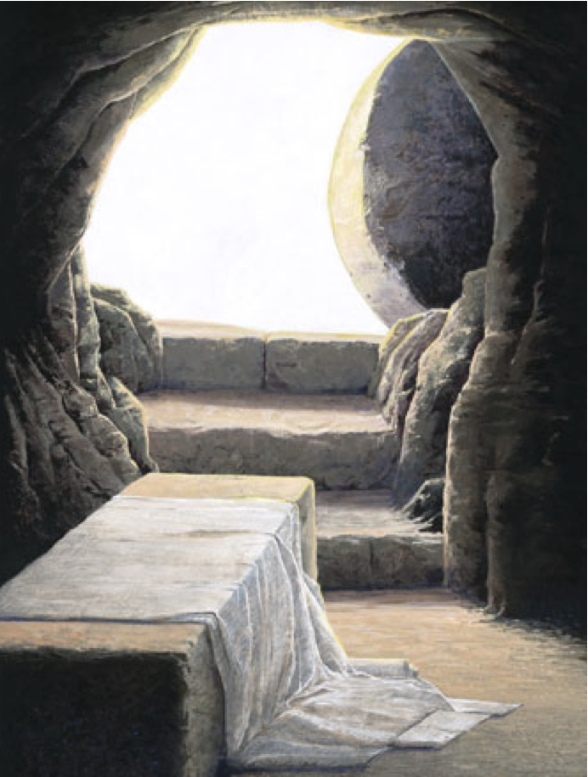
Notes:
The Bible tells me about another miracle involving a resurrection. The Resurrection of Jesus.
Since miracles prove that God lives and rules over the gods of this world, what does the miracle of Jesus’ resurrection tell us?
In his letter to the Romans Paul tells Jesus was shown to be the Son of God when he was raised from the dead by the power of the Holy Spirit.
In his letter to the Corinthians, Paul explains to the believers that Christ has been raised from the dead, the firstfruits of those who have fallen asleep. 21 For as by a man, Adam, came death for all men, then also by a man has come also the resurrection of the dead. 22 For as in Adam all die, so also in Christ shall all be made alive.
That’s an amazing promise, that when we die, we will be made alive in Christ.
We have a promise that
What is sown is perishable; what is raised is imperishable.
What is sown in dishonor; is raised in glory.
What is sown in weakness; is raised in power.
What is sown a natural body; is raised a spiritual body.
Why do we have this promise? Because of the gospel which is the power of God for salvation to everyone who believes. Because of the righteousness of God through the faithfulness of Jesus Christ for all who believe. These and many more promises show us that God desires all people to be saved and to come to the knowledge of the truth.
The truth is that the God of Israel, the God of the Bible lives. And he is asking that you place your faith in him today. Let us pray

