Slide 1
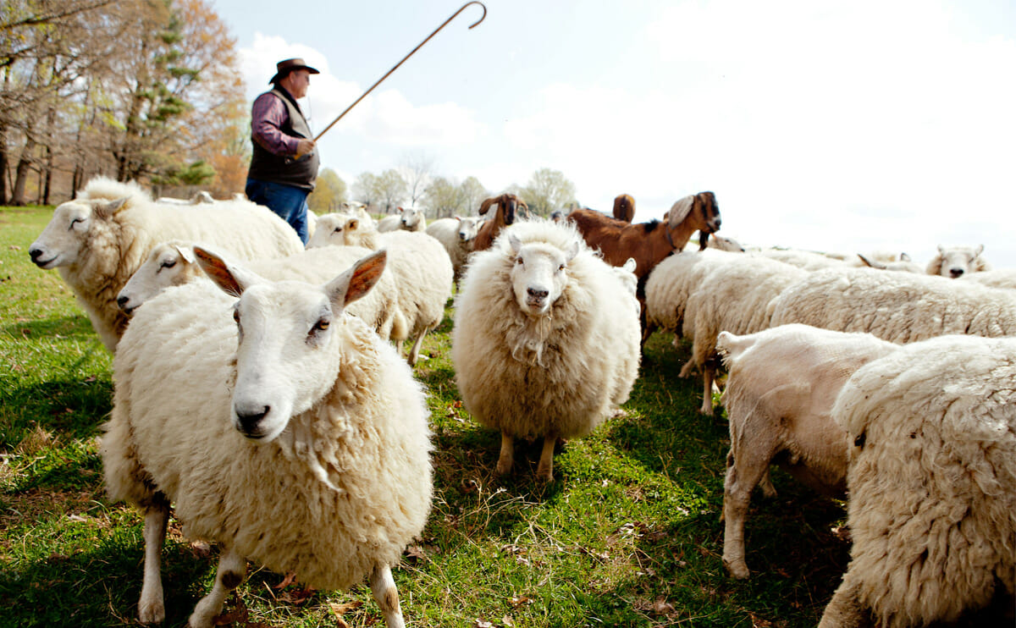
My Shepherd
Psalm 23

Slide 2
John 10:11-16
11 I am the good shepherd. The good shepherd lays down his life for the sheep. 12 He who is a hired hand and not a shepherd, who does not own the sheep, sees the wolf coming and leaves the sheep and flees, and the wolf snatches them and scatters them. 13 He flees because he is a hired hand and cares nothing for the sheep.
14 I am the good shepherd. I know my own and my own know me, 15 just as the Father knows me and I know the Father; and I lay down my life for the sheep. 16 And I have other sheep that are not of this fold. I must bring them also, and they will listen to my voice. So there will be one flock, one shepherd.

Slide 3
My Shepherd provides (1-3a)
Green pastures
Still waters
Soul restored

Slide 4
Sheep will not lay down if:
fear of predators
tension with other sheep
parasites
hunger

Slide 5
My Shepherd provides (1-3a)
"Sheep will not usually drink from fast-flowing water. They know the peril of
drowning if they were to fall in and their heavy wool coats become waterlogged.
They also know the danger of developing pneumonia if water gets into their
lungs. Sheep have been known to die from thirst alongside abundant rushing water."
-Ron Allen
Green pastures
Still waters
Soul restored

Slide 6
My Shepherd provides (1-3a)
Restoring
Restore withered hand (I Kings 13:6)
Captives return home to their land (Isaiah 52:8)
Repair broken walls (Isa 58:12)
Rebuild leveled cities (Dan 9:25)

Slide 7
My Shepherd guides (3b)
“The Christian is not obedient to some commandments and neglectful of others; he does not pick and choose, but yields to all. Observe, that the plural is used – ‘the paths of righteousness.’ Whatever God may give us to do we would do it, led by his love." -Charles Spurgeon

Slide 8
My Shepherd protects (4-6)
Genesis 39:21
"But the Lord was with Joseph and showed him steadfast love and gave him favor in the sight of the keeper of the prison."

Slide 9
My Shepherd protects (4-6)
Isaiah 41:10
"fear not, for I am with you; be not dismayed, for I am your God; I will strengthen you, I will help you, I will uphold you with my righteous right hand."

Slide 10
My Shepherd protects (4-6)
Matthew 1:23
“Behold, the virgin shall conceive and bear a son, and they shall call his name Immanuel”
(which means, God with us).

Slide 11
My Shepherd protects (4-6)
John 14:17-18
¹⁷ even the Spirit of truth, whom the world cannot receive, because it neither sees him nor knows him. You know him, for he dwells with you and will be in you.
¹⁸ “I will not leave you as orphans; I will come to you.

