Slide 1

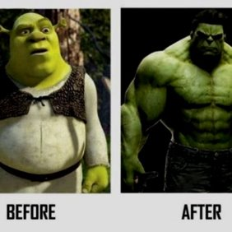

Slide 2
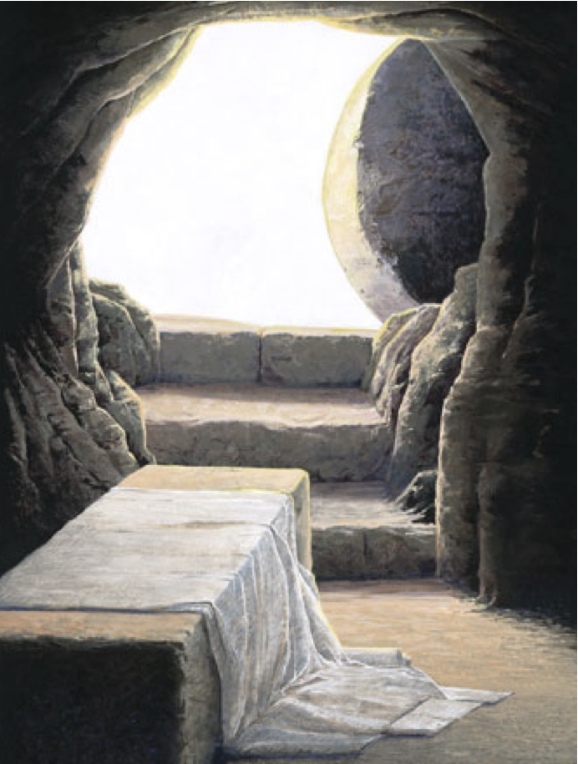
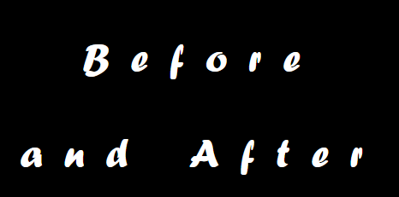
What is a resurrected body?​
1 Corinthians 15:35-49​

Slide 3
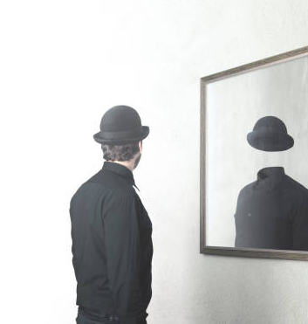
Our present body
a tent (2 Cor 5:2)
a clay pot (2 Cor 4:7)
fading grass (Isa 40:6-8)
flowers (James 1:9-11)
morning mist (James 4:14)

Slide 4
Philippians 3:20
²⁰ But our citizenship is in heaven, and from it we await a Savior, the Lord Jesus Christ, ²¹ who will transform our lowly body to be like his glorious body, by the power that enables him even to subject all things to himself.

Slide 5
Colossians 3:4
When Christ who is your life appears, then you also will appear with him in glory.

Slide 6
1 John 3:2
Beloved, we are God’s children now, and what we will be has not yet appeared; but we know that when he appears we shall be like him, because we shall see him as he is.

Slide 7
1 Corinthians 15:20-23
²⁰ But in fact Christ has been raised from the dead, the firstfruits of those who have fallen asleep. ²¹ For as by a man came death, by a man has come also the resurrection of the dead. ²² For as in Adam all die, so also in Christ shall all be made alive. ²³ But each in his own order: Christ the firstfruits, then at his coming those who belong to Christ.

Slide 8
The spiritual body is a superior replacement for the natural body (vs. 35-37)
God designs the nature of the spiritual body (vs. 38-42a)
The spiritual body is permanently fixed (v. 42)
Jude 1:24
Now to him who is able to keep you from stumbling and to present you blameless before the presence of his glory with great joy

Slide 9
The spiritual body is a superior replacement for the natural body (vs. 35-37)
God designs the nature of the spiritual body (vs. 38-42a)
The spiritual body is permanently fixed (v. 42)
The spiritual body radiates brilliant light (v. 43a)

Slide 10
Revelation 1:12-18
¹² Then I turned to see the voice that was speaking to me, and on turning I saw seven golden lampstands, ¹³ and in the midst of the lampstands one like a son of man, clothed with a long robe and with a golden sash around his chest. ¹⁴ The hairs of his head were white, like white wool, like snow. His eyes were like a flame of fire, ¹⁵ his feet were like burnished bronze, refined in a furnace, and his voice was like the roar of many waters. ¹⁶ In his right hand he held seven stars, from his mouth came a sharp two-edged sword, and his face was like the sun shining in full strength.

Slide 11
Revelation 1:12-18
¹⁷ When I saw him, I fell at his feet as though dead. But he laid his right hand on me, saying, “Fear not, I am the first and the last, ¹⁸ and the living one. I died, and behold I am alive forevermore, and I have the keys of Death and Hades.
Matthew 13:43
Then the righteous will shine like the sun in the kingdom of their Father. He who has ears to hear, let him hear.

Slide 12
The spiritual body is a superior replacement for the natural body (vs. 35-37)
God designs the nature of the spiritual body (vs. 38-42a)
The spiritual body is permanently fixed (v. 42)
The spiritual body radiates brilliant light (v. 43a)
The spiritual body possesses power
(v. 43c)
The spiritual body is guaranteed (v. 44)

