Slide 1
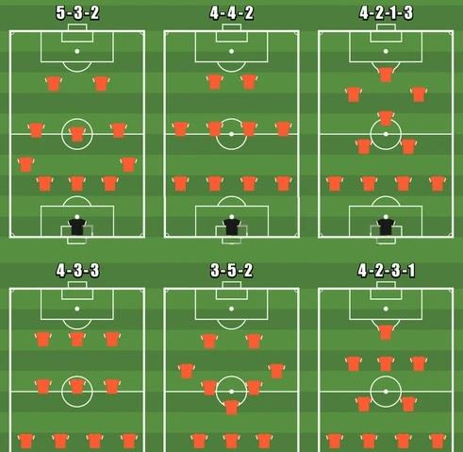
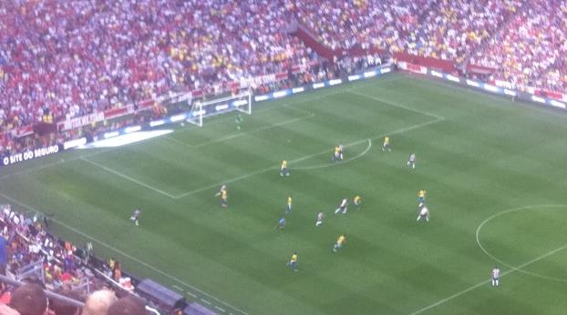
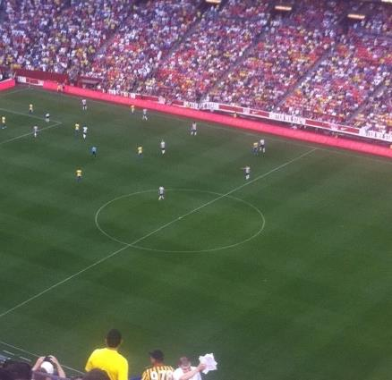
Is Life like Soccer?

Slide 2
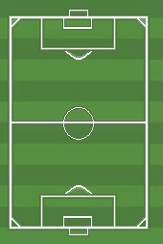
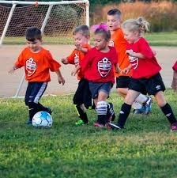
Kids Soccer

Slide 3
Kids Soccer

Slide 4
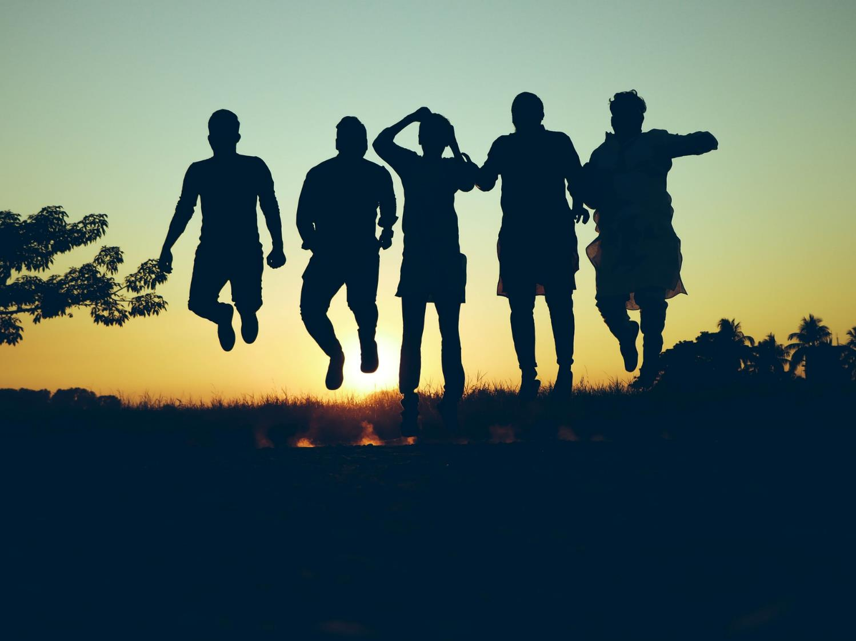
How can you Experience Joyful Christian Living?

Slide 5
Living the Christian Life

Slide 6
Joyful Christian Living
Philippians 1

Slide 7
Macedonia
Bithynia
Troas
Paul & Silas
Asia
Antioch
Jerusalem
2nd Missionary Journey
(Acts 15:39b – 18:22)

Slide 8
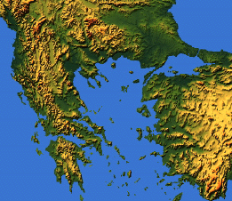
Philippi
Thessalonica
Berea
Troas
Athens
Corinth

Slide 9
Servants and Saints
Phil 1:1-2

Slide 10
¹ Paul and Timothy, servants of Christ Jesus,
To all the saints in Christ Jesus who are at Philippi, with the overseers and deacons:
² Grace to you and peace from God our Father and the Lord Jesus Christ.
Phil 1:1-2

Slide 11
ESV vs NLT
¹ Paul and Timothy, servants of Christ Jesus,
This letter is from Paul and Timothy, slaves of Christ Jesus.
Phil 1:1-2

Slide 12
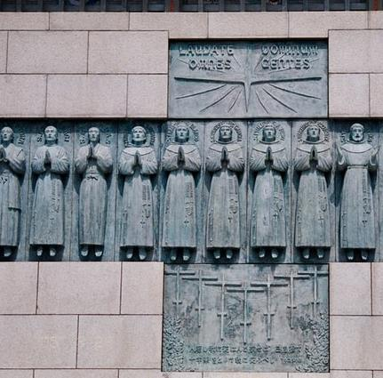
Paul and Timothy
Phil 2:19-24 ¹⁹ I hope in the Lord Jesus to send Timothy to you soon, so that I too may be cheered by news of you. ²⁰ For I have no one like him, who will be genuinely concerned for your welfare. ²¹ For they all seek their own interests, not those of Jesus Christ. ²² But you know Timothy's proven worth, how as a son with a father he has served with me in the gospel. ²³ I hope therefore to send him just as soon as I see how it will go with me, ²⁴ and I trust in the Lord that shortly I myself will come also.
Who are the Servants?

Slide 13
Paul and Timothy
Jesus
Phil 2:6-7 ⁶ who, though he was in the form of God, did not count equality with God a thing to be grasped, ⁷ but emptied himself, by taking the form of a servant,
Who are the Servants?

Slide 14
ESV vs NLT
To all the saints in Christ Jesus who are at Philippi, with the overseers and deacons:
I am writing to all of God’s holy people in Philippi who belong to Christ Jesus, including the church leaders and deacons.
Phil 1:1-2

Slide 15
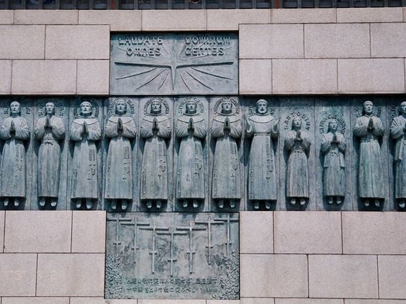
Twenty-Six Martyrs Museum and Monument
Nagasaki,
Japan
Who are the Saints?

Slide 16
Rom 1:7 To all those in Rome who are loved by God and called to be saints: Grace to you and peace from God our Father and the Lord Jesus Christ.
Acts 9:32 Now as Peter went here and there among them all, he came down also to the saints who lived at Lydda.
Jude 1:3 Beloved, although I was very eager to write to you about our common salvation, I found it necessary to write appealing to you to contend for the faith that was once for all delivered to the saints.
Who are the Saints?

Slide 17
ESV vs NLT
To all the saints in Christ Jesus who are at Philippi, with the overseers and deacons:
I am writing to all of God’s holy people in Philippi who belong to Christ Jesus, including the church leaders and deacons.
Phil 1:1-2

Slide 18
ESV vs NLT
² Grace to you and peace from God our Father and the Lord Jesus Christ.
May God our Father and the Lord Jesus Christ give you grace and peace.
Phil 1:1-2

Slide 19
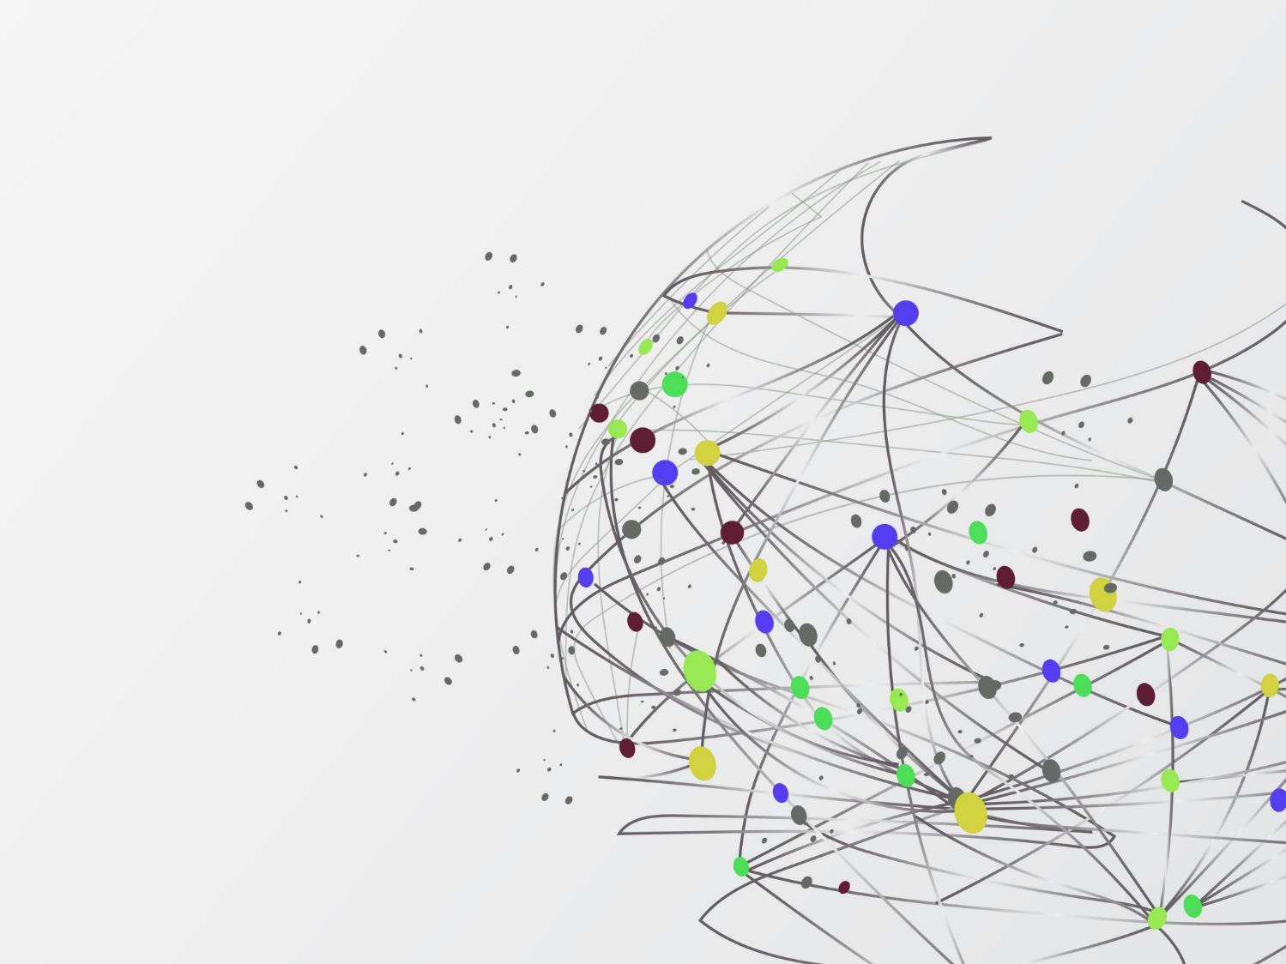
Joyful Blessings
²² Then the Lord said to Moses, ²³ “Tell Aaron and his sons to bless the people of Israel with this special blessing:
²⁴ ‘May the Lord bless you and protect you. ²⁵ May the Lord smile on you and be gracious to you. ²⁶ May the Lord show you his favor and give you his peace.’
Numbers 6

Slide 20
Believers Experience Joyful Christian Living by Reading God’s Word
Phil 1:1-2

Slide 21
Prayer and Partnership
Phil 1:3-11

Slide 22
³ I thank my God in all my remembrance of you, ⁴ always in every prayer of mine for you all making my prayer with joy, ⁵ because of your partnership in the gospel from the first day until now. ⁶ And I am sure of this, that he who began a good work in you will bring it to completion at the day of Jesus Christ.
Phil 1:3-11

Slide 23
³ I thank my God in all my remembrance of you, ⁴ always in every prayer of mine for you all making my prayer with joy, ⁵ because of your partnership in the gospel from the first day until now.
Phil 1:3-11

Slide 24
³ I thank my God in all my remembrance of you, ⁴ always in every prayer of mine for you all making my prayer with joy, ⁵ because of your partnership in the gospel from the first day until now.
Phil 1:3-11

Slide 25
Partnership in the Gospel
Luke 8:39-39 (ESV) . . . begged that he might be with him, but Jesus sent him away, saying, ³⁹ “Return to your home, and declare how much God has done for you.” And he went away, proclaiming throughout the whole city how much Jesus had done for him.
Luke 8:39-39 (ESV) . . . begged that he might be with him, but Jesus sent him away, saying, ³⁹ “Return to your home, and declare how much God has done for you.”

Slide 26
Twenty-Six Martyrs
Nagasaki,
Japan
Partnership in the Gospel

Slide 27
Luke 19:
²⁹ When (Jesus) drew near . . . , at the mount that is called Olivet, he sent two of the disciples, ³⁰ saying, “Go into the village in front of you, where on entering you will find a colt tied, on which no one has ever yet sat. Untie it and bring it here. ³¹ If anyone asks you, ‘Why are you untying it?’ you shall say this: ‘The Lord has need of it.’”

Slide 28
³² So those who were sent went away and found it just as he had told them. ³³ And as they were untying the colt, its owners said to them, “Why are you untying the colt?” ³⁴ And they said, “The Lord has need of it.” ³⁵ And they brought it to Jesus, and throwing their cloaks on the colt, they set Jesus on it.

Slide 29
³⁶ And as he rode along, they spread their cloaks on the road. ³⁷ As he was drawing near—already on the way down the Mount of Olives—the whole multitude of his disciples began to rejoice and praise God with a loud voice for all the mighty works that they had seen, ³⁸ saying, “Blessed is the King who comes in the name of the Lord! Peace in heaven and glory in the highest!”

Slide 30
³⁹ And some of the Pharisees in the crowd said to him, “Teacher, rebuke your disciples.” ⁴⁰ He answered, “I tell you, if these were silent, the very stones would cry out.”

Slide 31
³ I thank my God in all my remembrance of you, ⁴ always in every prayer of mine for you all making my prayer with joy, ⁵ because of your partnership in the gospel from the first day until now. ⁶ And I am sure of this, that he who began a good work in you will bring it to completion at the day of Jesus Christ.
Phil 1:3-11

Slide 32
Sanctification
²⁸ And we know that for those who love God all things work together for good, for those who are called according to his purpose. ²⁹ For those whom he foreknew he also predestined to be conformed to the image of his Son . . . ³⁰ And those whom he predestined he also called, and those whom he called he also justified, and those whom he justified he also glorified.
Sanctification
²⁸ And we know that for those who love God all things work together for good, for those who are called according to his purpose.
Romans 8:28-30

Slide 33
⁷ It is right for me to feel this way about you all, because I hold you in my heart, for you are all partakers with me of grace, both in my imprisonment and in the defense and confirmation of the gospel. ⁸ For God is my witness, how I yearn for you all with the affection of Christ Jesus.
Phil 1:3-11

Slide 34
⁹ And it is my prayer that your love may abound more and more, with knowledge and all discernment, ¹⁰ so that you may approve what is excellent, and so be pure and blameless for the day of Christ, ¹¹ filled with the fruit of righteousness that comes through Jesus Christ, to the glory and praise of God.
Phil 1:3-11

Slide 35
⁹ And it is my prayer that your love may abound more and more, with knowledge and all discernment, ¹⁰ so that you may approve what is excellent, and so be pure and blameless for the day of Christ, ¹¹ filled with the fruit of righteousness that comes through Jesus Christ, to the glory and praise of God.
Phil 1:3-11

Slide 36
⁹ And it is my prayer that your love may abound more and more, with knowledge and all discernment, ¹⁰ so that you may approve what is excellent, and so be pure and blameless for the day of Christ, ¹¹ filled with the fruit of righteousness that comes through Jesus Christ, to the glory and praise of God.
Phil 1:3-11

Slide 37
Believers Experience Joyful Christian Living by Growing in God’s Word
Phil 1:3-11

Slide 38
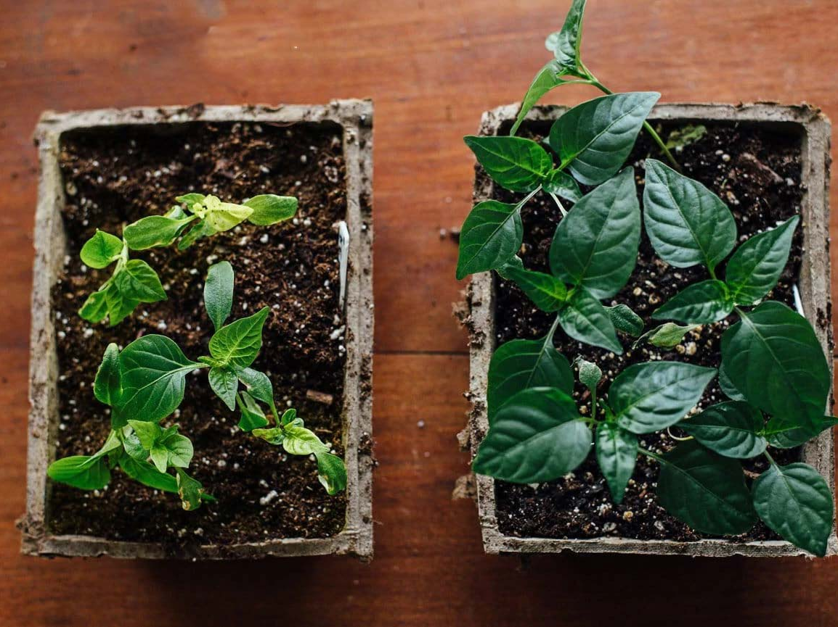
Am I Growing?

Slide 39
Believers Experience Joyful Christian Living by:
Reading God’s Word
Growing In God’s Word
Experiencing Adversity?

Slide 40
Experiencing Adversity
¹² I want you to know, brothers, that what has happened to me has really served to advance the gospel,
Phil 1:12-30

Slide 41
Descriptive,
not Prescriptive.

Slide 42
Experiencing Adversity
¹² I want you to know, brothers, that what has happened to me has really served to advance the gospel, ¹³ so that it has become known throughout the whole imperial guard and to all the rest that my imprisonment is for Christ. ¹⁴ And most of the brothers, having become confident in the Lord by my imprisonment, are much more bold to speak the word without fear.
Phil 1:12-30

Slide 43
Experiencing Adversity
¹⁵ Some indeed preach Christ from envy and rivalry, but others from good will. ¹⁶ The latter do it out of love, knowing that I am put here for the defense of the gospel. ¹⁷ The former proclaim Christ out of selfish ambition, not sincerely but thinking to afflict me in my imprisonment. ¹⁸ What then? Only that in every way, whether in pretense or in truth, Christ is proclaimed, and in that I rejoice.
Phil 1:12-30

Slide 44
Teachers: False Motives vs False Doctrine
Impure Motive
True Doctrine
Phil 1:17
Pure Motive
True Doctrine
Christ is proclaimed, and in that I rejoice.
Impure Motive
False Doctrine
Eph 4:13-14
Matt 18:6
Pure Motive
False Doctrine
Acts 18:24-28

Slide 45
Experiencing Adversity
Yes, and I will rejoice, ¹⁹ for I know that through your prayers and the help of the Spirit of Jesus Christ this will turn out for my deliverance, ²⁰ as it is my eager expectation and hope that I will not be at all ashamed, but that with full courage now as always Christ will be honored in my body, whether by life or by death. ²¹ For to me to live is Christ, and to die is gain. ²² If I am to live in the flesh, that means fruitful labor for me. Yet which I shall choose I cannot tell. ²³ I am hard pressed between the two. My desire is to depart and be with Christ, for that is far better. ²⁴ But to remain in the flesh is more necessary on your account. ²⁵ Convinced of this, I know that I will remain and continue with you all, for your progress and joy in the faith, ²⁶ so that in me you may have ample cause to glory in Christ Jesus, because of my coming to you again.
Phil 1:12-30

Slide 46
Christ will be honored!
In Paul’s Death
With full courage now as always

Slide 47
Experiencing Adversity
Yes, and I will rejoice, ¹⁹ for I know that through your prayers and the help of the Spirit of Jesus Christ this will turn out for my deliverance, ²⁰ as it is my eager expectation and hope that I will not be at all ashamed, but that with full courage now as always Christ will be honored in my body, whether by life or by death. ²¹ For to me to live is Christ, and to die is gain. ²² If I am to live in the flesh, that means fruitful labor for me. Yet which I shall choose I cannot tell. ²³ I am hard pressed between the two. My desire is to depart and be with Christ, for that is far better. ²⁴ But to remain in the flesh is more necessary on your account. ²⁵ Convinced of this, I know that I will remain and continue with you all, for your progress and joy in the faith, ²⁶ so that in me you may have ample cause to glory in Christ Jesus, because of my coming to you again.
Phil 1:12-30

Slide 48
Christ will be honored!
In Paul’s Death
In Paul’s life
With full courage now as always
Fruitful labor:
to continue in partnership in the Gospel with the Philippians

Slide 49
Experiencing Adversity
²⁷ Only let your manner of life be worthy of the gospel of Christ, so that whether I come and see you or am absent, I may hear of you that you are standing firm in one spirit, with one mind striving side by side for the faith of the gospel, ²⁸ and not frightened in anything by your opponents. This is a clear sign to them of their destruction, but of your salvation, and that from God.
Phil 1:12-30

Slide 50
Experiencing Adversity
²⁹ For it has been granted to you that for the sake of Christ you should not only believe in him but also suffer for his sake, ³⁰ engaged in the same conflict that you saw I had and now hear that I still have.
Phil 1:12-30

Slide 51
By reading and growing in God’s word, believers can overcome adversity from sharing the Gospel and experience Joyful Christian Living
Philippians Chapter 1

