Slide 1
T h e T e s t I n g
D e v e l o p i n g A b r a h a m ’ s R i g h t e o u s n e s s

Slide 2
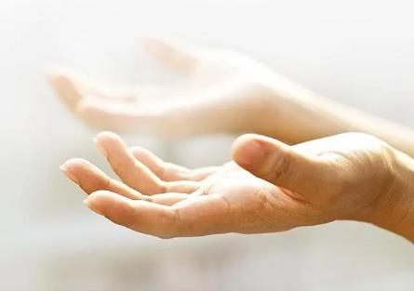
Will you Surrender What is Most Precious to You?
(Genesis 21-22)

Slide 3
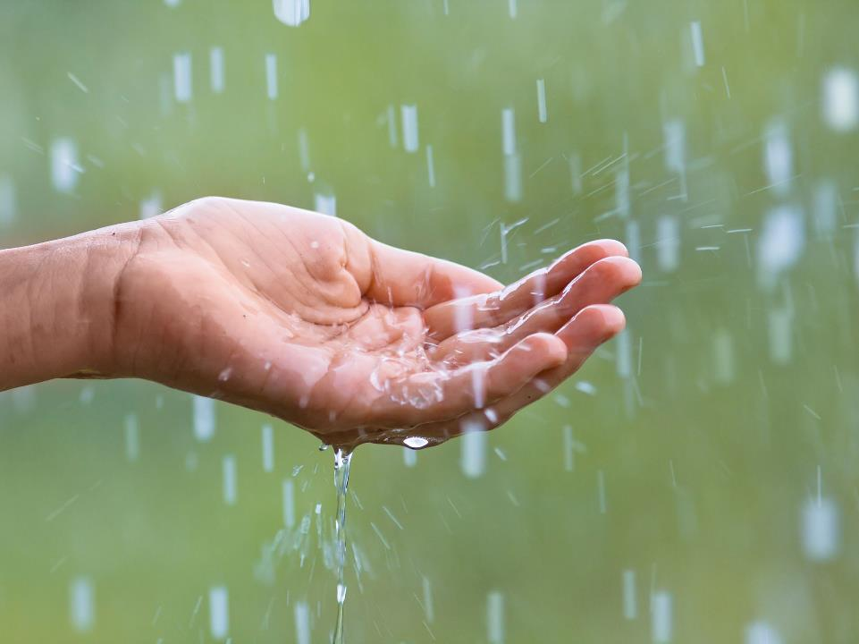
Enjoy remarkable gifts from God (Gen 21:1-7)
The Lord is trustworthy
The Lord is good
Romans 4:17
as it is written, “I have made you the father of many nations”—in the presence of the God in whom he believed, who gives life to the dead and calls into existence the things that do not exist.

Slide 4
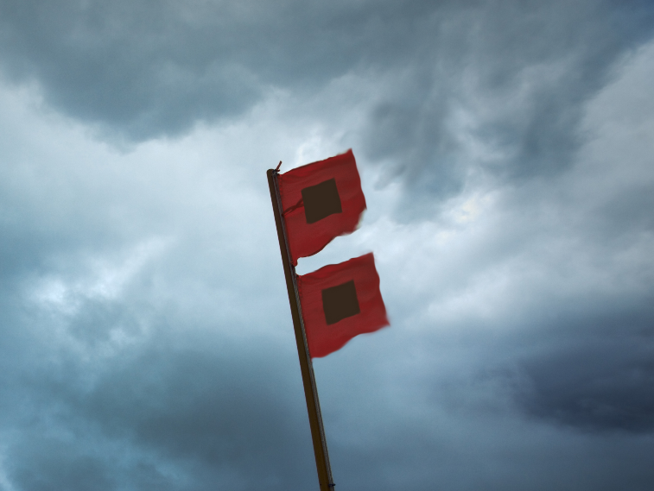
Handle challenges as they arise (Gen 21:8-21)
The Lord guides
The Lord provides

Slide 5
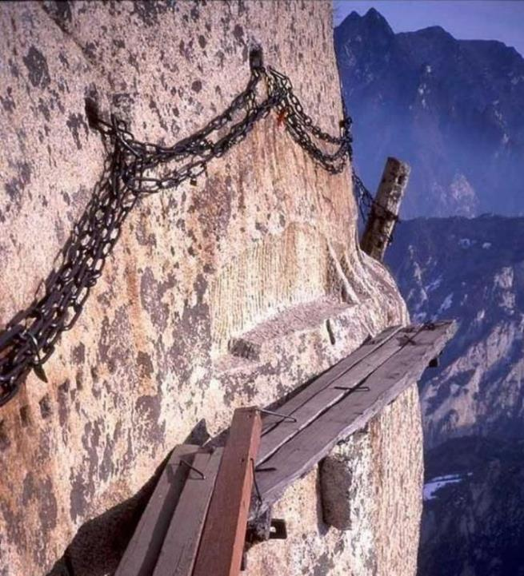
Luke 14:26-27
²⁶ “If anyone comes to me and does not hate his own father and mother and wife and children and brothers and sisters, yes, and even his own life, he cannot be my disciple. ²⁷ Whoever does not bear his own cross and come after me cannot be my disciple.
Boldly walk through traumatic tests of faith
(Gen 22:1-19)

Slide 6
Trust in the sovereignty of God’s promises
Boldly walk through traumatic tests of faith
(Gen 22:1-19)

Slide 7
Hebrews 11:17-19
17 By faith Abraham, when he was tested, offered up Isaac, and he who had received the promises was in the act of offering up his only son, 18 of whom it was said, “Through Isaac shall your offspring be named.” 19 He considered that God was able even to raise him from the dead, from which, figuratively speaking, he did receive him back.

Slide 8
2 Chronicles 3:1
Then Solomon began to build the house of the Lord in Jerusalem on Mount Moriah, where the Lord had appeared to David his father

Slide 9
Trust in the sovereignty of God’s promises
Boldly walk through traumatic tests of faith
(Gen 22:1-19)
Trust in the unexpected generosity of God’s provision

Slide 10
Romans 8:32
He who did not spare his own Son but gave him up for us all, how will he not also with him graciously give us all things?

