Slide 1
T h e T e s t I n g
D e v e l o p i n g A b r a h a m ’ s R i g h t e o u s n e s s

Slide 2
Will you follow God’s leading?
Where do you place your trust?
Will you wait for God to work?​
Are you more obedient to God than in the past?
Will you believe that God will do something extraordinary?
Do you believe in divine judgment?​

Slide 3
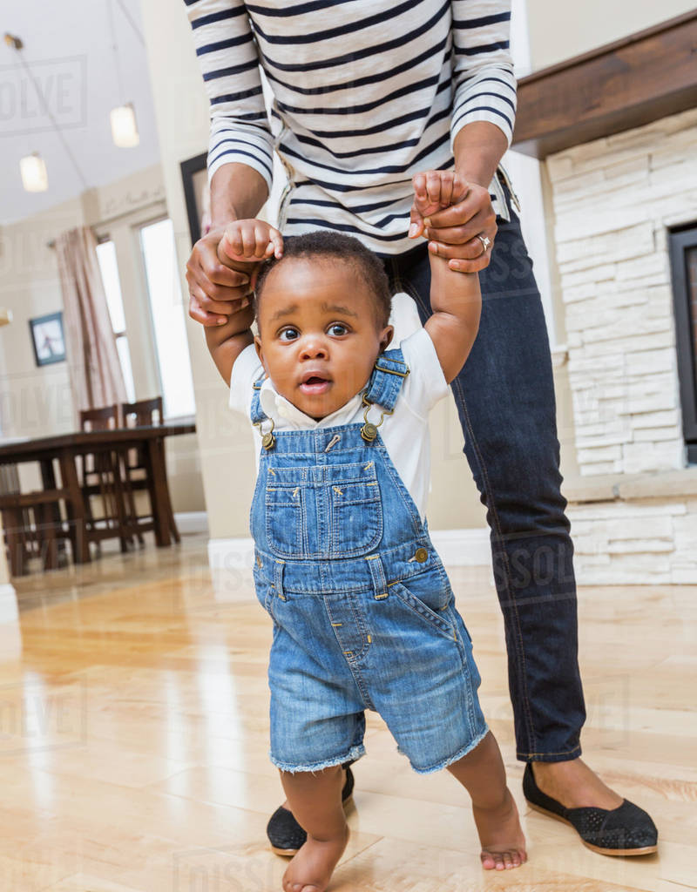
Do You Humbly Depend Upon God’s Grace?
(Genesis 20)

Slide 4
“But the episode here is chiefly one of suspense; on the brink of Isaac’s birth-story here is the very Promise put in jeopardy, traded away for personal safety. If it is ever to be fulfilled, it will owe very little to man. Morally as well as physically, it will clearly have to be achieved by the grace of God.”

Slide 5
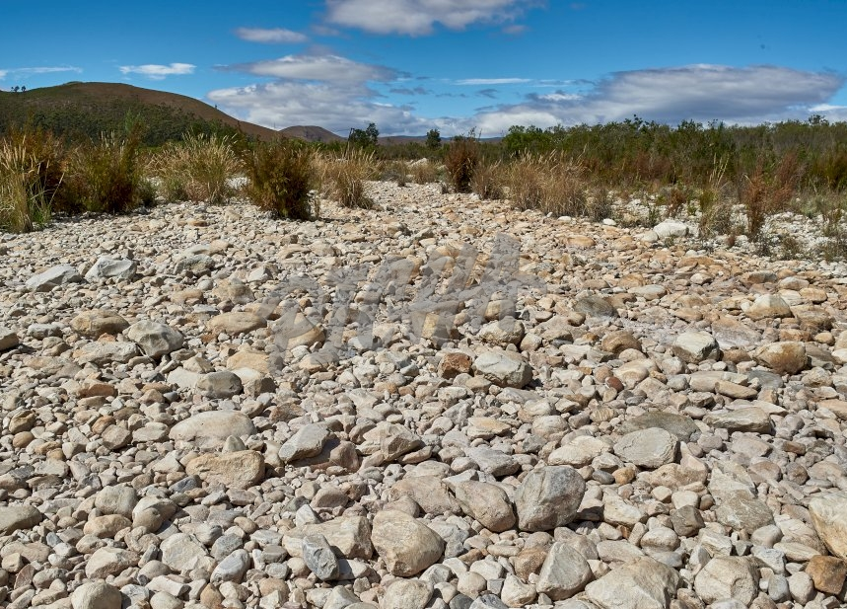
God rescues us when we revert back to sinful patterns (vs. 2, 13)
God intervenes when we are a poor testimony before the world (vs. 3-7)
God guards His honour when we fear man more than Him (vs. 8-11)
God reveals truth when we deceive (v. 12)
God blesses despite unworthiness (vs. 14-18)

