Slide 1
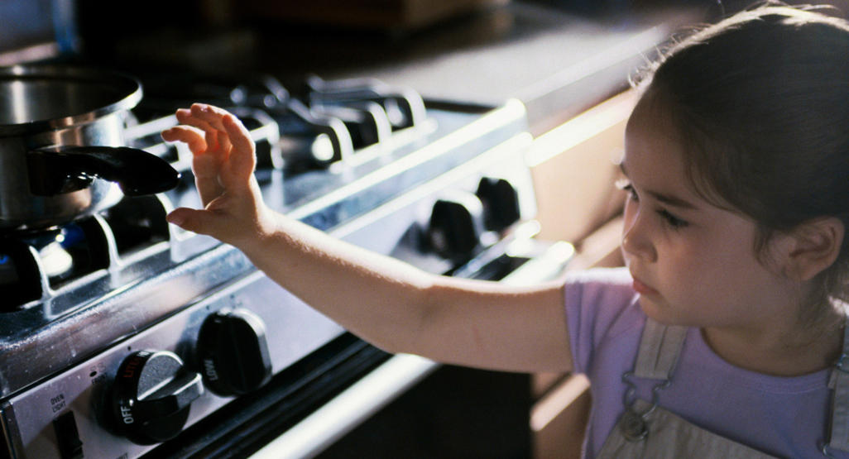

Slide 2
T h e T e s t I n g
D e v e l o p i n g A b r a h a m ’ s R i g h t e o u s n e s s

Slide 3
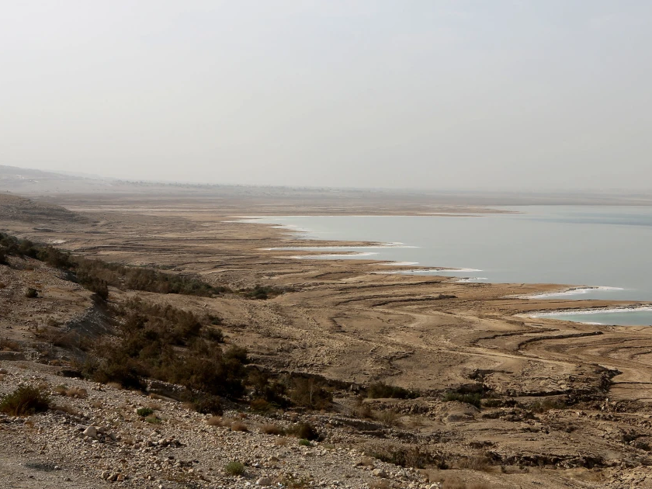
Do You Believe in Divine Judgement?
(Genesis 19:1-29)

Slide 4
The Story
The visit (vs. 1-11)
The warning (vs. 12-22)
The judgment (vs. 23-29)

Slide 5
The Lessons
God is holy and gracious

Slide 6
4 Stages of God’s judgement
Stage 1 Judgment: Conscience and civil law
Romans 2:14-16
14 For when Gentiles, who do not have the law, by nature do what the law requires, they are a law to themselves, even though they do not have the law. 15 They show that the work of the law is written on their hearts, while their conscience also bears witness, and their conflicting thoughts accuse or even excuse them 16 on that day when, according to my gospel, God judges the secrets of men by Christ Jesus.

Slide 7
Romans 13:1-5
1 Let every person be subject to the governing authorities. For there is no authority except from God, and those that exist have been instituted by God. 2 Therefore whoever resists the authorities resists what God has appointed, and those who resist will incur judgment. 3 For rulers are not a terror to good conduct, but to bad. Would you have no fear of the one who is in authority? Then do what is good, and you will receive his approval, 4 for he is God's servant for your good. But if you do wrong, be afraid, for he does not bear the sword in vain. For he is the servant of God, an avenger who carries out God's wrath on the

Slide 8
wrongdoer. ⁵ Therefore one must be in subjection, not only to avoid God's wrath but also for the sake of conscience.

Slide 9
4 Stages of God’s judgement
Stage 1 Judgment: Conscience and civil law
Stage 2 Judgment: God gives people over to natural consequences of sin

Slide 10
Romans 1:24, 26, 28
²⁴ Therefore God gave them up in the lusts of their hearts to impurity, to the dishonoring of their bodies among themselves,
²⁶ For this reason God gave them up to dishonorable passions. For their women exchanged natural relations for those that are contrary to nature;
²⁸ And since they did not see fit to acknowledge God, God gave them up to a debased mind to do what ought not to be done.

Slide 11
4 Stages of God’s judgement
Stage 1 Judgment: Conscience and civil law
Stage 2 Judgment: God gives people over to natural consequences of sin
Stage 3 Judgment: Earthly destruction

Slide 12
Nations that could receive judgment like Sodom & Gomorrah
Israel (Deut) 29:23)
Babylon (Jer 50:40)
Moab (Amos 4:9)
Israel acted like Sodom and Gomorrah
Oppression (Isa 1:10, 17)
Adultery, lying, abetting criminals (Jer 23:14)
Arrogance, complacency, and showing no pity on the needy (Ezek 16:49)

Slide 13
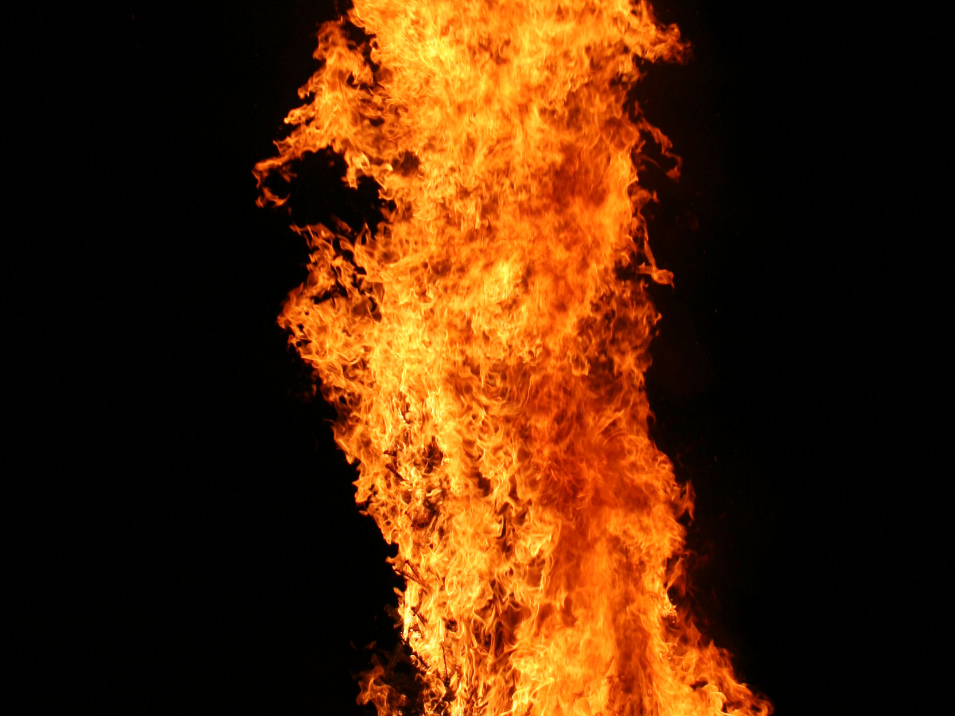
God’s judgment of fire
Sons of Aaron (Lev 10:1-3)
Soldiers of King Ahaziah (2 Kgs 1:9-12)
God’s appearance as fire
In the wilderness (Exod 13:31-32)
At Mount Sinai (Exod 19:16-25)
Elijah confronting prophets of Baal (1 Kgs 18:36-39)
Elijah’s ascent into heaven (2 Kgs 2:11-12)

Slide 14
Matthew 10:14-15
14 And if anyone will not receive you or listen to your words, shake off the dust from your feet when you leave that house or town. 15 Truly, I say to you, it will be more bearable on the day of judgment for the land of Sodom and Gomorrah than for that town.

Slide 15
Matthew 11:23-24
²³ And you, Capernaum, will you be exalted to heaven? You will be brought down to Hades. For if the mighty works done in you had been done in Sodom, it would have remained until this day. ²⁴ But I tell you that it will be more tolerable on the day of judgment for the land of Sodom than for you.”

Slide 16
4 Stages of God’s judgement
Stage 1 Judgment: Conscience and civil law
Stage 2 Judgment: God gives people over to natural consequences of sin
Stage 3 Judgment: Earthly destruction
Stage 4 Judgment: Eternal wrath

Slide 17
Romans 2:4-5
⁴ Or do you presume on the riches of his kindness and forbearance and patience, not knowing that God's kindness is meant to lead you to repentance? ⁵ But because of your hard and impenitent heart you are storing up wrath for yourself on the day of wrath when God's righteous judgment will be revealed.

Slide 18
2 Peter 3:9-10
⁹ The Lord is not slow to fulfill his promise as some count slowness, but is patient toward you, not wishing that any should perish, but that all should reach repentance. ¹⁰ But the day of the Lord will come like a thief, and then the heavens will pass away with a roar, and the heavenly bodies will be burned up and dissolved, and the earth and the works that are done on it will be exposed

Slide 19
The Lessons
God is holy and gracious
Man loves the sinful world
Isaiah 3:9
For the look on their faces bears witness against them; they proclaim their sin like Sodom; they do not hide it. Woe to them! For they have brought evil on themselves.

