Slide 1

CIC 2022

Slide 2
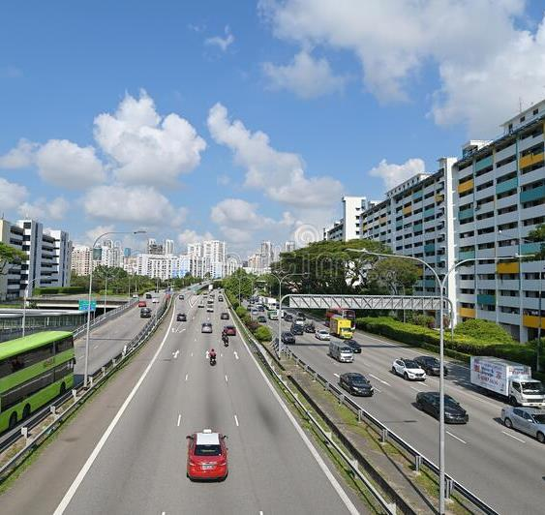
PIE Values
Passionate
International
Expository

Slide 3

Love God
What does this mean as a church?
Schedule monthly online prayer meetings
Plan retreats
Start giving to the Lord

Slide 4


Ministering to one another
Create & Risk
Oversee
LOVE THE CHURCH

Slide 5
Caring for
one another
Take initiative
Follow up
LOVE THE CHURCH

Slide 6
What does this mean as a church?
Launch new fellowship groups
Seek biblical discipleship
LOVE THE CHURCH

Slide 7

LOVE THE NATIONS
What does this mean as a church?
Expand mission outreach

Slide 8

How do we do mission work?
Proclaim the gospel
Nurture discipleship
Plant churches
Train leaders
Where do we do mission work?
Jerusalem
Samaria
Antioch

Slide 9
Who does CIC support?
Rick & Susan Griffith (Jordan)
Chas & Claudia Hahn (Turjikistan)
Jonathan Stone (Myanmar)
Michael Lyle (South Korea)
Isaac & Pat Lasky (Thailand)

Slide 10
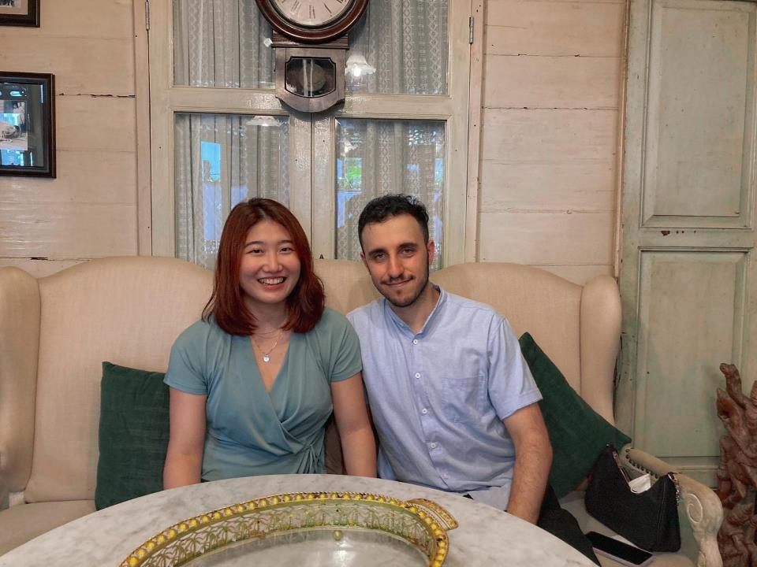
Isaac & Pat Lasky (Thailand) ​

Slide 11


Annual General Meeting
6 March 2022
Report
Audit
Budget
Plans

Slide 12
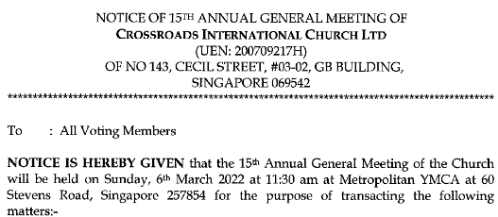

Issues to Vote On

Slide 13
financial Report
Prepared by Matt Lyle

Slide 18
Rent ~ Honorarium
Rent ~ 50%
Rent
Honorarium
Missions

Slide 19
2022

Slide 20
2021
Actual
135,758
144,607
48,523
53,000
29,764
13,321
2022
Proposed
180,000
174,955
84,780
48,000
35,400
6.775
Tithes & Offerings
Expenses*
Rent
Honorarium
Missions
Other
(projected)

Slide 21
praise
God provided a space for us to move when we filled the previous venue to capacity
God’s church is generous with their tithes and offerings as well their time and talents.

Slide 22

The Past (Oct 2020–Sep 2021)

Slide 23
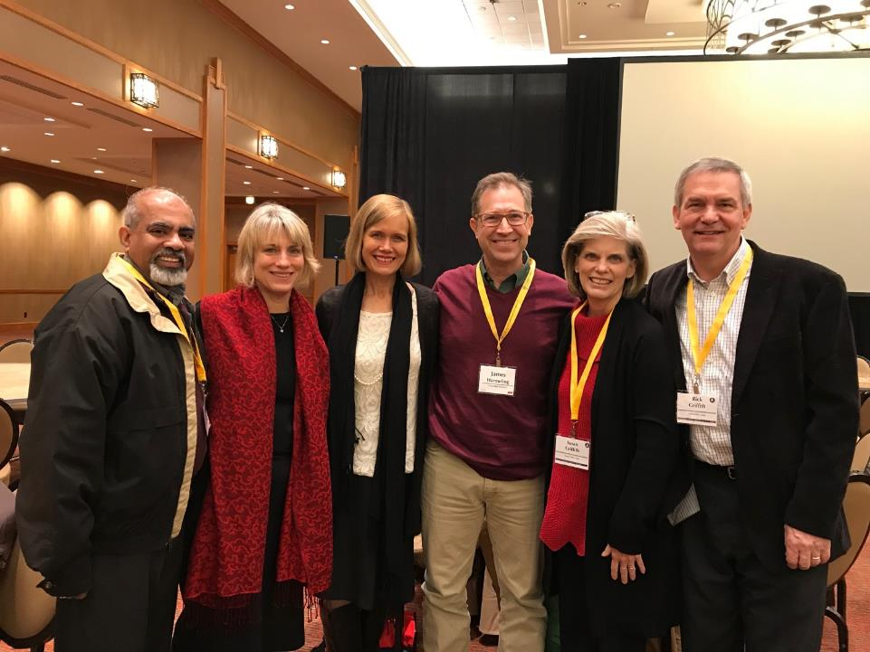
Full Time Missionary with Si
Full Time Professor at SBC
Full Time Professor at SBC
Jan 2020 elders & wives

Slide 24
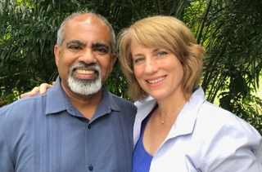
Andrew & Lori Spurgeon
Elder 1 Nov 2018—11 Jan 2021
Notes:
24
24

Slide 25
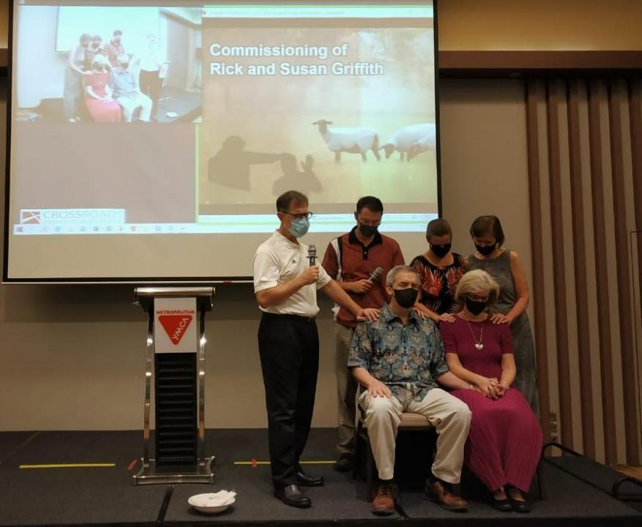

Rick & Susan Aug-Dec 2020 Sabbatical Planned for
Amman, Jordan

Slide 26
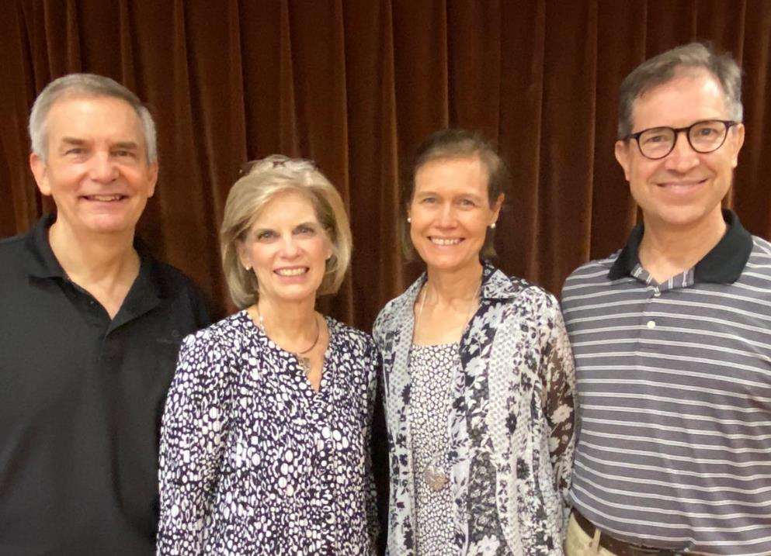

Rick & Susan
2006-2021
Jim & Jacqui
2019-???

Slide 27
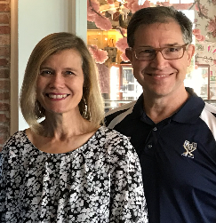
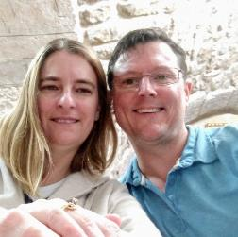
Current Leadership/Serving Team
Jim & Jacqui Harmeling
Matt & Karla Lyle
Full-time student at SBC until May 2023
Notes:
27
27

Slide 28
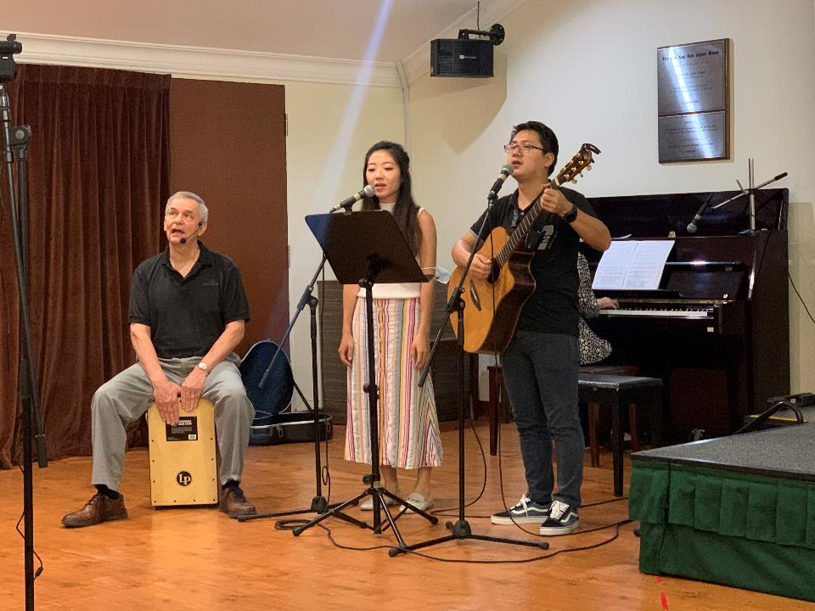
Leading/Serving is not just for Elders

Slide 29
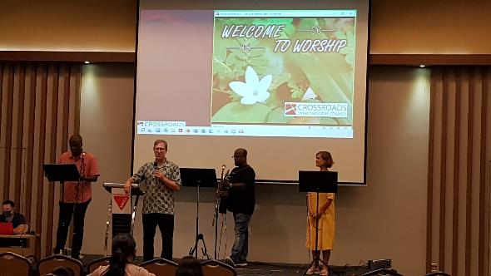
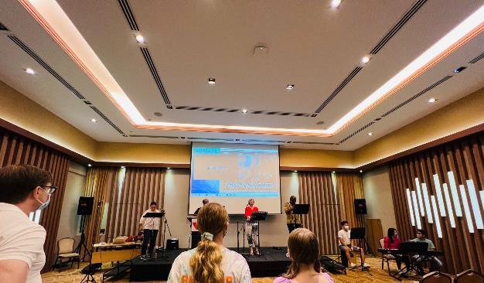

Slide 30






Slide 31
The Future

Slide 32

New Leaders Needed
Elders
SS Director & Teachers
Man2Man
Small Groups
Audio-Visual & Set-Up
Treasurer / Admin

Slide 33
The Lord’s Supper

