Slide 2
T h e T e s t I n g
D e v e l o p i n g A b r a h a m ’ s R i g h t e o u s n e s s

Slide 3
Are You Stronger in Your Trust in God Now Than in the Past?
(Genesis 17)

Slide 4
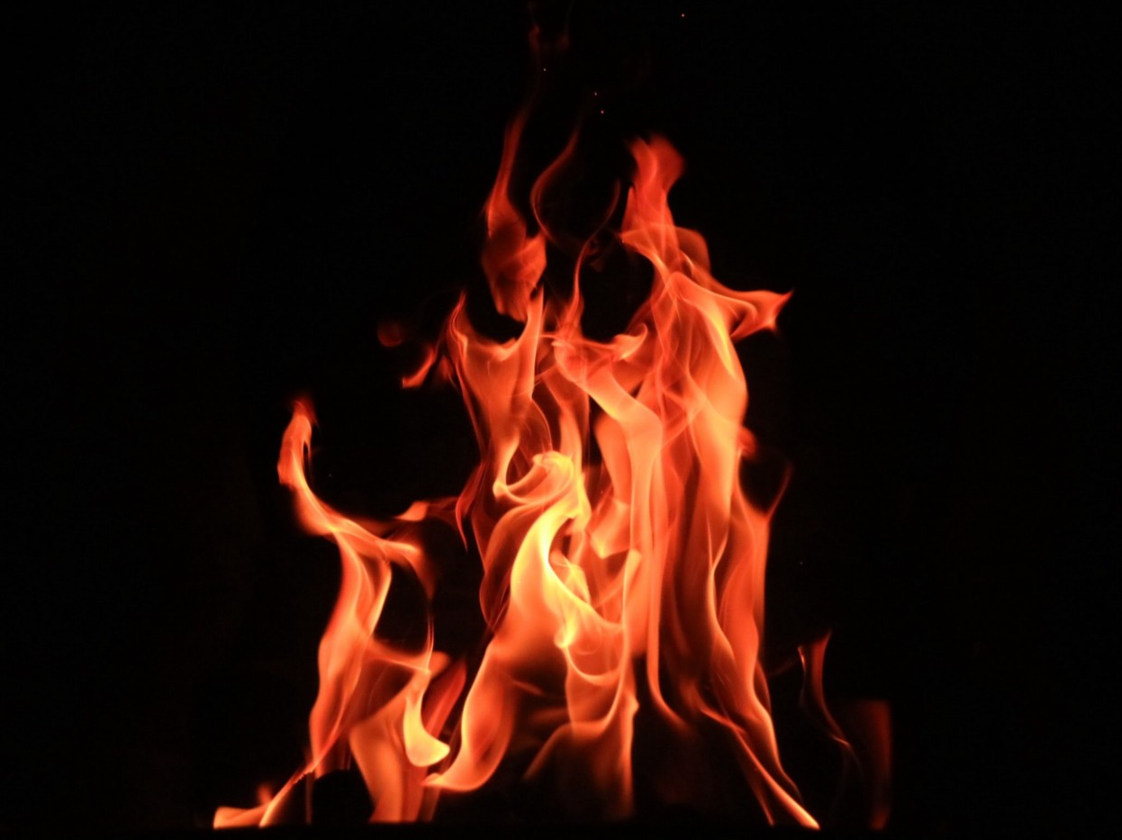
Live whole heartedly for the Lord (vs. 1-2)

Slide 5
Recognize your new identity in the Lord
(vs. 3-8)

Slide 6
Deuteronomy 10:16
Circumcise therefore the foreskin of your heart, and be no longer stubborn.
Remember your purpose in life
(vs. 9-13)

Slide 7
Deuteronomy 10:16​
And the Lord your God will circumcise your heart and the heart of your offspring, so that you will love the Lord your God with all your heart and with all your soul, that you may live.
Remember your purpose in life
(vs. 9-13)

Slide 8
Romans 2:29
But a Jew is one inwardly, and circumcision is a matter of the heart, by the Spirit, not by the letter. His praise is not from man but from God.
Remember your purpose in life
(vs. 9-13)

Slide 9
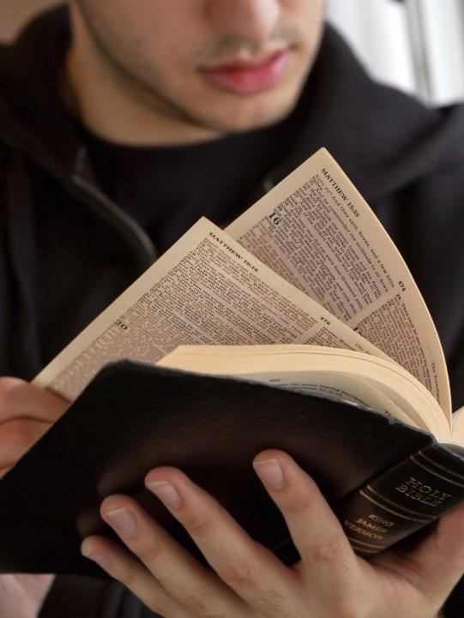
Grow in your understanding of God’s revelation
(vs. 14-21)

Slide 10
Obey without delay
(vs. 22-27)

