Slide 1
Tired of Waiting?

Slide 2
T h e T e s t I n g
D e v e l o p i n g A b r a h a m ’ s R i g h t e o u s n e s s

Slide 3
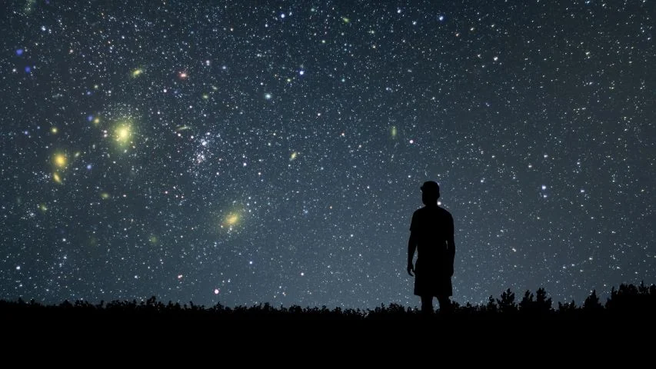
Will You Wait for God to Work?
(Genesis 15-16)

Slide 4
I will wait because I believe God can do the impossible
(Gen 15:1-6)

Slide 5
Romans 4:16-25
¹⁶ That is why it depends on faith, in order that the promise may rest on grace and be guaranteed to all his offspring—not only to the adherent of the law but also to the one who shares the faith of Abraham, who is the father of us all, ¹⁷ as it is written, “I have made you the father of many nations”—in the presence of the God in whom he believed, who gives life to the dead and calls into existence the things that do not exist. ¹⁸ In hope he believed against hope, that he should become the father of many nations, as he had been told, “So shall your offspring be.” ¹⁹ He did not weaken in faith when he considered his own body, which was as good as dead

Slide 6
Romans 4:16-25
(since he was about a hundred years old), or when he considered the barrenness of Sarah's womb. ²⁰ No unbelief made him waver concerning the promise of God, but he grew strong in his faith as he gave glory to God, ²¹ fully convinced that God was able to do what he had promised. ²² That is why his faith was “counted to him as righteousness.” ²³ But the words “it was counted to him” were not written for his sake alone, ²⁴ but for ours also. It will be counted to us who believe in him who raised from the dead Jesus our Lord, ²⁵ who was delivered up for our trespasses and raised for our justification.

Slide 7
Hebrews 11:1
Now faith is the assurance of things hoped for,
the conviction of things not seen.

Slide 8
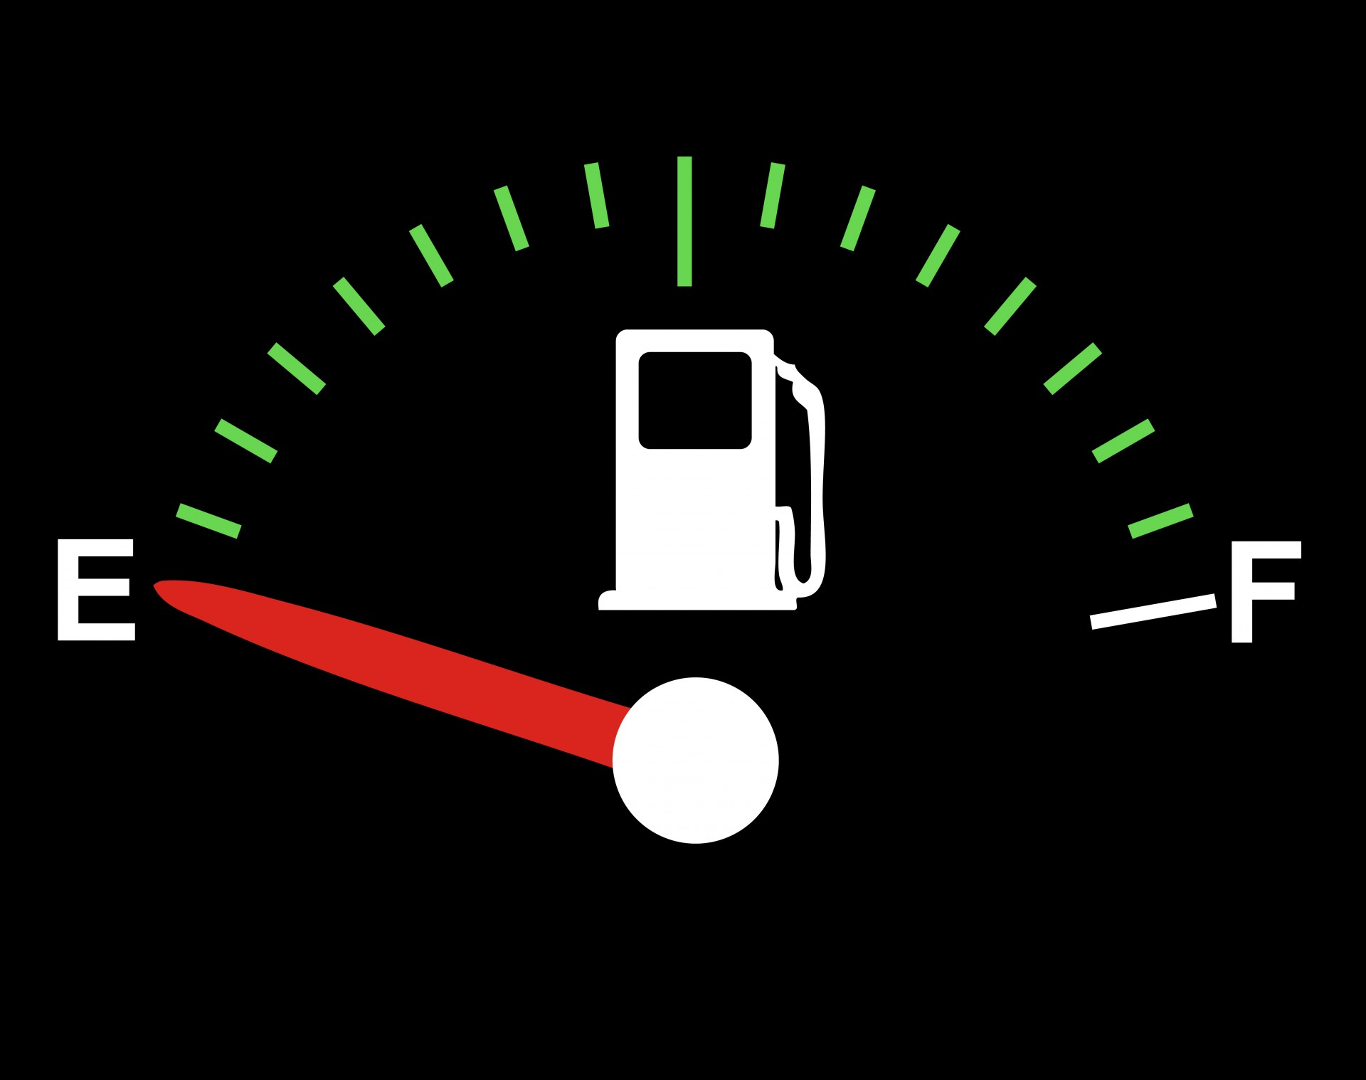

Slide 9
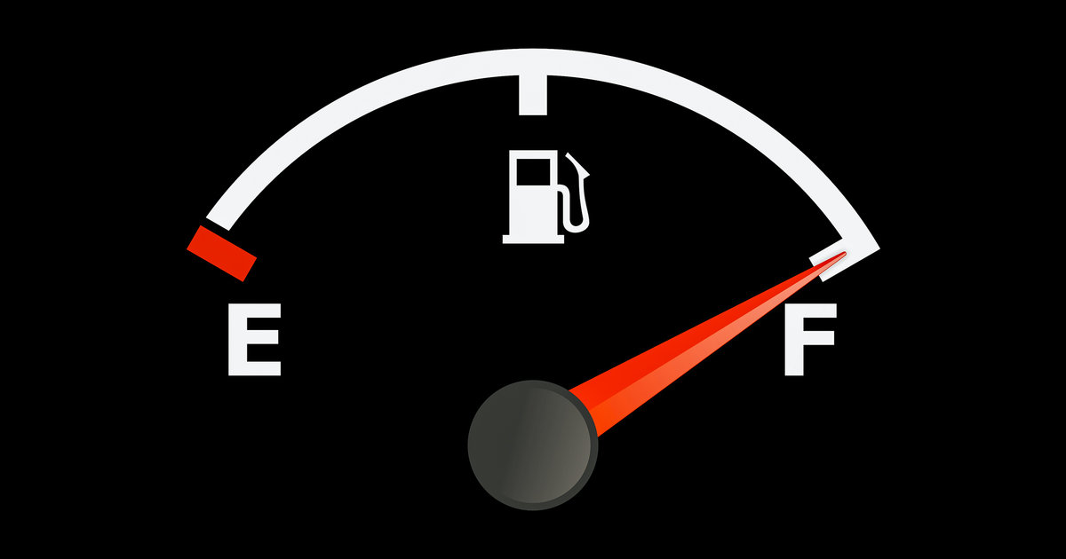

Slide 10
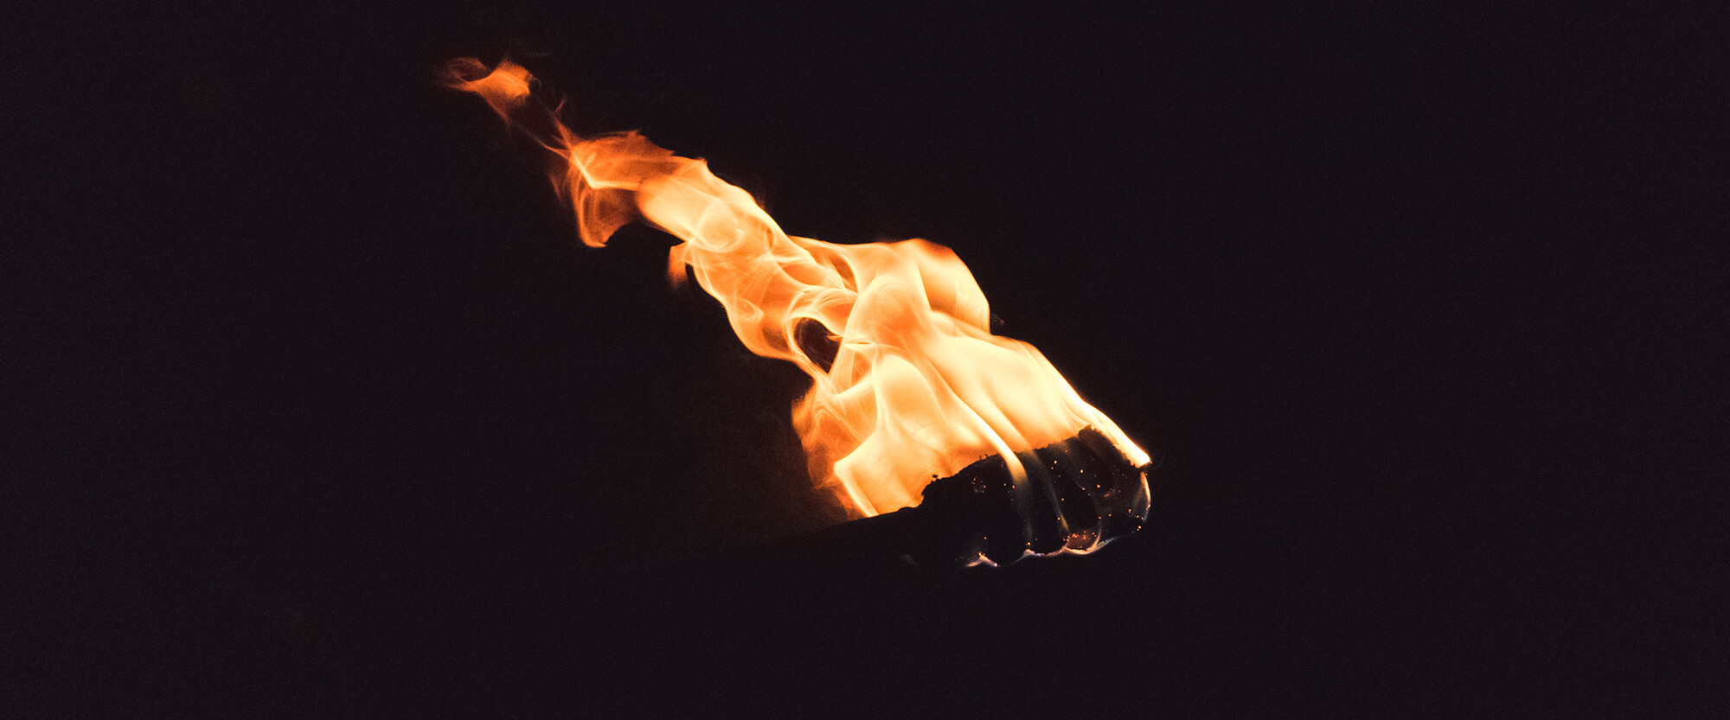
I will wait because I trust God will honor His word (Gen 15:7-15)

Slide 11
And while staying with them he ordered them not to depart from Jerusalem, but to wait for the promise of the Father, which, he said, “you heard from me;
Acts 1:4

Slide 12
²⁴ For in this hope we were saved. Now hope that is seen is not hope. For who hopes for what he sees? ²⁵ But if we hope for what we do not see, we wait for it with patience.
Romans 8:24-25

Slide 13
But our citizenship is in heaven, and from it we await a Savior, the Lord Jesus Christ,
Philippians 3:20

Slide 14
and to wait for his Son from heaven, whom he raised from the dead, Jesus who delivers us from the wrath to come.
1 Thessalonians 1:10

Slide 15
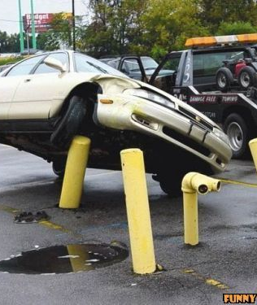
I will wait because forcing my will makes matters worse (Gen 16:1-6)

Slide 16
“Sarai . . . took . . . and gave” to her husband (v. 3)

Slide 17
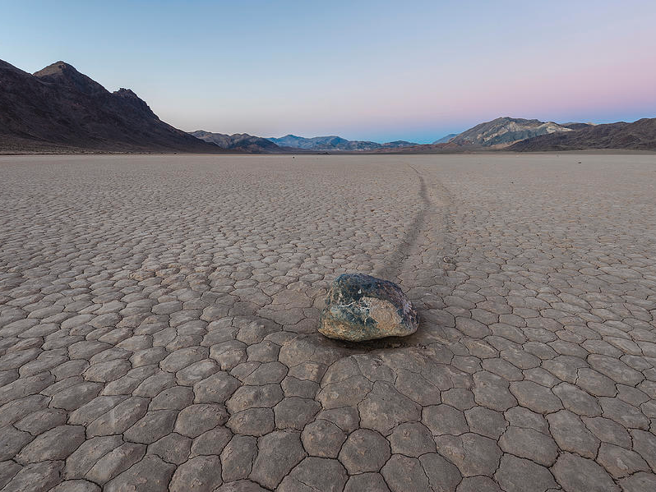
I will wait because God can bring life out of failure and injustice (Gen 16:7-16)

