Slide 1
T h e T e s t I n g
Developing Abraham’s Righteousness

Slide 2
James 1:2-4
2 Count it all joy, my brothers, when you meet trials of various kinds, 3 for you know that the testing of your faith produces steadfastness. 4 And let steadfastness have its full effect, that you may be perfect and complete, lacking in nothing.

Slide 3
Why is Abraham Important?
God’s Promise
Descendants
Land
Blessing

Slide 4
Why is Abraham Important?
God’s Promise
Abraham's Faith
Genesis 15:6
"And he believed the Lord, and he counted it to him as righteousness."

Slide 5
Romans 4:1-5
¹ What then shall we say was gained by Abraham, our forefather according to the flesh? ² For if Abraham was justified by works, he has something to boast about, but not before God. ³ For what does the Scripture say? “Abraham believed God, and it was counted to him as righteousness.” ⁴ Now to the one who works, his wages are not counted as a gift but as his due. ⁵ And to the one who does not work but believes in him who justifies the ungodly, his faith is counted as righteousness,

Slide 6
Why is Abraham Important?
God’s Promise
Abraham's Faith
God's Testing

Slide 7
Romans 4:11-12
¹¹ He received the sign of circumcision as a seal of the righteousness that he had by faith while he was still uncircumcised. The purpose was to make him the father of all who believe without being circumcised, so that righteousness would be counted to them as well, ¹² and to make him the father of the circumcised who are not merely circumcised but who also walk in the footsteps of the faith that our father Abraham had before he was circumcised.

Slide 8
Will you follow God's leading?
(Genesis 12)

Slide 9
Challenges to following God’s leading
Impossible demands to fulfill by human ability
Leave comfortable and familiar surroundings

Slide 10
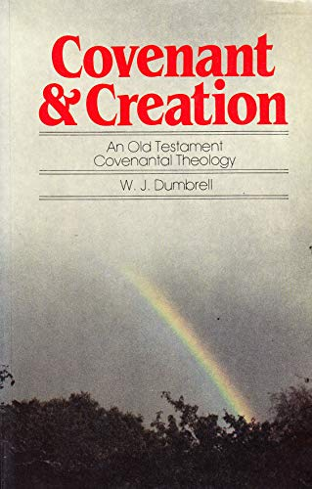
"In short, the call was to abandon all natural connections, to surrender all social customs and traditions, to leave land, clan and family. These were the very areas of strong attachment that in the ancient world would have been thought to provide ultimate personal security. Whatever binds him to the past is to be discarded in this call which now comes to him to be the father of a new nation."

Slide 11
Challenges to following God’s leading
Impossible demands to fulfill by human ability
Leave comfortable and familiar surroundings
Receive few details concerning process
Hebrews 11:8
"By faith Abraham obeyed when he was called to go out to a place that he was to receive as an inheritance. And he went out, not knowing where he was going."

Slide 12
Challenges to following God’s leading
Impossible demands to fulfill by human ability
Leave comfortable and familiar surroundings
Receive few details concerning process
Attempt something unlikely to succeed
Recognize potential danger

Slide 13
Challenges to following God’s leading
Impossible demands to fulfill by human ability
The fruit of following God is not always immediately realized
Confusion and fear tempt us to reconsider God’s leading

Slide 14
What do we learn from this testing?
We are weak: don’t compromise principle
God is sovereign: He will guide
God protects: He will rescue
God will provide: He will supply

