Slide 1
Transformation
Notes:
The idea of transformation is quite popular in today’s culture.

Slide 2
Transformation
Notes:
TV shows such as Extreme Makeover, Home Edition and The Biggest Loser are watched by millions of viewers in many different countries.
People watch because they want to see the transformation.

Slide 3
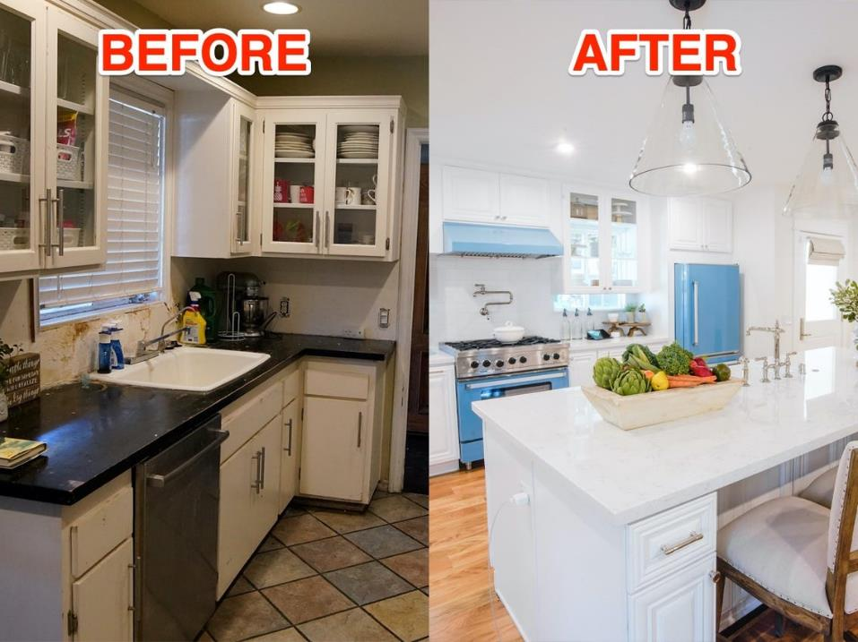
Notes:
In extreme Makeover, Home Edition, the transformation features a family that has faced some sort of recent or ongoing hardship who then receive a makeover of their home.

Slide 4
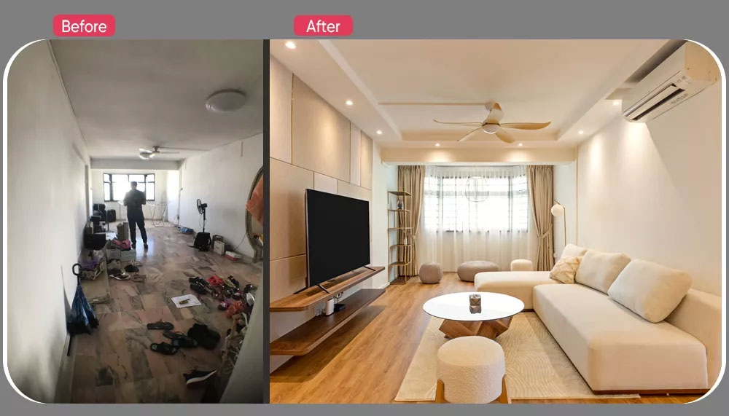
https://www.redbrickhomes.sg/extreme-makeover-this-5-room-hdb-flaunts-a-simple-and-luxurious-look/
SG EDITION
Notes:
The theme of transforming homes is not limited to reality TV shows as seen in an Extreme Makeover of a 5-room HDB flat in Singapore featured on a Singapore home improvement website.
https://www.redbrickhomes.sg/extreme-makeover-this-5-room-hdb-flaunts-a-simple-and-luxurious-look/

Slide 5
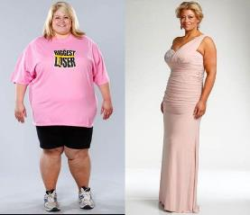
Notes:
Houses are not the only things we like to see transformed. In the Biggest Loser, contestants can lose up to half of their original bodyweight.

Slide 6
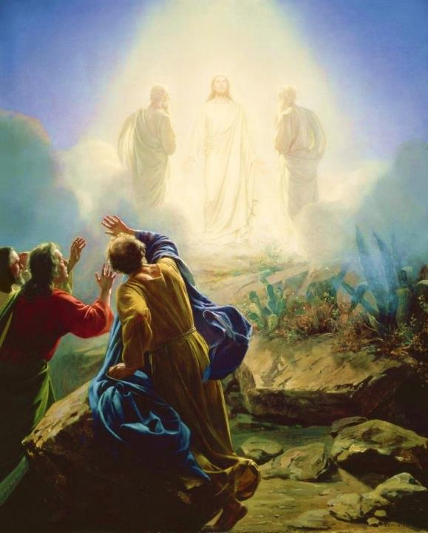
Carl Bloch, c. 1865
Transfiguration of Jesus
Mark 9:2-13 (ESV)
Notes:
Today’s scripture, found in Mark chapter 9, vs 2-13 is also about a transformation. This transformation is known as the Transfiguration of Jesus.
Transformation is an important theme in the Bible. The passage we read together earlier was from Paul’s letter to the Romans, ch 8 vs 19-30 was about transformation. As we saw in Romans 8:30, reading now from the ESV, Paul writes that “and those whom he predestined he also called, and those whom he called he also justified, and those whom he justified he also glorified.”
To go from sin and suffering to being called, justified, and glorified is an extreme transformation. So how do we get to that transformation? We look to Jesus. That is what we are going to do today. We will look at Jesus and his “transfiguration” or “transformation.”
We will see how it affected the disciples and how it should affect us.

Slide 7
The Miracles
of Jesus
Notes:
This will be the final part of our 10-part series on some of the Miracles of Jesus.

Slide 8
Feeding of the 5000 John 6:1-15
Water to Wine John 2:1-11
A Miraculous Catch Luke 5:1-11
The Virgin Birth Luke 1:26-38
Healing at the Pool John 5:1-17
Calming the Storm Matt 8:23-27
Casting Out Demons Matt 8:28-34
Healing the 10 Lepers Luke 17:11-19
Raising of Lazarus John 11:1-46
The Transfiguration Mark 9:2-13
www.cicfamily.com
Notes:
Now these 10 miracles represent just a small number of the miracles proclaimed in the four gospels.

Slide 9
# | Title | Mt | Mk | Lk | Jn
1 | An Angel Causes Zechariah to Become Mute |  |  | Lk 1: 18–20
2 | Elizabeth Becomes Pregnant |  |  | Lk 1:8–25
3 | Jesus’ Virgin Birth | Mt 1:18–25 |  | Lk 2:6–7
4 | The Star of Bethlehem Appears | Mt 2:1–10
5 | Spirit Descend like a Dove, a Voice from Heaven | Mt 3:16-17 | Mk 1:10-11 | Lk 3:21-22
7 | Darkness Covers the Land | Mt 27:45 | Mk 15:33 | Lk 23:4
8 | The Temple Curtain Is Torn in Two | Mt 27:51 | Mk 15:38 | Lk 23:45
9 | An Earthquake in Jerusalem | Mt 27:51
10 | The Resurrection of Saints | Mt 27:52-53
11 | Jesus Rises from the Dead | Mt 28:2–7 | Mk 16:5–8 | Lk 24:4–7 | Jn 20:1–10
Notes:
Some of the miracles in the gospels are performed by God. In the sermon the Sunday before Christmas, we read about Elizabeth becoming pregnant and Jesus’ virgin birth. In that story we also saw the angel Gabriel causing Zechariah to become mute.

Slide 10
# | Title | Mt | Mk | Lk | Jn
1 | The Twelve Cast Out Demons and heal the sick |  | Mk 6:13
2 | Unknown Man Casts Out Demons |  | Mk 9:38–41 | Lk 9:49–50
3 | Seventy Followers of Jesus Cast Out Demons |  |  | Lk 10:17
4 | Peter Walks on Water | Mt 14:29
Notes:
Some of the miracles mentioned in the gospels were performed by people, such as the 12 disciples casting out demons and healing the sick, peter walking on water, even an unnamed person casting out demons.

Slide 11
# | Title | Mt | Mk | Lk | Jn
1 | Jesus Heals Many | Mt 4:23–24 | Mk 1:32–34
2 | Jesus Casts Out Demons | Mt 4:24 | Mk 1:39 | Lk 7:18–23
3 | Jesus Cleanses a Leper | Mt 8:1–4 | Mk 1:40–45 | Lk 5:12–16
4 | Jesus Heals a Centurion’s Servant | Mt 8:5–13 |  | Lk 7:1–10
-----------------------------------------
59 | Jesus Appears in a Locked Room |  |  |  | Jn 20:19–23
60 | Jesus Appears in a Locked Room for Thomas |  |  |  | Jn 20:26–29
61 | Jesus Provides a Miraculous Catch of Fish (John) |  |  |  | Jn 21:4–6
Notes:
But most of the miracles mentioned in the gospels are performed by Jesus. Some 61 out of 76 miracles were Jesus making the blind see, the lame walk, the deaf hear, and the dead rise from the grave. These miracles were announcing Jesus as the Messiah, the Christ, the son of the Living God.
A list of all the miracles in the gospels is available in an excel file that has been uploaded into this zoom chat, out Church WhatsApp group, and will be placed on our website, along with the slides, notes, and audio for this and the other sermons.

Slide 12
Feeding of the 5000 John 6:1-15
Water to Wine John 2:1-11
A Miraculous Catch Luke 5:1-11
The Virgin Birth Luke 1:26-38
Healing at the Pool John 5:1-17
Calming the Storm Matt 8:23-27
Casting Out Demons Matt 8:28-34
Healing the 10 Lepers Luke 17:11-19
Raising of Lazarus John 11:1-46
The Transfiguration Mark 9:2-13
www.cicfamily.com
Notes:
Our short survey on Jesus’ miracles has focused on the accounts presented in Matthew, Luke, and John. But today we will look at Mark’s gospel account.

Slide 13
Notes:
The word “gospel” just simply means good news. The 4 gospel accounts by Matthew, Mark, Luke, and John give us 4 perspectives on this good news.

Slide 14
John 20:31: But these are written so that you may continue to believe that Jesus is the Messiah, the Son of God, and that by believing in him you will have life by the power of his name.
Notes:
The first two sermons in this series looked at John’s account of feeding of the 5,000 and turning water into wine. As you wind your way through John, you will come to the statement found in John 20:31 telling us why he wrote his gospel. He states that these are written so that you may continue to believe that Jesus is the Messiah, the Son of God, and that by believing in him you will have life by the power of his name.

Slide 15
Matt 3:1-2: In those days John the Baptist came to the Judean wilderness and began preaching. His message was, “Repent of your sins and turn to God, for the Kingdom of Heaven is near.”
Matt 4:17: From then on Jesus began to preach, “Repent of your sins and turn to God, for the Kingdom of Heaven is near.”
Notes:
When we looked at Matthew’s account of calming the storm and casting out demons, we saw the main thrust of his gospel was to preach “repent of your sins and turn to God for the Kingdom of heaven is near” as mentioned by both John the Baptist and Jesus with both near the beginning of his gospel account

Slide 16
Luke 1-4: Many people have set out to write accounts about the events that have been fulfilled among us. They used the eyewitness reports circulating among us from the early disciples. Having carefully investigated everything from the beginning, I also have decided to write an accurate account for you, most honorable Theophilus, so you can be certain of the truth of everything you were taught.
Notes:
We also looked at Luke’s account at a miraculous catch of fish and the virgin birth. There, we saw that Luke starts his gospel by telling us why he wrote his gospel, stating that . . .

Slide 17
Mark 1:1: This is the Good News about Jesus the Messiah, the Son of God
Notes:
In a similar manner as Luke, Mark starts his gospel telling us why he wrote his gospel. Unlike Luke though, Mark does not waste words, he jumps straight in the deep end of the pool, he states that “This is the Good News about Jesus the Messiah, the Son of God”
This sense of urgency or immediacy sets Mark’s gospel apart from the others.

Slide 18
εὐθύς - (yoo-thoos’)
Notes:
The Greek word εὐθύς when used adverbially (of time) means at once, immediately, forthwith, straightway.
Although it is used a total of 9 times by Matthew, Luke, and John, . . .

Slide 19
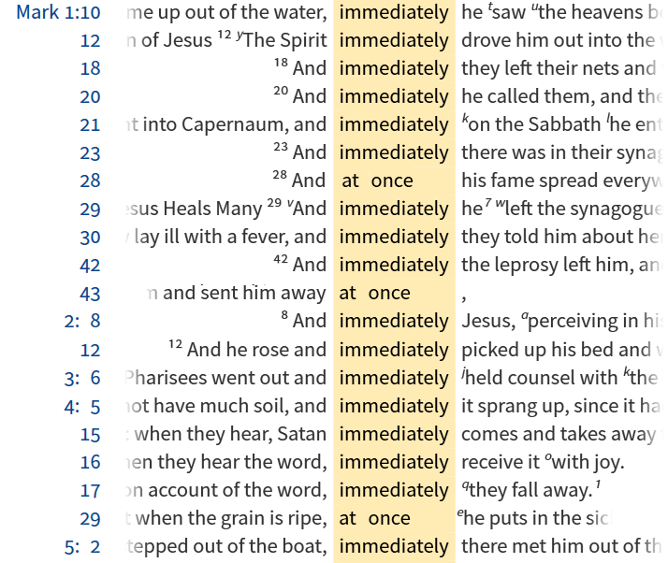
Notes:
it is used 40 times by Mark. So when you start with Mark ch 1, the account is fast paced, it just keeps moving non-stop.

Slide 20
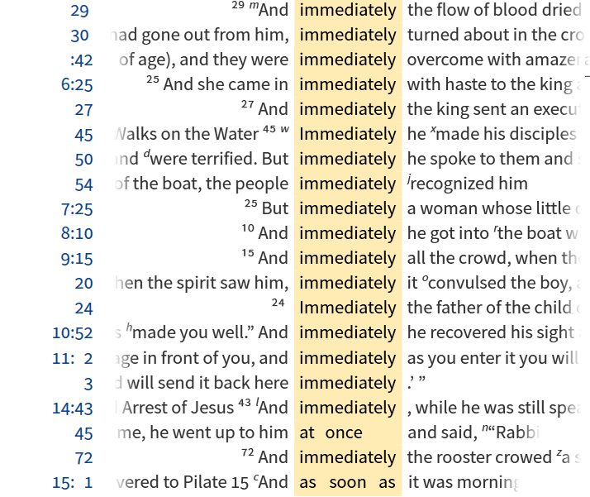
Notes:
If you have young kids, you can tell how excited they are about something by how fast they talk.
Most people outgrow that. But not me. I just turned 50, and I still tend to speed up when I get to talking about something that excites me. If you listen to some of my older sermons, this is very apparent, especially when I go through 60 slides in 20 minutes.
And today I am excited about transformation, seeing Jesus transformed, and seeing how we can go from sin and suffering to being called, justified, and glorified

Slide 21
Background

Slide 22
Healing the Blind Mk 8:22-26
Healing the Blind Mk 10:46-52
² And they came to Bethsaida. And some people brought to him a blind man and begged him to touch him. ²³ And he took the blind man by the hand and led him out of the village, and when he had spit on his eyes and laid his hands on him, he asked him, “Do you see anything?” ²⁴ And he looked up and said, “I see people, but they look like trees, walking.” ²⁵ Then Jesus laid his hands on his eyes again; and he opened his eyes, his sight was restored, and he saw everything clearly.
Notes:
Our scripture today falls within a section of Mark that is book-ended by stories of healing the blind. In the first story, in Bethsaida Jesus is led to a blind man, Jesus spits on the blind man’s eyes, then touched his eyes. But the blind man is only partially healed. He sees people but they look like trees walking. Jesus touches his eyes again and now he is completely healed! He can see everything clearly!
This two-stage healing shows the progression of the disciples understanding, they partially understand, but not clearly.

Slide 23
Healing the Blind Mk 8:22-26
1. Foretells death Mk 8:31
Rebukes Peter Mk 8:32-33
2. Foretells death Mk 9:30-32
Rebukes disciples Mk 9:33-37
3. Foretells death Mk 10:32-34
Rebukes James & John Mk 10:35-45
Healing the Blind Mk 10:46-52
Notes:
The disciples un-clear understanding is shown in a series of events where Jesus foretells his death 3 times. Each time Jesus foretells his death, the disciples do not understand as shown by their actions.
After the first time Jesus foretells his death, Peter rebukes Jesus for saying he must suffer and be killed. That is where Jesus tells Peter “get behind me Satan.”
After the second time Jesus foretells his death, all the disciples are arguing about who is the greatest. That is where Jesus uses a child to illustrate that who ever would be first, he must be last of all and servant of all.
After the third time Jesus foretells his death, James and John ask to be seated at Jesus’ right hand. That is where Jesus responds with The cup that I drink you will drink, and with the baptism with which I am baptized, you will be baptized, 40 but to sit at my right hand or at my left is not mine to grant, but it is for those for whom it has been prepared.”

Slide 24
Healing the Blind Mk 8:22-26
1. Foretells death Mk 8:31
Rebukes Peter Mk 8:32-33
The Transfiguration Mk 9:2-13
2. Foretells death Mk 9:30-32
Rebukes disciples Mk 9:33-37
3. Foretells death Mk 10:32-34
Rebukes James & John Mk 10:35-45
Healing the Blind Mk 10:46-52
Notes:
Our story on the transfiguration takes place after the first rebuke. That story about rebuking Peter actually ends with a promise.
The promise is that there are some standing here who will not taste death until they see the kingdom of God after it has come with power.”

Slide 25
² And after six days Jesus took with him Peter and James and John, and led them up a high mountain by themselves.
Mark 9:2-13 (ESV)
Notes:
Now we pick in in Mark ch 9 vs 2

Slide 26
Why only Peter, James, and John?
Mk 9:2-13 Transfiguration
Mk 14:33 Gethsemane
With Andrew
Mk 1:29-30 Peter’s Mother-in Law
Mk 13:3 Olivet Discourse

Slide 27
² And after six days Jesus took with him Peter and James and John, and led them up a high mountain by themselves.
Mark 9:2-13 (ESV)
Notes:
Now we pick in in Mark ch 9 vs 2

Slide 28
How do you recharge?
Mark 6:30-32
³⁰ The apostles returned to Jesus and told him all that they had done and taught. ³¹ And he said to them, “Come away by yourselves to a desolate place and rest a while.” For many were coming and going, and they had no leisure even to eat. ³² And they went away in the boat to a desolate place by themselves.

Slide 29
² And after six days Jesus took with him Peter and James and John, and led them up a high mountain by themselves. And he was transfigured before them, ³ and his clothes became radiant, intensely white, as no one on earth could bleach them. ⁴ And there appeared to them Elijah with Moses, and they were talking with Jesus.
Mark 9:2-13 (ESV)
Notes:
Now we pick in in Mark ch 9 vs 2

Slide 30
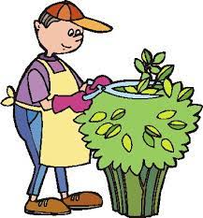
What did they see?
John 20:15 . . . Supposing him to be the gardener

Slide 31
¹² Then I turned to see the voice that was speaking to me, and on turning
I saw seven golden lampstands,
¹³ and in the midst of the lampstands one like a son of man, clothed with a long robe and with a golden sash around
his chest. ¹⁴ The hairs of his head were white, like white wool, like snow. His eyes were like a flame of fire, ¹⁵ his feet were like burnished bronze, refined in a furnace, and his voice was like the roar of many waters
¹⁶ In his right hand he held seven stars, from his mouth came a sharp two-edged sword, and his face was like the sun shining in full strength.

Slide 32
² And after six days Jesus took with him Peter and James and John, and led them up a high mountain by themselves. And he was transfigured before them, ³ and his clothes became radiant, intensely white, as no one on earth could bleach them. ⁴ And there appeared to them Elijah with Moses, and they were talking with Jesus.
Mark 9:2-13 (ESV)
Notes:
Now we pick in in Mark ch 9 vs 2

Slide 33
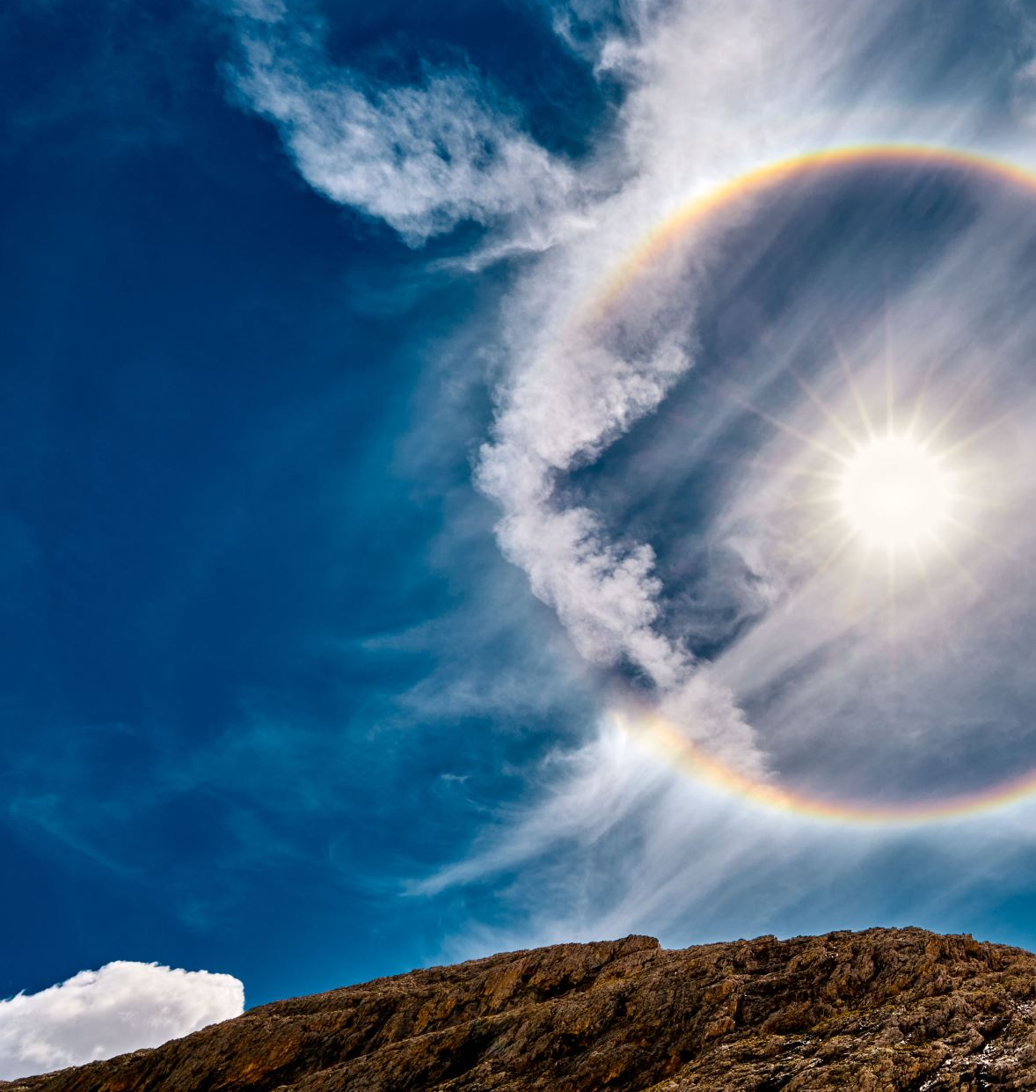
Genesis 1
³ And God said, “Let there be light,” and there was light.
¹⁴ And God said, “Let there be lights in the expanse of the heavens to separate the day from the night.
Revelation 22
⁵ And night will be no more. They will need no light of lamp or sun, for the Lord God will be their light, and they will reign forever and ever.

Slide 34
² And after six days Jesus took with him Peter and James and John, and led them up a high mountain by themselves. And he was transfigured before them, ³ and his clothes became radiant, intensely white, as no one on earth could bleach them. ⁴ And there appeared to them Elijah with Moses, and they were talking with Jesus.
Mark 9:2-13 (ESV)
Notes:
Now we pick in in Mark ch 9 vs 2

Slide 35
Jesus
Moses
Elijah

Slide 36
² And after six days Jesus took with him Peter and James and John, and led them up a high mountain by themselves. And he was transfigured before them, ³ and his clothes became radiant, intensely white, as no one on earth could bleach them. ⁴ And there appeared to them Elijah with Moses, and they were talking with Jesus. ⁵ And Peter said to Jesus, “Rabbi, it is good that we are here. Let us make three tents, one for you and one for Moses and one for Elijah.” ⁶ For he did not know what to say, for they were terrified.
Mark 9:2-13 (ESV)
Notes:
How do the disciples respond?

Slide 37
² And after six days Jesus took with him Peter and James and John, and led them up a high mountain by themselves. And he was transfigured before them, ³ and his clothes became radiant, intensely white, as no one on earth could bleach them. ⁴ And there appeared to them Elijah with Moses, and they were talking with Jesus. ⁵ And Peter said to Jesus, “Rabbi, it is good that we are here. Let us make three tents, one for you and one for Moses and one for Elijah.” ⁶ For he did not know what to say, for they were terrified.
Mark 9:2-13 (ESV)
Notes:
How do the disciples respond?

Slide 38
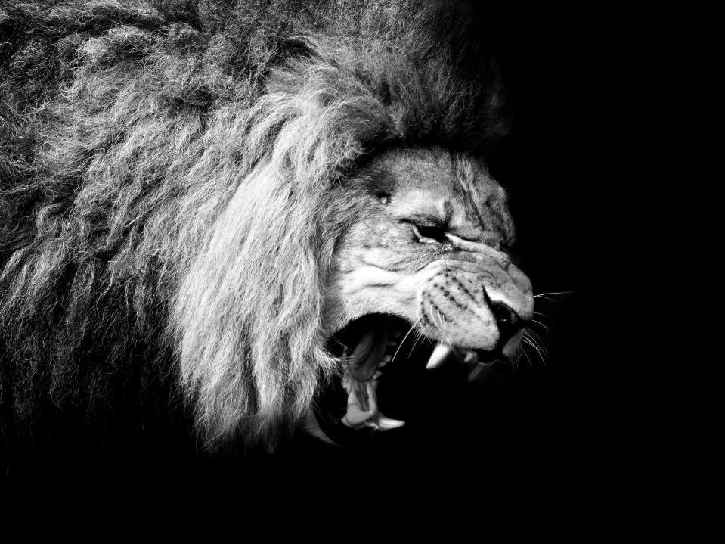
Terrified in the Presence of the Glory of the Lord
Notes:
They were terrified!
How do you feel when you are terrified?

Slide 39
Terrified
Notes:
We have emoji’s now to express our emotions. But can an emoji truly express being terrified?

Slide 40
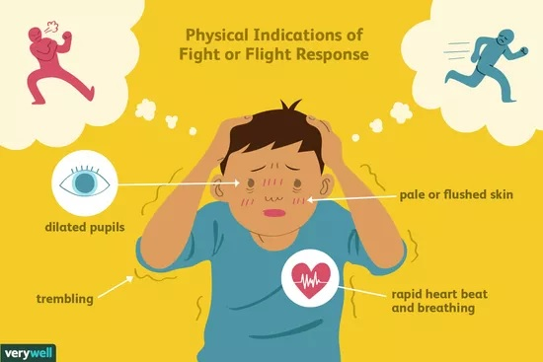

Slide 41
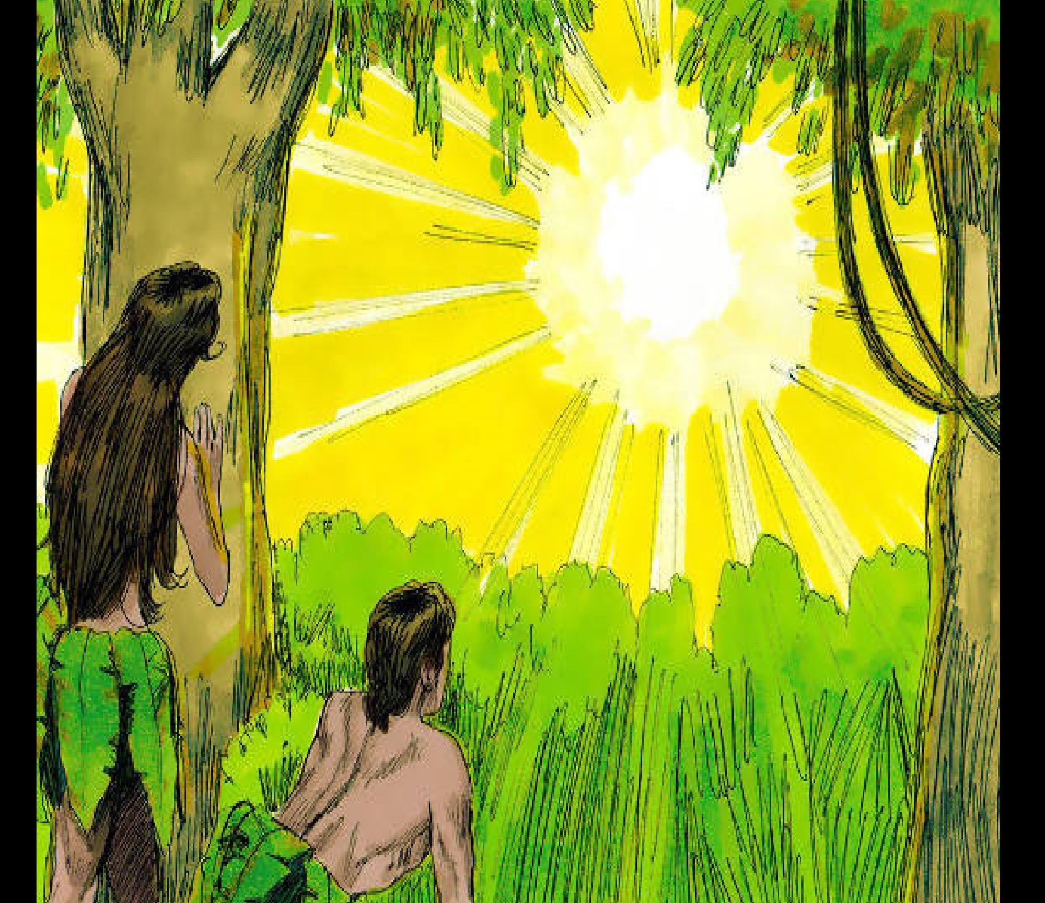
Gen 3
“The woman whom you gave to be with me, she gave me fruit of the tree, and I ate
Notes:
In Gen 3 Adam and Eve were afraid.

Slide 42
⁹ Or do you not know that the unrighteous will not inherit the kingdom of God? Do not be deceived: neither the sexually immoral, nor idolaters, nor adulterers, nor men who practice homosexuality, ¹⁰ nor thieves, nor the greedy, nor drunkards, nor revilers, nor swindlers will inherit the kingdom of God.
¹¹ And such were some of you.
But you were washed, you were sanctified, you were justified in the name of the Lord Jesus Christ and by the Spirit of our God.
Why be Afraid?
1 Cor 6

Slide 43
Terrified in the presence of the Lord
Listen to the Lord

Slide 44
⁷ And a cloud overshadowed them, and a voice came out of the cloud, “This is my beloved Son; listen to him.” ⁸ And suddenly, looking around, they no longer saw anyone with them but Jesus only.
Mark 9:2-13 (ESV)

Slide 45
⁷ And a cloud overshadowed them, and a voice came out of the cloud, “This is my beloved Son; listen to him.” ⁸ And suddenly, looking around, they no longer saw anyone with them but Jesus only.
Mark 9:2-13 (ESV)

Slide 46
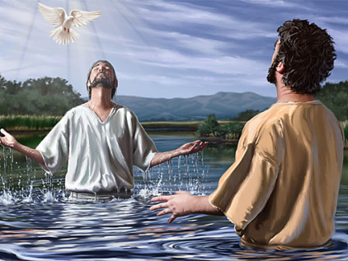
¹⁰ And when he came up out of the water, immediately he saw the heavens being torn open and the Spirit descending on him like a dove. ¹¹ And a voice came from heaven, “You are my beloved Son; with you I am well pleased.”

Slide 47
⁷ And a cloud overshadowed them, and a voice came out of the cloud, “This is my beloved Son; listen to him.” ⁸ And suddenly, looking around, they no longer saw anyone with them but Jesus only.
Mark 9:2-13 (ESV)

Slide 48
4 Moods of Greek Verbs
Indicative
Subjunctive
Optative
Imperative – indicates a command
How are we transformed?

Slide 49
Terrified in the presence of the Lord
Listen to the Lord
The Disciples Listened to the Lord

Slide 50
⁹ And as they were coming down the mountain, he charged them to tell no one what they had seen, until the Son of Man had risen from the dead. ¹⁰ So they kept the matter to themselves, questioning what this rising from the dead might mean.
Whose rising from the dead?
Mark 9:2-13 (ESV)

Slide 51
²⁵ “Therefore I tell you, do not be anxious about your life, what you will eat or what you will drink, nor about your body, what you will put on. . . . ²⁶ Look at the birds of the air: . . . Consider the lilies . . . ³¹ Therefore do not be anxious, saying, ‘What shall we eat?’ or ‘What shall we drink?’ or ‘What shall we wear?’ ³² For the Gentiles seek after all these things, and your heavenly Father knows that you need them all.
³³ But seek first the kingdom of God and his righteousness, and all these things will be added to you.

Slide 52
Terrified in the presence of the Lord
Listen to the Lord
The Disciples Listened to the Lord
Disciples' questions answered by the Lord

Slide 53
¹¹ And they asked him, “Why do the scribes say that first Elijah must come?” ¹² And he said to them, “Elijah does come first to restore all things. And how is it written of the Son of Man that he should suffer many things and be treated with contempt? ¹³ But I tell you that Elijah has come, and they did to him whatever they pleased, as it is written of him.”
Mark 9:2-13 (ESV)

Slide 54
A Good Question
Q: Why must Elijah come first?
A: The scriptures say so
Mal 3:1 “Behold, I send my messenger, and he will prepare the way before me.
Mal 4:5 “Behold, I will send you Elijah the prophet before the great and awesome day of the Lord comes.

Slide 55
Having established the authority of scripture
Q: Why must Messiah suffer?
A: The scriptures say so
Pss 69:20-21“Behold, I send my messenger, and he will prepare the way before me.
Isa 53 But he was pierced for our transgressions; he was crushed for our iniquities; upon him was the chastisement that brought us peace, and with his wounds we are healed.

Slide 56
¹¹ And they asked him, “Why do the scribes say that first Elijah must come?” ¹² And he said to them, “Elijah does come first to restore all things. And how is it written of the Son of Man that he should suffer many things and be treated with contempt? ¹³ But I tell you that Elijah has come, and they did to him whatever they pleased, as it is written of him.”
Mark 9:2-13 (ESV)

Slide 57
By what authority can Jesus proclaim John the Baptist fulfills prophecies about Elijah?

Slide 58
# | Title | Mt | Mk | Lk | Jn
1 | Jesus Heals Many | Mt 4:23–24 | Mk 1:32–34
2 | Jesus Casts Out Demons | Mt 4:24 | Mk 1:39 | Lk 7:18–23
3 | Jesus Cleanses a Leper | Mt 8:1–4 | Mk 1:40–45 | Lk 5:12–16
4 | Jesus Heals a Centurion’s Servant | Mt 8:5–13 |  | Lk 7:1–10
-----------------------------------------
59 | Jesus Appears in a Locked Room |  |  |  | Jn 20:19–23
60 | Jesus Appears in a Locked Room for Thomas |  |  |  | Jn 20:26–29
61 | Jesus Provides a Miraculous Catch of Fish (John) |  |  |  | Jn 21:4–6
61 Miracles

Slide 59
Terrified in the presence of the Lord
Listen to the Lord
The Disciples Listened to the Lord
Disciples' questions answered by the Lord

Slide 60
Be Transformed!
Not terrified

