Slide 1
The Miracles of Jesus

Slide 2
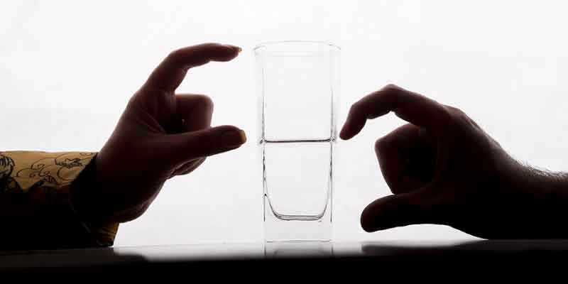
The SupernaturaL BASIS OF OUR FAITH
Is the glass half empty or half full?
From a naturalistic perspective, within a closed-universe, miracles simply do not happen.
From a Christian perspective, miracles are worked by a supernatural Creator, who is transcendent (far above and outside of all) and immanent (personally close and present).
Jesus makes the empty glass full!

Slide 3
“The Christian story is precisely the story of one grand miracle…what is beyond all space and time, what is uncreated, eternal, came into nature, into human nature, descended into His own universe, and rose again, bringing nature up with Him.”

Slide 4
RAISING OF LAZARUS – JOHN 11:1-46
PART 1 – THE PRELUDE
Where are they? John 10:40 – because of Jewish opposition, Jesus and disciples withdrew to the other side of the Jordan river, where John the Baptist first was.
Vs 1-3 – Jesus had a special friendship with Lazarus, Mary and Martha.
Vs 4 – “This illness will not lead to death. It is for the glory of God, so that the Son of God may be glorified through it.”
Vs 5-6: Jesus loved Martha, Mary and Lazarus but delayed his journey (2 days) – why? (Lazarus is already dead).

Slide 5
RAISING OF LAZARUS – JOHN 11:1-46
PART 1 – THE PRELUDE
Vs 7 – ‘Time to go to Judea!’ Disciples are not convinced.
Vs 9-10 – Walk while it is still light. There is work to be done before the night of Jesus’ arrest and death comes.
Vs 11-15 – The disciples are confused – they did not realised that Lazarus was dead.
Vs 16 – Disciples feared the Jews – thus Thomas said, “Let us go to die with him.”

Slide 6
RAISING OF LAZARUS – JOHN 11:1-46
PART II – MARTHA’S CONFESSION
Vs 17 – Lazarus was (truly) dead for 4 days – decomposition has begun.
Vs 18-19 – Formal mourning took place for 7 days, with lots of relatives, weeping and dirges. Burial usually occurs on the same day as death.
Vs 21-22 – Martha believed that Jesus could have healed Lazarus (like Mary, her sister – vs 32) but not yet that Jesus could raise him, even though she affirms belief in his power.
Vs 23-24 – Jesus speaks of present, not final resurrection.

Slide 8
RAISING OF LAZARUS – JOHN 11:1-46
PART II – MARTHA’S CONFESSION
Vs 17 – Lazarus was (truly) dead for 4 days – decomposition begins.
Vs 18-19 – Formal mourning took place for 7 days, with lots of relatives, weeping and dirges. Burial usually on the same day as death.
Vs 21-22 – Martha believed that Jesus could have healed Lazarus (like Mary her sister – vs 32) but not yet that Jesus could raise him, even though she affirms belief in his power.
Vs 23-24 – Jesus speaks of present, not final resurrection.
Vs 26: Martha confesses who Jesus is. (cf Peter’s confession in Matthew 16:16).

Slide 9
RAISING OF LAZARUS – JOHN 11:1-46
PART III – THE WEEPING
Vs 28-32 – Mary comes and speaks to Jesus
Vs 33: When Jesus saw her weeping and the other Jews – he was deeply moved and troubled.
‘Deeply moved’ in Greek is embrimaomai lit. ‘indignant, to snort with anger.’ Anger at whom? At death.

Slide 10
Jesus cried in anger at the wreckage death brought to one family. Death is a foe that in Christ is being defeated.
Gary M Burge,
The NIV Application Commentary - John.
(Zondervan:2009)

Slide 11
RAISING OF LAZARUS – JOHN 11:1-46
PART III – THE WEEPING
Vs 28-32 – Mary comes and speaks to Jesus
Vs 33: When Jesus saw her weeping and the other Jews – he was deeply moved and troubled.
‘Deeply moved’ in Greek is embrimaomai lit. ‘indignant, to snort with anger’. Anger at whom? At death.
Vs 35 – Shortest verse in the Bible but gives a long pause: “Jesus wept.”
He who knows victory over death still feels with us the
sting and stench of death.
Vs 36-37 – Jesus’ reaction divides the crowd.

Slide 12
RAISING OF LAZARUS – JOHN 11:1-46
PART IV – THE RAISING
Vs 38 – Again, Jesus is indignant as he stands at the tomb.
Vs 39 – Martha warns Jesus that he is dead and decomposing!
Vs 40 –Jesus reminds her that believing brings sight of God’s glory.
Vs 41-42: Jesus prayers in faith for their sake.
Vs 43-44: He calls Lazarus out with a great shout, and commands him to be unbound.
Vs 45- Some believe in him, but some betrayed his presence to the rulers.

Slide 13
RAISING OF LAZARUS – JOHN 11:1-46
What we must learn:
1. Jesus is Lord of both life and death
This story foreshadows the resurrection of Jesus.
The tomb that cannot contain Lazarus in, will also neither keep Jesus’ in.
2. Real life is found in Jesus
He is the focus, not Lazarus.
John gives us a whole list of titles for Jesus – rabbi, Lord, Christ, Son of God, He who is coming into the world, the resurrection and the life.

Slide 14
RAISING OF LAZARUS – JOHN 11:1-46
What we must do:
1. Go on believing in Christ (John 20:31).
“This is the work of God, that you believe in him whom he has sent.” (John 6:29)
2. Have a different attitude to death.

Slide 15
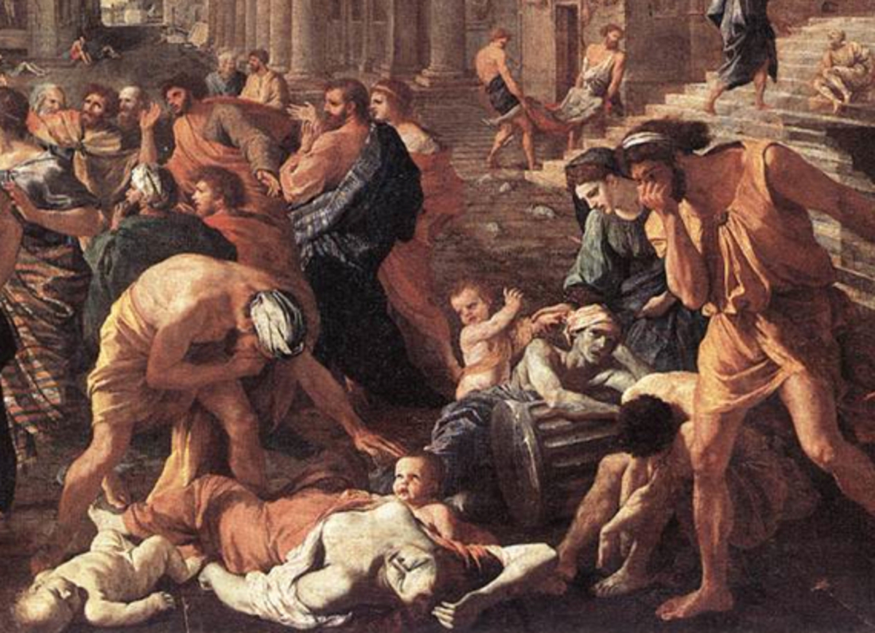
The Plague of Cyrian (250-270 AD)

Slide 16
RAISING OF LAZARUS – JOHN 11:1-46
What we must do:
1. Go on believing in Christ (John 20:31).
“This is the work of God, that you believe in him whom he has sent.” (John 6:29)
2. Have a different attitude to death – neither fear nor flippant.
“So teach us to number our days that we may get a heart of wisdom.” (Psalm 90:12)
3. Spread the news of Jesus to others.
Jesus is Lord of the living and the dead!

