Slide 1
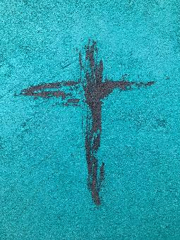
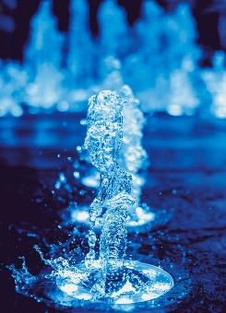
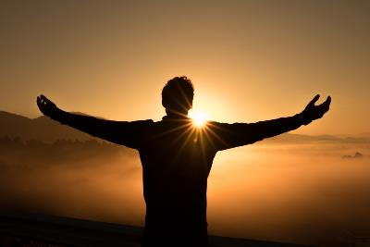
The Miracles
of Jesus

Slide 2
THE MIRACLES OF JESUS – What have we learnt so far?
1. Miracle of the feeding of the 5000 (John 6:5-14) - Jesus has power to feed us.
2. Miracle of turning water into wine (John 2:1-11) - Jesus has the power to re-create elements.

Slide 3
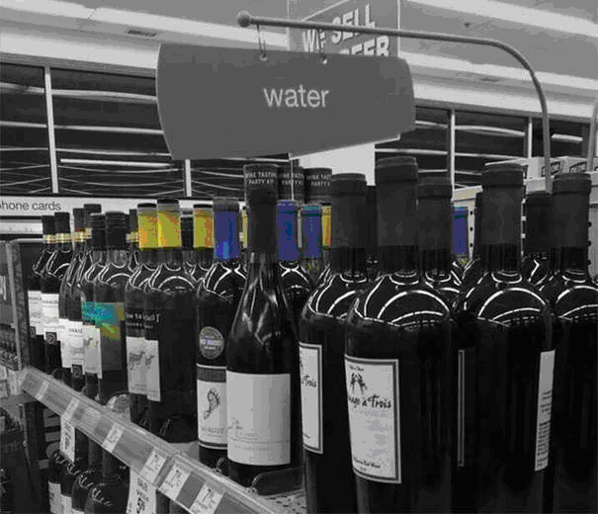

Slide 4
THE MIRACLES OF JESUS – What have we learnt so far?
1. Miracle of the feeding of the 5000 (John 6:5-14) - Jesus has power to feed us.
2. Miracle of turning water into wine (John 2:1-11) - Jesus has the power to re-create elements.
3. Miracle of the miraculous catch of fish(Luke 5:1-11) – Jesus has power over all creatures.
4. Miracle of the virgin birth (Luke 1:26-38) – Jesus is the UNIQUE Son of God.
5. Miracle of healing at the pool of Bethesda (John 5:1-17) – Jesus has power over human disability.
6. Miracle of the calming of the storm on Sea of Galilee (Matthew 8:23-27) – Jesus has power over nature.
7. Miracle of the casting out of demons (Matthew 8:28-34) – Jesus has power over demons.

Slide 5
THE MIRACLES OF JESUS – What have we learnt so far?
8. TODAY – Miracle of the healing of 10 lepers (Luke 17:11-19) – Jesus has power over disease.
TWO MORE TO GO – Jesus has power over death and Jesus is the EXALTED Lord of Glory.

Slide 6
Today – the healing of 10 lepers
The Gospel of Luke
Luke is the only Gentile writer in the New Testament.
Emphasises that the Gospel is for all people and the universal nature of Jesus’ work (Luke 2:14; 2:29-32; 3:6; 10:1; 24:47 – cf Acts 1:8; 28:28).

Slide 7
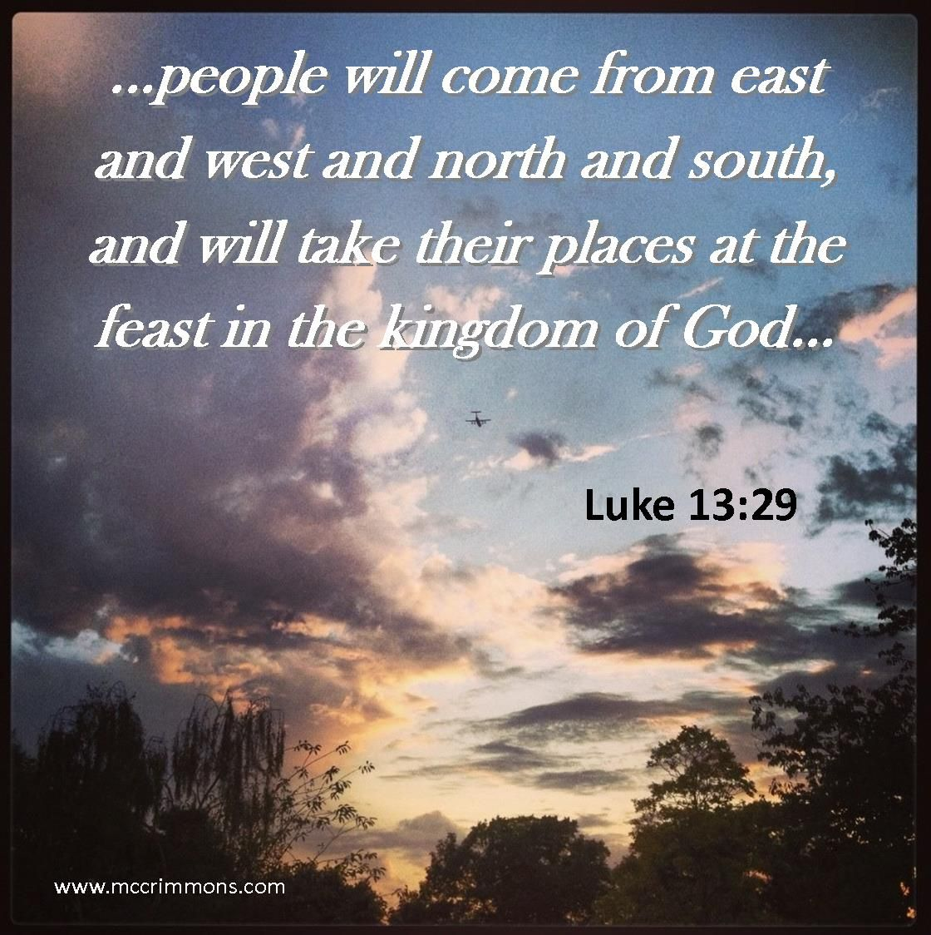

Slide 8
Today – the healing of 10 lepers
The Gospel of Luke
Luke is the only Gentile writer in the New Testament.
Emphasises that the Gospel is for all people and the universal nature of Jesus’ work (Luke 2:14; 2:29-32; 3:6; 10:1; 24:47 – cf Acts 1:8; 28:28).
Focused on the poor, the oppressed, the excluded and the despised (Luke 2:8-10; 6:20; 7:22; 7:36-50; 16:19-31; 19:1-10; 23:43).

Slide 9
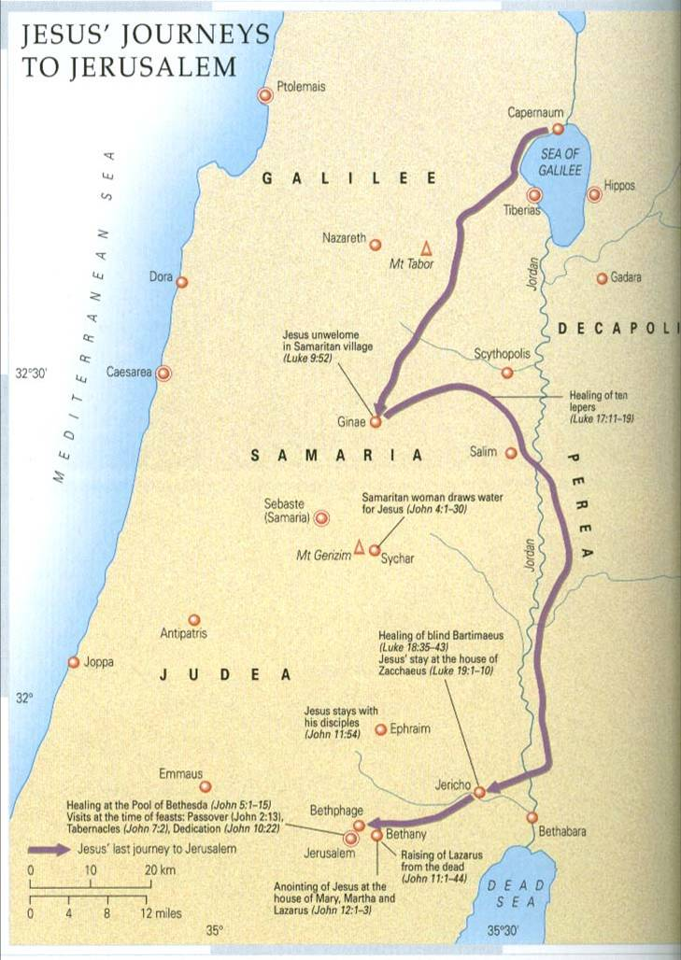
Healing of the 10 lepers – luke 17:11-19
WHERE is Jesus in the story?
Vs 11 – On his way to Jerusalem (Travel Narrative – Luke 9:51-19:44)
Luke reminds us periodically that Jesus is on his way there – Luke 9:53; 13:22; 17:11; 18:31; 19:11.
Passing along the border of Samaria and Galilee.
Vs 12 – In this no-man’s land, as he entered a village – he was met by 10 lepers at a distance.

Slide 10
Healing of the 10 lepers – luke 17:11-19
WHO was involved?
Vs 12: Two Despised groups in One
Lepers – Leprosy was probably what is ‘Hansen’s Disease’, but included other skins diseases too.
Those who had it where condemned to social isolation (Leviticus 23:45,46, Number 5:2).
Sin is like spiritual leprosy – not only are we unclean, but we live outside of community. Jesus came as Messiah to not only preach good news to the poor but to cleanse lepers (Luke 7:22).
Samaritan – One of the ten lepers is a Samaritan - the only one who returns to thank Jesus for his healing.

Slide 11
Who Were the Samaritans?
The Samaritans were half-Jew, half-Gentile.
The result of Israelites who inter-married Assyrians, after their conquest of the northern Kingdom of Israel in 721 B.C.
The Jews despised them and considered them ‘outcasts’. But Jesus not only interacted and preached to them (John 4:1-42), he spoke of them positively (Parable of the Good Samaritan – Luke 10:25-37) and received their worship (in today’s passage).

Slide 12
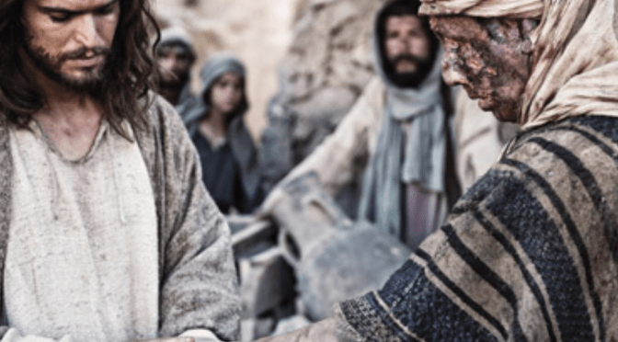
Healing of the 10 lepers – luke 17:11-19
WHAT HAPPENED?
Vs 13 – “Jesus, Master, have mercy on us.”
Called Jesus ‘Master’ – acknowledged his name and authority.
Asked for ‘mercy’ – cry of the outcast.
Vs 14 – ‘When (Jesus) saw them…”
He looked at them, spoke to them
and sent them to the priests – to
certify their healing.

Slide 13
Healing of the 10 lepers – luke 17:11-19
HOW IT HAPPENED?
Vs 14b - ‘As they went, they were cleansed.’

Slide 15
Healing of the 10 lepers – luke 17:11-19
HOW IT HAPPENED?
Vs 14b – “As they went, they were cleansed.”
They had to act on the words of Jesus. Grace must be received and believed/acted on by faith.
Vs 15 – “One of them turned back, praising God with a loud voice, and he fell on his face at Jesus’ feet giving him thanks.”
“Ten of them prayed, only one of them praised.” (Charles Spurgeon).
He was a Samaritan!

Slide 16
Healing of the 10 lepers – luke 17:11-19
WHY DID JESUS RESPOND THE WAY HE DID?
Vs 17 – Jesus was surprised that only one ‘foreigner’ returned to praise God.
Vs 18 – “Your faith has made you well.”
Gk. sōzō – lit. meaning to save, deliver or protect, heal, preserve and be (made) whole.
The others may have experienced physical healing – the Samaritan received spiritual healing (salvation) as well.

Slide 17
Healing of the 10 lepers – luke 17:11-19
1. The Gospel is for all people!
The Gospel must be taken to all people (Matthew 28:19) and to all places, including Samaria (Acts 1:8).
See the difference with the Apostle John in Luke 9:52-56 with Acts 8:14-17.
2. The Gift of God must be received and acted on.
“Do not merely listen to the word, and so deceive yourselves. Do what it says.”(James 1:22, NIV)
3. Gratitude and Praise are the hallmarks of true faith.
The Samaritan saw Jesus through his miracle. He found a greater salvation beyond him immediate cleansing.

Slide 18
APPLICATION
An Exercise in Thankfulness
(1 Chronicles 16:34; Psalm 100:4; Psalm103:2; 2 Corinthians 9:15; Ephesians 5:20; 1 Thessalonians 5:18; Hebrews 13:15.)

Slide 19
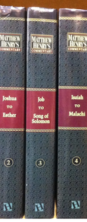
Matthew Henry,
17th Century Bible Commentator and Minister
First, that he had never been robbed before.
Second, that though they took his wallet, they did not take his life.
Third, because even though they took it all, it wasn’t very much.
Finally, because he was the one who was robbed and not the one who did the robbing.

Slide 20
APPLICATION
An Exercise in Thankfulness
Write 3 things you are thankful to God for today…
1.
2.
3.

Slide 21
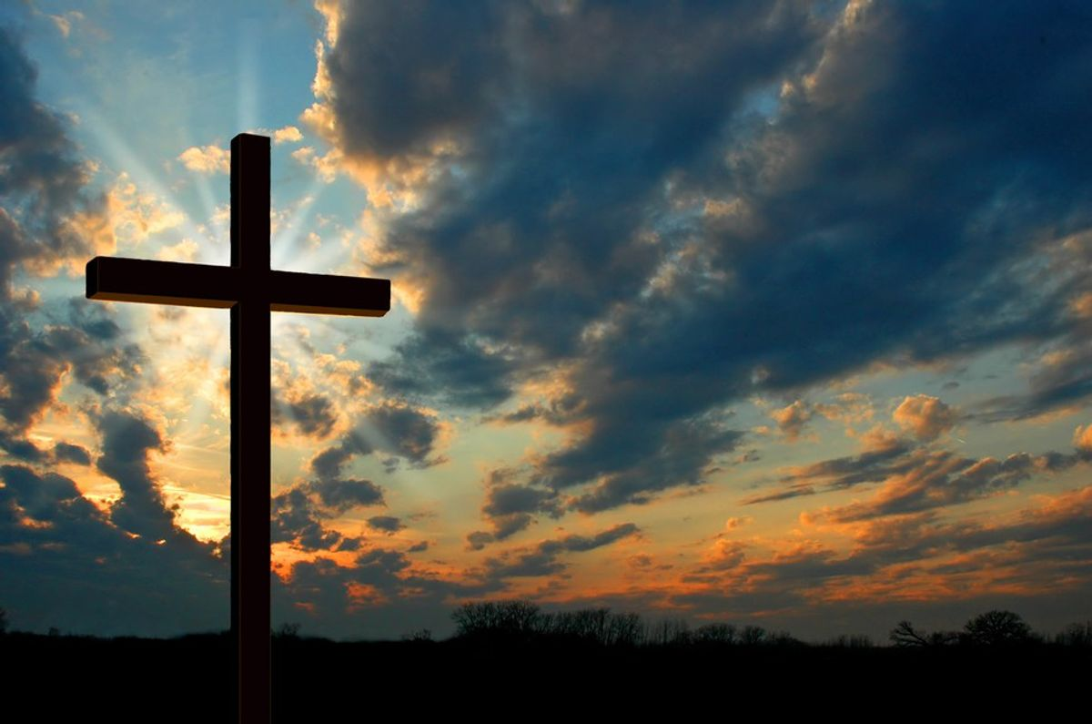
Thank You,
Lord Jesus Christ

