Slide 1
AUTHORITY
Notes:
What do you think of when you hear the word authority?
If you live or work in Singapore, you are probably familiar with Singapore government’s authority.

Slide 2
Notes:
Most Singapore government entities include the words Singapore and authority in their name.
The Monetary Authority of Singapore is the central bank, and controls money.
Want to buy some land? You need to register property ownership with the Singapore Land Authority.
Want to get a pilot's license, you need to go through the Civil Aviation Authority of Singapore.

Slide 3
Singapore Immigration and Checkpoints Authority
ICA .
SICA
Notes:
What if your passport is expired? You visit the Singapore Immigration and Control Authority.
For their acronym, they dropped the S for Singapore, but they kept the A for authority.
This shows the importance of authority.

Slide 4
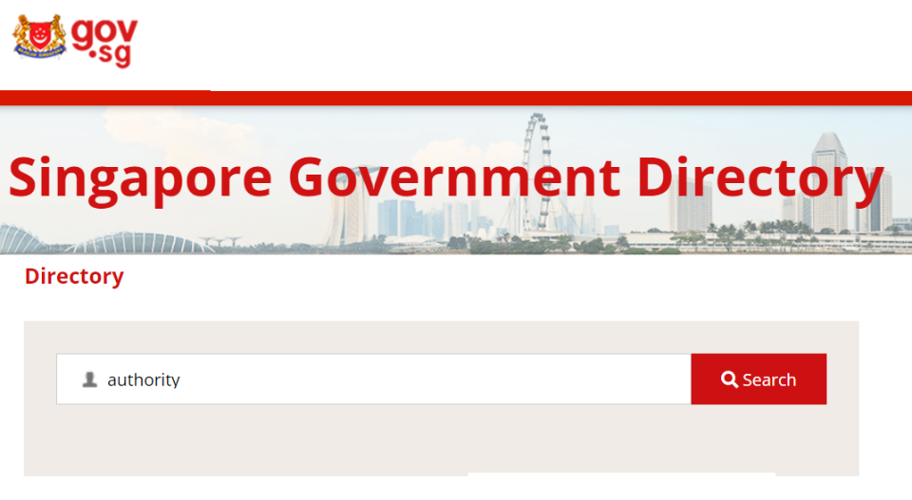
Found 4255 listings in Government Directory.
Notes:
In fact, if you search the Singapore government director for the term “authority,” . . . you will find over 4,000 results.

Slide 5
The Miracles
of Jesus
Notes:
This is in stark contrast with the authority we have been looking at in our series on the miracles of Jesus. In this series, we see ALL authority resides in Jesus.
This is important, because we need to recognize Jesus’ authority in our own lives.

Slide 6
Feeding of the 5000 John 6:1-15
Water to Wine John 2:1-11
A Miraculous Catch Luke 5:1-11
The Virgin Birth Luke 1:26-38
Healing at the Pool John 5:1-17
www.cicfamily.com
Notes:
In this series, we see that Jesus has authority over matter itself, multiplying bread and fish to feed 5,000, and changing water to wine.
Jesus has control over live animals, enabling a miraculous catch of fish.
Jesus has authority of the human body, with the virgin birth the healing at the pool on the Sabbath.

Slide 7
Calming the Storm Matt 8:23-27
Casting out Demons Matt 8:28-34
www.cicfamily.com
Notes:
Last week we saw that Jesus has authority over the weather and the seas.
This week we will look at Matthew chapter 8, vs 28-34, and see that Jesus even has authority over the spiritual realm.
Recognizing that Jesus has all authority is important, but as we look at our passage today, we find it is not enough.

Slide 8
²⁸ And when he came to the other side, to the country of the Gadarenes, two demon-possessed men met him, coming out of the tombs, so fierce that no one could pass that way. ²⁹ And behold, they cried out, “What have you to do with us, O Son of God? Have you come here to torment us before the time?”
Matt 8:28-29 (ESV)

Slide 9
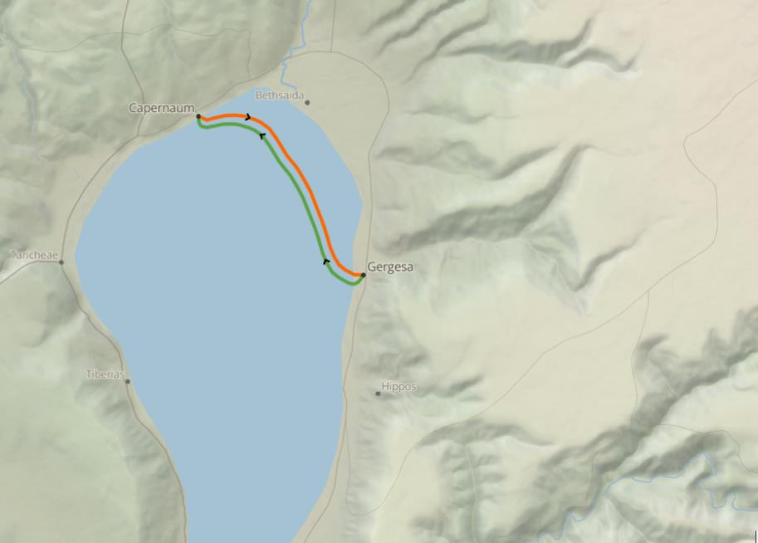
Sermon on the Mount
Calms the Storm
Country of the Gadarenes

Slide 10
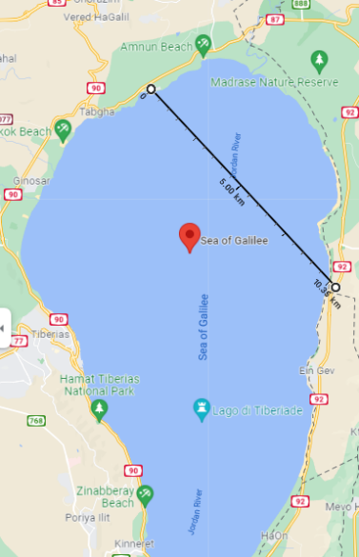
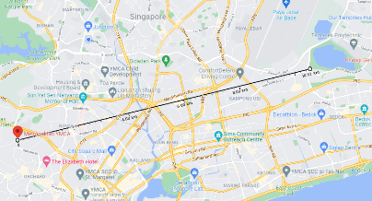
Metropolitan YMCA
to
Bedok Reservoir
10 km
10 km

Slide 11
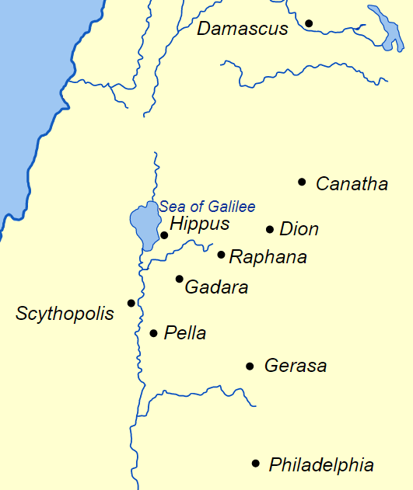
to the country of the Gadarenes
(Matt 8:28 ESV)
to the country of the Gerasenes
(Mark 5:1 & Luke 8:26 ESV)

Slide 13
²⁸ And when he came to the other side, to the country of the Gadarenes, two demon-possessed men met him, coming out of the tombs, so fierce that no one could pass that way. ²⁹ And behold, they cried out, “What have you to do with us, O Son of God? Have you come here to torment us before the time?”
Matt 8:28-29 (ESV)

Slide 14
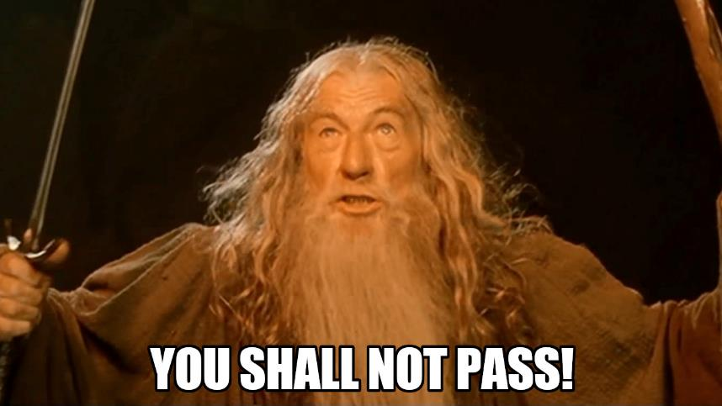

Slide 15
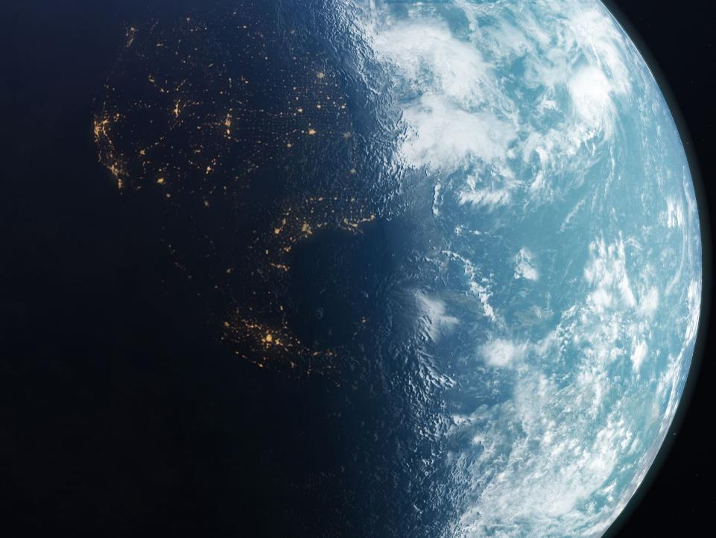
Power
Pleasure
Fame
Fortune
Promises of the world

Slide 16
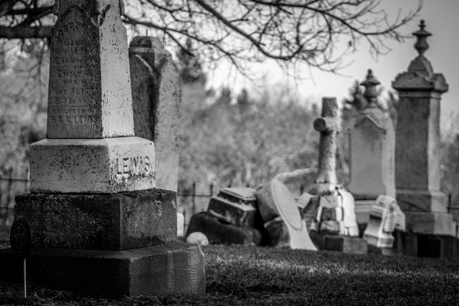
Deceit of the world

Slide 17
Unanswered questions
Why were the men possessed?
Did the men want to be free?
The story is not about the men

Slide 18
²⁸ And when he came to the other side, to the country of the Gadarenes, two demon-possessed men met him, coming out of the tombs, so fierce that no one could pass that way. ²⁹ And behold, they cried out, “What have you to do with us, O Son of God? Have you come here to torment us before the time?”
Matt 8:28-29 (ESV)

Slide 19
Demons recognize spiritual truth
Demons recognize Jesus as the Son of God (Disciples did not)
Demons recognize that God is in control
Demons recognize the penalty for sin
Matt 8:28-29 (ESV)

Slide 20
Time for a Demonstration

Slide 21
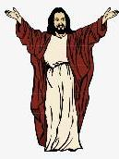
vs
+
Jesus
2 men
Legion of demons
Mark 5:9 & Luke 8:30

Slide 22
³⁰ Now a herd of many pigs was feeding at some distance from them. ³¹ And the demons begged him, saying, “If you cast us out, send us away into the herd of pigs.” ³² And he said to them, “Go.” So they came out and went into the pigs, and behold, the whole herd rushed down the steep bank into the sea and drowned in the waters.
Matt 8:30-32 (ESV)

Slide 23
³⁰ Now a herd of many pigs was feeding at some distance from them. ³¹ And the demons begged him, saying, “If you cast us out, send us away into the herd of pigs.” ³² And he said to them, “Go.” So they came out and went into the pigs, and behold, the whole herd rushed down the steep bank into the sea and drowned in the waters.
Matt 8:30-32 (ESV)

Slide 24
Power of Jesus’ word
Notes:
With the single word “go,” Jesus commanded the legion of demons to depart from the 2 men.
With a simple rebuke, Jesus calmed the winds and the seas.
The creation of the universe began with the phrase “Let there be light”

Slide 25
³⁰ Now a herd of many pigs was feeding at some distance from them. ³¹ And the demons begged him, saying, “If you cast us out, send us away into the herd of pigs.” ³² And he said to them, “Go.” So they came out and went into the pigs, and behold, the whole herd rushed down the steep bank into the sea and drowned in the waters.
Matt 8:30-32 (ESV)

Slide 26
Answered question
Why did the demons want to go into the herd of pigs?
The demons are bent on destruction

Slide 27
Jesus demonstrates authority over an evil spiritual realm bent on destruction
Matt 8:30-32 (ESV)

Slide 28
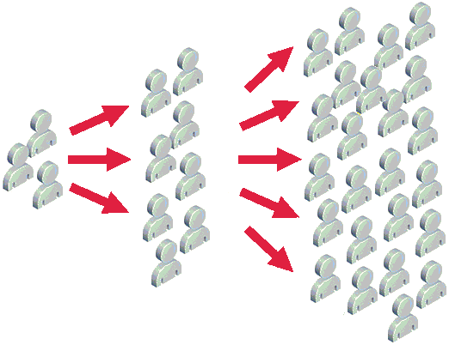
Spreading the News

Slide 29
³³ The herdsmen fled, and going into the city they told everything, especially what had happened to the demon-possessed men. ³⁴ And behold, all the city came out to meet Jesus, and when they saw him, they begged him to leave their region.
Matt 8:28-34 (ESV)

Slide 30
³³ The herdsmen fled, and going into the city they told everything, especially what had happened to the demon-possessed men. ³⁴ And behold, all the city came out to meet Jesus, and when they saw him, they begged him to leave their region.
Matt 8:28-34 (ESV)

Slide 31
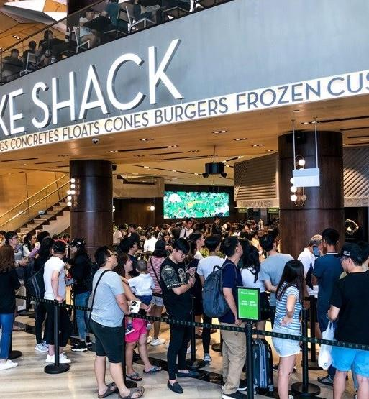
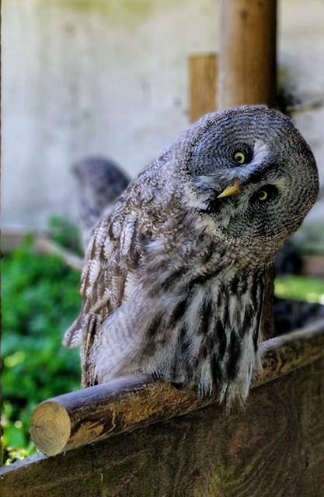
Curiosity?

Slide 32
³³ The herdsmen fled, and going into the city they told everything, especially what had happened to the demon-possessed men. ³⁴ And behold, all the city came out to meet Jesus, and when they saw him, they begged him to leave their region.
Matt 8:28-34 (ESV)

Slide 33
Despite credible witnesses to a miracle, the people of the city deny Jesus’ authority

Slide 34
Not everyone denied Jesus’ authority
Luke 8:39-39 (ESV) . . . begged that he might be with him, but Jesus sent him away, saying, ³⁹ “Return to your home, and declare how much God has done for you.” And he went away, proclaiming throughout the whole city how much Jesus had done for him.

Slide 35
Believers must demonstrate their faith
Demons recognize the authority of Jesus
James 1:19 (NLT) You say you have faith, for you believe that there is one God. Good for you! Even the demons believe this, and they tremble in terror.

Slide 36
Believers must
stand firm in their faith
Demons recognize the authority of Jesus
Jesus demonstrates authority over an evil spiritual realm bent on destruction
1 Peter 5:8 (NLT): Stay alert! Watch out for your great enemy, the devil. He prowls around like a roaring lion, looking for someone to devour.

Slide 37
Believers accept Jesus as the authority in their lives
Demons recognize the authority of Jesus
Jesus demonstrates authority over an evil spiritual realm bent on destruction
Despite credible witnesses to a miracle, the people of the city deny Jesus’ authority

Slide 38
Believers must demonstrate their faith
Believers must stand firm in their faith
Believers accept Jesus as the authority in their lives

Slide 39
How can believers demonstrate they accept Jesus as the authority in their lives
By declaring how much God has done for us!

