Slide 1
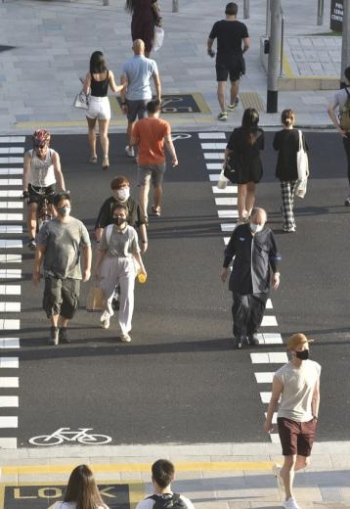
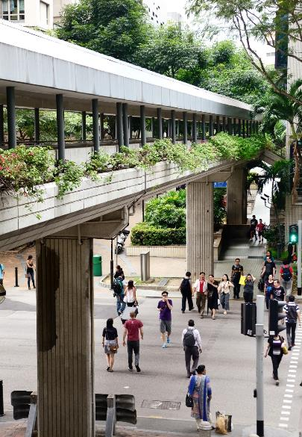
Notes:
There are many amazing things about Singapore. One amazing thing you probably don’t hear about much ---
--- is how easy it is to cross the street.
Of course, there are the standard cross walks with traffic lights.
But then there are overpasses, lined with shrubs and flowers

Slide 2
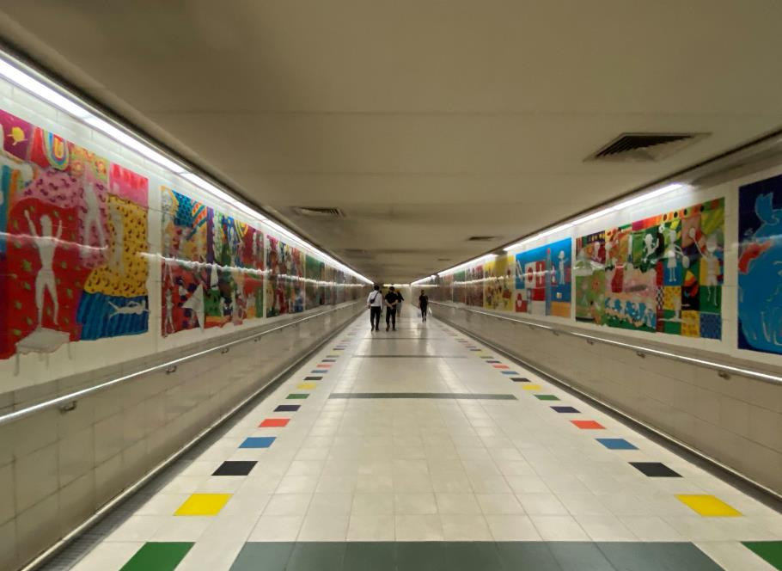
Notes:
There are even air-conditioned underpasses with walls lined with modern art.

Slide 3
Notes:
But once you’ve been in Singapore for a while, you will come to find out that you don’t need to use a cross walk, overpass, or underpass to cross the street.
At first, I was hesitant to just cross the street. But then I see everyone else, so I figure, I will just follow someone.

Slide 4
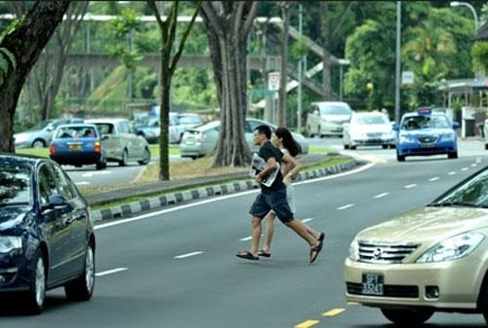
Who Should you Follow?
Notes:
But you need to be careful about who you follow. You don’t want to follow someone who is running across the street in front of other cars.
So who do you follow

Slide 5
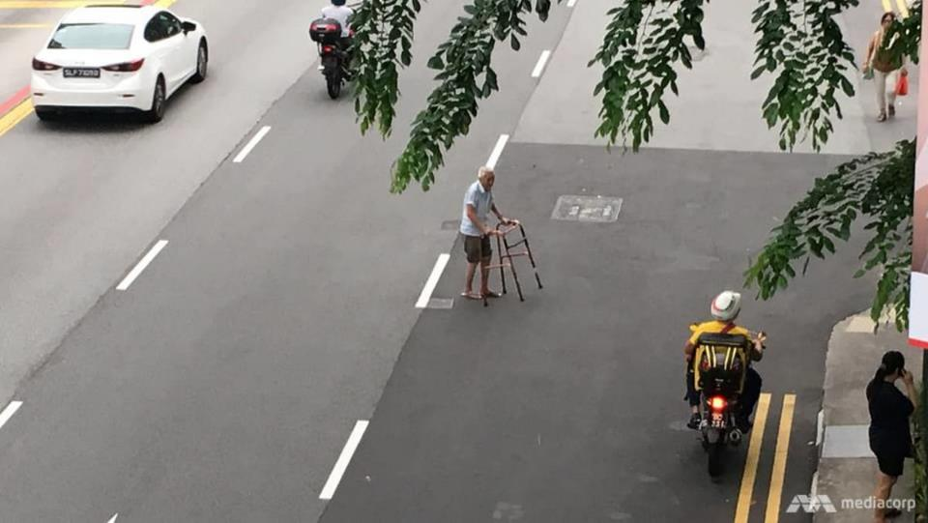
Notes:
When it comes to crossing the street, I found it best to follow someone who must take it slow, and will only go when it is safe to do so.

Slide 6
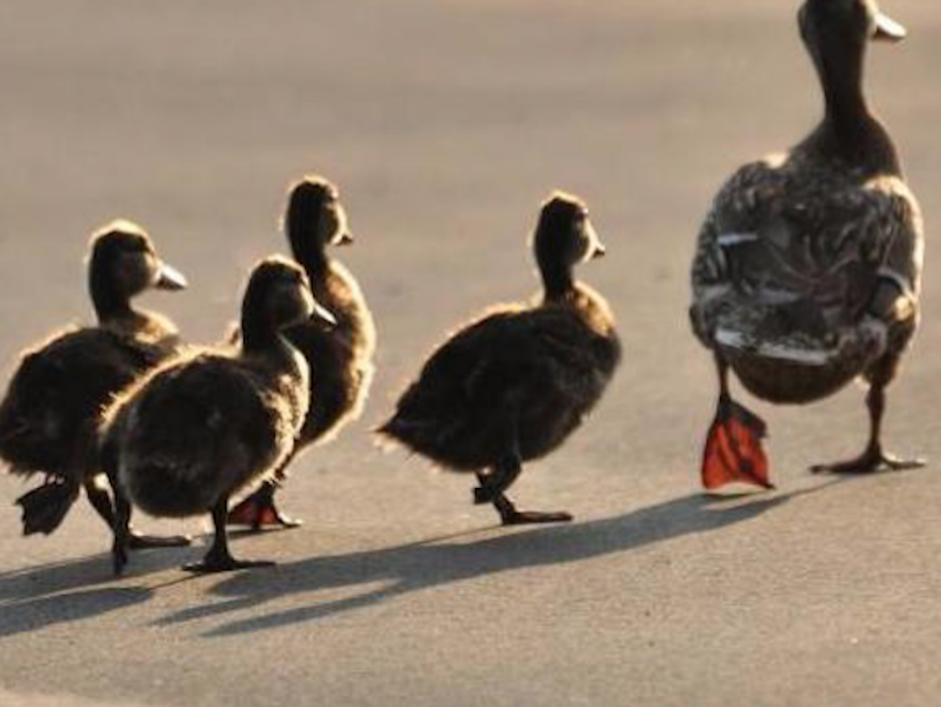
Why Follow JESUS?
Notes:
Today we will look Matthew ch 8 and see why we should follow Jesus, not just when crossing the street, but we should follow Jesus through storms.

Slide 7
The Miracles
of Jesus
Notes:
This is part 6 of a 10-part series that Manik and I are preaching on the Miracles of Jesus.

Slide 8
Feeding of the 5000 John 6:1-15
Water to Wine John 2:1-11
A Miraculous Catch Luke 5:1-11
The Virgin Birth Luke 1:26-38
Healing at the Pool John 5:1-17
www.cicfamily.com

Slide 9
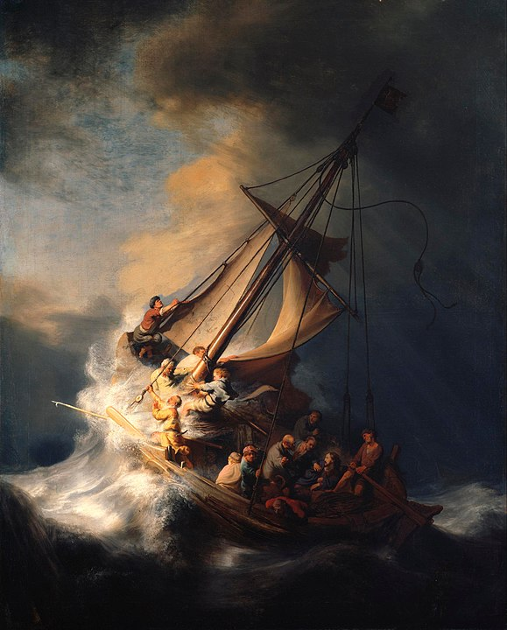
Matt 8:23-27
Jesus CALMS THE STORM
Notes:
The Miracle we will look at today is found in Matthew chapter 8, vs 23-27 and is the miracle where Jesus calms the storm.

Slide 10
Matt 8:23-27
The Storm on the Sea of Galilee
by Rembrandt
Notes:
The renaissance painter Rembrandt captures this miracle in his painting The Storm on the Sea of Galilee.”
In his painting Jesus is sitting calmly in the back of the boat, and the 12 disciples all in a panic,

Slide 11
Notes:
One disciple is seasick and is leaning over the side of the boat. Some say this is Judas, since he the only one of the 12 not from Galilee, he would not be as comfortable on a boat as the Galileans.

Slide 12
Notes:
And then the 14th person on the boat is looking directly at the viewer. Turns out this is a self portrait of the artist, Rembrandt. This is the original cameo.
To find out why the disciples followed Jesus and were on this boat in the first place, let me first give you a background of Matthew’s gospel account.

Slide 13
Overall Message
Matt 3:1-2 (NLT)
¹ In those days John the Baptist came to the Judean wilderness and began preaching. His message was, ² “Repent of your sins and turn to God, for the Kingdom of Heaven is near.
Matt 4:17 (NLT)
¹⁷ From then on Jesus began to preach, “Repent of your sins and turn to God, for the Kingdom of Heaven is near.

Slide 14
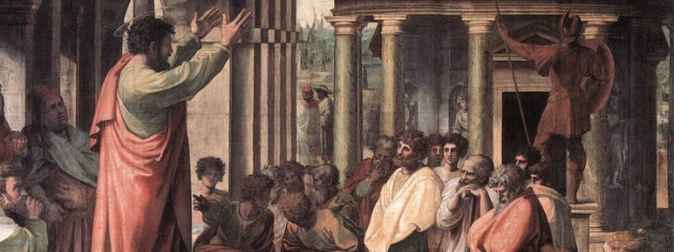
Peter Speaks at Pentecost
Acts 2:38 (NLT)
³⁸ Peter replied, “Each of you must repent of your sins and turn to God, and be baptized in the name of Jesus Christ for the forgiveness of your sins. Then you will receive the gift of the Holy Spirit.

Slide 15
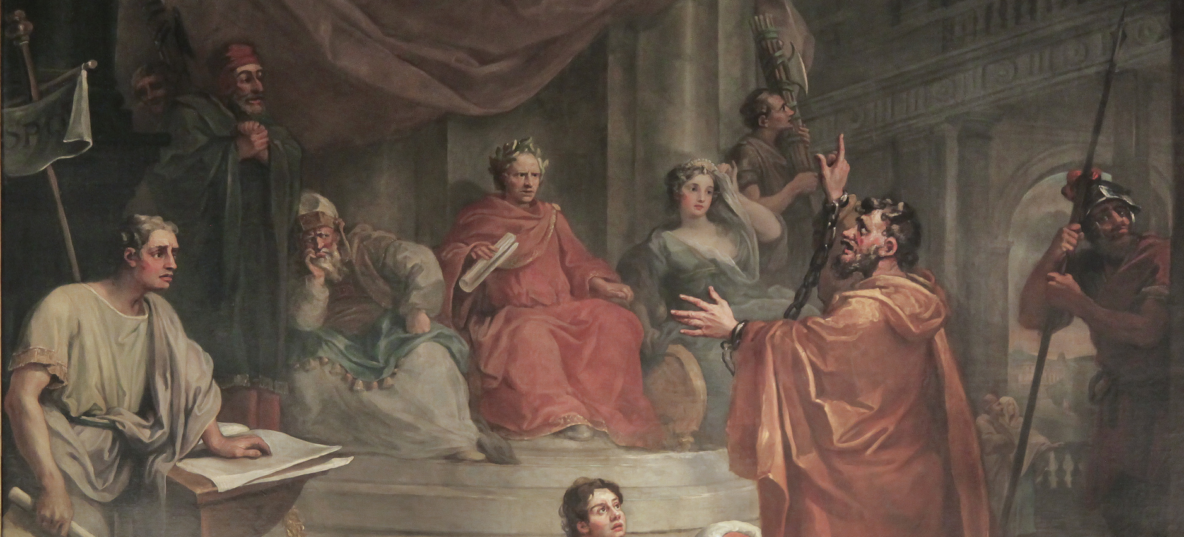
²⁰ I preached first to those in Damascus, then in Jerusalem and throughout all Judea, and also to the Gentiles, that all must repent of their sins and turn to God—and prove they have changed by the good things they do.
Paul speaks to King Agrippa
Acts 26:20 (NLT)

Slide 16
What
Repent and Turn to God
Why
the Kingdom of God is Near

Slide 17
Matthew’s Gospel Account demonstrates why
Jesus is the Christ, the Son of the Living God
Matt 16:16

Slide 18
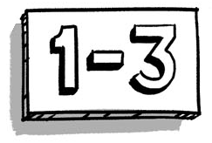
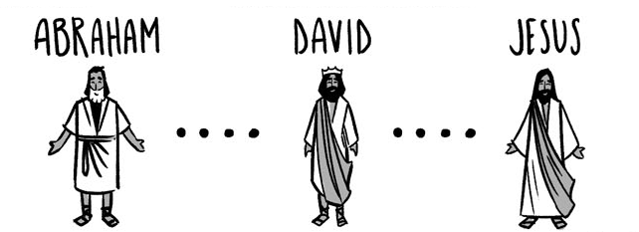
www.bibleproject.com

Slide 19
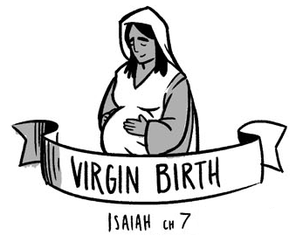

Slide 20
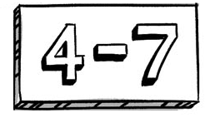
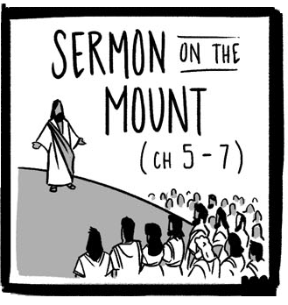
Matt Ch 7: ²⁸ And when Jesus finished these sayings, the crowds were astonished at his teaching, ²⁹ for he was teaching them as one who had authority, and not as their scribes.

Slide 21
Authority in Teaching
Authority in Miracles

Slide 22
General
Specific
Matt 4:23 (ESV)
Matt 8:1-4
And he went throughout all Galilee, teaching in their synagogues and proclaiming the gospel of the kingdom and healing every disease and every affliction among the people
Cleanses a Leper
Matt 8:5-13
Heals Centurion's Servant
Matt 8:16 (ESV)
That evening they brought to him many who were oppressed by demons, and he cast out the spirits with a word and healed all who were sick.
Matt 8:14-15
Heals Peter’s Mother-In-Law
Miracles of Healing

Slide 23
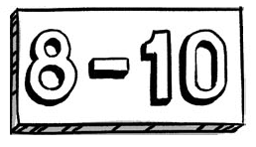
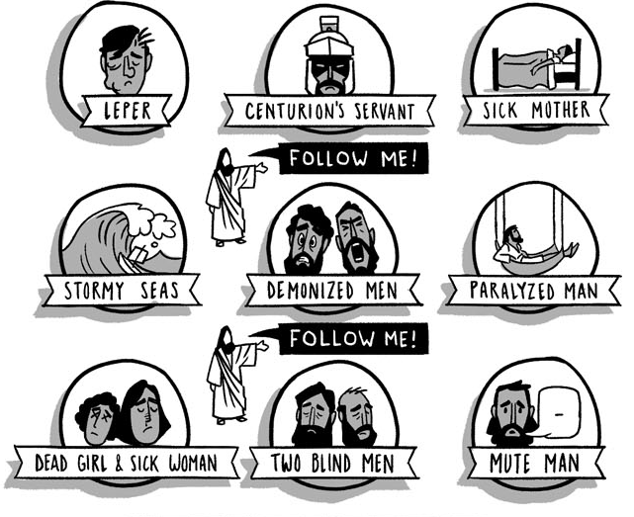
Matt 8:18-22
Matt 8: 23-27

Slide 24
²³ And when he got into the boat, his disciples followed him. ²⁴ And behold, there arose a great storm on the sea, so that the boat was being swamped by the waves; but he was asleep. ²⁵ And they went and woke him, saying, “Save us, Lord; we are perishing.” ²⁶ And he said to them, “Why are you afraid, O you of little faith?” Then he rose and rebuked the winds and the sea, and there was a great calm. ²⁷ And the men marveled, saying, “What sort of man is this, that even winds and sea obey him?”
Matt 8:23-27 (ESV)
Looking Back

Slide 25
¹⁸ Now when Jesus saw a crowd around him, he gave orders to go over to the other side. ¹⁹ And a scribe came up and said to him, “Teacher, I will follow you wherever you go.” ²⁰ And Jesus said to him, “Foxes have holes, and birds of the air have nests, but the Son of Man has nowhere to lay his head.” ²¹ Another of the disciples said to him, “Lord, let me first go and bury my father.” ²² And Jesus said to him, “Follow me, and leave the dead to bury their own dead.”
Disciples need Training
Following Jesus

Slide 26
¹⁸ Now when Jesus saw a crowd around him, he gave orders to go over to the other side. ¹⁹ And a scribe came up and said to him, “Teacher, I will follow you wherever you go.” ²⁰ And Jesus said to him, “Foxes have holes, and birds of the air have nests, but the Son of Man has nowhere to lay his head.” ²¹ Another of the disciples said to him, “Lord, let me first go and bury my father.” ²² And Jesus said to him, “Follow me, and leave the dead to bury their own dead.”
Disciples expect Hardship
Following Jesus

Slide 27
¹⁸ Now when Jesus saw a crowd around him, he gave orders to go over to the other side. ¹⁹ And a scribe came up and said to him, “Teacher, I will follow you wherever you go.” ²⁰ And Jesus said to him, “Foxes have holes, and birds of the air have nests, but the Son of Man has nowhere to lay his head.” ²¹ Another of the disciples said to him, “Lord, let me first go and bury my father.” ²² And Jesus said to him, “Follow me, and leave the dead to bury their own dead.”
Disciples expected to be Devoted
Following Jesus

Slide 28
²³ And when he got into the boat, his disciples followed him. ²⁴ And behold, there arose a great storm on the sea, so that the boat was being swamped by the waves; but he was asleep. ²⁵ And they went and woke him, saying, “Save us, Lord; we are perishing.” ²⁶ And he said to them, “Why are you afraid, O you of little faith?” Then he rose and rebuked the winds and the sea, and there was a great calm. ²⁷ And the men marveled, saying, “What sort of man is this, that even winds and sea obey him?”
Matt 8:23-27 (ESV)

Slide 30
²³ And when he got into the boat, his disciples followed him. ²⁴ And behold, there arose a great storm on the sea, so that the boat was being swamped by the waves; but he was asleep. ²⁵ And they went and woke him, saying, “Save us, Lord; we are perishing.” ²⁶ And he said to them, “Why are you afraid, O you of little faith?” Then he rose and rebuked the winds and the sea, and there was a great calm. ²⁷ And the men marveled, saying, “What sort of man is this, that even winds and sea obey him?”
Matt 8:23-27

Slide 31
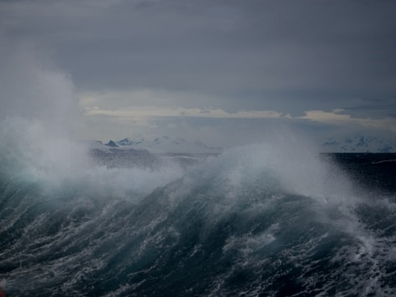
An Unusual Storm
σεισμός
seismos

Slide 32
Followers of Jesus Suffer Storms
Phil 1:29 (NLT)
²⁹ For you have been given not only the privilege of trusting in Christ but also the privilege of suffering for him.
James 1:2-3 (NLT)
² Dear brothers and sisters, when troubles of any kind come your way, consider it an opportunity for great joy.
³ For you know that when your faith is tested, your endurance has a chance to grow.

Slide 33
²³ And when he got into the boat, his disciples followed him. ²⁴ And behold, there arose a great storm on the sea, so that the boat was being swamped by the waves; but he was asleep. ²⁵ And they went and woke him, saying, “Save us, Lord; we are perishing.” ²⁶ And he said to them, “Why are you afraid, O you of little faith?” Then he rose and rebuked the winds and the sea, and there was a great calm. ²⁷ And the men marveled, saying, “What sort of man is this, that even winds and sea obey him?”
Matt 8:23-27

Slide 34
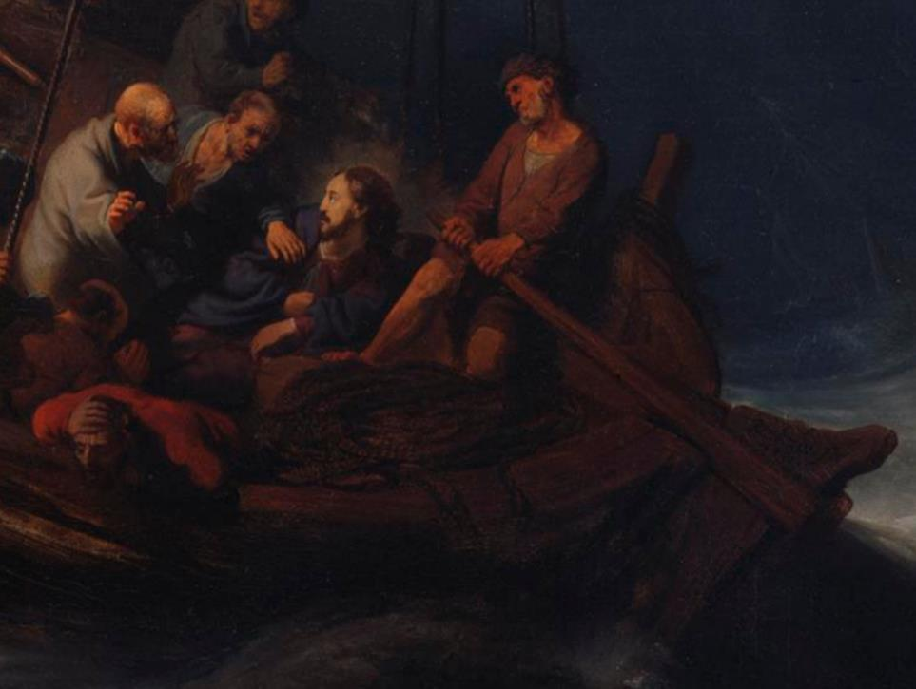
Jesus was fully Human
Jesus was in full control

Slide 35
God is in Control
Rom 8:28 (NLT)
²⁸ And we know that God causes everything to work together for the good of those who love God and are called according to his purpose for them.

Slide 36
God is in Control
Matt 6:25-34
²⁵ “That is why I tell you not to worry about everyday life— . . .

Slide 37
²³ And when he got into the boat, his disciples followed him. ²⁴ And behold, there arose a great storm on the sea, so that the boat was being swamped by the waves; but he was asleep. ²⁵ And they went and woke him, saying, “Save us, Lord; we are perishing.” ²⁶ And he said to them, “Why are you afraid, O you of little faith?” Then he rose and rebuked the winds and the sea, and there was a great calm. ²⁷ And the men marveled, saying, “What sort of man is this, that even winds and sea obey him?”
Matt 8:23-27

Slide 38
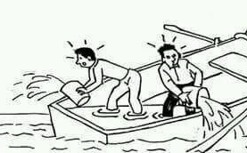
Disciples asked to be saved out of fear

Slide 39
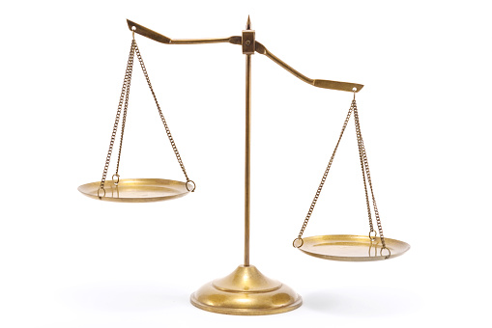
Disciples Faith
Centurion's Faith

Slide 40
⁶ “Lord, my servant is lying paralyzed at home, suffering terribly.” ⁷ And he said to him, “I will come and heal him.” ⁸ But the centurion replied, “Lord, I am not worthy to have you come under my roof, but only say the word, and my servant will be healed.
¹⁰ When Jesus heard this, he marveled and said to those who followed him, “Truly, I tell you, with no one in Israel have I found such faith
Centurion’s Faith
Matt 8:5-13

Slide 41
Even in Jesus’ presence, the disciples had little faith
Centurion had great faith that Jesus could heal the servant without even being present.

Slide 42
⁸ For by grace you have been saved through faith. And this is not your own doing; it is the gift of God, ⁹ not a result of works, so that no one may boast.
We are Saved from our Storms through Faith

Slide 43
²³ And when he got into the boat, his disciples followed him. ²⁴ And behold, there arose a great storm on the sea, so that the boat was being swamped by the waves; but he was asleep. ²⁵ And they went and woke him, saying, “Save us, Lord; we are perishing.” ²⁶ And he said to them, “Why are you afraid, O you of little faith?” Then he rose and rebuked the winds and the sea, and there was a great calm. ²⁷ And the men marveled, saying, “What sort of man is this, that even winds and sea obey him?”
Matt 8:23-27

Slide 44
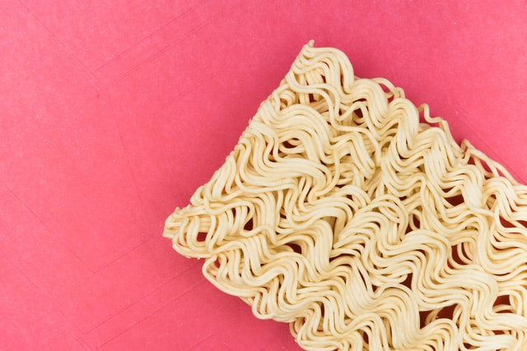
When Jesus
saves, it is immediate

Slide 45
²³ And when he got into the boat, his disciples followed him. ²⁴ And behold, there arose a great storm on the sea, so that the boat was being swamped by the waves; but he was asleep. ²⁵ And they went and woke him, saying, “Save us, Lord; we are perishing.” ²⁶ And he said to them, “Why are you afraid, O you of little faith?” Then he rose and rebuked the winds and the sea, and there was a great calm. ²⁷ And the men marveled, saying, “What sort of man is this, that even winds and sea obey him?”
Matt 8:23-27

Slide 46
²³ And when he got into the boat, his disciples followed him. ²⁴ And behold, there arose a great storm on the sea, so that the boat was being swamped by the waves; but he was asleep. ²⁵ And they went and woke him, saying, “Save us, Lord; we are perishing.” ²⁶ And he said to them, “Why are you afraid, O you of little faith?” Then he rose and rebuked the winds and the sea, and there was a great calm. ²⁷ And the men marveled, saying, “What sort of man is this, that even winds and sea obey him?”
Matt 8:23-27

Slide 47
JESUS SAVES

Slide 48
Repent of your sins and turn to God
When you Follow Jesus, Expect to be Amazed
μετανοέω – I repent
“refers not simply to changing one’s mind but to turning back to God.”
Repentance” Douglas Mangum, Derek R. Brown, Rachel Klippenstein, and Rebekah Hurst, eds, Lexham Theological Wordbook, Lexham Bible Reference Series, (Bellingham, WA: Lexham Press), 2014.

Slide 49
When you Follow Jesus, Expect to be Amazed
Followers of Jesus Suffer Storms
In the Midst of Storms, God is in Control
We are Saved from our Storms through Faith
When Jesus saves, it is immediate

