Slide 1


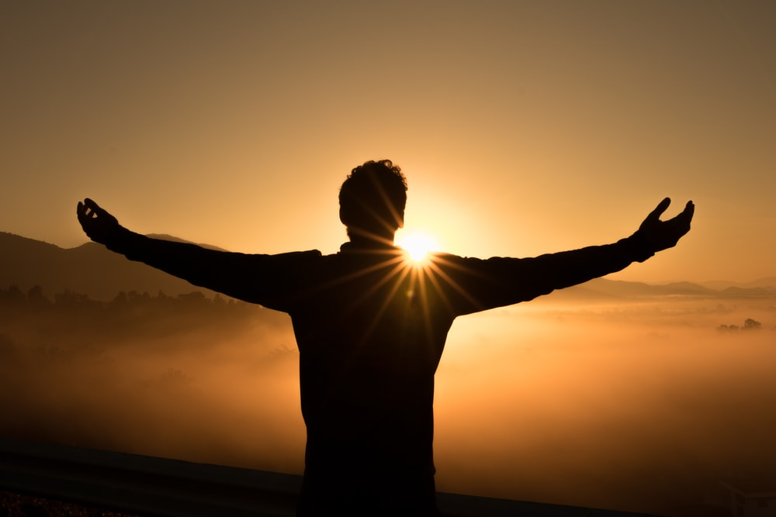
The Miracles of Jesus

Slide 2
The Miracles of Jesus
LAST WEEK…..

Slide 3
Context of Luke 5
In Luke Chapter 4, 3 things happen
1) Jesus is tempted in the wilderness (vs 1-13)
2) He begins his ministry by preaching at synagogue in Nazareth – he announces the messianic fulfilment of Isaiah 61:1-2 (vs 14-30)
3) Jesus heals the sick and delivers those tormented by demons (vs 31-44)
Jesus the Messiah, Phd -
Preaching, Healing and Deliverance!

Slide 4
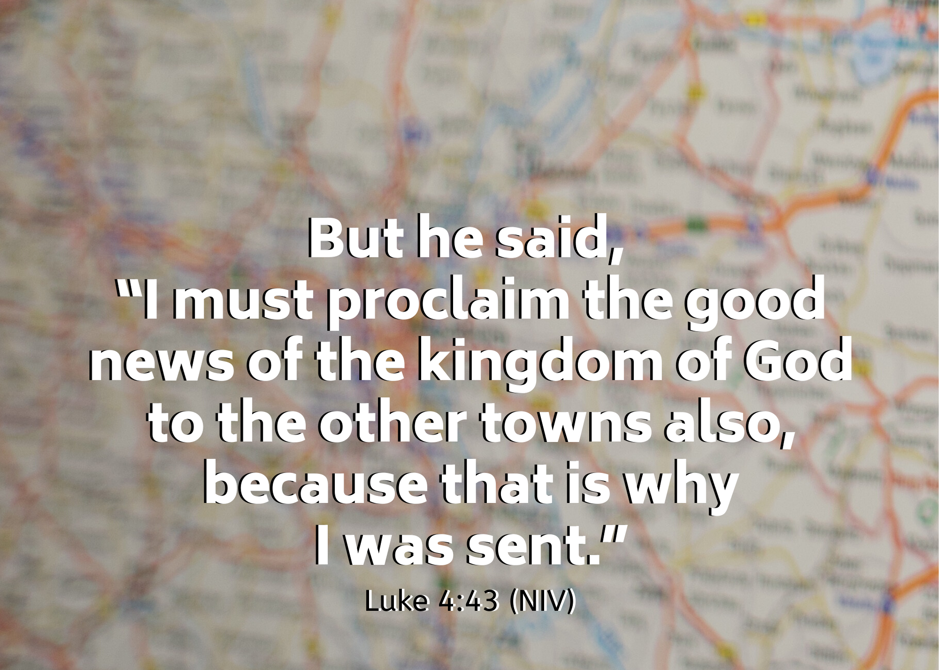

Slide 5

Luke 5:1-11
Vs 1 – From general purpose statement in Luke 4:43, to specific example.
“…the crowd was pressing in on Him to hear the word of God.”
Vs 2 – 2 boats by the lake – fisherman washing their nets, i.e. their work was over.
Vs 3 – Jesus ‘recomissions’ Simon’s boat as a pulpit to teach the crowds.
Vs 4 – When we think our work is done, Jesus’ work has only begun.
Jesus said to him “Put out into the deep and let down your nets for a catch.” And Simon answered, “Master, we toiled all night and took nothing! But at your word I will let down the nets.” (Luke 5:5)

Slide 6
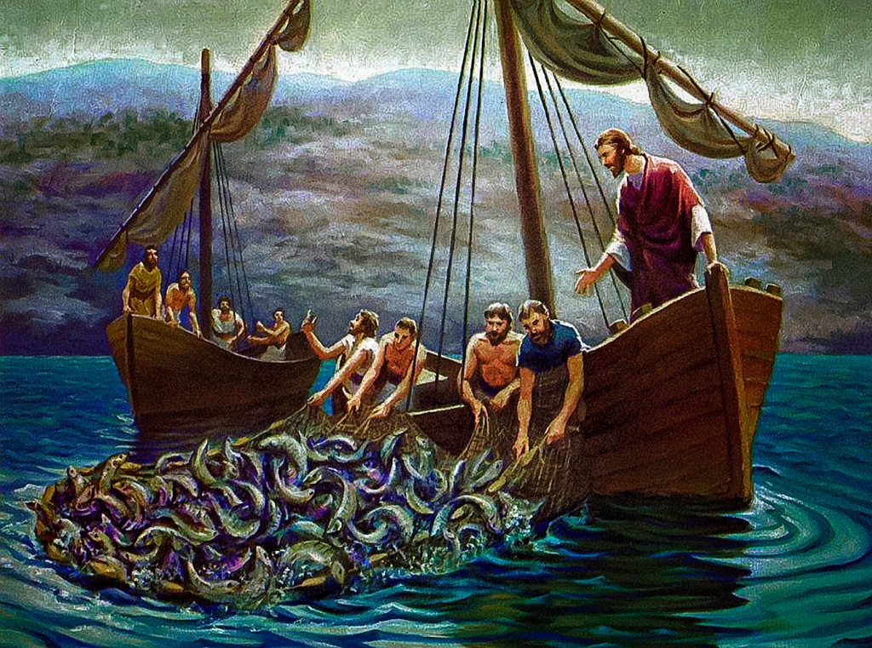

Slide 7
Luke 5:1-11
Vs 6 – “They enclosed a large number of fish, and their nets were breaking.” - More fish than they could contain on their own.
Vs 7 – Called for help from other boat – filled and sinking!
There is no miracle of Jesus which is not at once both transforming AND abundant.
Vs 8 – The response of Simon is equally significant – revelation of one’s unworthiness.
He sees Jesus in all his glory, and feels his shame!
Vs 9-10 – The result was general astonishment all round.
And Jesus said to Simon, “Do not be afraid; from now on you will be catching men.” (Luke 5:10b)

Slide 8
Luke 5:1-11
Vs 11 – Outcome – they left everything and followed him.
What does this passage teach us about discipleship?

Slide 9
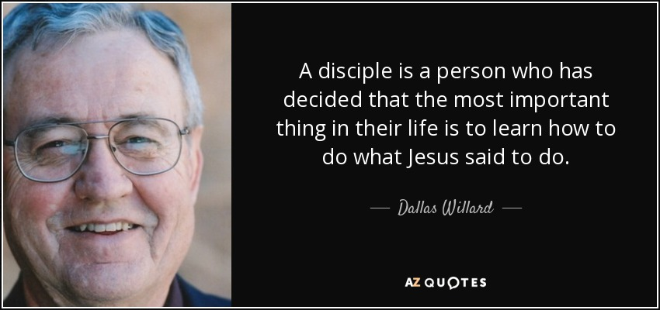

Slide 10
Luke 5:1-11
Vs 11 – Outcome – they left everything and followed him.
What does this passage teach us about discipleship?
It involves repentance. Peter falls on his knees before Jesus. ACTION: Behold God daily, abide and worship in His presence (Isaiah 6:1-7, 2
Corinthians 3:18 cf John 4:23)
It involves obedient faith. ACTION: Let His Word Order and Direct you (John 8:31 cf John 2:5).
It involves an all-of-life response to follow Jesus. ACTION: Surrender to His Will, walk in His Ways (Matthew 10:25,16:24 ).
It involves reaching others for Christ. ACTION: Pray and learn to be a disciple who makes other disciples (Matthew
4:19; 28:19-20).

Slide 11

What will you leave
behind to follow Christ?
Who will you bring
with you after him?

