Slide 1

Notes:
In 2015, Singapore celebrated the 50th anniversary of its independence.
This celebration was called SG50 and included a year-long series of activities and events.
https://www.csc.gov.sg/articles/sg50-what-the-public-service-learnt

Slide 2
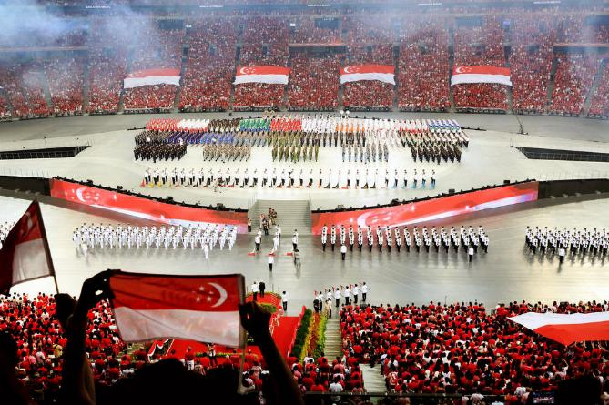
Notes:
Some of these events included parades with hundreds of people moving together in unison.
SG50 parade courtesy of
https://www.todayonline.com/singapore/show-treat-new-venue-gets-mixed-reviews

Slide 3

Notes:
There was also plenty of fireworks, synchronized to music, with some even spelling out SG50.
Fireworks courtesy of
https://www.parkhotelgroup.com/en/stories/singapore-national-day-parade-fireworks-alternatives

Slide 4
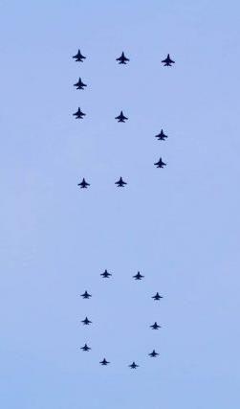
Notes:
There was also an amazing airshow, with fighter jets from the Singapore Armed Forces flying in tight formation.
Lots of planning and preparation were needed to ensure all these events happened without any hiccups.
Airshow rehearsal courtesy of
https://zitseng.com/archives/8797

Slide 5
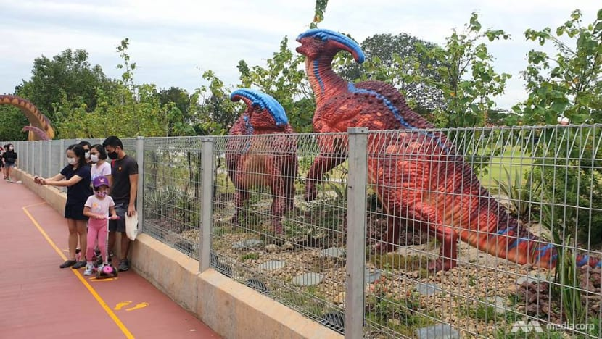
Changi Jurassic Mile
Notes:
Sometimes, even with careful planning, unforeseen issues arise.
For instance, take the Changi Jurassic Mile. First, it is only 1 km long, but that is not the issue.
Turns out, it was built next to a golf course, and the designers did not account for stray golf balls.
Jurassic Mile photo courtesy of
https://www.channelnewsasia.com/singapore/changi-jurassic-mile-golf-ball-injury-safety-netting-981391

Slide 6
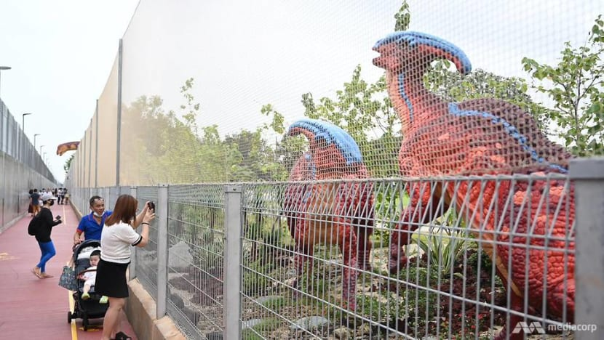
Changi Jurassic Mile
Notes:
So within 2 weeks of opening, netting had to be installed.
Jurassic Mile photo courtesy of
https://www.channelnewsasia.com/singapore/changi-jurassic-mile-golf-ball-injury-safety-netting-981391

Slide 7
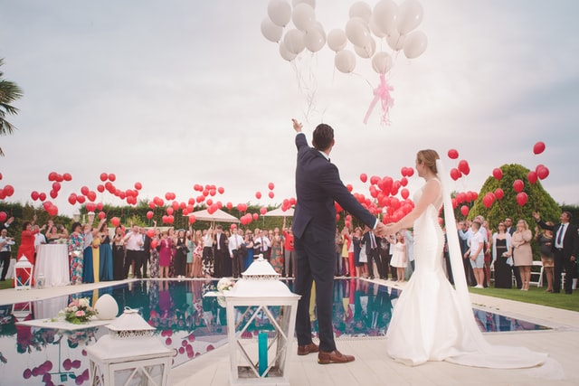
Notes:
Most of you have either been in a wedding, or at least invited to one.
A lot of planning goes into a wedding
Photo by Álvaro CvG on Unsplash
https://unsplash.com/photos/mW8IZdX7n8E

Slide 8
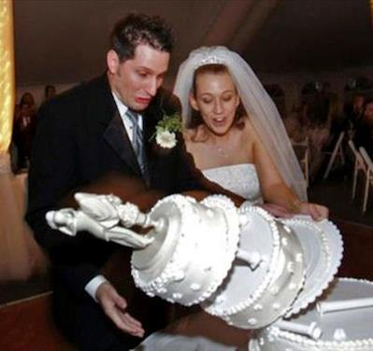
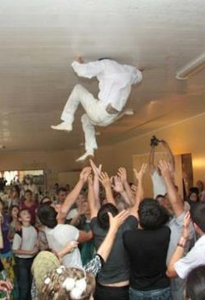
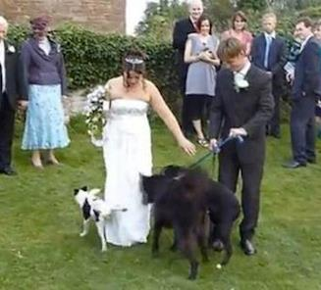
Notes:
Unfortunately, even with all the careful wedding planning, sometimes things do not go as planned.
Wedding fails courtesy of
https://ruinmyweek.com/funny/wedding-fails/

Slide 9
Signs and Wonders
at a Wedding
John 2:1-11 (ESV)
Notes:
Today we will look at John ch 2, vs 1-11 and we will read about a wedding where things did not go as planned. Fortunately, Jesus was at that wedding.
When you hear “Jesus at a wedding,” you probably think about Jesus turning water into wine, one of the Miracles of Jesus.
Photo by Foto Pettine on Unsplash
https://unsplash.com/photos/IfjHaIoAoqE

Slide 10


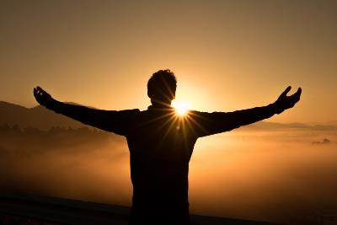
The Miracles of Jesus
Notes:
Here at Crossroads, Manik and I are currently preaching through a series on the Miracles of Jesus.

Slide 11
John 6:1-15
Feeding of the 5000
1. Where do we go to find bread for the hungry?
2. Look past the miracle – behold Jesus!
3. Don’t come to him with your agenda. Bow down, surrender your life, worship Him!
Notes:
Last week Manik preached about Jesus’ feeding of the 5000, found in John Ch. 6.
In his message he answered the question, where do we go to find bread for the hungry?
The answer is that we need to look past the miracle and see Jesus.

Slide 12
Signs and Wonders
at a Wedding
John 2:1-11 (ESV)
Notes:
This week, in John Ch. 2, we also need to look past the miracle at the marriage.
What will we see? Once again we will see Jesus. Were going to learn something about Jesus and then see how we should respond.
Before we look past the miracle, though, let me give you a little background.
Photo by Foto Pettine on Unsplash
https://unsplash.com/photos/IfjHaIoAoqE

Slide 13
John 1:1-14
Jesus is God
Jesus created all things
Jesus is Life
Jesus is Light
BACKGROUND
Notes:
The first chapter of John’s gospel account can be considered an introduction that contains 3 parts.
We read the first part as our corporate reading, John 1-14.
In this section John tells us that Jesus is God. In the beginning was the word, and the word was with God, and the word was God!.
John continues to tell us that Jesus, the word, created all things, In him is life and he is the light of the world.

Slide 14
John 1:1-14
Jesus is God
Jesus created all things
Jesus is Life
Jesus is Light
John 1:15-34
BACKGROUND
Testimony of John the Baptist
I am not the Christ
One who comes after is greater
Saw Jesus coming towards him, . . . saw the spirit descend from heaven like a dove and remain on him
Notes:
The next part of the introduction is the testimony of John the Baptist. He said that:
He is not the Christ,
That one who comes after him is greater.
He saw Jesus coming towards him, and that he saw the spirit descend from heaven like a dove and remain on Jesus.

Slide 15
John 1:1-14
Jesus is God
Jesus created all things
Jesus is Life
Jesus is Light
John 1:15-34
BACKGROUND
Testimony of John the Baptist
John 1:35-51
Jesus calls Disciples
2 of John’s disciples (Andrew and ???)
Peter (Andrew’s brother)
Philip and Nathaniel (Philip’s brother)
Notes:
In the final part of the introduction, we see Jesus call the first group of his disciples.

Slide 16
GENERAL
SPECIFIC
John 1:1-14
The next day . . .
John 1:29-34
Jesus is God
Jesus created all things
Jesus is Life
Jesus is Light
Saw Jesus . . . Spirit descend . . .
The next day . . .
John 1:35-42
John 1:15-28
John’s two disciples
I am not the Christ
One who comes after is greater
The next day . . .
John 1:43-51
Philip and Nathaniel

Slide 17
Ch 2 ¹ On the third day there was a wedding at Cana in Galilee,
The next day . . .
John 1:29-34
Saw Jesus . . . Spirit descend . . .
The next day . . .
John 1:35-42
John’s two disciples
The next day . . .
John 1:43-51
Philip and Nathaniel

Slide 18
Ch 2 ¹ On the third day there was a wedding at Cana in Galilee,
Gen 2:24
Therefore a man shall leave his father and his mother and hold fast to his wife, and they shall become one flesh.
Rev 19:6-10
⁹ And the angel said to me, “Write this: Blessed are those who are invited to the marriage supper of the Lamb.”

Slide 19
Ch 2 ¹ On the third day there was a wedding at Cana in Galilee, and the mother of Jesus was there. ² Jesus also was invited to the wedding with his disciples.
? ?

Slide 20
³ When the wine ran out, the mother of Jesus said to him, “They have no wine.”

Slide 21




Family
Relationship
Notes:
Photo by Shane Rounce on Unsplashv
https://unsplash.com/photos/DNkoNXQti3c

Slide 22
Family
Relationship
Luke 8:20-21
²⁰ And he was told, “Your mother and your brothers are standing outside, desiring to see you.”
²¹ But he answered them, “My mother and my brothers are those who hear the word of God and do it.”

Slide 23

True
Relationship
Paul:
Apostle of Jesus (7x)
Servant of Jesus (3x)
Prisoner for Jesus (1x)
James
Slave
Jude
Slave
Brother of James

Slide 24
³ When the wine ran out, the mother of Jesus said to him, “They have no wine.”
miracle
John 2:11: This, the first of his signs, . . .

Slide 25
³ When the wine ran out, the mother of Jesus said to him, “They have no wine.” ⁴ And Jesus said to her, “Woman, what does this have to do with me? My hour has not yet come.”

Slide 26
Woman, . . . .
          TRANSITION
          Eldest son
          taking care of family
          Son of God
          obedient to the Father
          =>
John 19: ²⁶ When Jesus saw his mother and the disciple whom he loved standing nearby, he said to his mother, “Woman, behold, your son!” ²⁷ Then he said to the disciple, “Behold, your mother!” And from that hour the disciple took her to his own home.

Slide 27
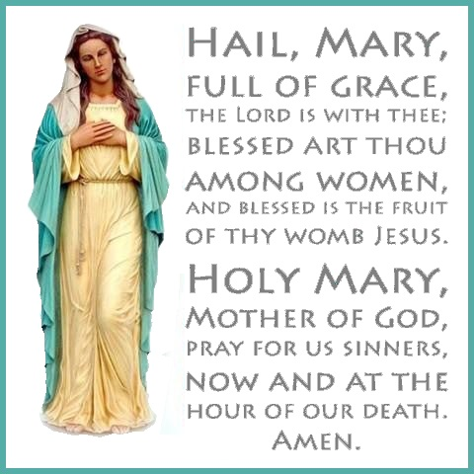
Luke 1:28
And the angel came in unto her, and said, Hail, thou that art highly favoured, the Lord is with thee: blessed art thou among women.
Luke 1:42
And she spake out with a loud voice, and said, Blessed art thou among women, and blessed is the fruit of thy womb.
Notes:
Hail Mary prayer courtesy of
http://drcm.info/wp/wp-content/uploads/2017/10/Hail-Mary.jpg

Slide 28
1 Sam 2:2
“There is none holy like the Lord

Slide 29
John 1:1
In the beginning, was the word . . .
John 2:3 &
John 19:26
Mother of Jesus.

Slide 30
Heb 7:23-25
²³There were many priests under the old system, for death prevented them from remaining in office. ²⁴But because Jesus lives forever, his priesthood lasts forever. ²⁵Therefore he is able, once and forever, to save completely those who come to God through him. He lives forever to intercede with God on their behalf.

Slide 31
³ When the wine ran out, the mother of Jesus said to him, “They have no wine.” ⁴ And Jesus said to her, “Woman, what does this have to do with me? My hour has not yet come.” ⁵ His mother said to the servants, “Do whatever he tells you.”

Slide 32
How do you see Jesus?
Do whatever he tells you!
Notes:
Photo by Wesley Tingey on Unsplash
https://unsplash.com/photos/0are122T4ho

Slide 33
⁶ Now there were six stone water jars there for the Jewish rites of purification, each holding twenty or thirty gallons.
Notes:
Filling stone water jars courtesy of:
https://tabletalkmagazine.com/posts/why-did-jesus-turn-water-into-wine/

Slide 34
Ceremonial Washing
Mark 7:1-2
Pharisees . . . saw that some of his disciples ate with hands that were . . . unwashed.
Mark 7: 14-16
And he called the people to him again and said to them, “Hear me, all of you, and understand: There is nothing outside a person that by going into him can defile him, but the things that come out of a person are what defile him.”

Slide 35
Ceremonial Washing
Mark 7:20-23
. . . “What comes out of a person is what defiles him. For from within, out of the heart of man, come evil thoughts, sexual immorality, theft, murder, adultery, coveting, wickedness, deceit, sensuality, envy, slander, pride, foolishness. 23 All these evil things come from within, and they defile a person.”

Slide 36
Ceremonial Washing
Num 19:17
For the unclean they shall take some ashes of the burnt sin offering, and fresh water shall be added in a vessel.

Slide 37
Ceremonial vs
Actual Hand Washing
20-30 seconds: sanitizer
40-60 seconds: soap & water
Notes:
8 Steps to clean your hands courtesy of Singapore Ministry of Health
https://www.moh.gov.sg/docs/librariesprovider5/default-document-library/practise-good-personal-hygiene---english-(05-feb).pdf
https://www.moh.gov.sa/en/HealthAwareness/EducationalContent/Corona/Pages/005.aspx

Slide 38
⁷ Jesus said to the servants, “Fill the jars with water.” And they filled them up to the brim.
to the brim.

Slide 39
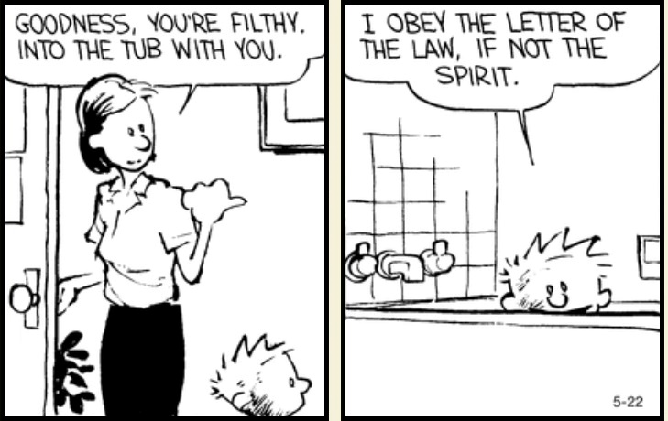
Notes:
Calvin and Hobbes courtesy of
https://www.gocomics.com/calvinandhobbes/2017/05/22?utm_source=ch-twitter&utm_medium=socialmarketing&utm_content=ch-quotes&utm_campaign=social

Slide 41
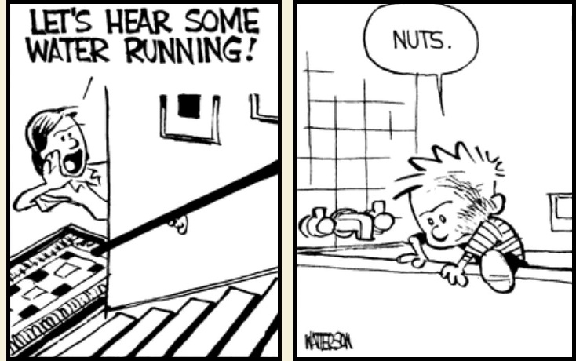

Slide 43
1 Cor 1:27
But God chose what is foolish in the world to shame the wise; God chose what is weak in the world to shame the strong;
⁸ And he said to them, “Now draw some out and take it to the master of the feast.” So they took it.

Slide 44
How do you obey Jesus?
Heartfelt and pure or just for show (ceremonial)?
Complete (to the brim) or letter of the law ?
Even when foolish in the eyes of the world?
Notes:
Filling stone water jars courtesy of:
https://tabletalkmagazine.com/posts/why-did-jesus-turn-water-into-wine/

Slide 45
⁹ When the master of the feast tasted the water now become wine, and did not know where it came from (though the servants who had drawn the water knew),
Notes:
Photo by Elle Hughes on Unsplash
https://unsplash.com/photos/hErgu3X7gvY

Slide 46
the master of the feast called the bridegroom ¹⁰ and said to him, “Everyone serves the good wine first, and when people have drunk freely, then the poor wine. But you have kept the good wine until now.”

Slide 47
the master of the feast called the bridegroom ¹⁰ and said to him, “Everyone serves the good wine first, and when people have drunk freely, then the poor wine. But you have kept the good wine until now.”

Slide 48

Multi-Course Meal
Light =====> Flavorful Main Course

Slide 49
the master of the feast called the bridegroom ¹⁰ and said to him, “Everyone serves the good wine first, and when people have drunk freely, then the poor wine. But you have kept the good wine until now.”

Slide 50
God’s Plan Of Salvation
Gen 12: ¹ Now the Lord said to Abram, “Go from your country and your kindred and your father's house to the land that I will show you. ² And I will make of you a great nation, and I will bless you and make your name great, so that you will be a blessing. ³ I will bless those who bless you, and him who dishonors you I will curse, and in you all the families of the earth shall be blessed and in you all the families of the earth shall be blessed.

Slide 51
God’s Plan Of Salvation
John 3:14-17
¹⁴ And as Moses lifted up the serpent in the wilderness, so must the Son of Man be lifted up, ¹⁵ that whoever believes in him may have eternal life.
¹⁶ “For God so loved the world, that he gave his only Son, that whoever believes in him should not perish but have eternal life. ¹⁷ For God did not send his Son into the world to condemn the world, but in order that the world might be saved through him.

Slide 52
God’s Plan Of Salvation
John 3:36
And anyone who believes in God’s Son has eternal life. Anyone who doesn’t obey the Son will never experience eternal life but remains under God’s angry judgment.”
John 5:24
“I tell you the truth, those who listen to my message and believe in God who sent me have eternal life. They will never be condemned for their sins, but they have already passed from death into life.

Slide 53
God’s Plan Of Salvation
John 6:40 For it is my Father’s will that all who see his Son and believe in him should have eternal life. I will raise them up at the last day.”
John 6:47 “I tell you the truth, anyone who believes has eternal life.
John 11:25 Jesus told her, “I am the resurrection and the life. Anyone who believes in me will live, even after dying.
John 11:26 Everyone who lives in me and believes in me will never ever die.

Slide 54
God’s Plan Of Salvation
John 6:29 Jesus told them, “This is the only work God wants from you: Believe in the one he has sent.”
John 8:31 Jesus said to the people who believed in him, “You are truly my disciples if you remain faithful to my teachings.

Slide 55
¹¹ This, the first of his signs, Jesus did at Cana in Galilee, and manifested his glory. And his disciples believed in him.
Notes:
Do you believe in him?

Slide 56
What do you see when
you look past the miracle . . .

Slide 57
Demonstrate faith in Jesus
by obedience to his words
in order to experience God’s Glory

Slide 58
Baptism
Communion
Matt 28:18-20
Luke 22:19-20
¹⁸ Jesus came and told his disciples, “I have been given all authority in heaven and on earth. ¹⁹ Therefore, go and make disciples of all the nations, baptizing them in the name of the Father and the Son and the Holy Spirit.
²⁰ Teach these new disciples to obey all the commands I have given you. And be sure of this: I am with you always, even to the end of the age.”
¹⁹ And he took bread, and when he had given thanks, he broke it and gave it to them, saying, “This is my body, which is given for you. Do this in remembrance of me.” ²⁰ And likewise the cup after they had eaten, saying, “This cup that is poured out for you is the new covenant in my blood.

Slide 59
Who can take communion?
Acts 8:37: If you believe that Jesus Christ
is the Son of God.
1 Cor 11:27-29
²⁷ So anyone who eats this bread or drinks this cup of the Lord unworthily is guilty of sinning against the body and blood of the Lord. ²⁸ That is why you should examine yourself before eating the bread and drinking the cup. ²⁹ For if you eat the bread or drink the cup without honoring the body of Christ, you are eating and drinking God’s judgment upon yourself.

Slide 60
²³ For I received from the Lord what I also delivered to you, that the Lord Jesus on the night when he was betrayed took bread, ²⁴ and when he had given thanks,
                he broke it, and said, “This is my body, which
                is for you. Do this in in
                remembrance of me.”

Slide 61
²⁵ In the same way also he took the cup, after supper, saying, “This cup is the new covenant in my blood. Do this, as often as you drink it, in remembrance of me.”

Slide 62
²⁶ For every time you eat this bread and drink this cup, you are announcing the Lord’s death until he comes again.

