Slide 1



The Miracles of Jesus

Slide 2

Miracles: “Unusual workings of God that are clearly supernatural.” (Theologian Millard Erickson)

Slide 3
The Purpose of Miracles
1. To glorify God – he is always the source of the miraculous (Matt 9:8, 15:31; Mark 2:12b; Luke 17:15).
2. To affirm the supernatural basis of revelation. They confirm the message about Jesus. Greek word often used for miracles – ‘signs’ (John 14:11; Mark 16:20; Heb 2:4).
3. To meet human needs. Jesus’ miracles are a result of his compassion for the suffering and the lost. (Mark 1:41; Matt 14:14, 20:34).
Adapted from Millard Erickson, Christian Theology, Baker Books:2004, pg 434

Slide 4
Context of John 6:1-15
The 7 signs of John
The 7 miraculous signs of John
1) Water into wine (John 2:1-11)
2) The healing of the official’s son (John 4:46-54)
3)The healing at the pool of Bethesda (John 5:1-17)
4) Feeding of the 5,000 (John 6:1-15)
5) Walking on water (John 6:16-21)
6) The healing of the blind man from birth (John 9:1-41)
7) The raising of Lazarus from the dead (John 11:1-144)

Slide 5
The 7 ‘I AM’ Sayings in John
1. I am the Bread of Life (John 6:35)
2. I am the Light of the World (John 8:12)
3. I am the Door (John 10:9)
4. I am the Good Shepherd (John 10:11-14)
5. I am the Resurrection and the Life (John 11:25)
6. I am the Way and the Truth and the Life (John 14:6)
7. I am the Vine (John 15:1-5)

Slide 6
The 7 witnesses to jesus
1) John the Baptist - John 1:29-34
2) Nathaniel - John 1:43-51
3) Peter - John 6:66-69
4) Jesus himself - John 10:22-30
5) Martha - John 11:27
6) Thomas - John 20:28
7) John - John 20:30-31

Slide 7
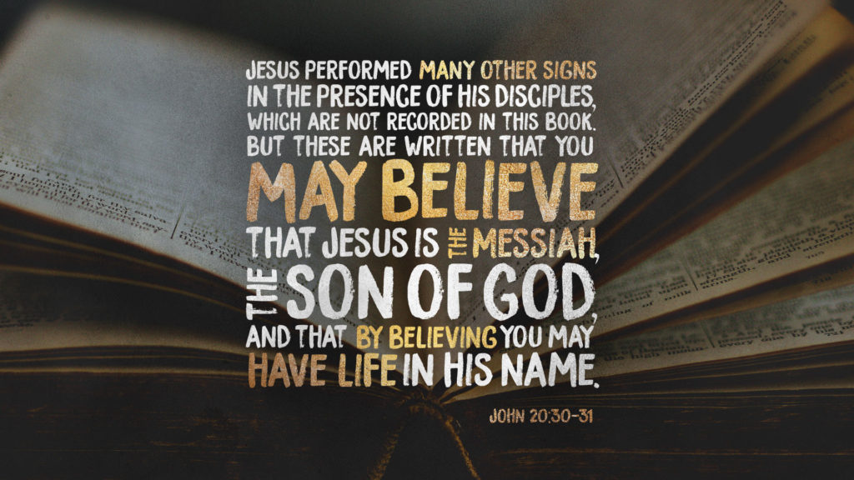

Slide 8
John 6:1-15
Vs 1-4 – Jesus is the bread of life, the Passover Lamb (John 6:35; 48-58)
Vs 5-9 – Right answer, wrong question.
Great hunger, little meal.
Vs 10-13 – Faith exercised before food provided.
Food enough for others.

Slide 9
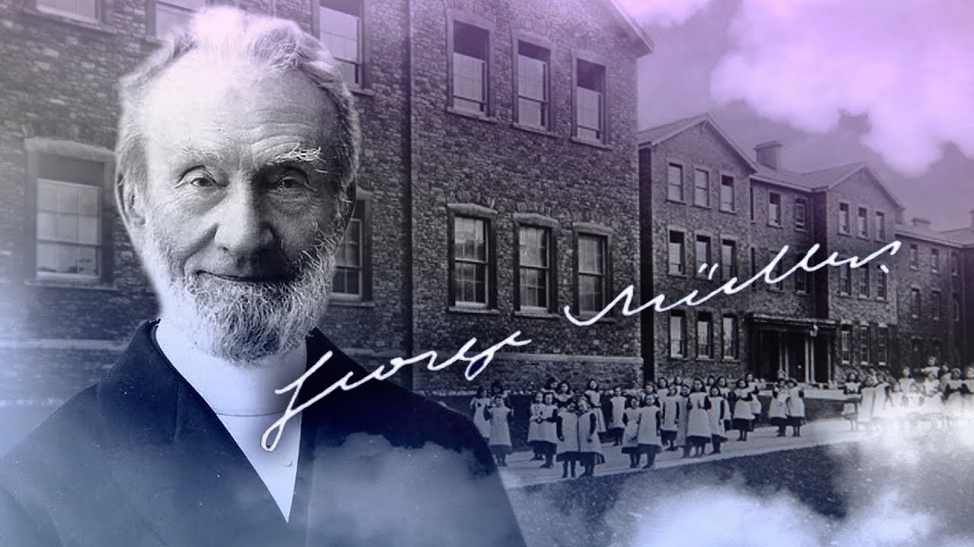
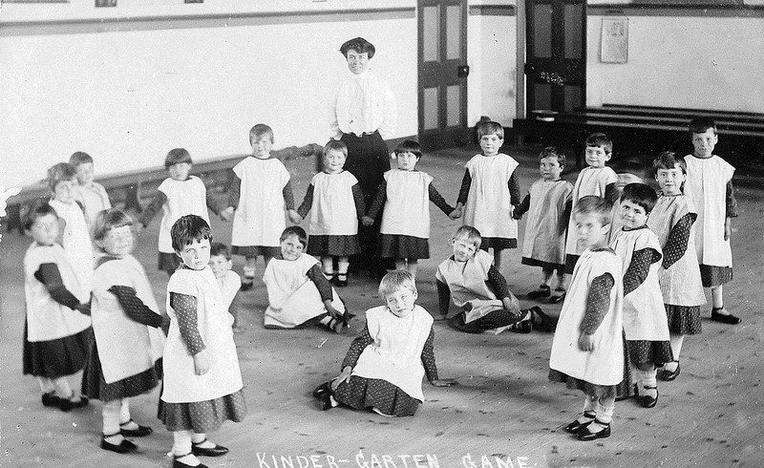
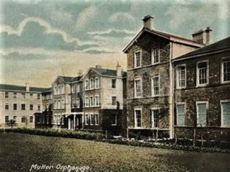

Slide 10
John 6:1-15
Vs 1-4 – Jesus is the bread of life, the Passover Lamb (John 6:35; 48-58)
Vs 5-9 – Right answer, wrong question.
Great hunger, little meal.
Vs 10-13 – Faith exercised before food provided.
Food enough for others.

Slide 11
John 6:1-15
Vs 1-4 – Jesus is the bread of life, the Passover Lamb (John 6:35; 48-58)
Vs 5-9 – Right answer, wrong question.
      Great hunger, little meal.
Vs 10-13 – Faith exercised before food provided.
Food enough for others.
Vs 14-15 – Crowd wanted to forcefully make Jesus king but he would not let them.

Slide 12
John 6:1-15
1. Where do we go to find bread for the hungry?
2. Look past the miracle – behold Jesus!
3. Don’t come to him with your agenda. Bow down, surrender your life, worship Him!

