Slide 2
I am blessed by God and a demonstration of His Power
I was dead but now I’m alive
I was alone but now I’m part of Christ’s body
I am joined with other believers to accomplish God’s will on earth
I walk in a new way
I stand strong in my faith in Christ

Slide 3
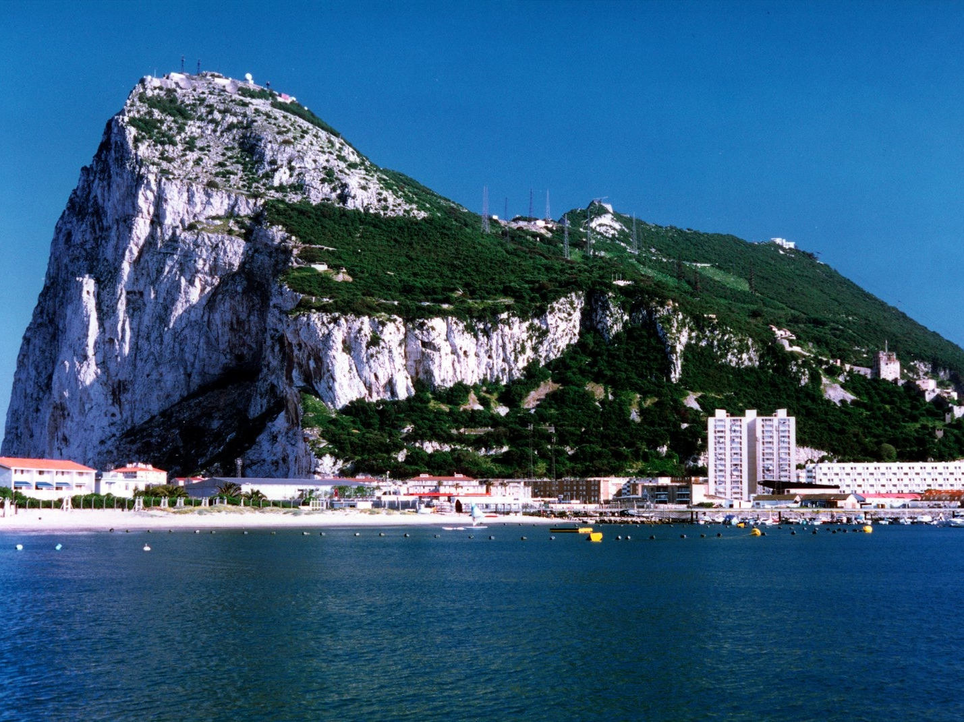
We Stand Strong in God’s Might
Ephesians 6:10-24
Rely on God’s strength (vs. 10-13)
Put on God’s armor (vs. 14-24)

Slide 4
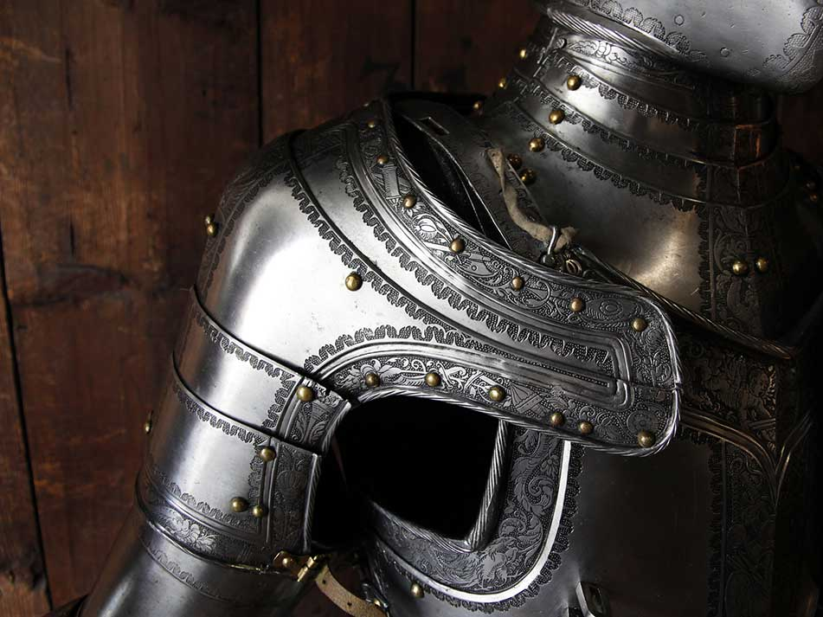
Armor of God
Conviction of truth (belt of truth)
Integrity of life (breastplate of righteousness)
Promotion of the gospel (shoes made ready for gospel of peace)
Resist temptation (shield of faith)

Slide 5
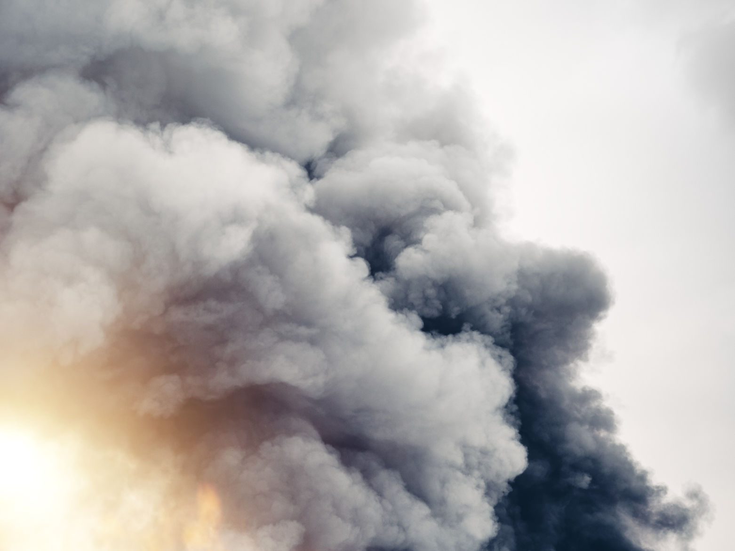
Satan is
“the tempter”
Matthew 4:1
Then Jesus was led up by the Spirit into the wilderness to be tempted by the devil.
1 Thessalonians 3:5
For this reason, when I could bear it no longer, I sent to learn about your faith, for fear that somehow the tempter had tempted you and our labor would be in vain.
James 1:14
But each person is tempted when he is lured and enticed by his own desire.

Slide 6
Satan is
“the tempter”
“the accuser”
Zechariah 3:1-5
¹ Then he showed me Joshua the high priest standing before the angel of the Lord, and Satan standing at his right hand to accuse him. ² And the Lord said to Satan, “The Lord rebuke you, O Satan! The Lord who has chosen Jerusalem rebuke you! Is not this a brand plucked from the fire?” ³ Now Joshua was standing before the angel, clothed with filthy garments. ⁴ And the angel said to those who were standing before him, “Remove the filthy garments from him.” And to him he said, “Behold, I have taken your iniquity away from you, and I will clothe you with pure vestments.” ⁵ And I said, “Let them put a clean turban on his head.” So they put a clean turban on his head and clothed him with garments. And the angel of the Lord was standing by.

Slide 7
Satan is
“the tempter”
“the accuser”
Revelation 12:10-11
¹⁰ And I heard a loud voice in heaven, saying, “Now the salvation and the power and the kingdom of our God and the authority of his Christ have come, for the accuser of our brothers has been thrown down, who accuses them day and night before our God. ¹¹ And they have conquered him by the blood of the Lamb and by the word of their testimony, for they loved not their lives even unto death.

Slide 8
Armor of God
Conviction of truth (belt of truth)
Integrity of life (breastplate of righteousness)
Promotion of the gospel (shoes made ready for gospel of peace)
Resist temptation (shield of faith)
Assurance of salvation (helmet of salvation)
Living by God’s Word (sword of the Spirit)

Slide 9
2 Corinthians 10:3-5
³ For though we walk in the flesh, we are not waging war according to the flesh. ⁴ For the weapons of our warfare are not of the flesh but have divine power to destroy strongholds. ⁵ We destroy arguments and every lofty opinion raised against the knowledge of God, and take every thought captive to obey Christ,

Slide 10
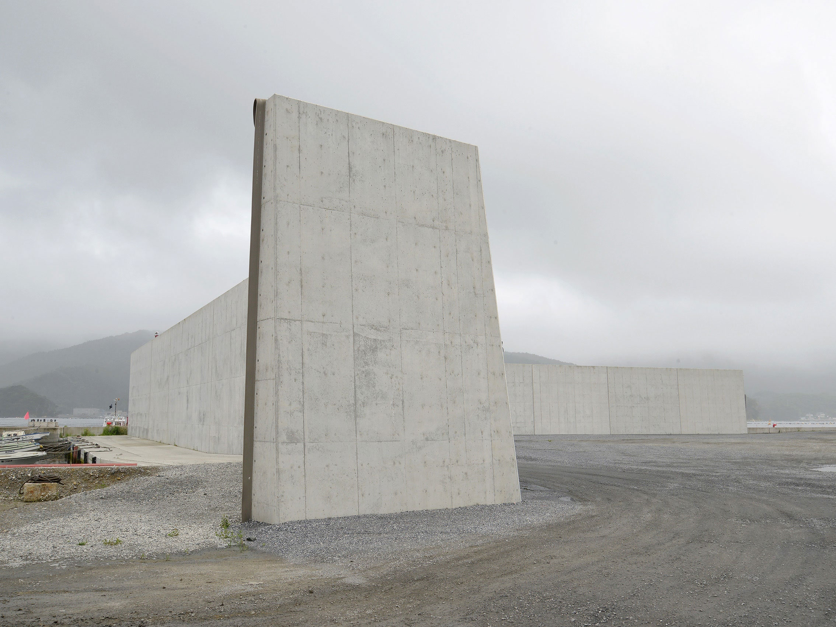
Religion
Philosophy
Religious experience
Reasonin
Tradition
Materialism
Pleasure
unbeliever
believer

Slide 11
Religion
Philosophy
Religious experience
Reasonin
Tradition
Materialism
Pleasure
unbeliever
believer

Slide 12
Armor of God
Conviction of truth (belt of truth)
Integrity of life (breastplate of righteousness)
Promotion of the gospel (shoes made ready for gospel of peace)
Resist temptation (shield of faith)
Assurance of salvation (helmet of salvation)
Living by God’s Word (sword of the Spirit)
Prayer and intercession

Slide 13
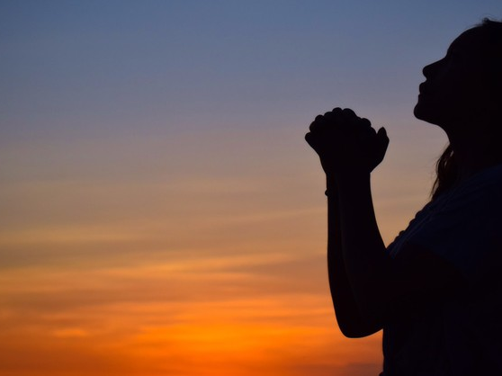
When do we pray?
“at all times”
How do we pray?
“all prayer and supplication”
How long do we pray?
“all perseverance”
Who do we pray for?
“all the saints”

Slide 14
Warfare Prayer
Pray that fellow believers at CIC will grow more convinced of and confident in the truth of the gospel.
Pray that fellow believers at CIC will live out the gospel message in doing what is right, pure, and honest.

Slide 15
Pray that fellow believers at CIC will be effective witnesses to the truth of the gospel of peace.
Pray that fellow believers at CIC will resist temptations to sin or doubt the teachings of Scripture.
Pray that fellow believers at CIC will affirm the truth of the gospel and be confident of their eternal state with God.

Slide 16
Pray that fellow believers at CIC will learn the Bible and be able to use it for growth and teaching others.
Pray that church leaders at CIC will be faithful in fulfilling their calling to proclaim and teach the Scriptures.

