Slide 3
Luke 22
³¹ “Simon, Simon, behold, Satan demanded to have you, that he might sift you like wheat, ³² but I have prayed for you that your faith may not fail. And when you have turned again, strengthen your brothers.”
³³ Peter said to him, “Lord, I am ready to go with you both to prison and to death.”
⁵⁰ And one of them struck the servant of the high priest and cut off his right ear.
⁵⁶ Then a servant girl, seeing him as he sat in the light and looking closely at him, said, “This man also was with him.” ⁵⁷ But he denied it, saying, “Woman, I do not know him.”

Slide 4
Isaiah 14:12-15
¹² “How you are fallen from heaven, O Day Star, son of Dawn! How you are cut down to the ground, you who laid the nations low! ¹³ You said in your heart, ‘I will ascend to heaven; above the stars of God I will set my throne on high; I will sit on the mount of assembly in the far reaches of the north; ¹⁴ I will ascend above the heights of the clouds; I will make myself like the Most High.’ ¹⁵ But you are brought down to Sheol, to the far reaches of the pit.

Slide 5
Ezekiel 28:14-16
¹⁴ You were an anointed guardian cherub.I placed you; you were on the holy mountain of God; in the midst of the stones of fire you walked. ¹⁵ You were blameless in your ways from the day you were created, till unrighteousness was found in you. ¹⁶ In the abundance of your trade you were filled with violence in your midst, and you sinned; so I cast you as a profane thing from the mountain of God, and I destroyed you, O guardian cherub, from the midst of the stones of fire.

Slide 6
Revelation 12:9-10
⁹ And the great dragon was thrown down, that ancient serpent, who is called the devil and Satan, the deceiver of the whole world—he was thrown down to the earth, and his angels were thrown down with him. ¹⁰ And I heard a loud voice in heaven, saying, “Now the salvation and the power and the kingdom of our God and the authority of his Christ have come, for the accuser of our brothers has been thrown down, who accuses them day and night before our God.

Slide 7
Job 1:9-12
⁹ Then Satan answered the Lord and said, “Does Job fear God for no reason? ¹⁰ Have you not put a hedge around him and his house and all that he has, on every side? You have blessed the work of his hands, and his possessions have increased in the land. ¹¹ But stretch out your hand and touch all that he has, and he will curse you to your face.” ¹² And the Lord said to Satan, “Behold, all that he has is in your hand. Only against him do not stretch out your hand.” So Satan went out from the presence of the Lord.

Slide 8
1 John 5:18
We know that everyone who has been born of God does not keep on sinning, but he who was born of God protects him, and the evil one does not touch him.
1 Corinthians 10:13
No temptation has overtaken you that is not common to man. God is faithful, and he will not let you be tempted beyond your ability, but with the temptation he will also provide the way of escape, that you may be able to endure it.

Slide 9
1 Peter 5:8-9
⁸ Be sober-minded; be watchful. Your adversary the devil prowls around like a roaring lion, seeking someone to devour. ⁹ Resist him, firm in your faith, knowing that the same kinds of suffering are being experienced by your brotherhood throughout the world.
2 Corinthians 2:11
so that we would not be outwitted by Satan; for we are not ignorant of his designs.

Slide 10
John 8:44
You are of your father the devil, and your will is to do your father's desires. He was a murderer from the beginning, and does not stand in the truth, because there is no truth in him. When he lies, he speaks out of his own character, for he is a liar and the father of lies.

Slide 11
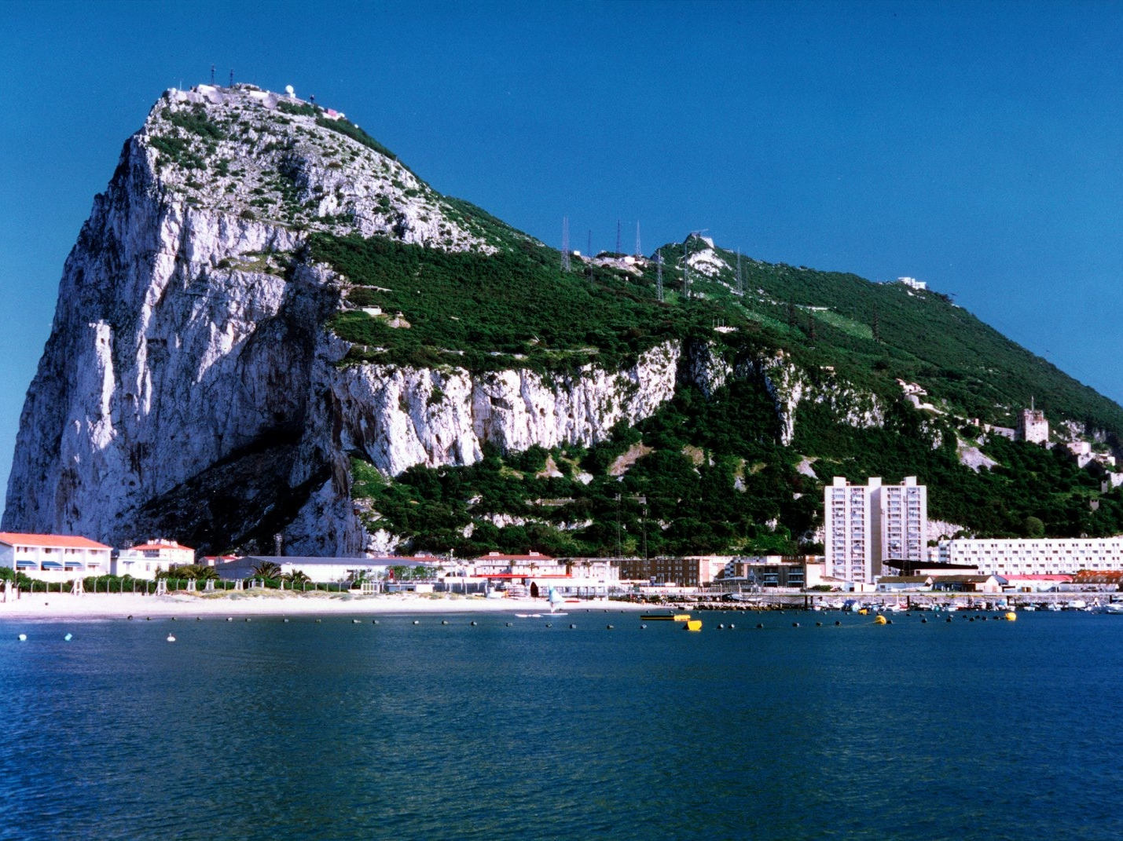
We Stand Strong in God’s Might
Ephesians 6:10-24
Rely on God’s strength (vs. 10-13)

Slide 12
Ouija boards
Tarot cards
Psychic readings
Crystal ball or medium seances
Shaman incantations
Spirit channeling
Horoscopes
Wicca pagan spell casting.

Slide 13
Deuteronomy 18:9-12
⁹ “When you come into the land that the Lord your God is giving you, you shall not learn to follow the abominable practices of those nations. ¹⁰ There shall not be found among you anyone who burns his son or his daughter as an offering, anyone who practices divination or tells fortunes or interprets omens, or a sorcerer ¹¹ or a charmer or a medium or a necromancer or one who inquires of the dead, ¹² for whoever does these things is an abomination to the Lord. And because of these abominations the Lord your God is driving them out before you.

Slide 14
2 Corinthians 11:3-4, 13-15
³ But I am afraid that as the serpent deceived Eve by his cunning, your thoughts will be led astray from a sincere and pure devotion to Christ. ⁴ For if someone comes and proclaims another Jesus than the one we proclaimed, or if you receive a different spirit from the one you received, or if you accept a different gospel from the one you accepted, you put up with it readily enough.
¹³ For such men are false apostles, deceitful workmen, disguising themselves as apostles of Christ. ¹⁴ And no wonder, for even Satan disguises himself as an angel of light. ¹⁵ So it is no surprise if his servants, also, disguise themselves as servants of righteousness. Their end will correspond to their deeds.

Slide 15
“He, therefore, who rushes into this conflict without thinking of Christ, without putting his trust in him, and without continually looking to him for strength and regarding himself as a member of his body, deriving all life and vigor from him, is demented. He knows not what he is doing. He has not strength even to reach the field. With him the whole conflict is a sham.”
Charles Hodge

Slide 16
We Stand Strong in God’s Might
Ephesians 6:10-24
Rely on God’s strength (vs. 10-13)
To withstand schemes of evil spirits
2 Corinthians 2:11
so that we would not be outwitted by Satan; for we are not ignorant of his designs.

Slide 17
We Stand Strong in God’s Might
Ephesians 6:10-24
Rely on God’s strength (vs. 10-13)
To withstand schemes of evil spirits
To stand firm

Slide 18
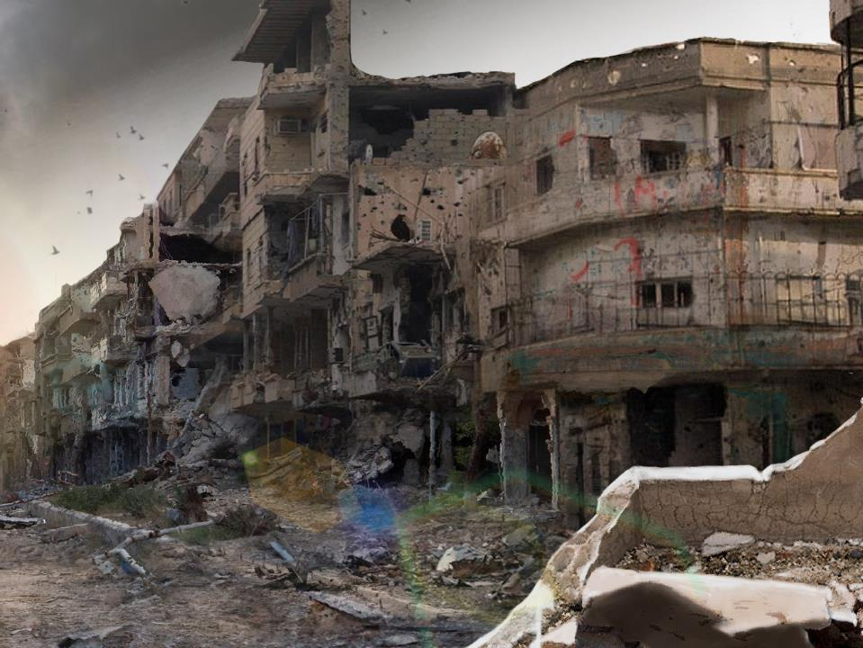
Casualties
Professing believers who walk away from the faith
Christians who reject the local church
Christians who engage in sexual immorality
Christians who carry unethical business practices
Churches compromised on essential gospel principles
Churches needlessly split because of selfish and sinful issues

Slide 19
We Stand Strong in God’s Might
Ephesians 6:10-24
Rely on God’s strength (vs. 10-13)
Put on God’s armor (vs. 14-24)

Slide 20
Isaiah 11:4-5
⁴ but with righteousness he shall judge the poor, and decide with equity for the meek of the earth; and he shall strike the earth with the rod of his mouth, and with the breath of his lips he shall kill the wicked. ⁵ Righteousness shall be the belt of his waist, and faithfulness the belt of his loins.
Isaiah 59:17
He put on righteousness as a breastplate, and a helmet of salvation on his head; he put on garments of vengeance for clothing, and wrapped himself in zeal as a cloak.

Slide 21
Isaiah 49:2
He made my mouth like a sharp sword; in the shadow of his hand he hid me; he made me a polished arrow; in his quiver he hid me away.
Isaiah 52:7
How beautiful upon the mountains are the feet of him who brings good news, who publishes peace, who brings good news of happiness, who publishes salvation, who says to Zion,
“Your God reigns.”

Slide 22
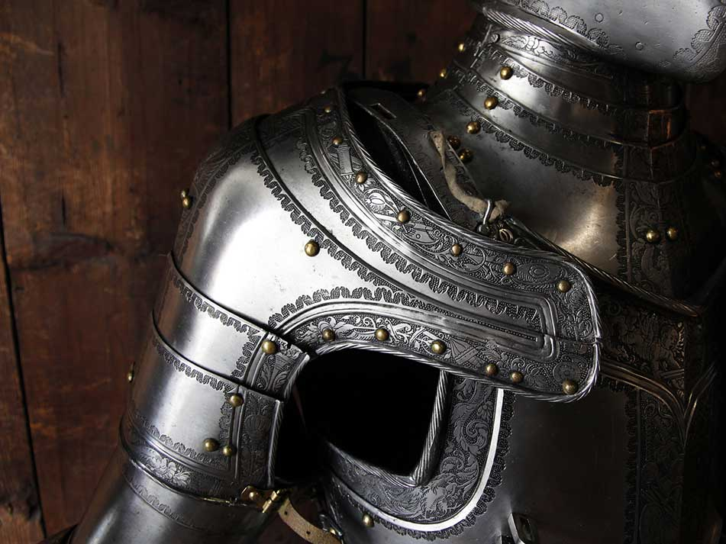
Armor of God
Conviction of truth (belt of truth)

Slide 23
“Let not anyone imagine that he is prepared to withstand the assaults of the powers of darkness, if his mind is stored with his own theories or with the speculations of other men. Nothing but the truth of God clearly understood and cordially embraced will enable him to keep his feet for a moment, before these celestial potentates. Reason, tradition, speculative conviction, dead orthodoxy, are a girdle of spider webs. They give way at the first onset.”
Charles Hodge

Slide 24
Armor of God
Conviction of truth (belt of truth)
Integrity of life (breastplate of righteousness)
Promotion of the gospel (shoes made ready for gospel of peace)

Slide 25
Isaiah 52:7
How beautiful upon the mountains are the feet of him who brings good news, who publishes peace, who brings good news of happiness, who publishes salvation, who says to Zion,
“Your God reigns.”

