Slide 2
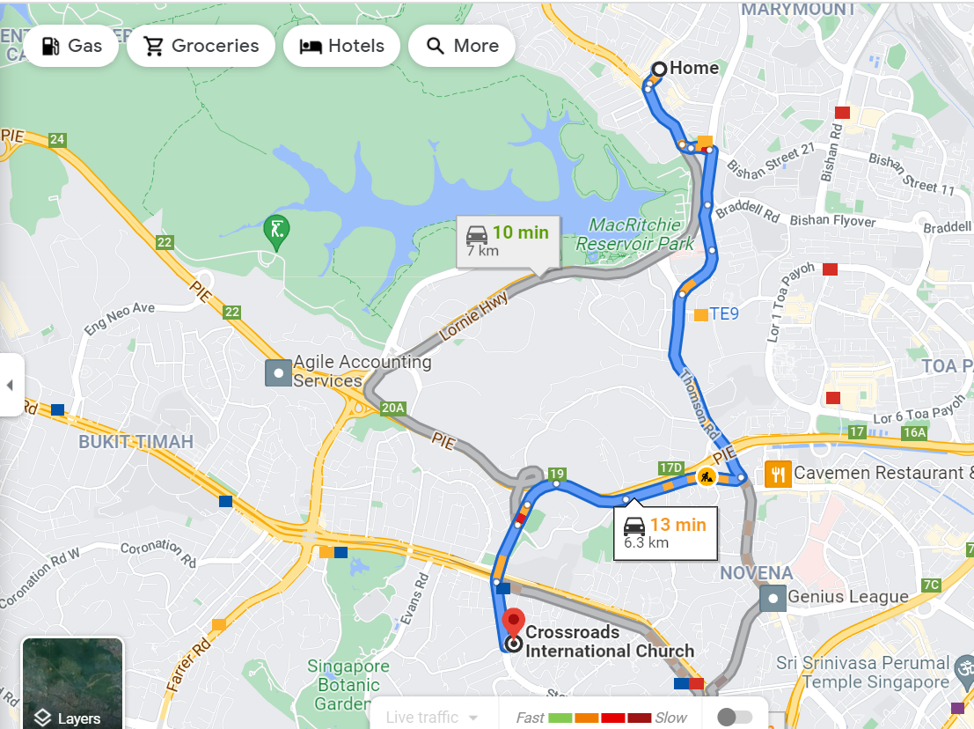
We Walk Carefully
-Part 3-
Ephesians 5:17-6:9
We use our time for best godly purposes (vs. 15-16)
We act consistent in our faith (v. 17)
We are controlled by the Holy Spirit (5:18-6:9)

Slide 3
Being Spirit Controlled
Spirit controlled words (5:19-20)
Spirit controlled marriage (5:21-32)
Spirit controlled family (6:1-4)

Slide 4
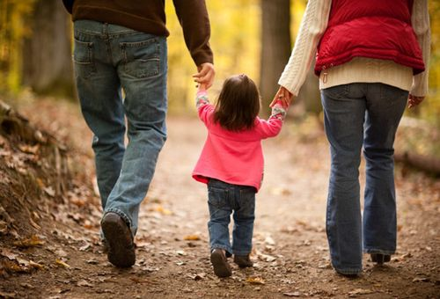
Children obey and honor parents
“in the Lord”
“right”

Slide 5
That it may go well with you and you live long in the land
Deuteronomy
4:40
5:16
5:29
6:2-3
11:9
12:25
12:28
22:7
28:1-68
Proverbs 3:1-2

Slide 6
OBEY THE LAW OF GOD
1st Generation Israelites
2nd Generation Israelites
Did not enter the Promised Land
Entered the Promised Land

Slide 7
Children obey and honor parents
Parents nurture their children in the Lord

Slide 8
“Children are not allowed to grow up without care or control. They are to be instructed, disciplined, and admonished, so that they be brought to knowledge, self-control, and obedience.”
Charles Hodge

Slide 9
Children obey and honor parents
Parents nurture their children in the Lord
“do not provoke” “bring them up”

Slide 10
Being Spirit Controlled
Spirit controlled words (5:19-20)
Spirit controlled marriage (5:21-32)
Spirit controlled family (6:1-4)
Spirit controlled employment (6:5-9)

Slide 11
Facts on Roman Slavery
50-60 million slaves in Roman Empire
1/3 population of Rome and Ephesus
Became slaves due to debt, judicial sentence, & loss at war
Some became slaves to gain Roman citizenship
Under the Roman system slaves could
Purchase their freedom
Gain education
Own land
Own slaves

Slide 12
Paul said . . .
Gain freedom if possible, but live for Christ if you remain a slave (1 Cor 7:21-24)
Philemon to offer freedom to his runaway slave Onesimus, but the runaway is also encouraged to return home (Philemon 1:15-17)

Slide 13
Employees work as unto the Lord
“rendering service . . . as to the Lord”
“with a sincere heart”
“not by the way of eye-service”
“with a good will”

Slide 14
Questions to ask
“Is this the best I can do?”
“Would God approve of my work or work attitude?”
“Do I treat others, either subordinates or superiors, with fairness, kindness, and respect?”
“Am I a cheerful person to be around?”

Slide 15
Employees work as unto the Lord
Employers treat their employees with fairness
“do the same to them”

