Slide 1
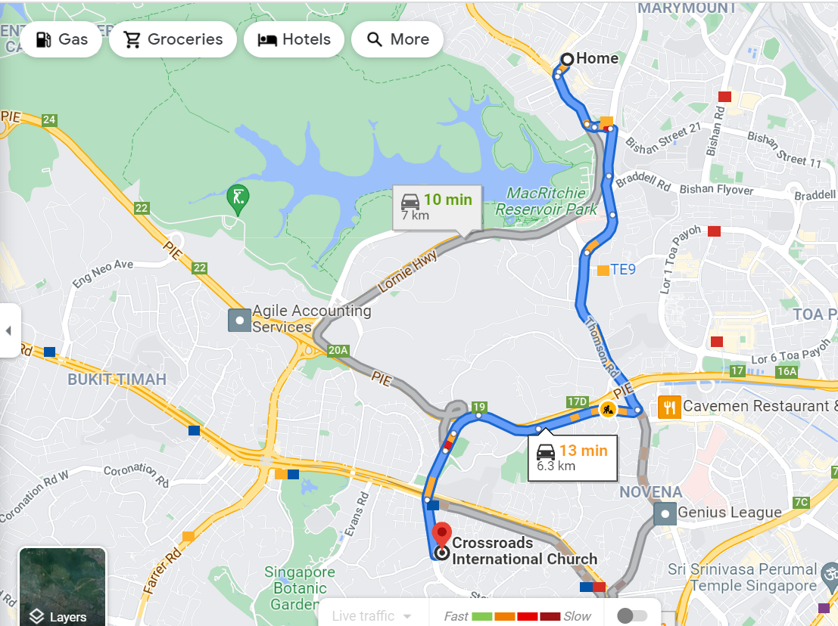

Slide 3
We Walk Carefully
Ephesians 5:17-6:9
We use our time for best godly purposes (vs. 15-16)

Slide 4
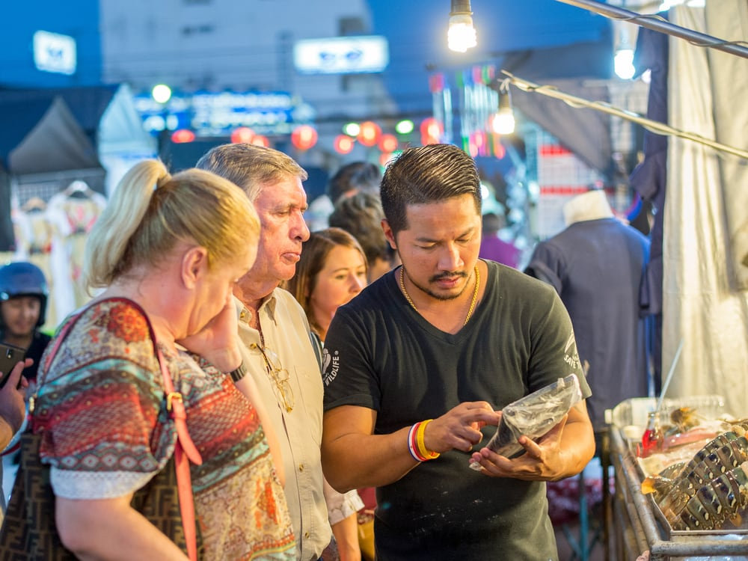
Bartering

Slide 5
“Certainly wise people know that time is a precious commodity. All of us have the same amount of time at our disposal, with sixty minutes in every hour and twenty four hours in every day. None of us can stretch time. But wise people use it to the fullest possible advantage. They know that time is passing, and also that the days are evil. So they seize each fleeting opportunity while it is there. For once it has passed, even the wisest people cannot recover it.”
John Stott

Slide 6
We Walk Carefully
Ephesians 5:17-6:9
We use our time for best godly purposes (vs. 15-16)
We act consistent in our faith (v. 17)
We are controlled by the Holy Spirit (5:18-6:9)

Slide 7
John 14:16-17
¹⁶ And I will ask the Father, and he will give you another Helper, to be with you forever, ¹⁷ even the Spirit of truth, whom the world cannot receive, because it neither sees him nor knows him. You know him, for he dwells with you and will be in you.
Acts 6:3
Therefore, brothers, pick out from among you seven men of good repute, full of the Spirit and of wisdom, whom we will appoint to this duty.

Slide 8
1 Corinthians 12:13
For in one Spirit we were all baptized into one body—Jews or Greeks, slaves or free—and all were made to drink of one Spirit.
John 14:16-17
¹⁶ And I will ask the Father, and he will give you another Helper, to be with you forever, ¹⁷ even the Spirit of truth, whom the world cannot receive, because it neither sees him nor knows him. You know him, for he dwells with you and will be in you.

Slide 9
Being Spirit Controlled
Spirit controlled words (5:19-20)

