Slide 1
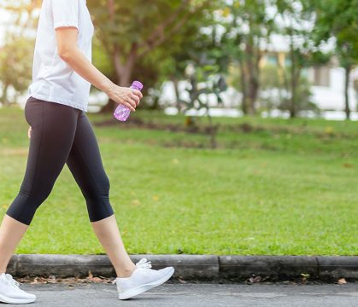
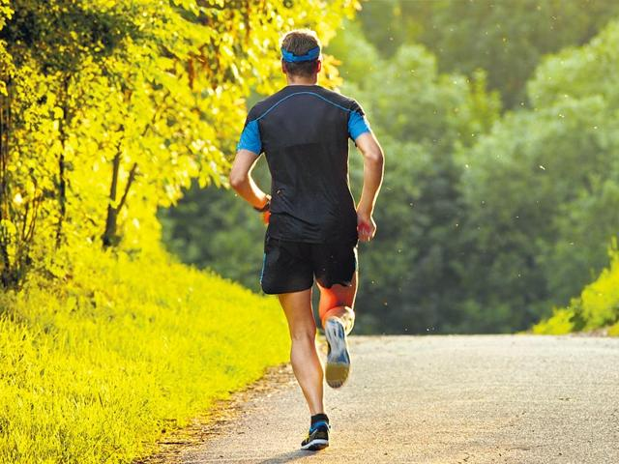
Walk
Run

Slide 2
Taking a walk with the Ephesians
How
4:1 – “in a manner worthy of the calling”
4:17 – “no longer . . . as the Gentiles”
5:15 – “as wise”
Where
2:10 – in prepared “good works”
5:1 – “in love”
5:8 – “as children of light

Slide 4
E P H E S I A N S 5 : 1 – 1 4
Continued

Slide 5
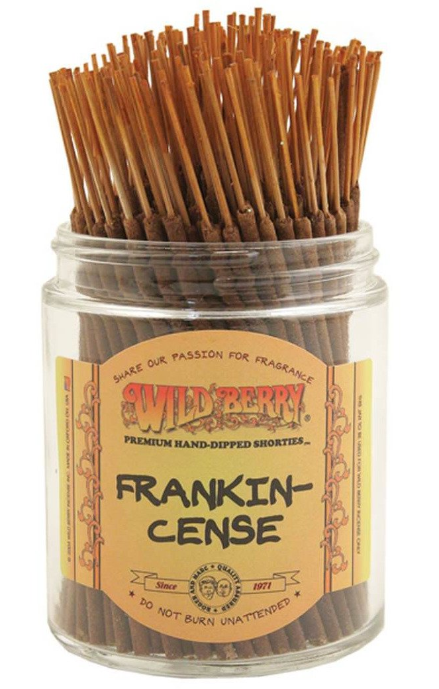
Sacrifice self for others (vs. 1-2)
2 Corinthians 2:14-16
¹⁴ But thanks be to God, who in Christ always leads us in triumphal procession, and through us spreads the fragrance of the knowledge of him everywhere. ¹⁵ For we are the aroma of Christ to God among those who are being saved and among those who are perishing, ¹⁶ to one a fragrance from death to death, to the other a fragrance from life to life.

Slide 6
Sacrifice self for others (vs. 1-2)
Live in purity and contentment (vs. 3-7)
Contrast the world’s darkness (vs. 8-14)
Remind yourself of your identity (8-9)
“If they are light, then let them behave as children of light, and this will mean living by values that are diametrically opposed to those of their surrounding society.”
Peter O’Brien

Slide 7
Sacrifice self for others (vs. 1-2)
Live in purity and contentment (vs. 3-7)
Contrast the world’s darkness (vs. 8-14)
Remind yourself of your identity (8-9)
Discern what is pleasing to God (10)
Expose and transform darkness (vs. 11-14)

Slide 8
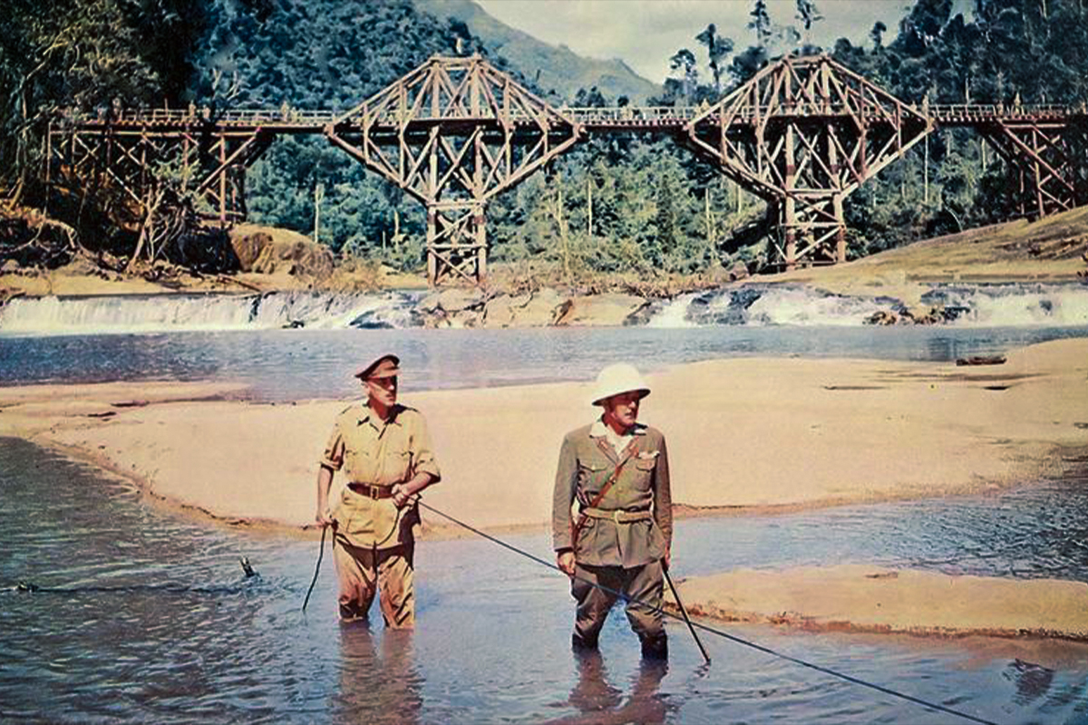
Light in the Valley of the Kwai

