Slide 2
We Do Not Walk Like the World
Ephesians 4:17-24

Slide 3
1 John 2:15-17
¹⁵ Do not love the world or the things in the world. If anyone loves the world, the love of the Father is not in him. ¹⁶ For all that is in the world—the desires of the flesh and the desires of the eyes and pride of life—is not from the Father but is from the world. ¹⁷ And the world is passing away along with its desires, but whoever does the will of God abides forever.

Slide 4
Galatians 5:16-17
¹⁶ But I say, walk by the Spirit, and you will not gratify the desires of the flesh. ¹⁷ For the desires of the flesh are against the Spirit, and the desires of the Spirit are against the flesh, for these are opposed to each other, to keep you from doing the things you want to do.

Slide 5
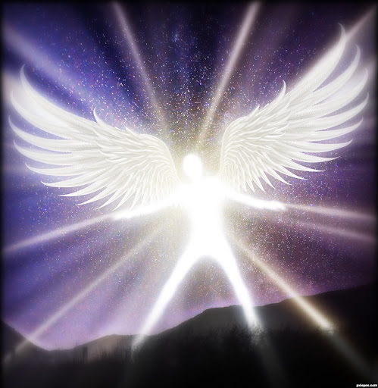
2 Corinthians 4:4
In their case the god of this world has blinded the minds of the unbelievers, to keep them from seeing the light of the gospel of the glory of Christ, who is the image of God.

Slide 6
John 8:44
You are of your father the devil, and your will is to do your father’s desires. He was a murderer from the beginning, and does not stand in the truth, because there is no truth in him. When he lies, he speaks out of his own character, for he is a liar and the father of lies.

Slide 7
Spiritual
Deadness
Spiritual
Regeneration
Spiritual
Maturation
Christlikeness
Opposition
Sinful world-sinful self-the devil

Slide 8
Stop living like an unregenerateperson (vs. 17-19)

Slide 9
A mindset without purpose (v. 17)
“Because it lacks a true relationship with God, Gentile thinking suffers from the consequences of having lost touch with reality and is left fumbling with inane trivialities and worthless side issues.”
Peter O’Brien

Slide 10
A mindset without purpose (v. 17)
Darkened in understanding (v. 18a)
Hard hearted towards God (v. 18b)
Callous in conscience towards impurity (v. 19)

Slide 11
Replace sinful lifestyle with new lifestyle consistent with profession of faith (vs. 20-24)

Slide 12
“The readers of this letter did indeed learn the Christ, but not in such a way as to condone their old pagan habits. When they received the gospel, they were taught that Christian discipleship required the renunciation of all pagan vices and the cultivation of true Christian holiness.”
Curtis Vaughn

Slide 13
2 Timothy 2:22
So flee youthful passions and pursue righteousness, faith, love, and peace, along with those who call on the Lord from a pure heart.
Put off old self (v. 22)
Put on new self (vs. 22-24)

Slide 14
Autobiography in 5 short chapters
P o r t i a N e l s o n
Chapter 1
I walk down the street.
There is a deep hole in the sidewalk.
I fall in.
I am lost. . . I am hopeless.
It isn’t my fault.
It takes forever to find a way out.

Slide 15
Autobiography in 5 short chapters
P o r t i a N e l s o n
Chapter 2
I walk down the same street.
There is a deep hole in the sidewalk.
I pretend I don’t see it.
I fall in again.
I can’t believe I’m in the same place.
But it isn’t my fault.
It still takes a long time to get out.

Slide 16
Autobiography in 5 short chapters
P o r t i a N e l s o n
Chapter 3
I walk down the same street.
There is a deep hole in the sidewalk.
I see it is there.
I still fall in. . . it’s a habit.
My eyes are open.
I know where I am.
It is my fault.
I get out immediately.

Slide 17
Autobiography in 5 short chapters
P o r t i a N e l s o n
Chapter 4
I walk down the same street.
There is a deep hole in the sidewalk.
I walk around it.

Slide 18
Autobiography in 5 short chapters
P o r t i a N e l s o n
Chapter 5
I walk down another street.

