Slide 1
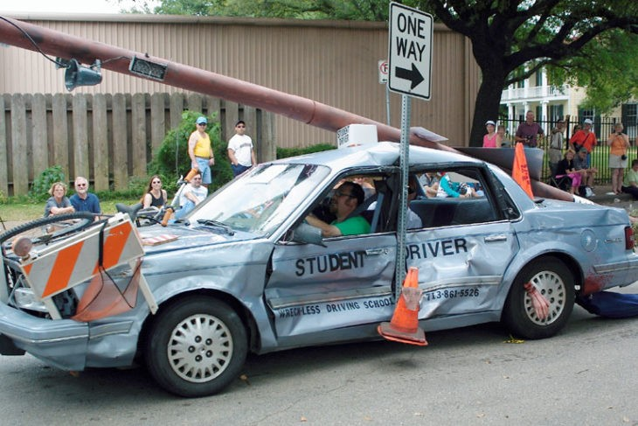

Slide 3
Who am I?
I am a blessed demonstration of God’s power
Who are we?
We are dead people made alive
We are a new body of people in Christ
We are God’s radical plan for His glory
We are an impossible project
How Do We Glorify God as New People?

Slide 4
We Walk in Unity
Ephesians 4:1-6

Slide 5
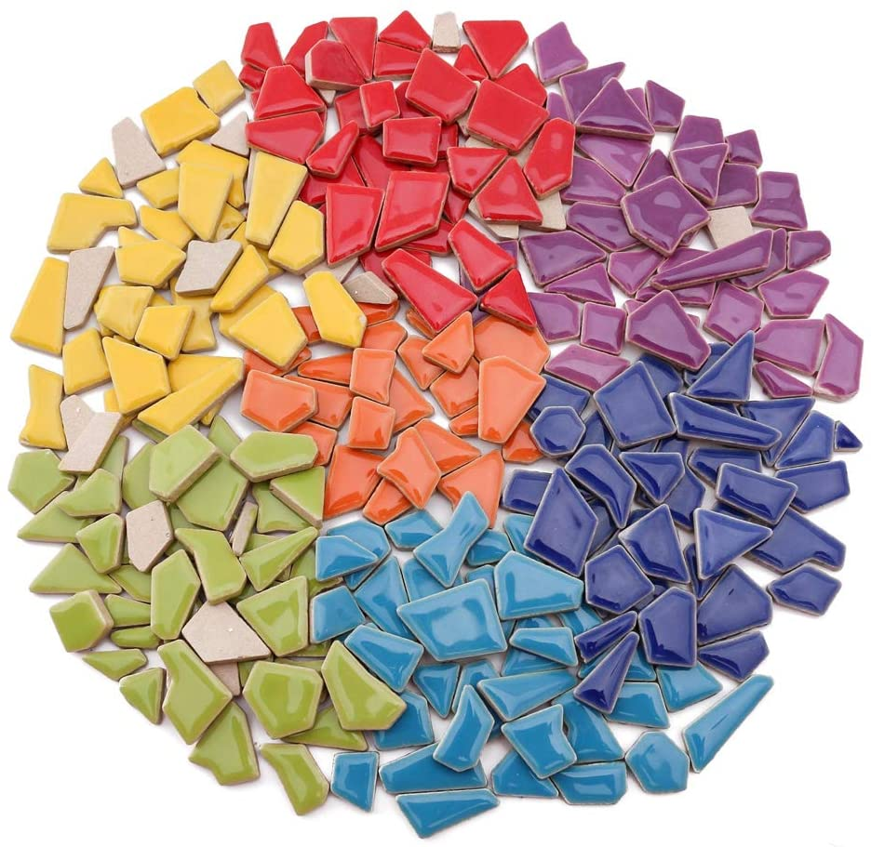
We remind ourselves of our new identity (v. 1)
We work hard to keep the Spirit’s unity (vs. 2-4)
We are to be humble (2a)
We are to be meek (v. 2b)

Slide 6
“this quality does not suggest weakness but characterizes the person who does not need to assert or dominate and is not touchy, resentful, or retaliatory.”
William Klein

Slide 7
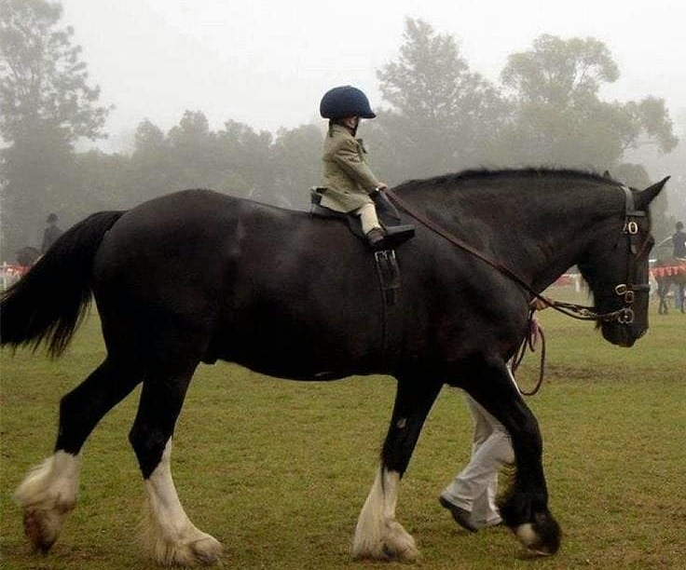

Slide 8
We remind ourselves of our new identity (v. 1)
We work hard to keep the Spirit’s unity (vs. 2-4)
We are to be humble (2a)
We are to be meek (2b)
We are to be patient and endure each other (2c)
We are to be eager for peace (3)

Slide 9
We remind ourselves of our new identity (v. 1)
We work hard to keep the Spirit’s unity (vs. 2-4)
We represent God’s unity (vs. 5-6)

