Slide 1
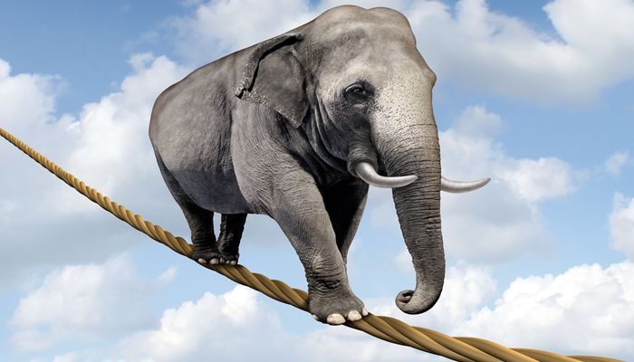
Impossible

Slide 3
Who am I?
I am a blessed demonstration of God’s power
Who are we?
We are dead people made alive
We are a new body of people in Christ
We are God’s radical plan for His glory

Slide 4
We are an Impossible Project
Ephesians 3:14-21

Slide 6
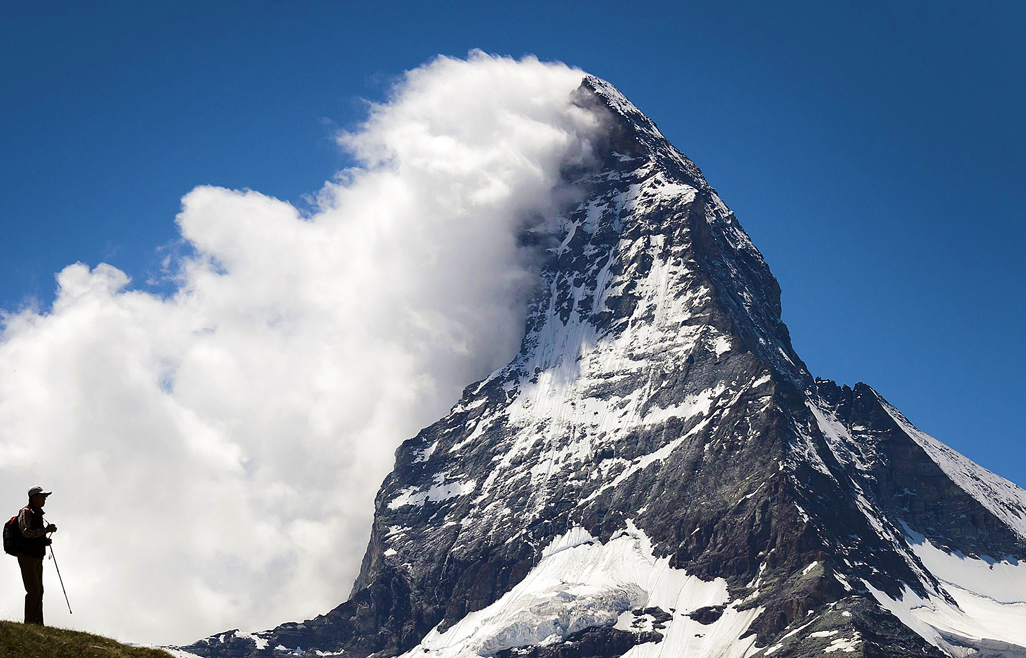
We bend the knee before our Father in heaven (vs. 14-15)
We are strengthened by the Holy Spirit in our heart (vs. 16-17a)
He deepens and solidifies us in the love of Christ (vs. 17b-19)

Slide 7
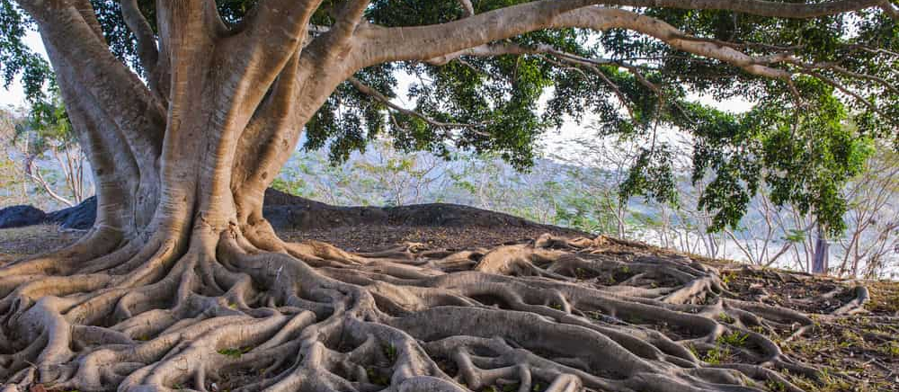
“The definite goal to which the Christian life must move, and for which therefore the apostle prays, is for his readers to know the love of Christ, to know how He loved and loves, and to experience His love in loving Him and loving others for His sake.”
Francis Foulkes

Slide 8
We bend the knee before our Father in heaven (vs. 14-15)
We are strengthened by the Holy Spirit in our heart (vs. 16-17a)
He deepens and solidifies us in the love of Christ (vs. 17b-19)
We rely on God to go beyond what we can do and accomplish what we never thought about doing (v. 20)
God receives the glory to realize an impossible idea (v. 21)

Slide 9
Great God in Heaven,
We bend our knee before you because you are our Father in heaven and can do all things. You have transformed our lives through Christ and he is alive in us. Help us to grow in understanding his love for us and be empowered by your Spirit so we can in turn love each other. Do an incredible work in this church body beyond anything we could possibly accomplish. Do something we never considered before so that everyone will know you are the one who did it. We ask that you glorify your name in this church through Christ who teaches us how to love. Amen.

